Slide 1
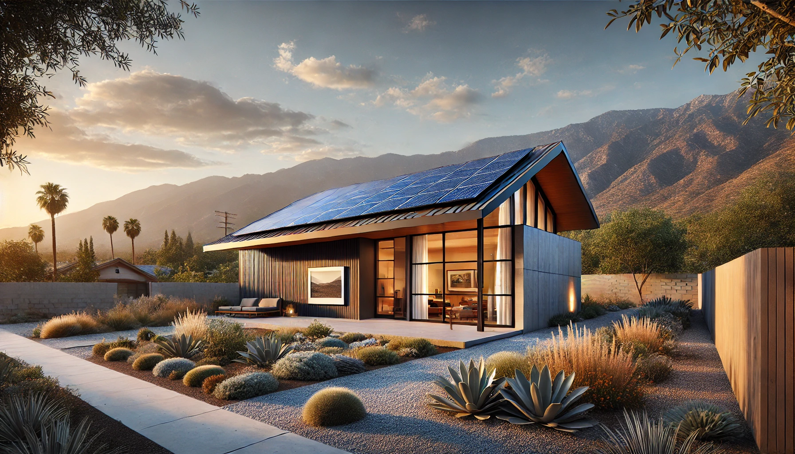
Green Rebuild Initiative
Facilitating 100% Electric, Net Zero Energy Homes, featuring Solar Microgrid Resilience and Engineered for Extreme Weather

Slide 2
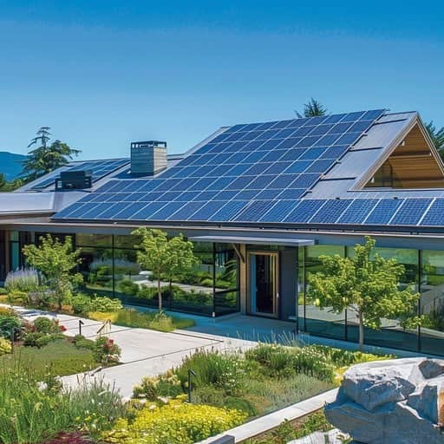
Meet the Team
Craig Lewis, Executive Director
Founder of Clean Coalition, a nonprofit organization dedicated to accelerating the transition to clean energy and a modern grid.
Lollie Kuhl, Design Lead
Architectural designer focused on empowering homeowners with actionable guidance for rebuilding sustainably.
Haley Weinstein, Communications Lead
Communications lead for community outreach and corporate partnering.
John Bello, P.E., Real Estate Development Lead
Professional Engineer and experienced Real Estate Developer assisting the team with construction cost estimating and project management.
Gregory Young, Director of Programs
Leveraging his expertise to conduct sophisticated analyses for Solar Microgrid and Community Microgrid projects.

Slide 3
Green Rebuild Initiative
Mission:
The Green Rebuild Initiative (GRI) aims to facilitate sustainable and resilient rebuilds through “Super Green” home designs, featuring 100% Electric Net Zero Energy (NZE) designs, supported by Solar Microgrids – for unparalleled resilience. The new homes will also be built with non-toxic materials and be engineered to withstand extreme weather events.
Plan:
Identify Homeowners
Facilitate Design
Perform Load Analysis and Size Solar + Storage
Streamline Permitting
Coordinate with Contractors
Repeat to develop Super Green neighborhoods!
Notes:
3

Slide 4
Current Collaborators
Architects
Altadena Collective
Tim Vordtreide
Chris Corbett Design
Uriu Architecture: Scott Uriu
Joubert Homes: Steffen Andrews
Bildsten Arch: Ellen Bildsten
Union Studios: Ben Willis
Lance Collins: NOMA
Garcia Architecture: Elisa Garcia
Landscape Architects
Kiesel Design: Jack Kiesel
General Contractors
Allen Construction: Dennis Allen
Williams Homes: Patrice Queensberry
Best Tech Contracting: Jason Scheurer
Prefab/Modular Manufacturers
Plant Prefab: Steve Glenn
Joubert Homes: Darin & Steffen
ReMo Homes: Ryan Blowers/ Vamsi Kotla
BPublicPrefab
Other Collaborators
Mayor of LA: Karen Bass
Ben Stapleton: USGBC LA
Desert Estate Development: John Pedalino
Taft Office: Margie Taft
Box Power: Fallon Vaughan
Steadfast LA: Rick Caruso
Permacity Foundation: Jonathan Port
California Home+Design: Lauren Michele
Direct Relief
Habitat for Humanity

Slide 5
Community Engagement
State of California
Elena Kounalakis - Lt. Governor Cali
City of Los Angeles
Steadfast LA
LA Rises
USGBC-LA
Mayor's Office
Kathryn Barger - County Supervisor
LA Sentinel
Altadena
Altadena Collective
Altadena Rebuild Coalition: NOMA
Altadena Chamber of Commerce
Altadena Heritage
Altadena Green
Altadena Strong
Pacific Palisades
Resilient Palisades
Palisades Recovery Coalition
Pacific Palisades Community Rebuild
Pacific Palisades Preservation Coalition (PPPC)

Slide 6
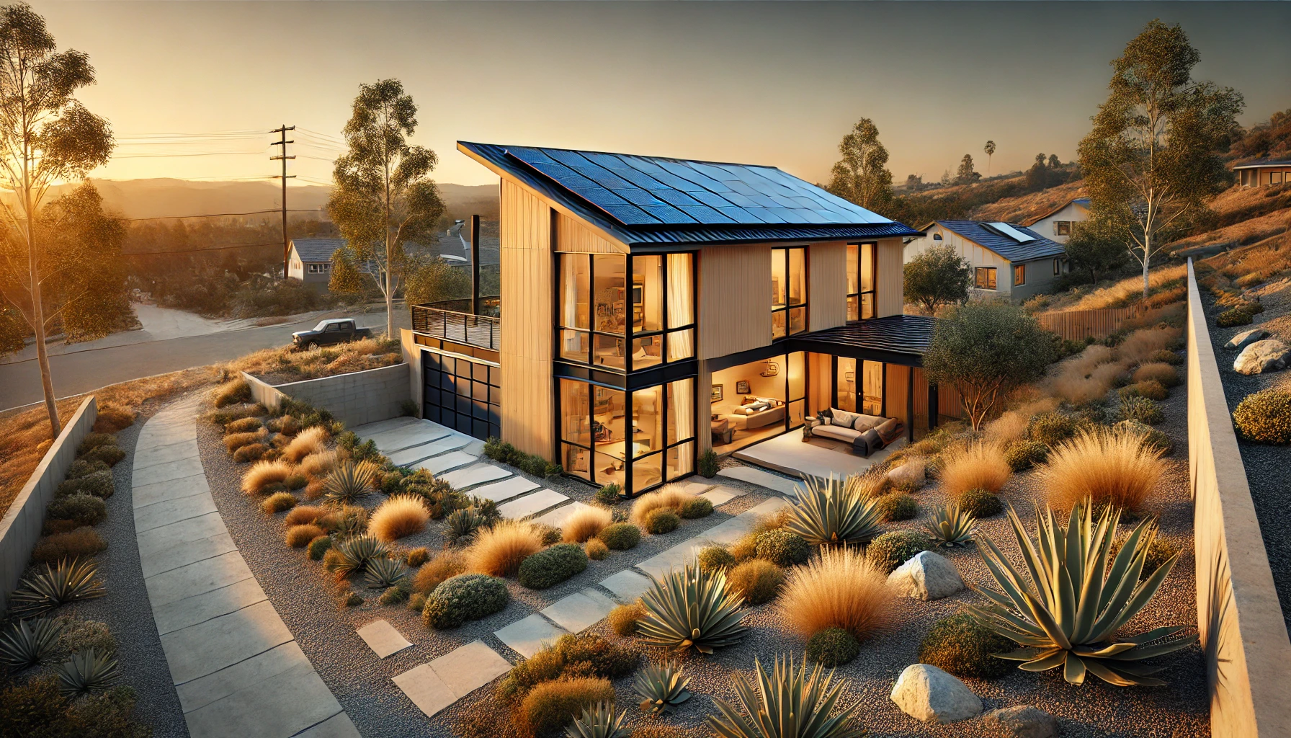
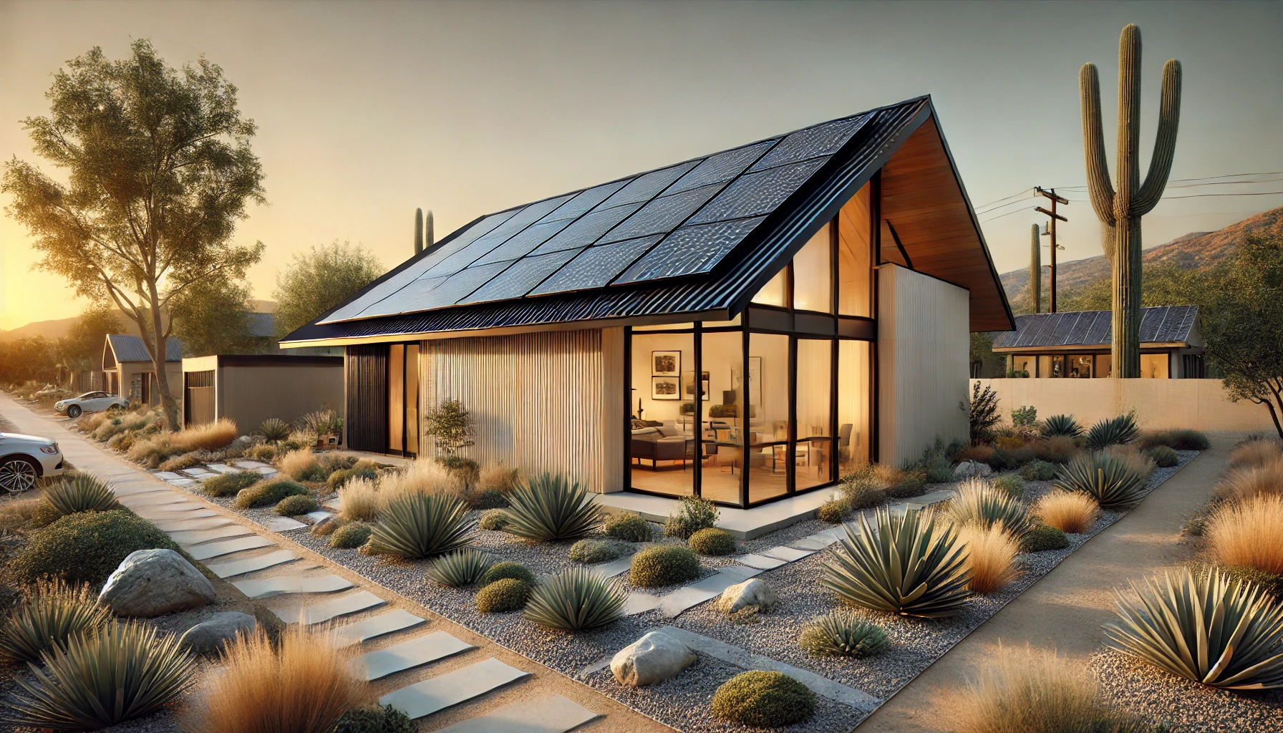
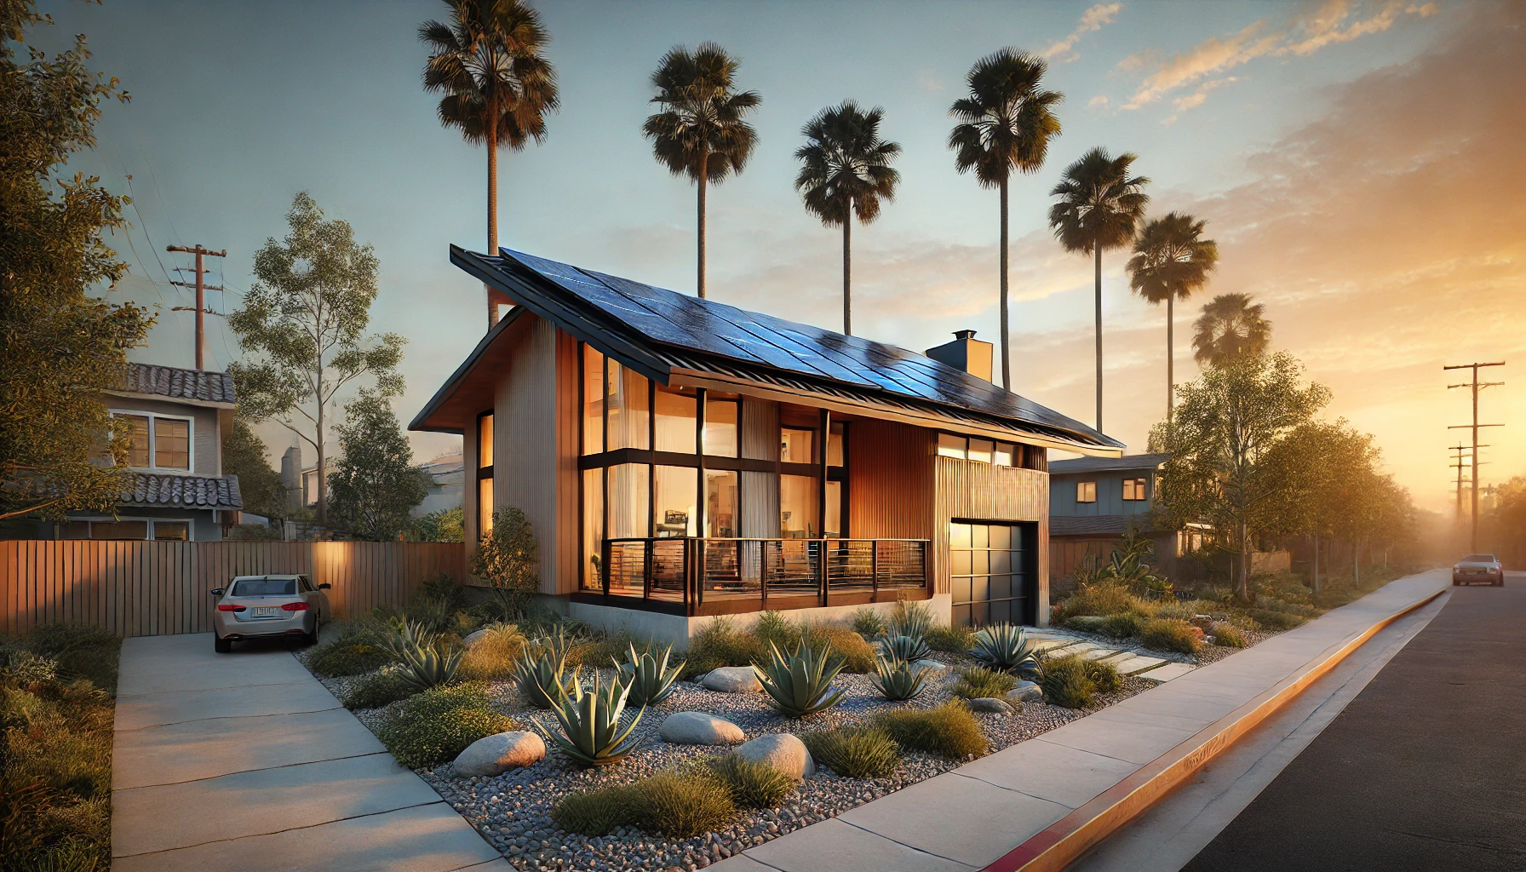
Conceptual Design: Exterior

Slide 7
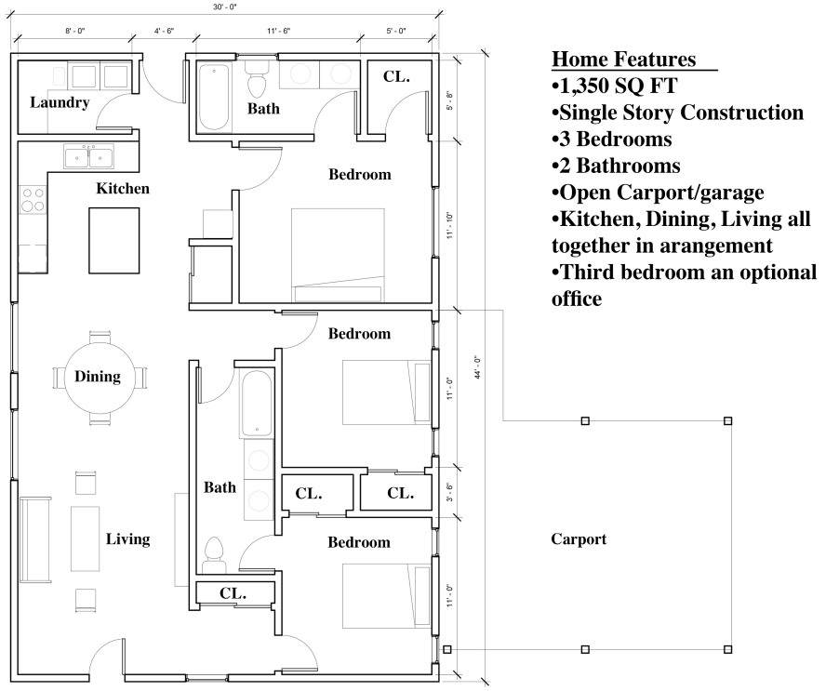
Conceptual Design: Interior

Slide 8
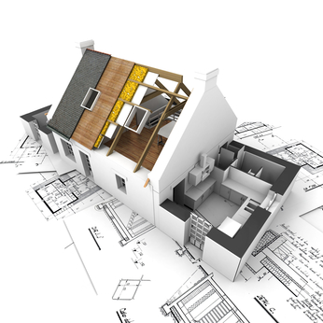
Timeline
Conceptual Design: Architect
Finalize home size:
Square Footage
Orientation
# of Bedrooms
# of Bathrooms
Develop Conceptual Rendering (4-6 weeks)
Clean Coalition (2-4 weeks):
Design Solar Array + Battery System
Size System for Microgrid Resilience
Economic Analysis
Design Development: Architect
SD: Schematic (2-4 Mo.)
Site Survey (1-2 Weeks)
Submit for Permit Review (4-6 Weeks)
CD: Construction Documents (1-2 Mo.)
Construction Schedule: GC
Foundation (1-2 Month)
Utility Tie-Ins (4-6 Weeks)
Framing (1-2 Months)
MEP (3-4 Months)
Interior Finishes (3-4 Months)
Exterior Finishes (1 Month)
Certificate of Occupancy (2-4 Weeks)
Opportunity for PreFab or Modular Construction

Slide 9
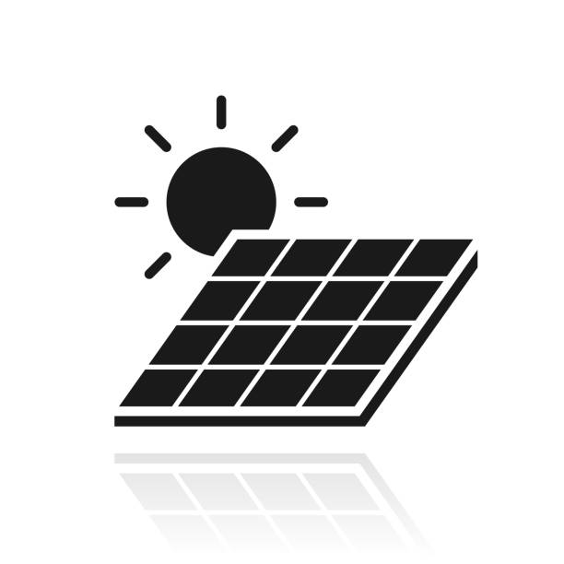
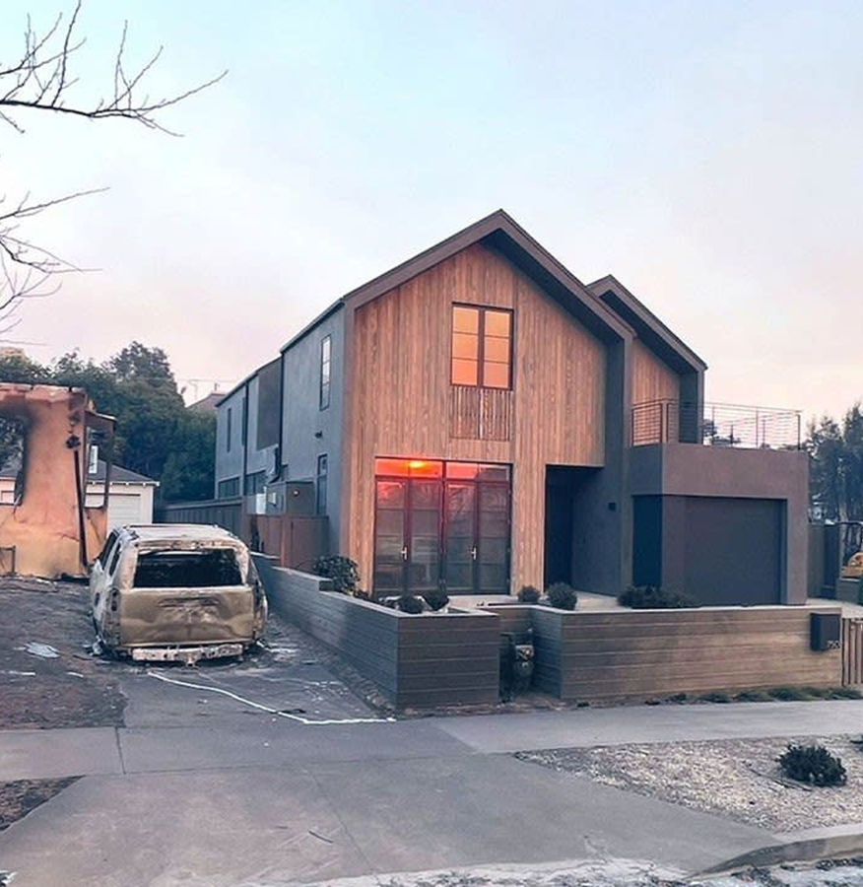
GRI - Overview
Super Green
100% Electric
Net-Zero Operational Energy
Community Microgrid
Energy Efficiency
Passive House Design
High-Performance Insulation
Blower Door Testing
Extreme Weather Resilience
Extreme Heat
Smoke Protection
Wildfire Resilient
Healthy Development
Low Embodied Carbon
Low Operational Carbon
Indoor Air Quality
ILFI Red-list Free Materials
Thermal Comfort

Slide 10
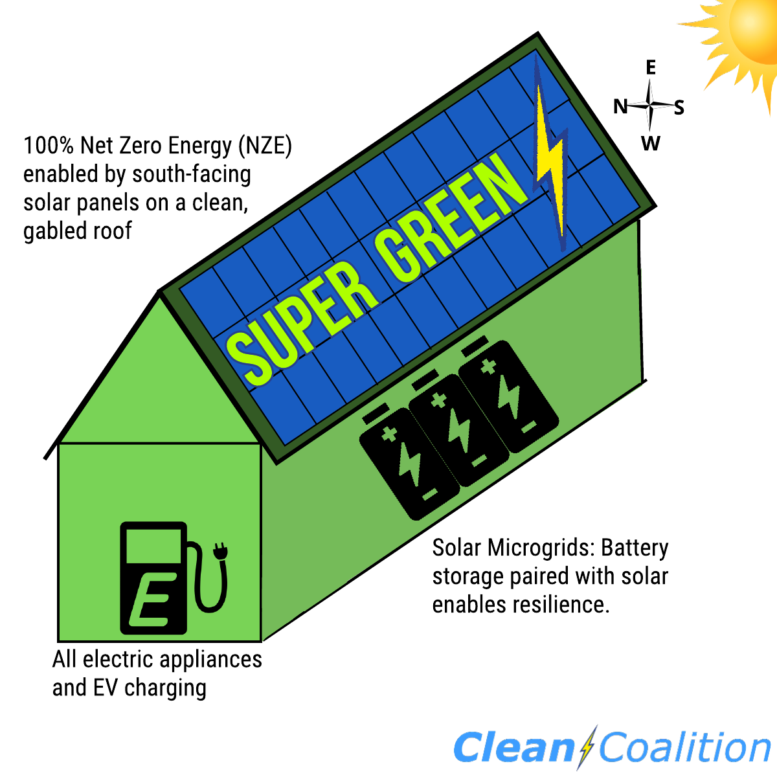
Super Green
What is ”super green”?
1. 100% electric (no gas service to the home and ideally be an all-EV household).
2. Hosts enough solar to achieve Net Zero Energy (will require about 35 solar panels for a typical 2,500 square foot all-electric home with about 10,000 miles of home EV charging per year).
3. Includes a Solar Microgrid that combines the solar to a battery.

Slide 11
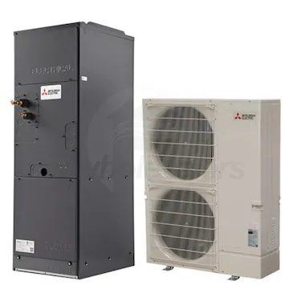
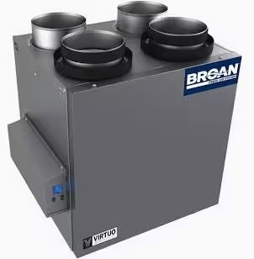
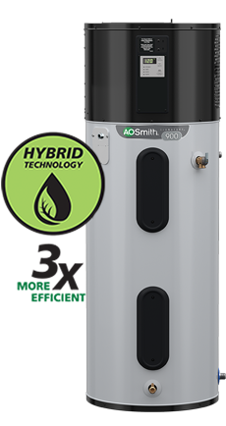
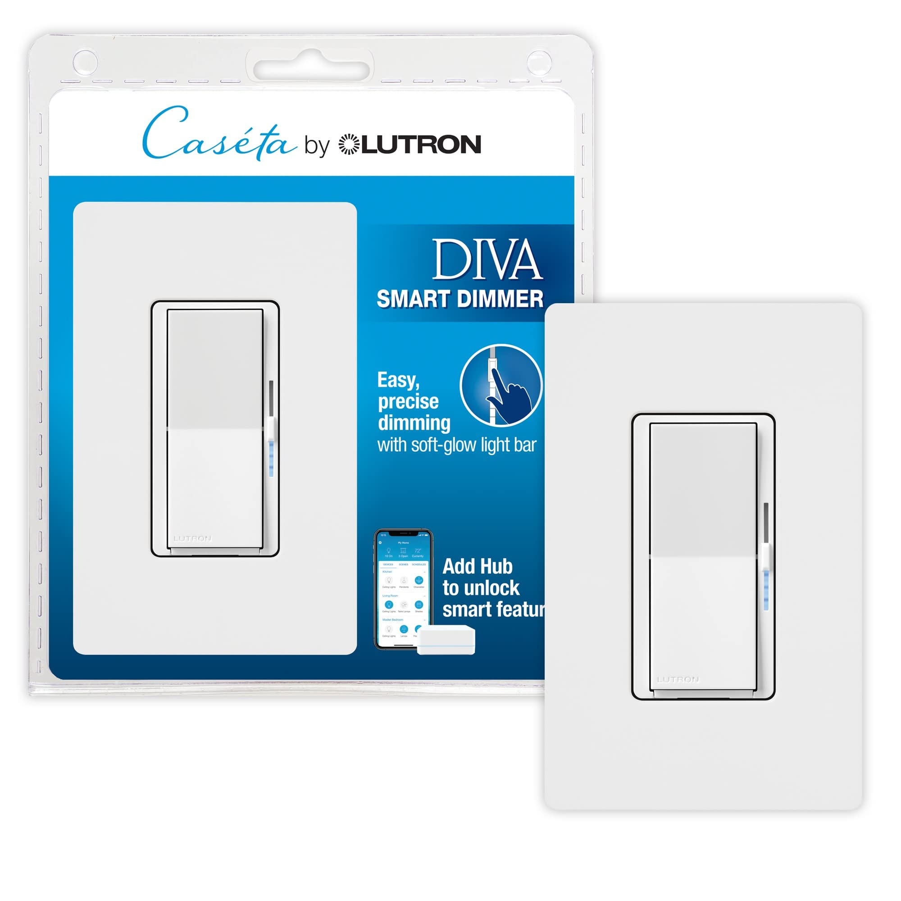
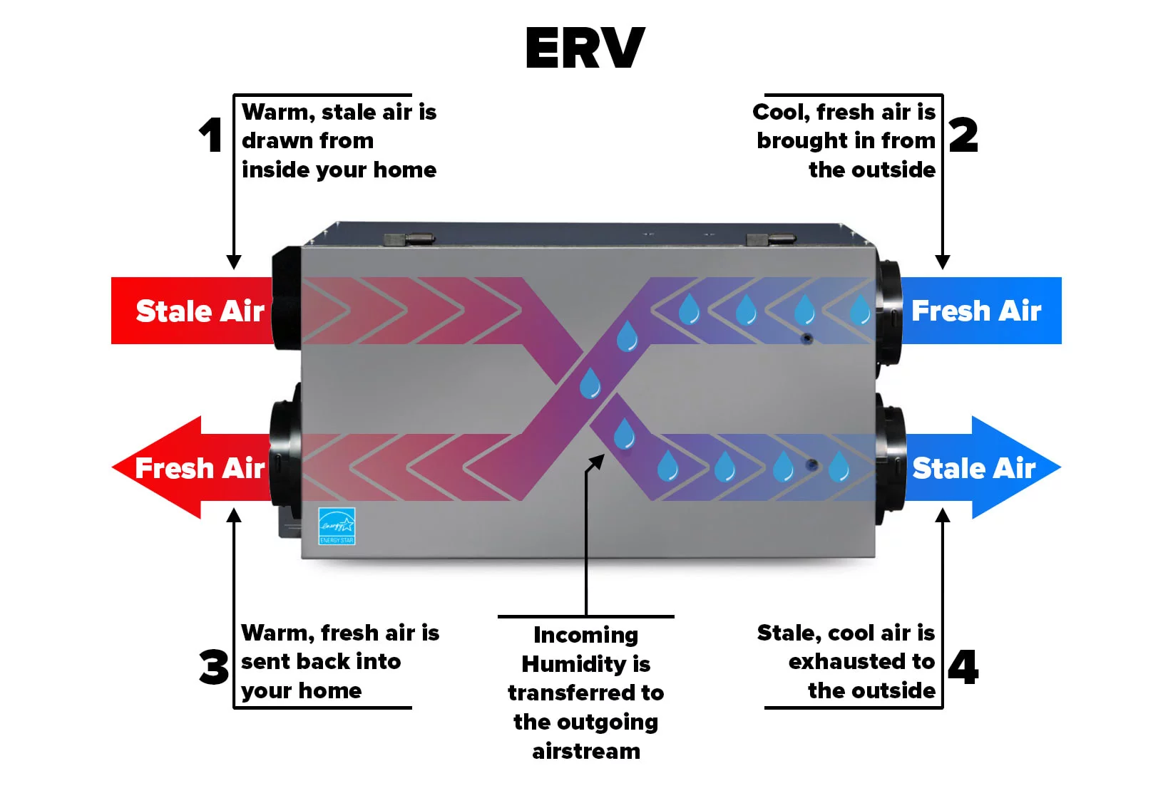
Super Green: 100% Electric
Specifications
Mechanical and Plumbing
Heat Pump: Mitsubishi Hyper-Heating H2i
ERV: Broan Model: B130E65RT
Air Purifier: Lifebreath TFP3000HEPA
Thermostat: Ecobee
Water Heater: AO Smith 900 Series (50 Gal)
Lighting
Light Bulbs
Interior: Bulbrite LED (776774)
Exterior: Bulbrite LED (778672)
Fixtures
Energy Star Certified
Exterior: DarkSky Compliant
Controls/Sensors: Lutron
Occupancy
Vacancy
Notes:
Sealed Ducting, No Flex Duct (G90 Zinc) w/ R6 Insulation
Wall and Ceiling Registers - Titus

Slide 12
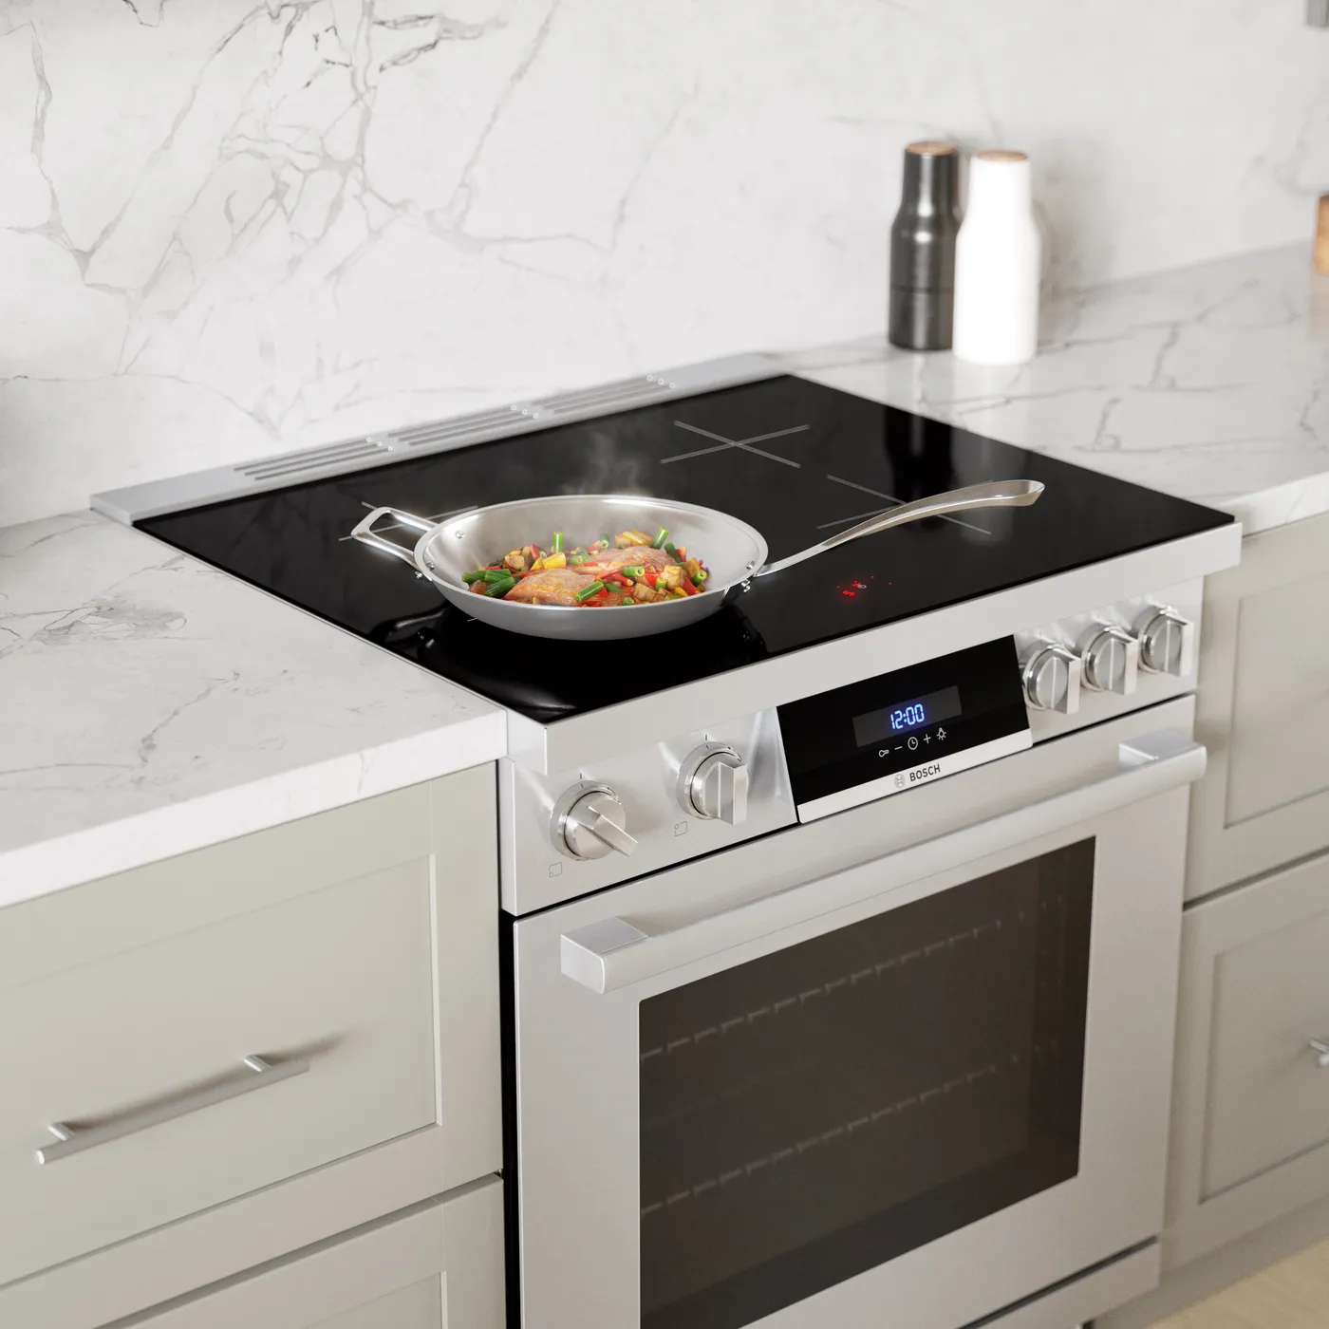
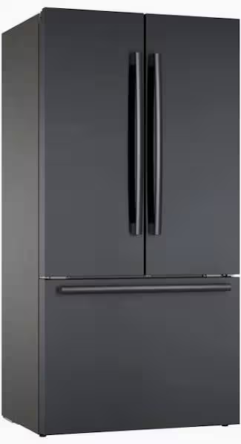
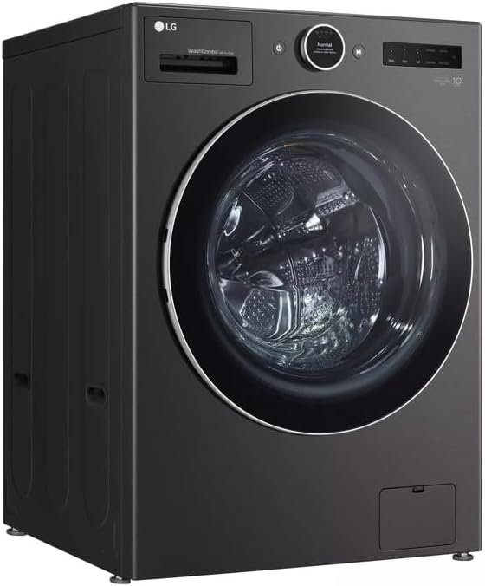
Super Green: 100% Electric
Appliances
Bosch Range - 30" HIS8055U
Broan Vent Hood (BBN1243SS)
Bosch Microwave (HMB57152UC)
Bosch Refrigerator - 21 cf (B36CT80)
Bosch Dishwasher - 24“ (SHX65CM5N)
LG All-in-One Washer/Dryer (WM6998HBA)
HomeFlex Level 2 EV Charger (J1772)
Energy Efficient
100% Electric
Induction Cooktops

Slide 13
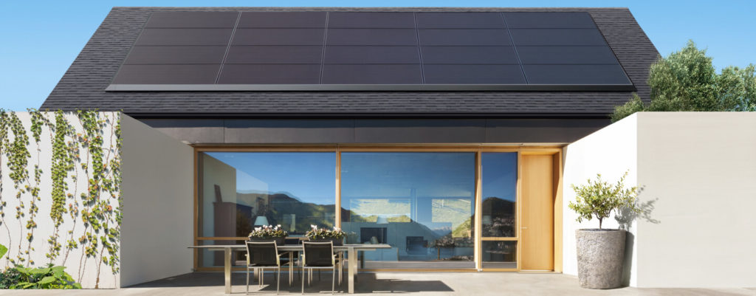
Super Green: Net Zero
Solar (Photovoltaic: PV)
CalGreen Title 24 Energy Code: Solar required for all new homes
Traditional
1,500sf = 4kW (10 Solar Panels)
2,500sf = 7kW (16 Solar Panels)
Net-Zero
1,500sf = 10W (24 Solar Panels)
2,500sf = 15kW (35 Solar Panels)
Battery Storage
Store Solar during Day and use at Night
Back Up Generator
Notes:
Beyond concrete
Xeroscape
Hot Roof (No Vents)
Minimal Eaves
Compact Design
Heat Treated Wood Siding
Stucco
Metal Roof
NuWool or TimberHP Insulation
EcoCocon - Straw panel (2hr Rating)
Pro Clima Mento - Air Barrier
Tempered Windows
Class A Rated Deck Materials

Slide 14
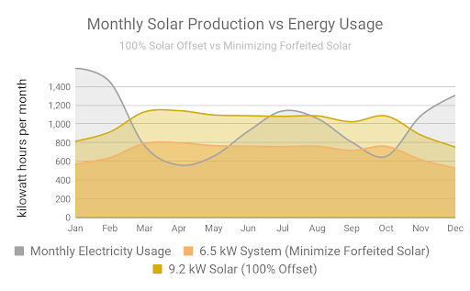
Super Green: Net Zero
Net Zero Energy (NZE) a building produces as much renewable energy on-site as it consumes over the course of a year
Notes:
Beyond concrete
Xeroscape
Hot Roof (No Vents)
Minimal Eaves
Compact Design
Heat Treated Wood Siding
Stucco
Metal Roof
NuWool or TimberHP Insulation
EcoCocon - Straw panel (2hr Rating)
Pro Clima Mento - Air Barrier
Tempered Windows
Class A Rated Deck Materials

Slide 15
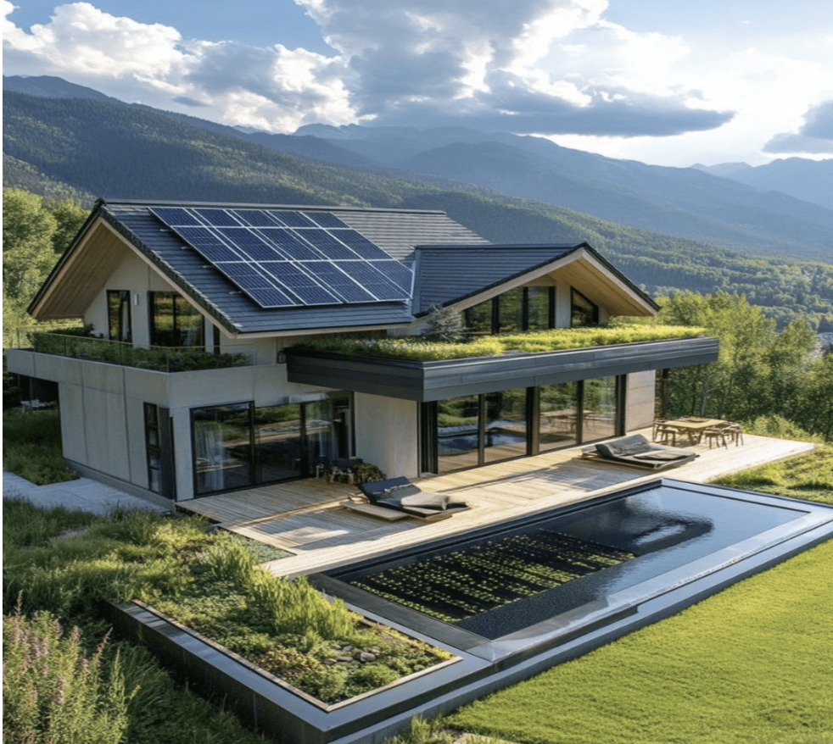
Super Green: Net Zero
A typical 2,500 sq ft all-electric house that provides about 10,000 miles of home EV charging annually will need about 15kW of solar to achieve Net Zero Energy (NZE), which requires about 35 standard-sized solar panels, requiring about 700 sq ft of clean (no protrusions) south-facing roof surface.
Importantly, achieving Super Green for a new 2,500 sq ft house adds about $80k to the construction cost, but about half of that can be recovered via tax benefits, rebates, and other incentives -- and the net investment will generally earn a 10%+ tax-free, risk-free return-on-investment (ROI), via reduced energy bills. There is no other type of investment anywhere that provides such a high return for what is essentially equivalent to a long-term certificate-of-deposit (CD) that pays a 15%+ annual-percentage-rate (APR).
Notes:
15

Slide 16
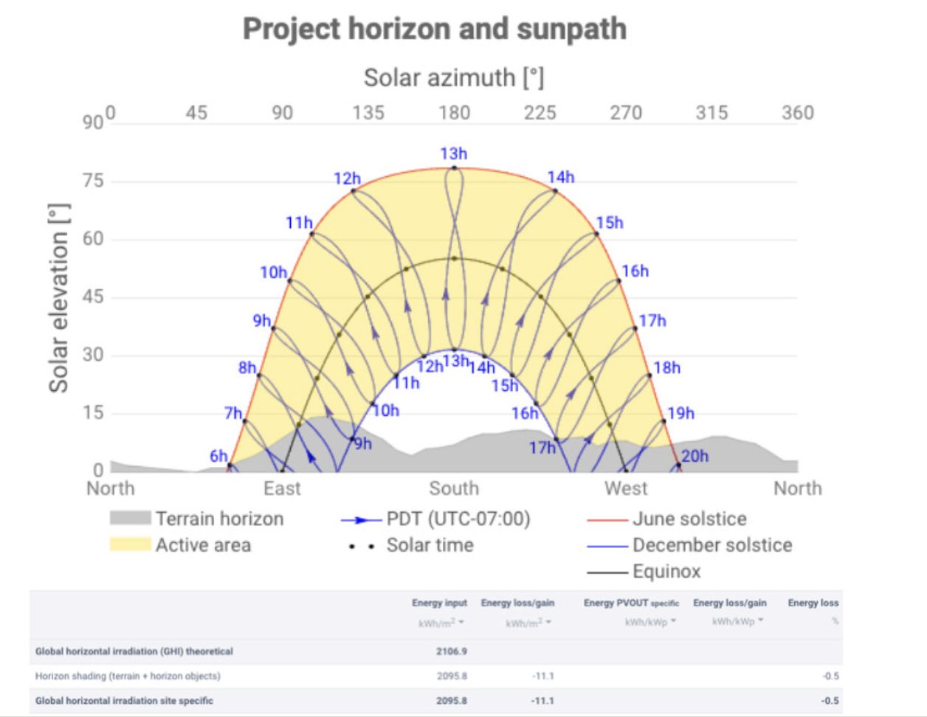
Super Green: Net Zero
The importance of south-facing rooftops:
Notes:
16

Slide 17
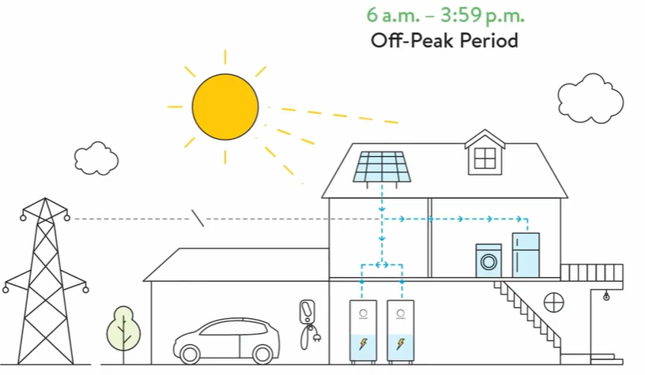
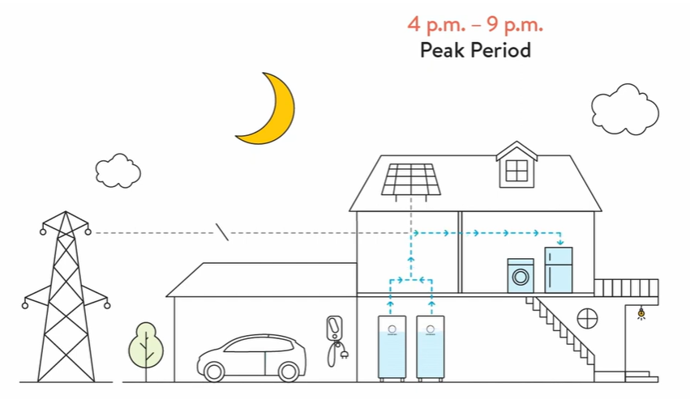
Super Green: Solar Microgrid
Off-Peak Period
Power from Sun
During the day the home draws power from its solar array and charges the home battery.
Peak Period
Power from Battery
Power is drawn from the home’s battery, and Peak Utility-based costs are avoided
© Sonnen
Notes:
Operate independently from the utility company

Slide 18
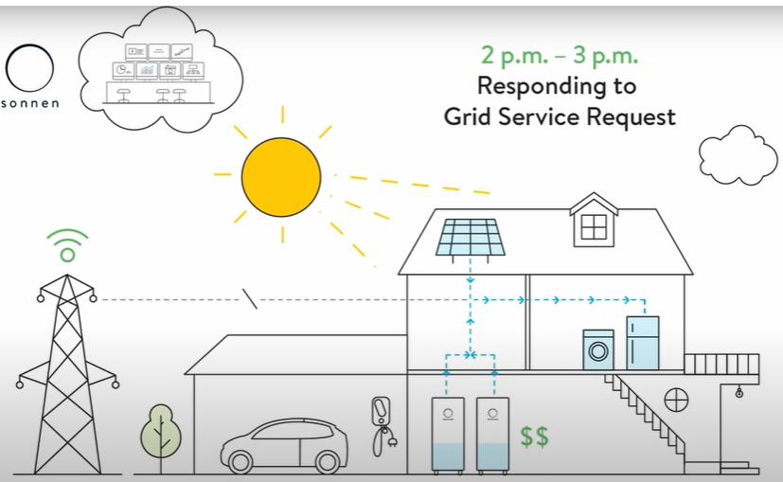
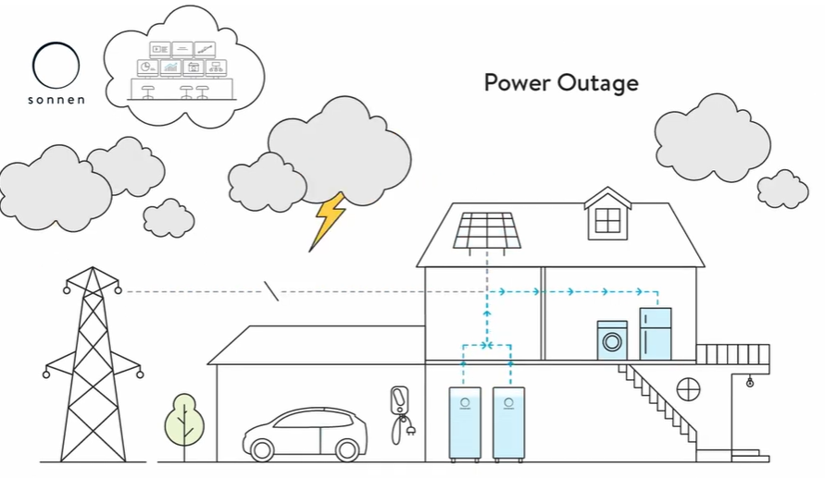
Super Green: Solar Microgrid
Grid Service Request
Earn Credits
Homeowner can earn credits from the utility company by providing excess power during a Grid Service Request. These credits can be used to offset future utility charges
Power Outage
Off-Grid Mode
During a planned and/or unexpected power outage, homeowners can shift consumption to Critical Loads and consume energy entirely from their solar + battery system. Critical Loads include only essential appliances and circuits, (HVAC, Refrigerator, Microwave, WiFi, fire-life-safety devices and select outlets).
© The Climate Center
© Sonnen
Notes:
Operate independently from the utility company

Slide 19
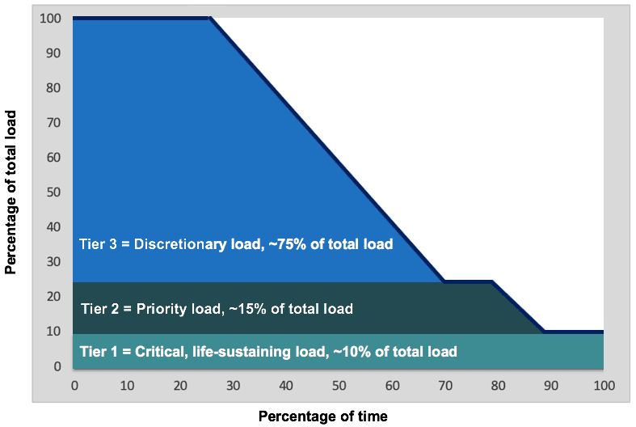
Super Green: Solar Microgrid
VOR123: Value of Resilience
Tier 1: Mission-critical, life-sustaining loads that warrant 100% resilience — usually about 10% of a facility’s total load.
Tier 2: Priority loads that should be maintained as long as doing so doesn’t threaten ability to maintain Tier 1 loads — usually about 15% of the total load.
Tier 3: Discretionary loads that should be maintained only when doing so does not threaten Tier 1 and Tier 2 resilience — usually about 75% of the total load.

Slide 20
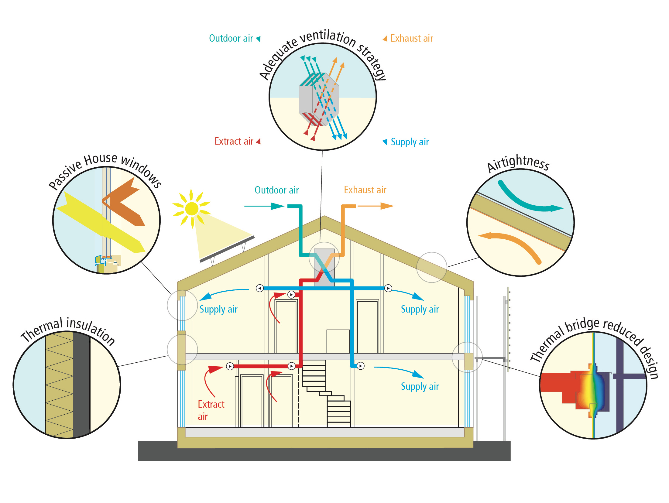
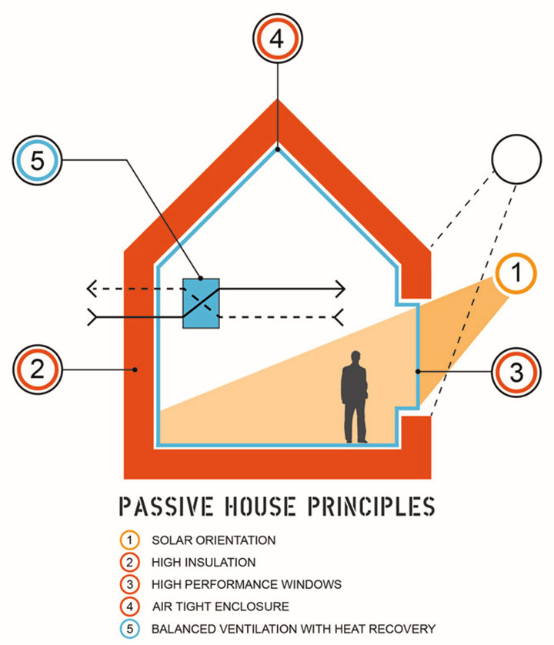
Energy Efficiency: Passive House
Passive House Design
Up to 90% Reduction in Energy Demand
Triple-paned Windows
Superior Indoor Air Quality
Reduced Size of Mechanical Equipment
Passive House is the pinnacle standard for energy efficiency. Incorporating these principles into the home’s design ensure the maximum benefit for occupancy health, well-being and energy cost savings.
Notes:
Pinnacle of Energy of Efficiency: Passive House design, originating in Germany, maximizes energy efficiency through super-insulation, airtight construction, and heat recovery ventilation to minimize heating and cooling needs.

Slide 21
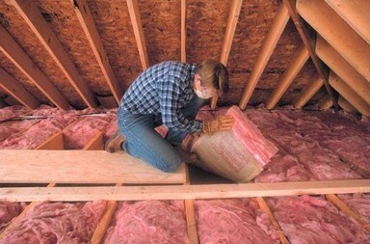
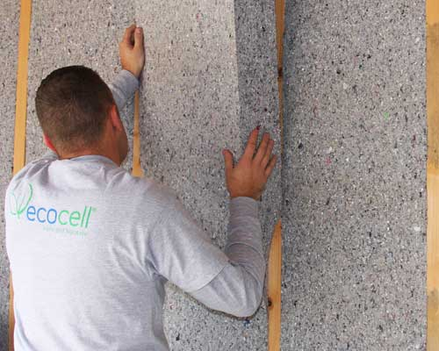
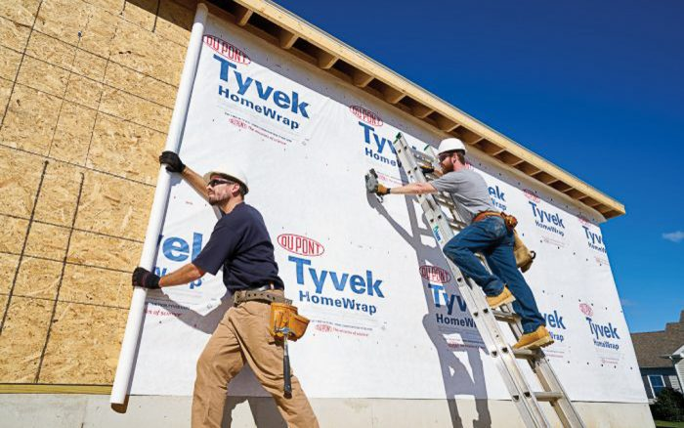
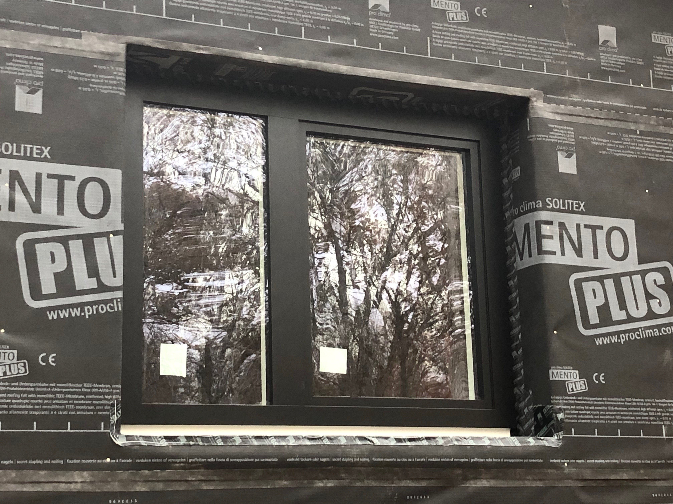
Energy Efficiency: Insulation
High-Performance Insulation
Conventional
Passive House
Foundation = R5
Floors = R10
Wall Assembly = R10
Roof Assembly = R20
Foundation = R10
Floors = R20
Wall Assembly = R30
Roof Assembly = R50
Warning: likely to contain formaldehyde, VOCs, titanium dioxide, PFAS, glass fibers, phenol, heavy metals and other toxic chemicals.
GRI homes will be built with non-toxic materials.
See the Healthy Materials section at the end of this presentation for more info on ILFI’s Red List Free materials
Note: High-performing insulation reduces the energy demand stressed on the HVAC system, creating a tremendous long-term cost saving opportunity for the homeowner.

Slide 22
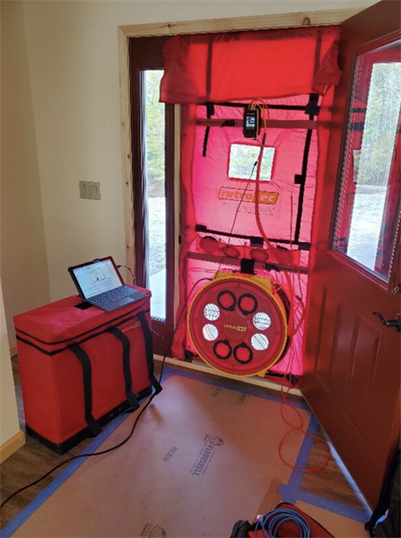
Energy Efficiency: Blower Door Test
Blower Door Test
Conventional Home (Code-Built)
ACH50 Range: 3.0 to 7.0
LEED Silver Home (Standard “Green” Home)
ACH50 Range: 1.5 to 3.0
Passive House (Super Green Home)
ACH50 Range: ≤ 0.6
Blower Door Tests are conducted on each home to measure air tightness and identify leaks in the home’s exterior envelope. These leaks are then sealed prior to homeowner occupancy.
Note: Air Changes per Hour (ACH)
Notes:
Pressurize the home, creating an air difference between inside & outside equal to 50 Pascals (ACH50) [~1lb/sf]
The fan pulls air out of the house
Air pressure is lowered, causes air to be drawn into the building through leaks in the building envelope
ACH = The Qty of Home Air Volumes moved in One Hour

Slide 23
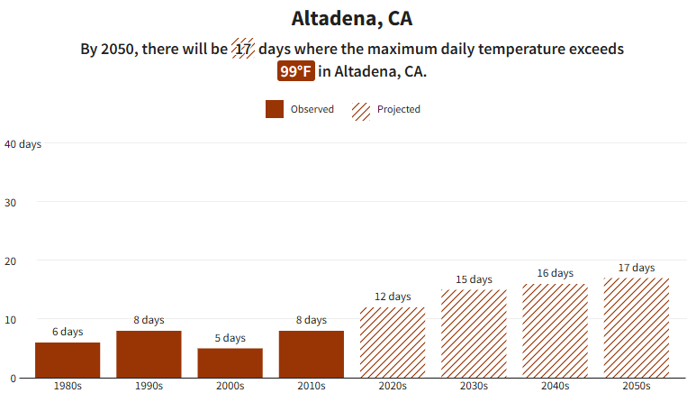
Extreme Weather Resilience: Extreme Heat
Extreme Heat
Notes:
Beyond concrete
Xeroscape
Hot Roof (No Vents)
Minimal Eaves
Compact Design
Heat Treated Wood Siding
Stucco
Metal Roof
EcoCocon - Straw panel (2hr Rating)
Tempered Windows
Class A Rated Deck Materials (IPE)
WUI: Wildland Urban Interface
Trees no closer than 10’ from home

Slide 24
Extreme Weather Resilience: Extreme Heat
Extreme Heat
⚡ HIGH HEAT EVENTS STRAIN CALIFORNIA’S RESIDENTS & ELECTRIC GRID
1. Skyrocketing Demand for Air Conditioning
On hot days, there is a massive peak in electricity use due to widespread use of air conditioning.
This leads to the risk of blackouts or brownouts when demand exceeds supply.
2. Reduced Efficiency of Power Infrastructure
Transmission lines lose efficiency in high heat, which reduces their capacity to deliver electricity.
Some gas plants also become less efficient or must throttle down to avoid overheating.
3. Higher Risk of Heat Stroke
Prolonged exposure to high temperatures combined with dehydration leads to the body’s temperature regulation system failing.
Who’s at Risk: Elderly individuals, infants, and people with chronic illnesses (especially heart disease or diabetes).
🧊 COMFORT + RESILIENCE = STAYING COOL
A homeowner in a Passive House-certified, net-zero energy home with battery backup is vastly more prepared to withstand a heatwave because:
The house stays cool for long periods without active cooling thanks to thermal mass, insulation, and air sealing.
When cooling is needed, a high-efficiency mini-split and heat pump system can operate with minimal energy use.
Battery storage ensures that even during blackouts, the home remains livable.
Utility bills stay low or net-positive, freeing up income during high-price periods.
Notes:
Beyond concrete
Xeroscape
Hot Roof (No Vents)
Minimal Eaves
Compact Design
Heat Treated Wood Siding
Stucco
Metal Roof
EcoCocon - Straw panel (2hr Rating)
Tempered Windows
Class A Rated Deck Materials (IPE)
WUI: Wildland Urban Interface
Trees no closer than 10’ from home

Slide 25
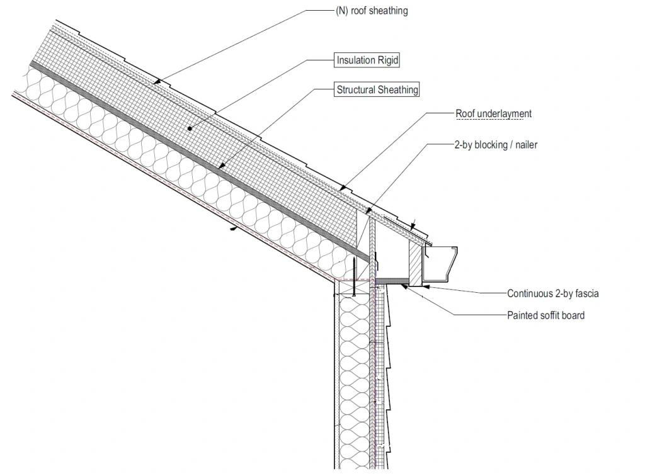
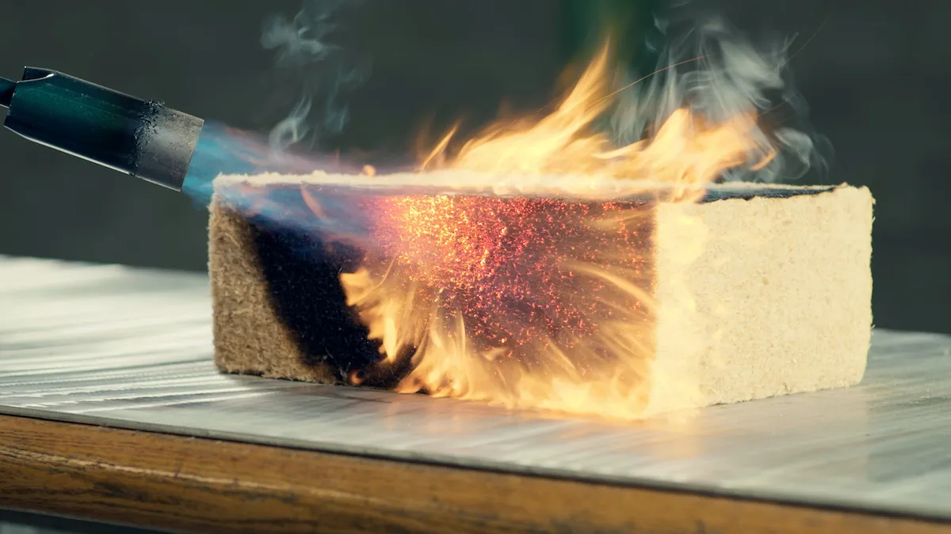
Extreme Weather Resilience: Wildfire
USGBC Wildfire Defense Toolkit
Defensive Perimeter
Class A Materials
Hot Roof (Non-Vented)
Tempered Triple-pane Windows
Heat Resistant Siding
Build back better once
Hot air and gases are deflected out away from the building
Timber HP: Class A (2-Hr Rated)
Notes:
Beyond concrete
Xeroscape
Hot Roof (No Vents)
Minimal Eaves
Compact Design
Heat Treated Wood Siding
Stucco
Metal Roof
EcoCocon - Straw panel (2hr Rating)
Tempered Windows
Class A Rated Deck Materials (IPE)
WUI: Wildland Urban Interface
Trees no closer than 10’ from home

Slide 26
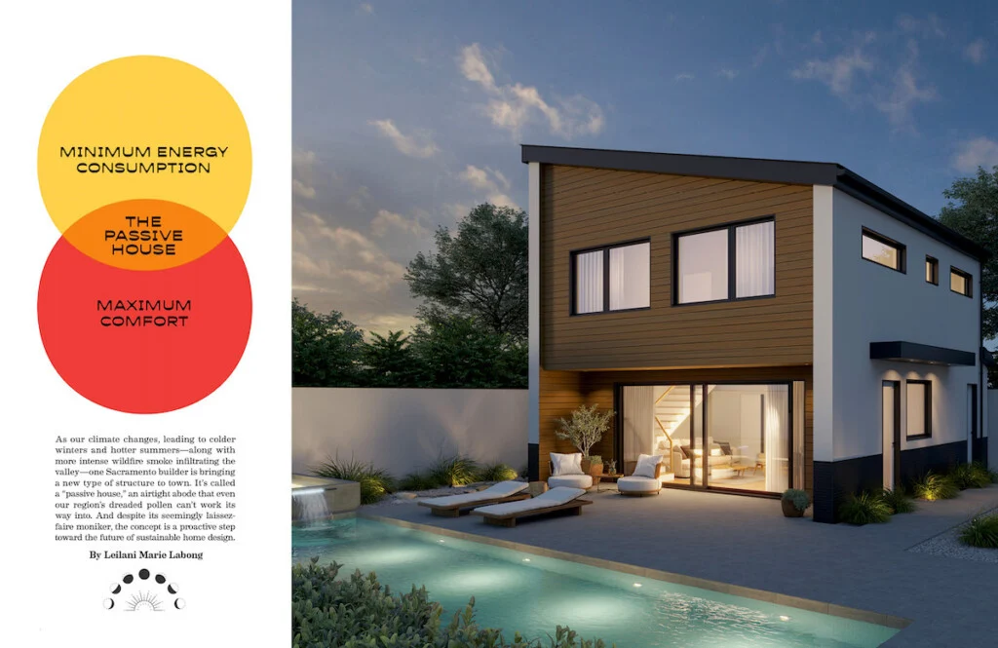
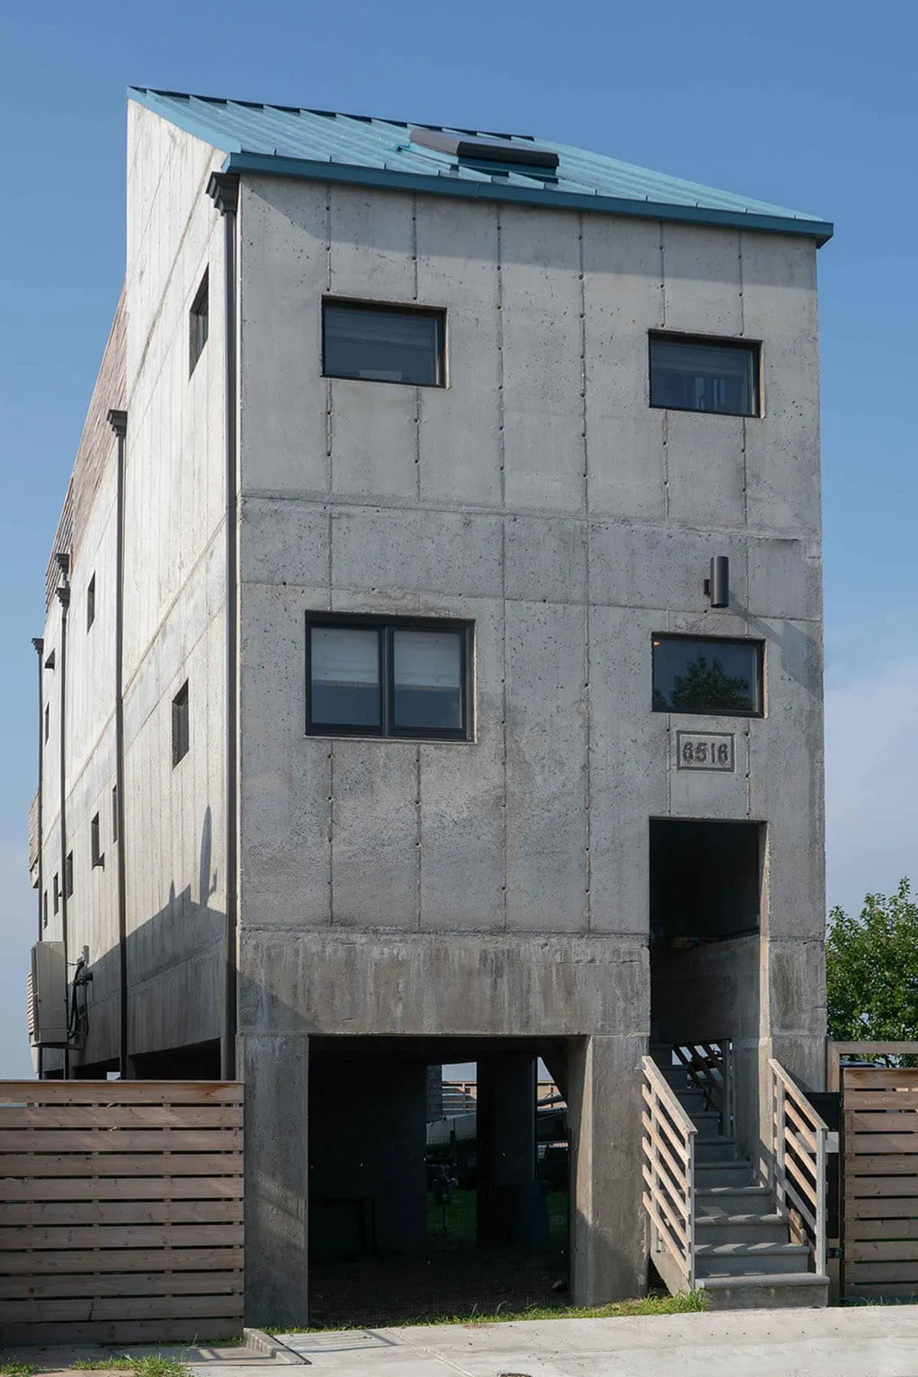
Extreme Weather Resilience: Wildfire
Fire Wise Design
=
2-Hour Fire Rating
Note: By using Class A materials for siding, insulation, decking, and other exterior components, the home can achieve the same 2-Hour fire rating as a home with concrete walls, without the high embodied carbon impact.
2-Hour Fire Rating
Build a fortress without it looking like a fortress
Notes:
Beyond concrete
Xeroscape
Hot Roof (No Vents)
Minimal Eaves
Compact Design
Heat Treated Siding
Stucco
Metal Roof
NuWool or TimberHP Insulation
EcoCocon - Straw panel (2hr Rating)
Pro Clima Mento - Air Barrier
Tempered Windows
Class A Rated Deck Materials

Slide 27
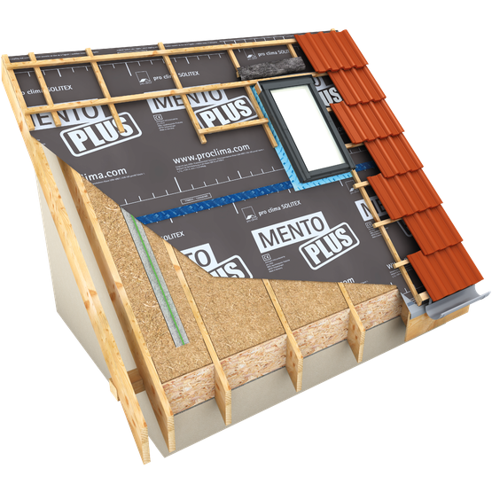
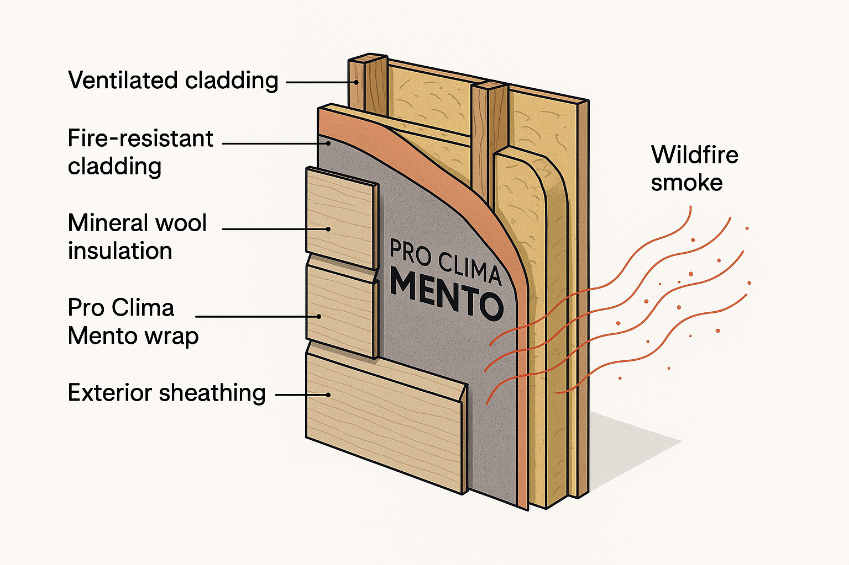
Extreme Weather Resilience: Smoke Protection
Smoke Protection: Air Barrier
🔥 HOW IT PROTECTS AGAINST WILDFIRE SMOKE
Monolithic TEEE membrane: Unlike microporous wraps (like Tyvek), the Mento series uses a continuous polymer layer that physically blocks fine particles like wildfire smoke (PM2.5 and PM10).
Highly vapor-open: Allows interior moisture to escape, protecting your wall assembly from condensation and mold.
Windproof and waterproof: Stops wind-driven rain and air leaks, increasing thermal performance.
UV and heat resistant: Can be left exposed for a time during construction and remains stable in extreme heat.
Notes:
Strategic placement of windows and shading to maximize passive solar heating in winter while minimizing overheating in summer.
Super Insulated
Triple-paned windows and well-insulated doors
A continuous air barrier reduces uncontrolled air leakage, improving energy efficiency and indoor air quality.

Slide 28
Healthy Development
Low Embodied Carbon
Operational Carbon
Indoor Air Quality
Healthy Materials
Human Health
Environmental Health
Thermal Comfort

Slide 29
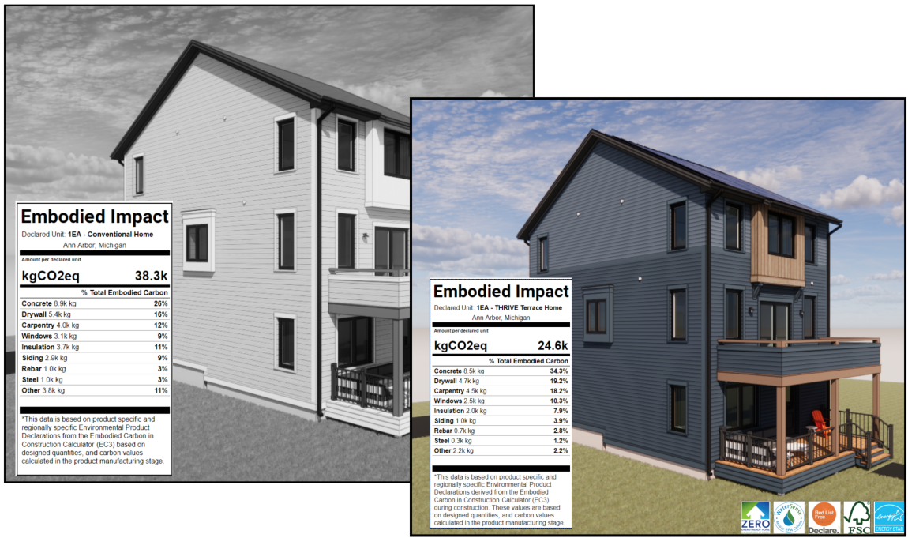
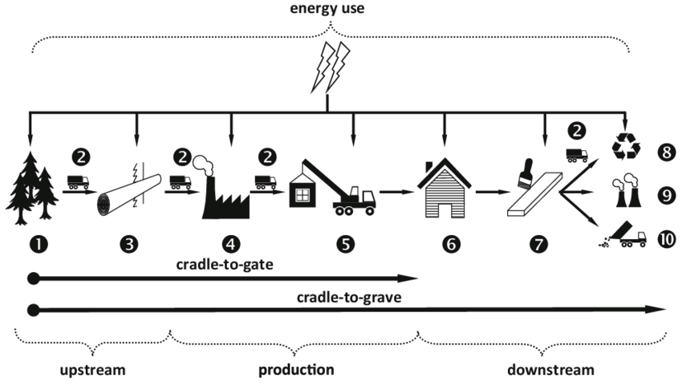
Healthy Development: Low Embodied Carbon
This example compares the same style home built with sustainably-sourced materials vs. a conventionally built home of the same size.
© Thrive Collaborative
Embodied Carbon: all carbon expended during raw material extraction, manufacturing and transportation to the construction site (Cradle-to-Gate).

Slide 30
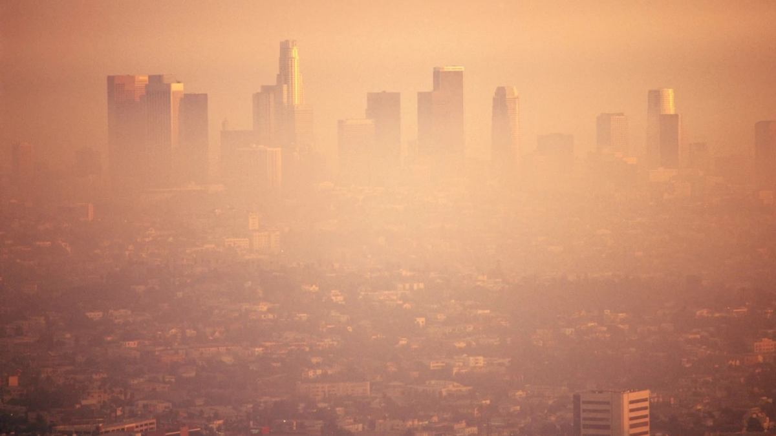
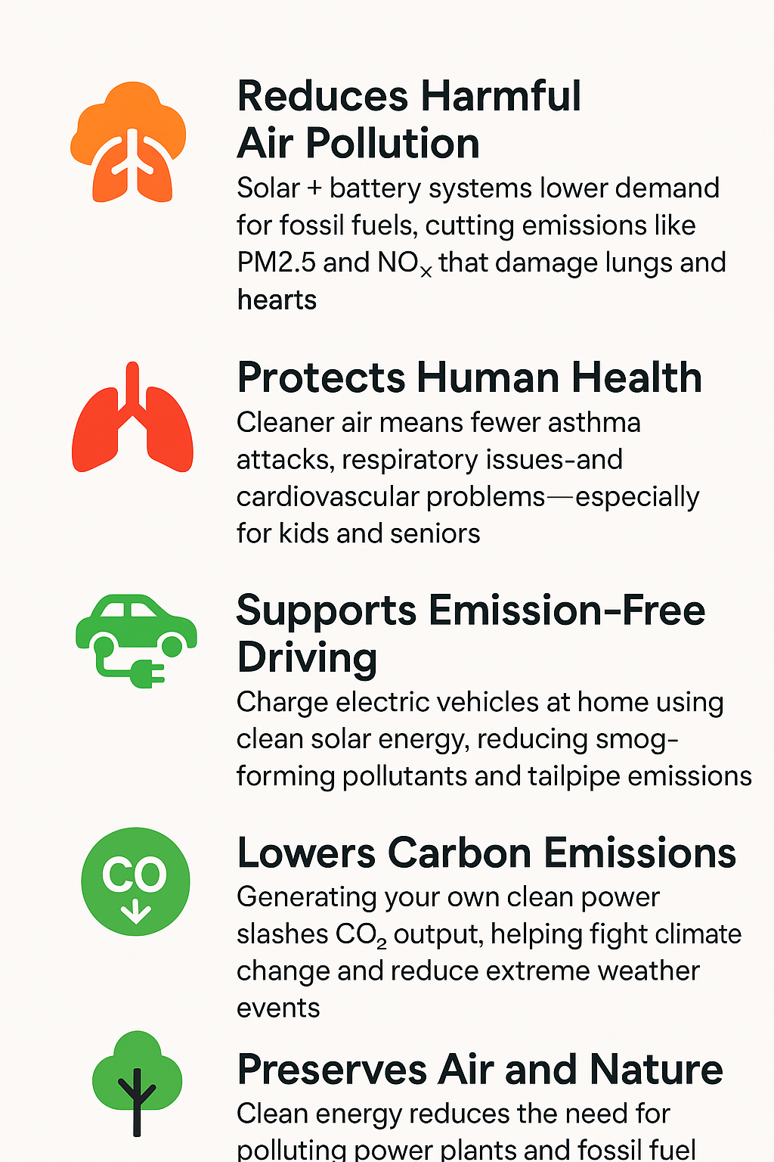
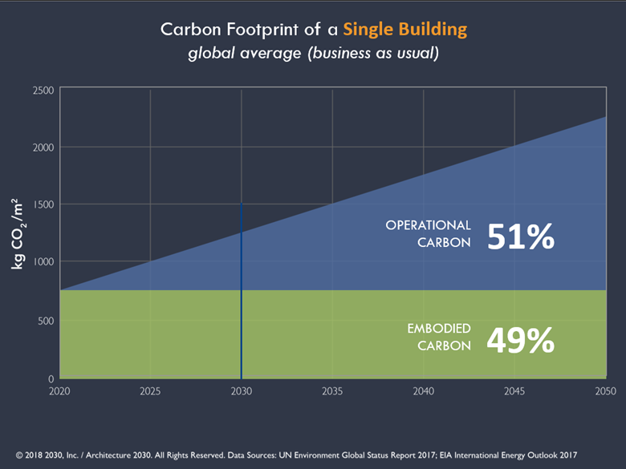
Healthy Development: Low Operational Carbon
© Thrive Collaborative

Slide 31
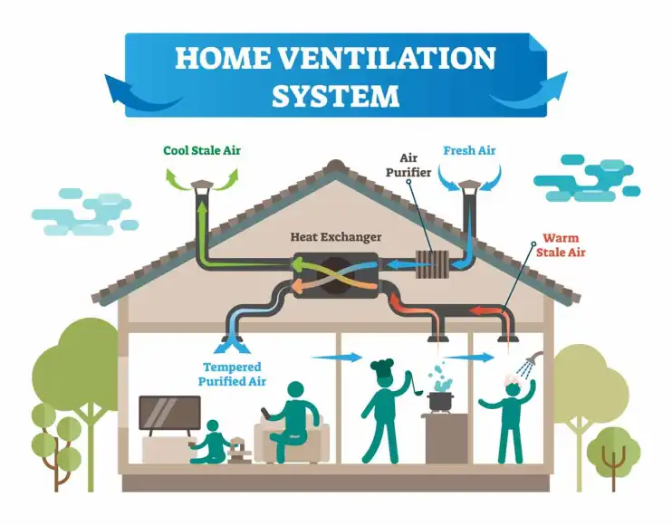
Healthy Development: IAQ
Indoor Air Quality
ERV (Heat Exchanger): Brings in fresh air while managing humidity and removing indoor pollutants like CO₂ and VOCs.
Air Purifier: In-line Air Purifier provides enhanced protection against wildfire smoke and airborne viruses.
MERV 13 Air Filter: Captures dust, pollen, and mold spores to reduce allergens and improve respiratory health.
Red List Free Materials: Eliminates harmful chemicals, reducing off-gassing and supporting long-term occupant health.
© Thrive Collaborative

Slide 32
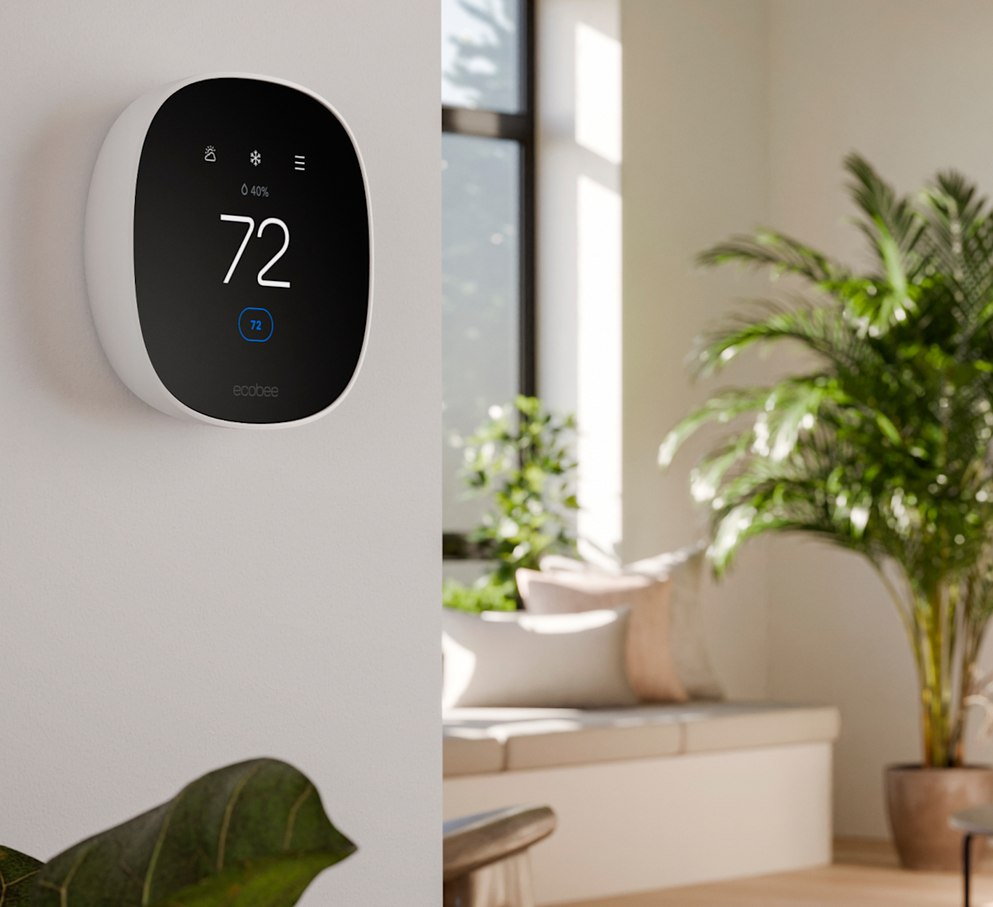
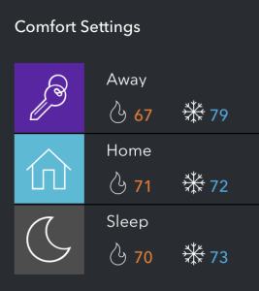
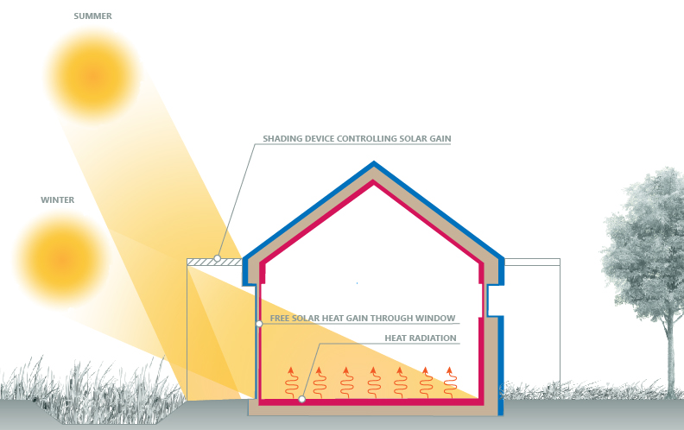
Healthy Development: Thermal Comfort
Thermal Comfort
Home Orientation: A south-facing orientation maximizes sun exposure during winter, capturing free heat from the low-angled sun.
Summer Condition: Roof overhangs or shade structures block high summer sun, keeping interiors cool without mechanical cooling.
Winter Condition: With no shading, the low winter sun penetrates deep into living spaces, naturally warming the home during cold months.
Triple-Paned Windows: High-performance windows reduce heat loss while allowing sunlight in, enhancing both insulation and passive heat gain.
Ecobee Thermostat: A smart thermostat that optimizes indoor temperatures by learning usage patterns and adjusting heating based on real-time conditions, maximizing comfort and energy efficiency.
© Thrive Collaborative

Slide 33
Healthy Development: Materials
Living Future Red List
The Living Future Red List is a list of chemicals representing the “worst in class” substances prevalent in the building industry that pose serious risks to human health and environmental health.
Hazards include cancer, reproductive toxicity, acute or chronic organ toxicity, endocrine disruption, environmental persistence, bioaccumulation, ozone depletion, and others.
Homes built as part of GRI will target procurement of exclusively Red List Free material.
https://living-future.org/red-list/

Slide 34
Healthy Development: Materials
Living Future Red List
Chemical | Where It’s Found | Environmental Impacts | Human Health Impacts
Asbestos | Insulation, flooring, roofing, cement board | Persistent in the environment, hazardous waste | Causes lung cancer, mesothelioma, and asbestosis
Formaldehyde | Composite wood, insulation, adhesives, cabinetry | Air pollutant, contributes to smog formation | Respiratory irritant, probable human carcinogen
PVC (Polyvinyl Chloride) | Vinyl flooring, pipes, wall coverings, windows | Toxic byproducts during manufacturing and disposal (dioxins) | May contain phthalates and heavy metals; endocrine disruptor
Phthalates (e.g., DEHP) | Vinyl products, sealants, adhesives, wall coverings | Persistent, bioaccumulative; toxic to aquatic organisms | Hormone disruption, developmental and reproductive toxicity
Flame Retardants (e.g., PBDEs) | Insulation, upholstery, electronics casings | Persistent organic pollutants; accumulate in wildlife | Thyroid disruption, neurodevelopmental harm, possible carcinogen
Halogenated Solvents | Paint removers, cleaners, degreasers, adhesives | Air and water pollutant; hazardous waste | Neurotoxic, liver/kidney damage, suspected carcinogen

Slide 35
Healthy Development: Materials
Living Future Red List
Chemical | Where It’s Found | Environmental Impacts | Human Health Impacts
Cadmium | Pigments, coatings, plastic stabilizers | Soil and water contaminant; bioaccumulative in food | Kidney damage, respiratory issues, known carcinogen
Lead | Paint, plumbing, roofing materials | Long-lasting soil/water contaminant; harmful to wildlife | Neurotoxic, affects child development, cardiovascular effects
Mercury | Fluorescent lighting, switches, thermostats | Bioaccumulative in fish; persistent in water systems | Nervous system damage, cognitive impairment, kidney damage
Isocyanates (e.g., MDI, TDI) | Spray foam insulation, paints, sealants | Contribute to smog, hazardous waste | Respiratory sensitizer, asthma, skin and eye irritation
PFAS | Paints, Stain-resistant carpets, sealants, coatings, membranes | Extremely persistent ('forever chemicals'), water pollution | Hormone disruption, cancer, immune system effects
VOCs | Paints, sealants, adhesives, flooring, cabinetry | Ground-level ozone (smog) formation, indoor air pollution | Eye/nose/throat irritation, liver/kidney damage, carcinogenic

Slide 36
Healthy Development: Materials
Material Specifications
Foundation
Concrete with Low GWP
Framing
FSC Certified Lumber
Roofing
26g Standing Seam Metal
Insulation
TimberHP, Rockwool, UltraTouch Denim or NuWool
Drywall
USG Ecosmart
Flooring
FSC Red Oak w/ Rubio Monocoat
Forbo Marmoleum
Tile
DalTile or Fireclay
Air Barrier
Pro Clima Mento
Plumbing
PEX, IBEX and ABS
Windows and Doors
Elitfonster Triple Paned
Countertops
Dekton or Reclaimed Wood
Paint
Benjamin Moore Ultra Spec
Siding
Stucco and/or Metal
Decking
Bison IPE Class A Wood
Cabinets
FSC Maple and MDF

Slide 37
Conclusion
Conclusion: Clean Coalition is committed to ensuring communities achieve resilient energy solutions and an unparalleled trifecta of economic, environmental, and resilience benefits.
Our plan bridges innovation and community action, turning the tragedy of the fires into an opportunity to create a sustainable, resilient, and thriving Palisades.
Together, we can lead the way toward a future built on renewable energy and environmental responsibility.

Slide 38
Conclusion

