Slide 1
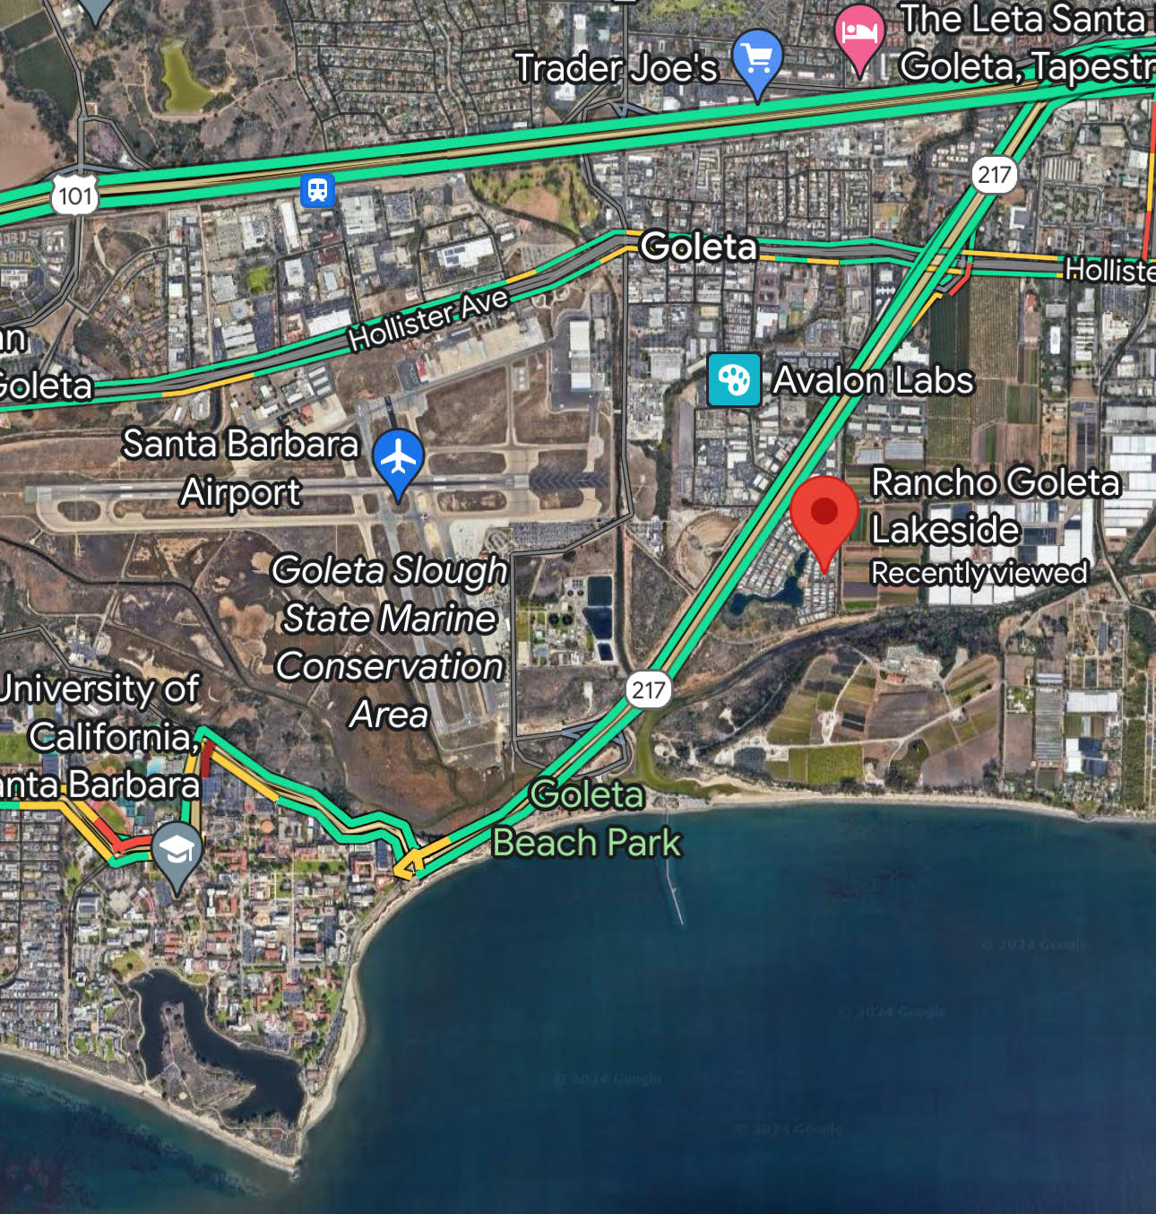
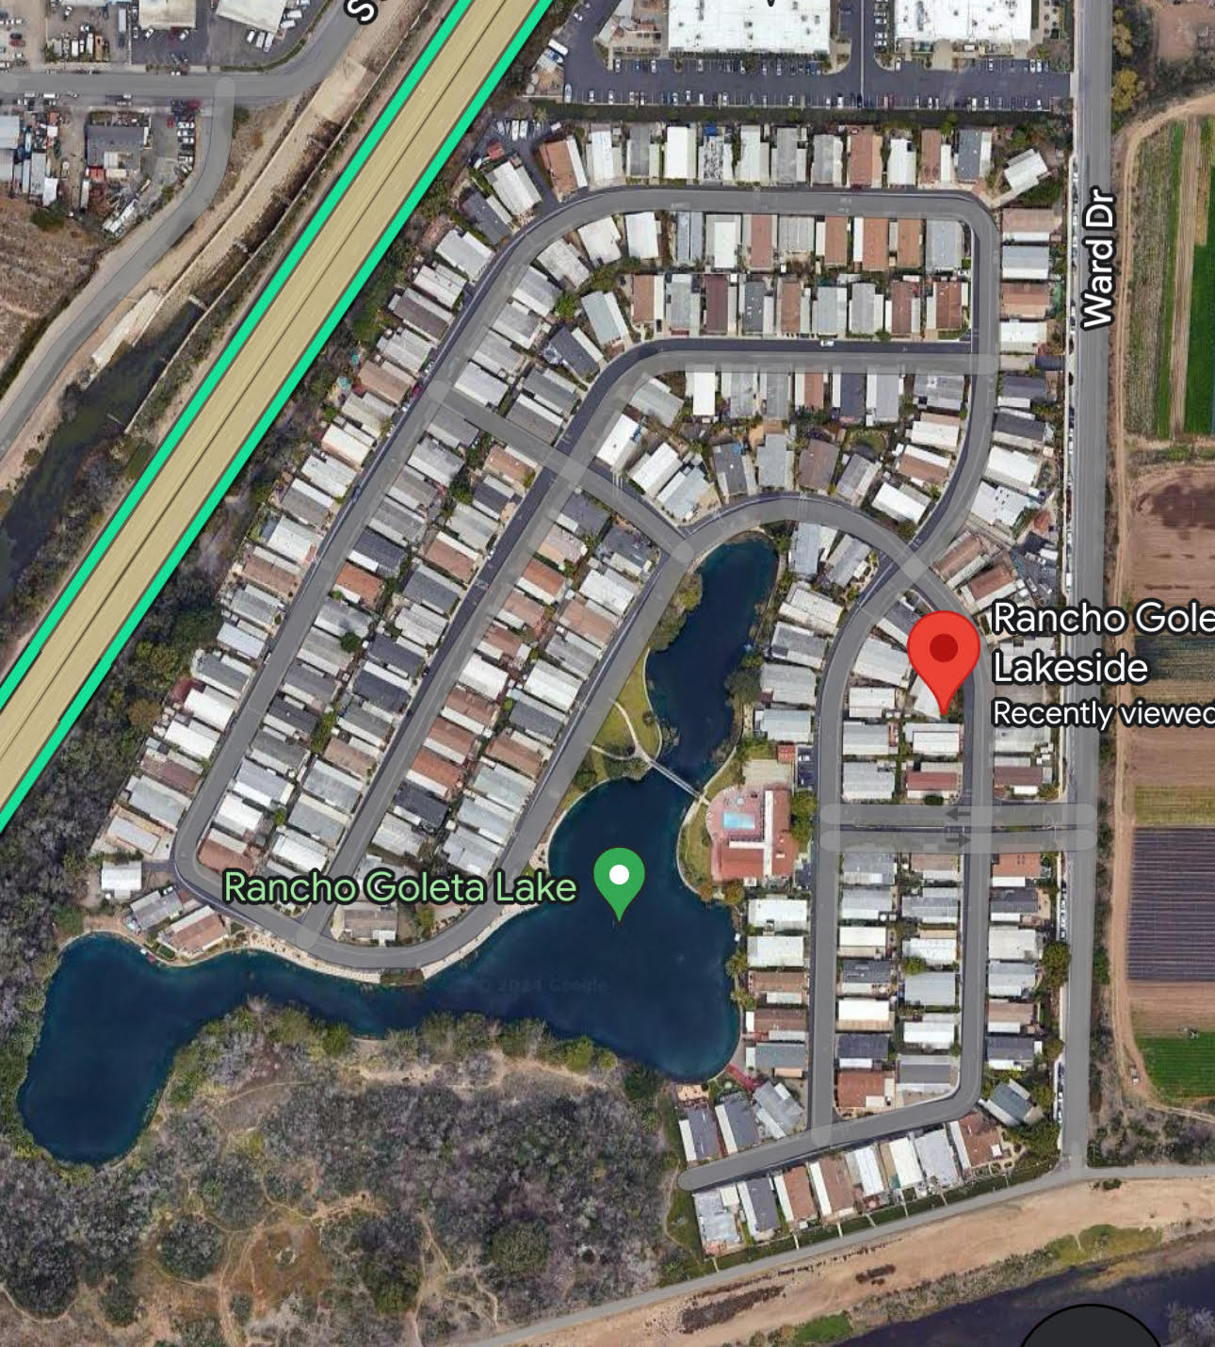
Rancho Goleta Lakeside (RGL) Community Microgrid
Craig Lewis
Executive Director
650-796-2353 mobile
craig@clean-coalition.org
8 May 2025
Notes:
FRANK
Welcome and introductions
Thank you for inviting us to speak here this evening
We're here today to talk to you about Community Microgrid as an energy resilience solution.
Over the past couple of months we've discussed ideas and options with Dylan and folks from Recolte Energy, and today we're here to present our early findings and some solutions.

Slide 2
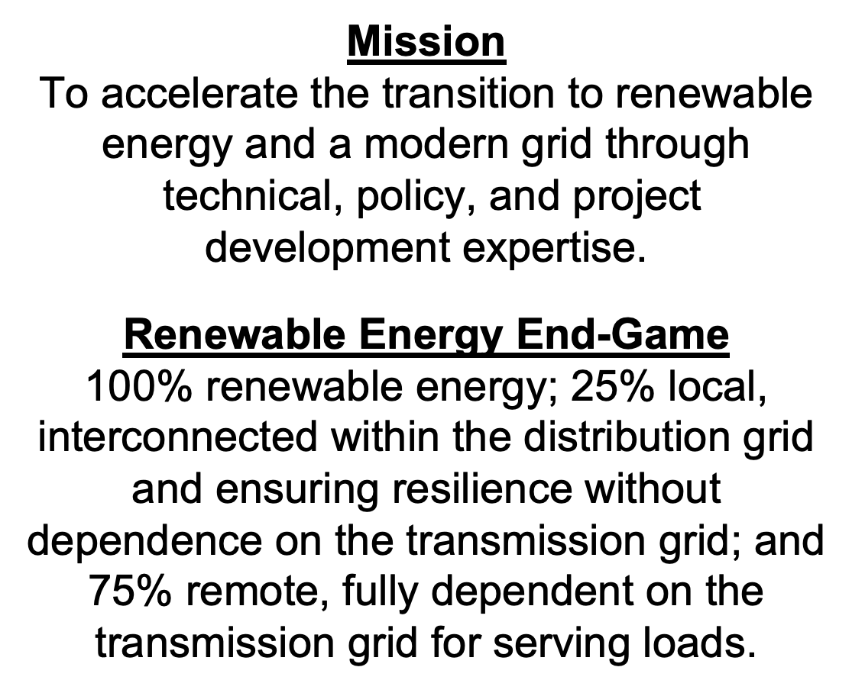
Clean Coalition (nonprofit)
Notes:
FRANK
Clean Coalition's mission is to accelerate the transition to renewable energy and a modern grid through technical, policy, and project development expertise
2

Slide 3
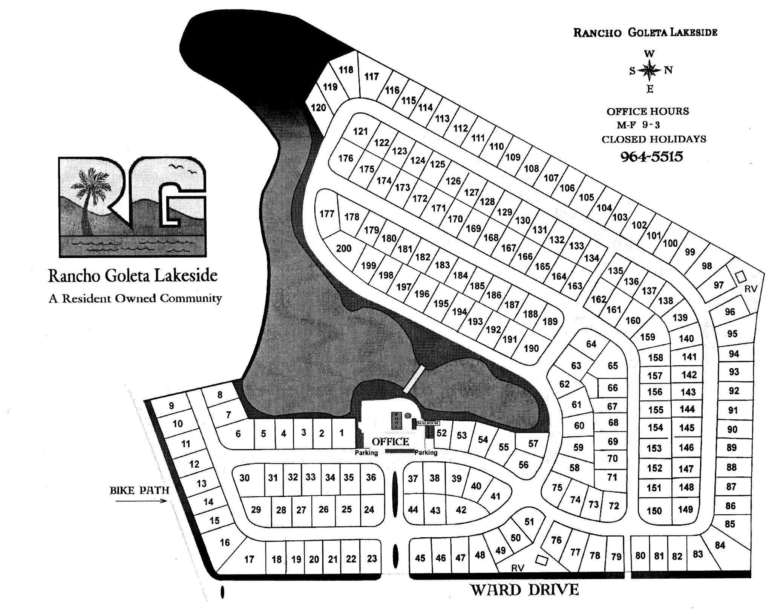
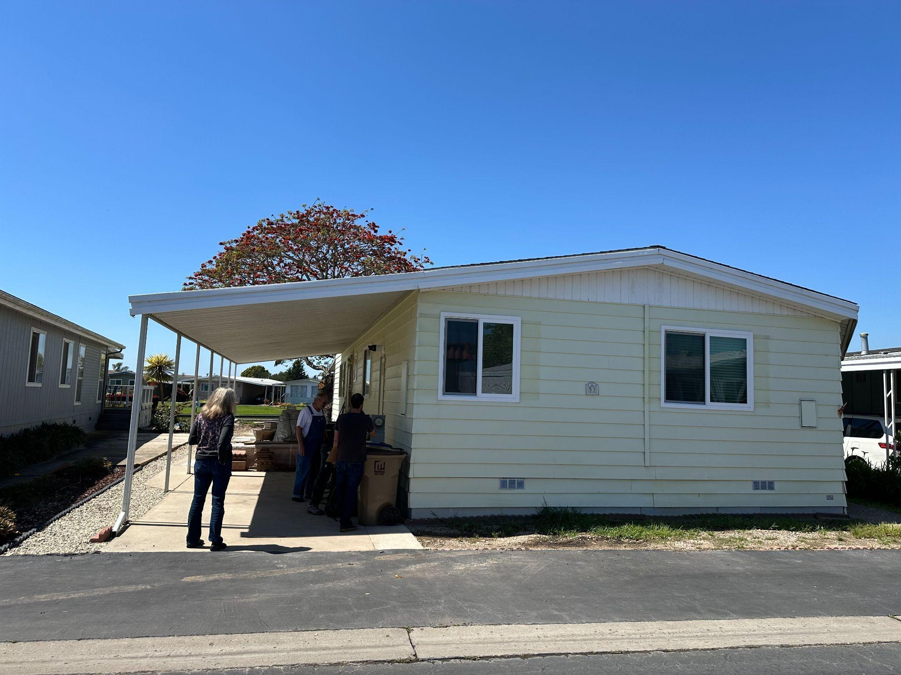
RGL Community Microgrid overview
200 mobile homes, many ready for replacement, in disadvantaged area of Goleta.
Single master meter with SCE and privately submetered at each home.
Private underground distribution grid that is significantly constrained with upgrades needed to enable significant electrification, including EV adoption.
Solar to be distributed across the homes and combined with a single central battery to create a solar-driven microgrid to deliver a trifecta of economic, environmental, and resilience benefits.
Perfect opportunity to showcase the importance of Master Metering for optimizing economics from solar and resilience from microgrids.
RGL layout of 200 mobile homes
Typical RGL mobile home

Slide 4
Percentage of time online for Tier 1, 2, and 3 loads for a Solar Microgrid designed for the University of California Santa Barbara (UCSB) with enough solar to achieve net zero and 200 kWh of energy storage per 100 kW solar.
Solar-driven resilience is unparalleled
Percentage of total load
Tier 3 = Discretionary load, ~75% of total load
Tier 2 = Priority load, ~15% of total load
Tier 1 = Critical, life-sustaining load, ~10% of total load
Percentage of time

Slide 5
A typical diesel generator is configured to maintain 25% of the normal load for two days. If diesel fuel cannot be resupplied within two days, goodbye. This is hardly a solution for increasingly necessary long-term resilience. In California, Solar Microgrids provide a vastly superior trifecta of economic, environmental, and resilience benefits.
Diesel generators are designed for limited resilience
Percentage of total load
Tier 3 = Discretionary load, ~75% of total load
Tier 2 = Priority load, ~15% of total load
Tier 1 = Critical, life-sustaining load, ~10% of total load
Percentage of time

Slide 6
RGL is in the disaster-prone Goleta Load Pocket
Map of the Goleta Load Pocket, showing the RGL location and high fire threat areas (shaded in red and yellow).

Slide 7
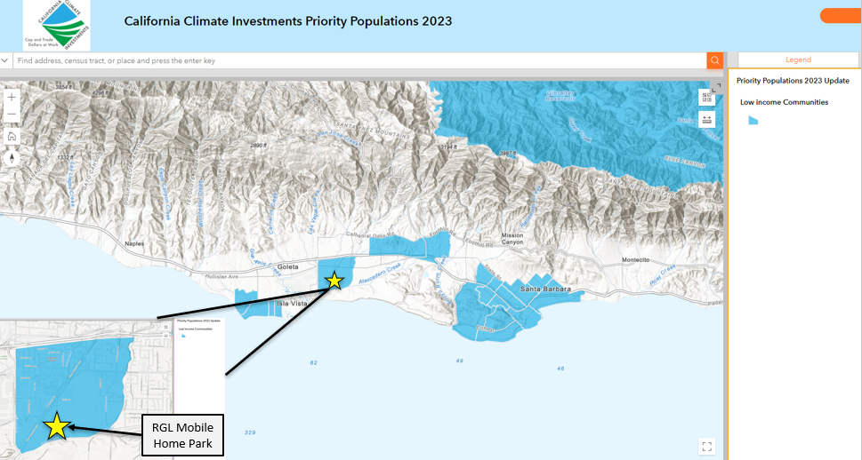
RGL in the only disadvantaged area of Goleta
RGL is in one of the few disadvantaged communities (shaded in blue) within the Goleta Load Pocket.

Slide 8
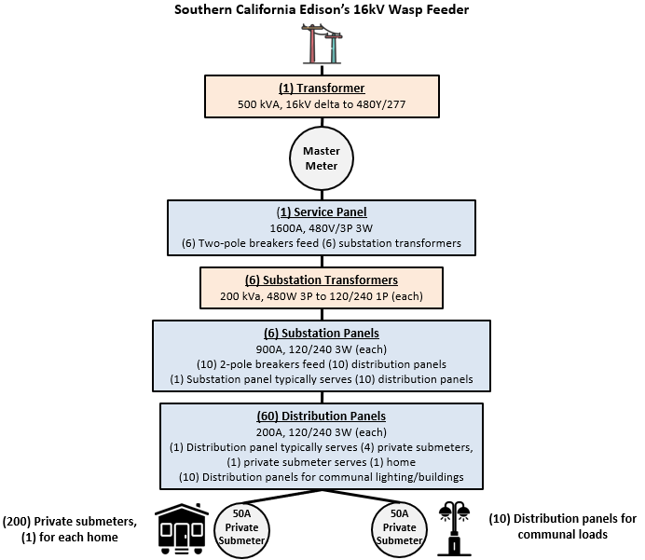
RGL is perfect for showcasing Master Metering
Master Metering is currently illegal for Multi-Unit Housing (MUH) facilities in California, unless grandfathered in. This needs to change, because the only way to provide solar-driven resilience and economic optimization for MUH facilities is by sharing solar across the homes.
Diagram of RGL electrical infrastructure

Slide 9
RGL Community Microgrid challenges
Two miles of private underground distribution grid that is significantly constrained and blocking electrification measures, including EV charging.
Solar design that needs to distributed on the verandas across the 200 home sites. This will require new verandas to ensure structural integrity, and the homes need to be easily detachable from the verandas to accommodate home replacements.
$150k in funding to conduct a robust feasibility study (engineering, policy, and economic).
Typical RGL mobile home

Slide 10
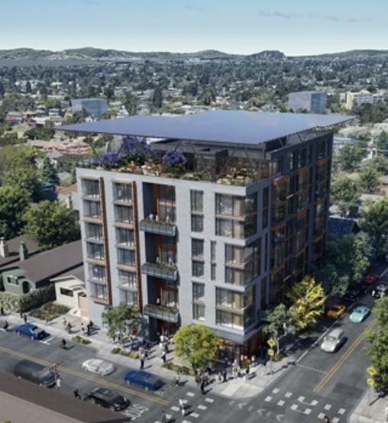
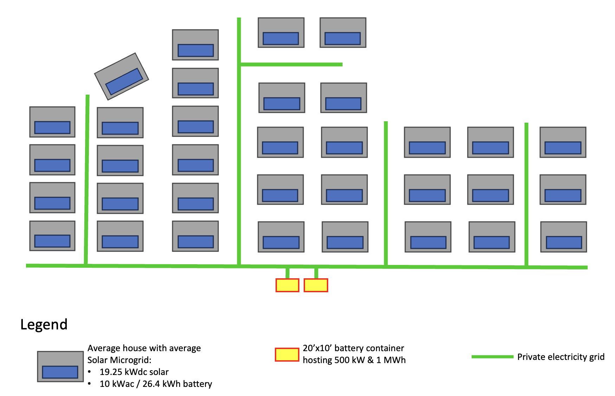
RGL Community Microgrid benefits
Trifecta of economic, environmental, and resilience benefits to RGL, a MUH showcase in the most disadvantaged area of Goleta.
Blueprint for MUH facilities to electrify, including EV charging.
Evidence for policymakers to understand the importance of Master Metering to MUH, for optimizing economics from solar and resilience from microgrids.

Slide 11
Key needs now
$150k in funding for the comprehensive RGL Community Microgrid feasibility study.
Legislative champion in Sacramento to resurrect SB 1148 (2023) and lead the way to re-establishing Master Metering in California.

