Slide 1

CCA Joint Rate Comparisons
Max Andre
15 Aug 2025

Slide 2
Background
Each Community Choice Aggregation (CCA) publishes Joint Rate Comparisons which compare its rates to its respective Investor-Owned Utilities’ (IOU) rates.
This presentation serves as a catalog of the Joint Rate Comparisons between each CCA and its respective IOU under the following rates:
PG&E: E-TOU C
SCE: TOU-D-PRIME
SDGE: TOUDR
These Joint Rate Comparisons were used in the Clean Coalition’s CCA Rate Analysis presentation.

Slide 3
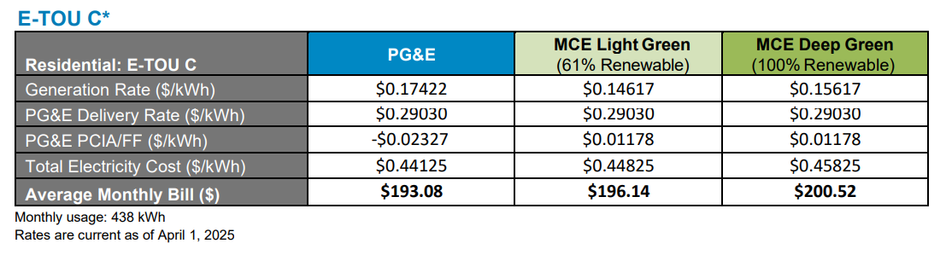
Marin Clean Energy (MCE)
MCE has a $0.035/kWh added cost of the PG&E PCIA/FF
Bad terms w/ PG&E because it was the first CCA

Slide 4
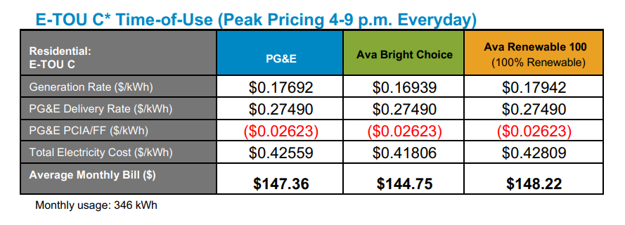
Ava Community Energy (Ava)

Slide 5
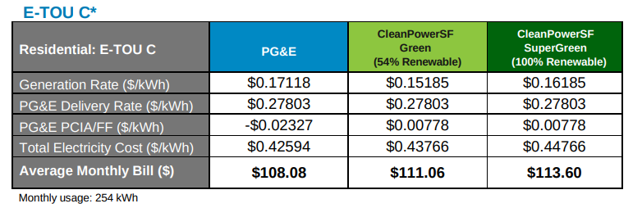
Clean Power SF (CPSF)

Slide 6
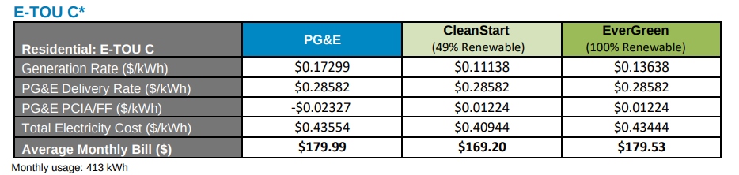
Sonoma Clean Power (SCP)

Slide 7
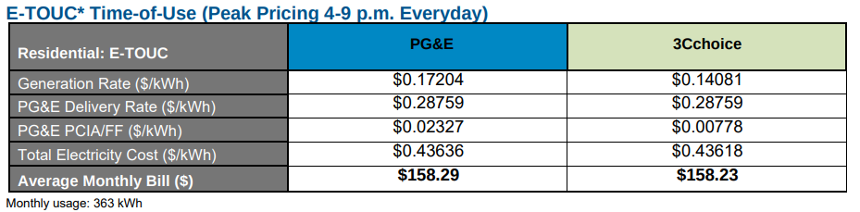
Central Coast Community Energy (3CE) & PG&E

Slide 8
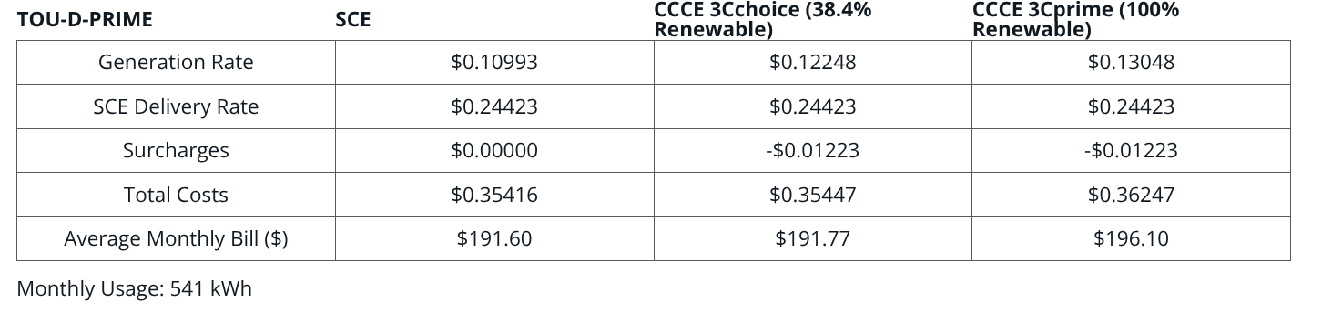
Central Coast Community Energy (3CE) & SCE

Slide 9
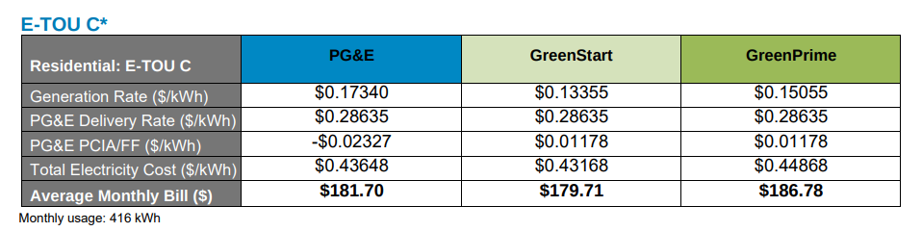
Silicon Valley Clean Energy (SVCE)

Slide 10
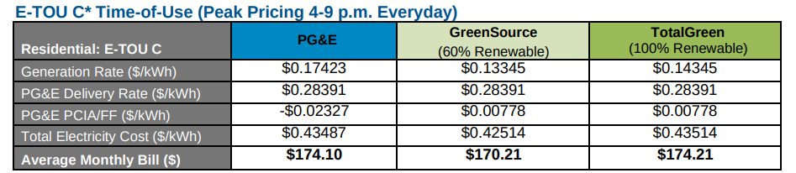
San Jose Clean Energy (SJCE)

Slide 11
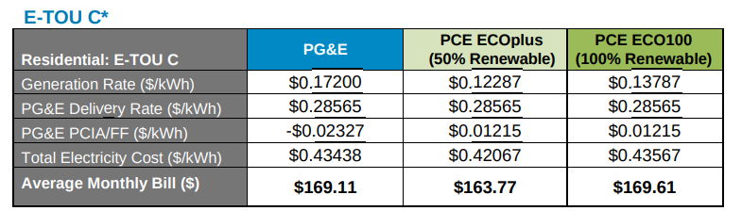
Peninsula Clean Energy (PCE)

Slide 12
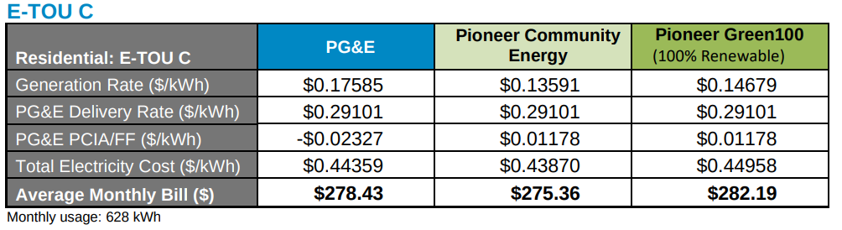
Pioneer Community Energy

Slide 13
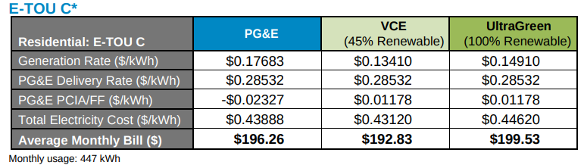
Valley Clean Energy (VCE)

Slide 14
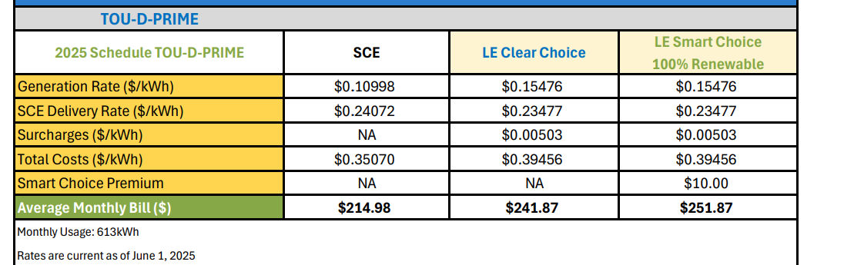
Lancaster Choice Energy (LE)

Slide 15
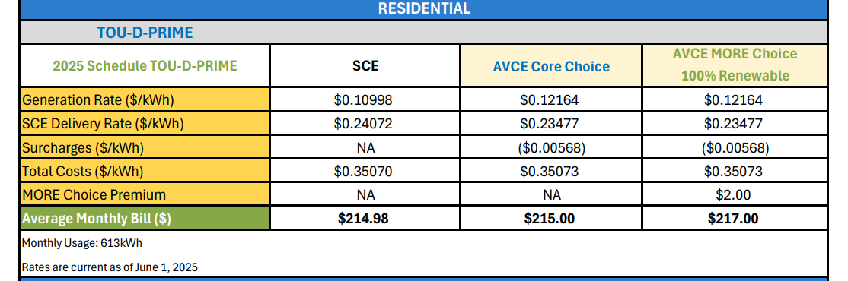
Apple Valley Choice Energy (AVCE)

Slide 16
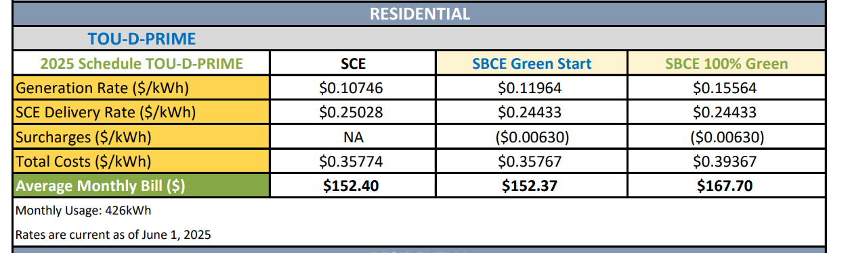
Santa Barbara Clean Energy (SBCE)

Slide 17
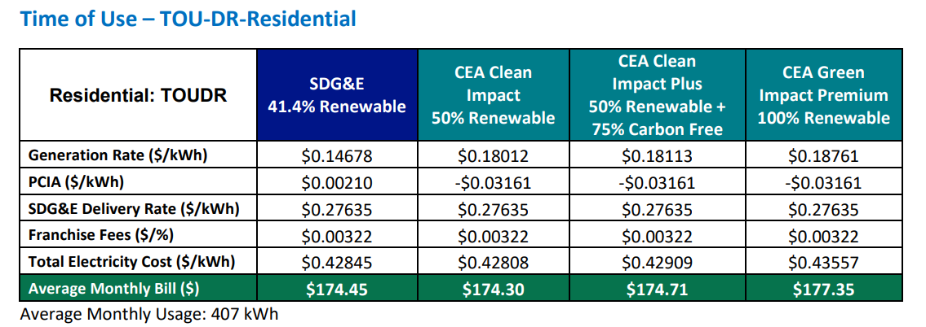
Clean Energy Alliance (CEA)

Slide 18
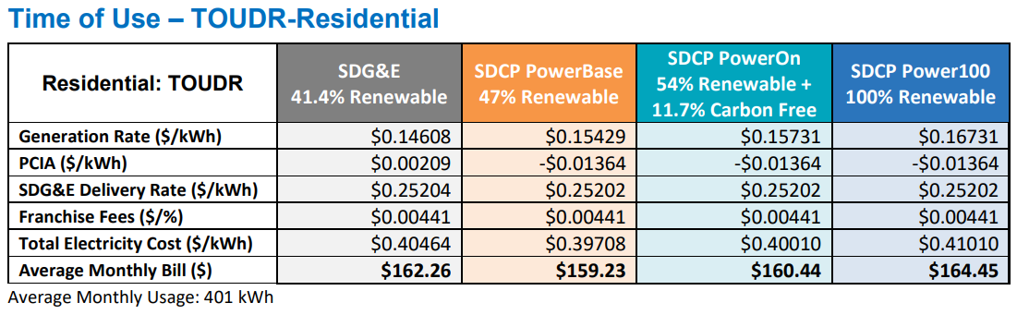
San Diego Community Power (SDCP)

Slide 19
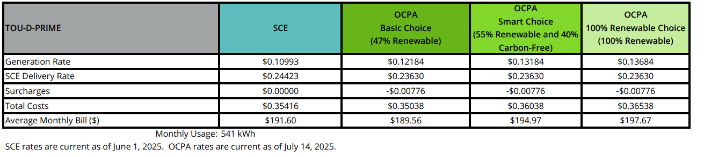
Orange County Power Authority (OCPA)

Slide 20
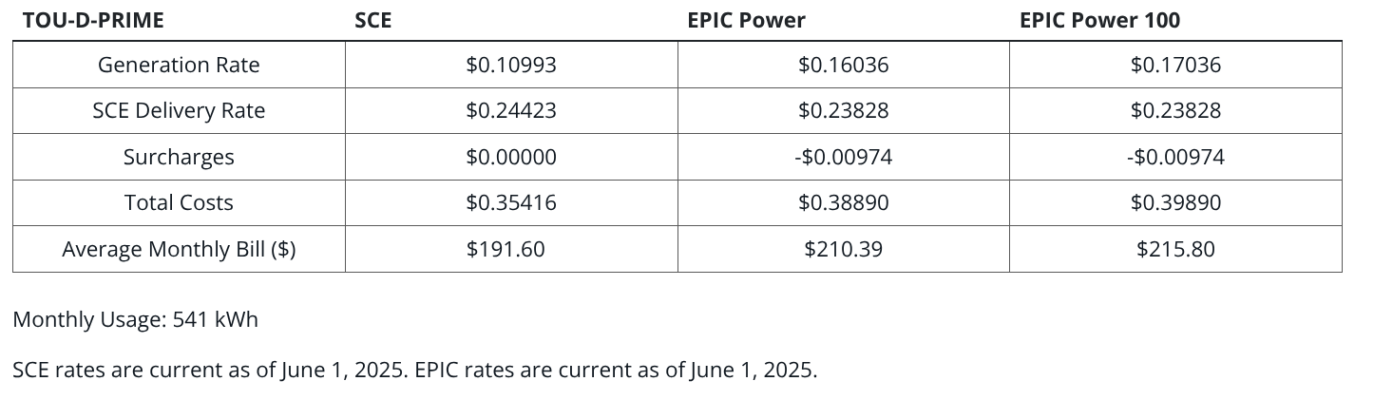
Palmdale EPIC Energy (EPIC)

Slide 21
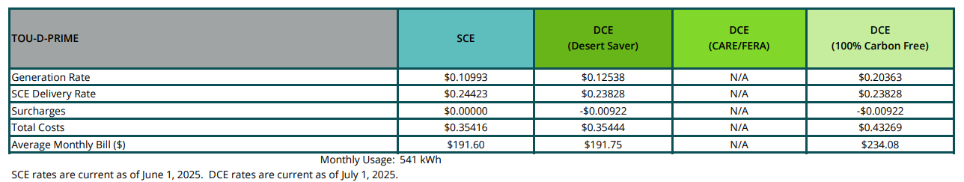
Desert Community Energy (DCE)

Slide 22
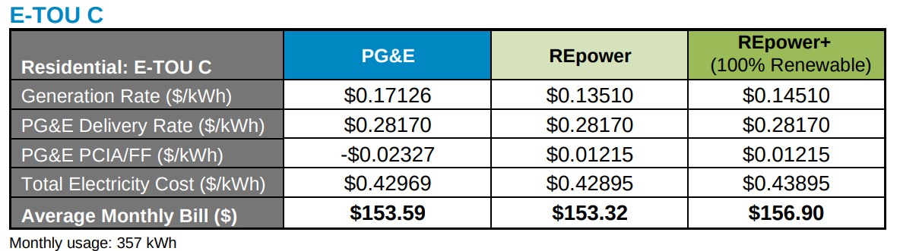
Redwood Coast Energy Authority (RCEA)

Slide 23
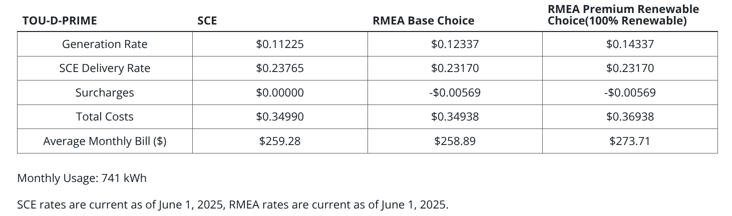
Rancho Mirage Energy Authority (RMEA)

Slide 24
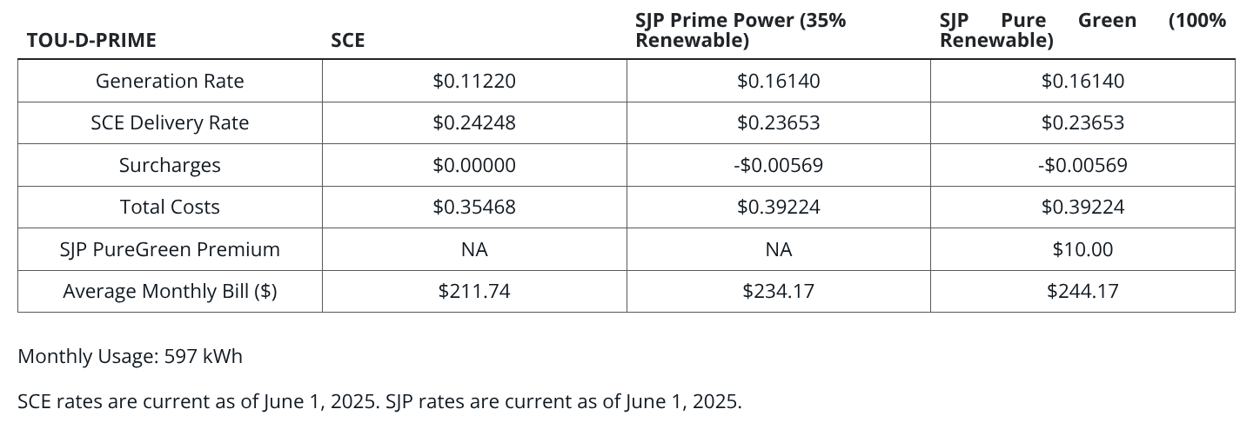
San Jacinto Power (SJP)

Slide 25
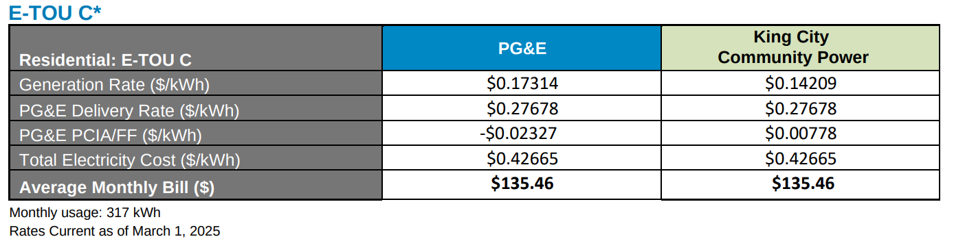
King City Community Power (KCCP)

