Slide 1

CCA Programs and Rate Analysis
Max Andre
15 Aug 2025

Slide 2
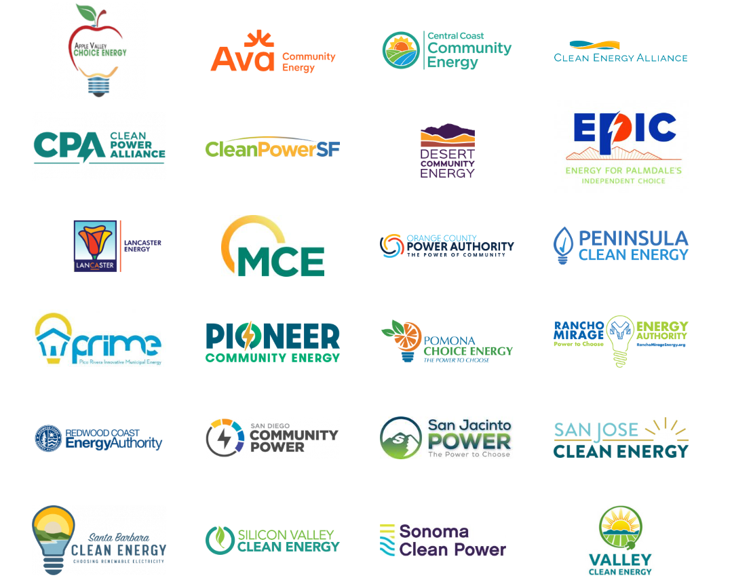
What is a CCA?
A Community Choice Aggregation (CCA) is an entity that provides renewable electricity alternatives to the local Investor-Owned Utility (IOU) like PG&E, SCE, and SDGE, and also provides other programs with incentives and rebates for electrification. As not-for-profit organizations, they focus on meeting climate action goals in their local communities.

Slide 3
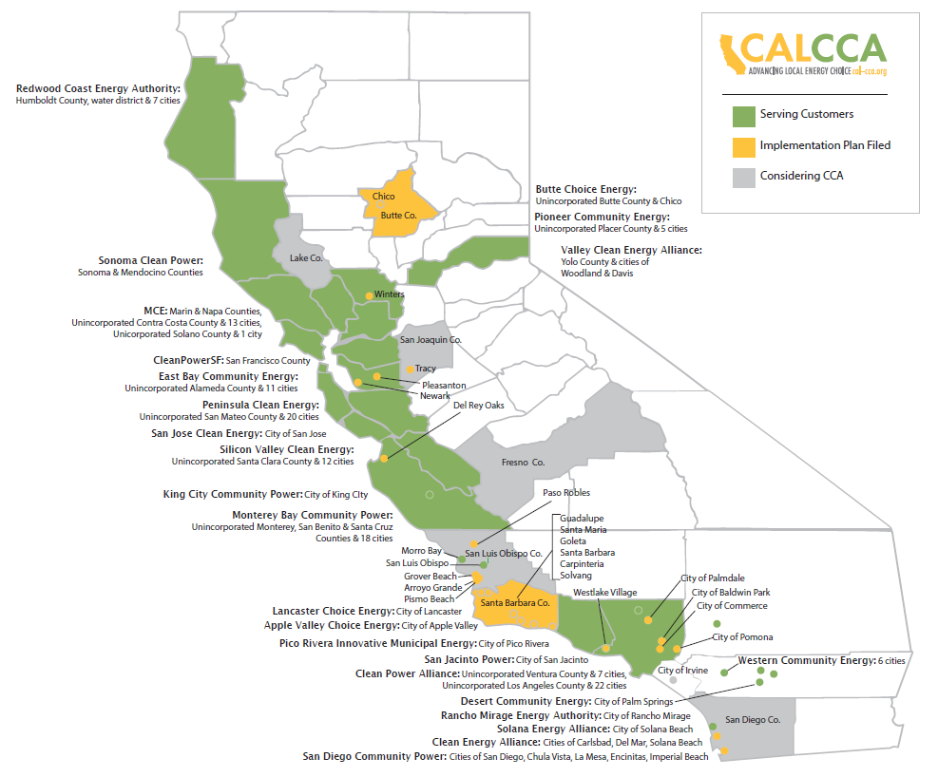
Map of California CCAs
Indicates CCA with at least 100,000 total customers
Note: map is as of 2021

Slide 4
Programs
CCA Programs

Slide 5
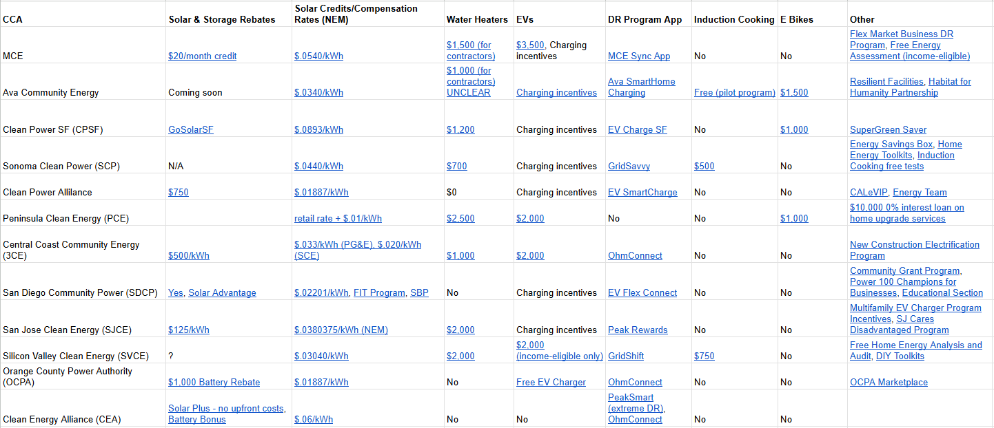
Overview of CCA Programs
Link to spreadsheet

Slide 6
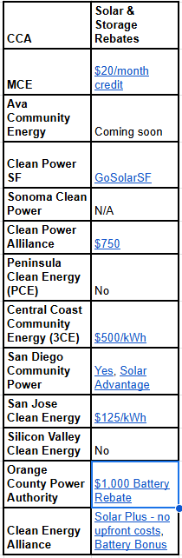

Solar and Storage Programs
MCE’s Solar Storage Credit: $20/month for exporting solar back to the grid during peak hours (battery must be <20%)
CPSF’s Solar Inverter Replacement Program: up to $3,000 in rebates for solar maintenance (income-eligible only)
CEA’s Solar Plus & Battery Bonus: solar+battery for “no up-front costs” (income-eligible only)

Slide 7
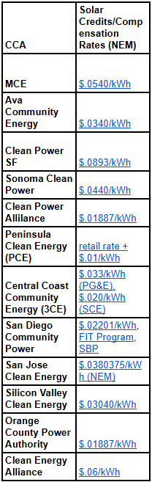
Net surplus compensation (NEM) rates across the CCAs
With Net Energy Metering (NEM), customers with solar receive credits at the retail rate for their solar exports back to the grid
At the end of the annual billing cycle, excess solar export credits can be paid out in cash or future credits
Most CCAs offer slightly higher rates than the IOUs
PCE offers $.01/kWh above the retail rate (~$.15/kWh), the highest by far of all CCAs

Slide 8
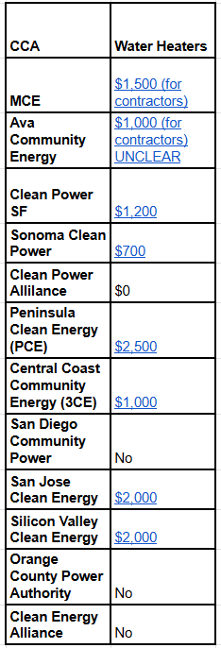
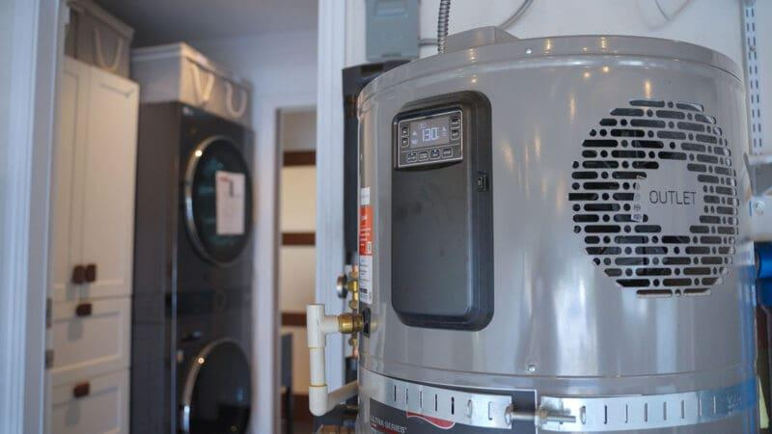
Heat pump water heaters
Some CCAs offer incentives of up to $2,500 for all customers and $3,500 for income-eligible customers
MCE and Ava offer rebates for contractors to discount prices for customers

Slide 9
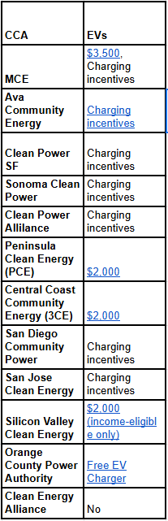
EVs and charging stations
Almost every CCA offers EV or charging incentives
EVs can be programmed to charge during off-peak hours, so they’re often used in demand response programs and apps
Some CCAs offer both new and used EV or hybrid incentives
OCPA offers a free EV charger (level 2)

Slide 10
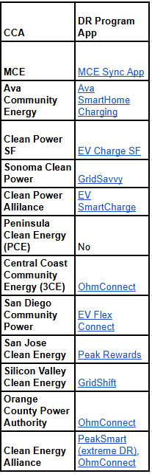
Demand response (DR) apps
Most of California is partnered with OhmConnect, but other CCAs have their own DR apps
Customers are incentivized to consume less energy during peak hours to manage the load on the grid
  Some export energy from home batteries during peak hours as well
CEA’s PeakSmart: up to 30% cheaper energy throughout the year, but on PeakSmart Days (<18 days/year), energy costs these customers an extra $1.10/kWh (super expensive)

Slide 11
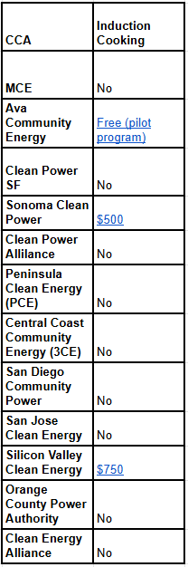
Induction cookware electrification
Replaces gas stoves in homes
Ava offers free induction cookware to income-eligible customers that allow Ava to study the effects of electrification on air quality in homes
SCP offers a free induction cooktop checkout for customers to test-drive induction cookware for two weeks
Most CCAs encourage switching to induction cooking even if they don’t offer direct incentives

Slide 12
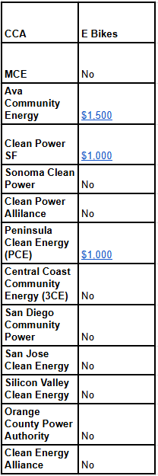
E-bikes
While e-bike incentives are rather uncommon (most simply encourage e-bike use), some CCAs still provide incentives to green transportation
E-bikes may vary in utility based on geographic location

Slide 13
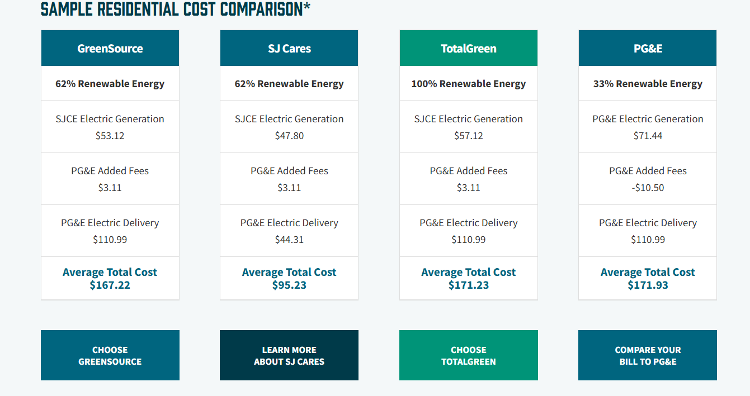
Income–eligible incentives
SJCares - almost ½ price
CPSF SuperGreen Saver
  20% discount on 100% renewable energy
CARE/FERA rate plans offer discounted rates across all CCAs

Slide 14
Other unique programs
PCE’s 0% interest loan for home upgrades up to $10,000
DIY Energy Toolkits/boxes (SCP, SVCE)
OCPA Marketplace: discounted online store for energy-saving products
Free Home Energy Assessments (MCE's income-eligible customers only, CPA)
SCP’s free induction cooktop checkout
Ava’s partnership with Habitat for Humanity to electrify income-eligible customers
SJCE’s Multifamily EV Charger Assistance Program and CPA’s CALeVIP to provide EV incentives to businesses especially in disadvantaged communities
3CE’s New Construction Electrification Program to build new, all electric housing

Slide 15
Residential Rates
Rate Analysis

Slide 16
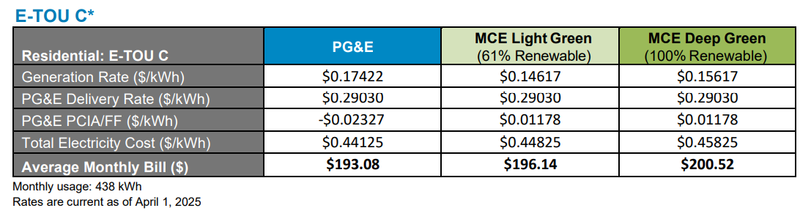
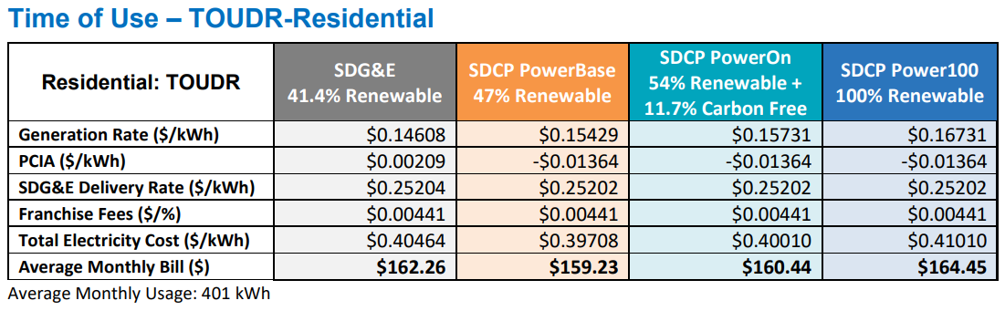
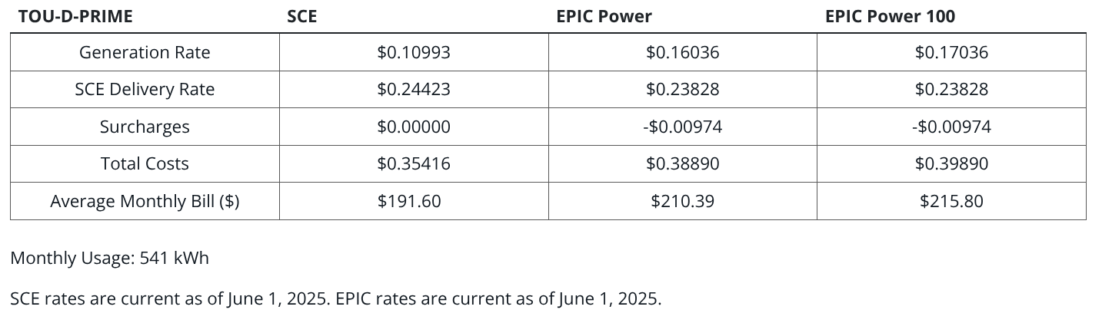
Rate plan analysis of CCAs with the local IOU
Sample Joint Rate Comparisons:
Default Plans:
  E-TOU C (PG&E)
  TOU-D-PRIME (SCE)
  TOUDR (SDGE)

Slide 17
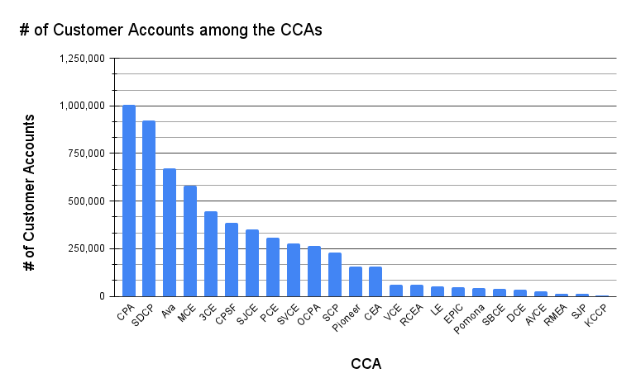
Some CCAs serve more customers than others
This separates the CCAs with at least 100,000 total customers.

Slide 18
Rate Analysis
Total Base Plan Rates

Slide 19
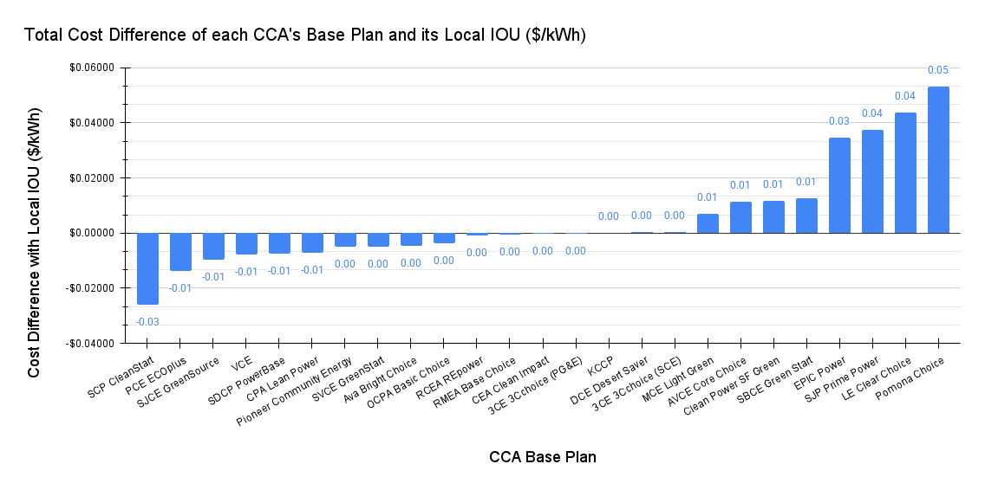
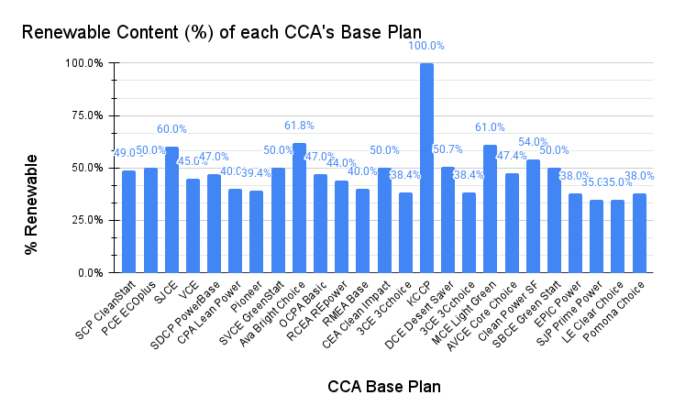
How the CCAs’ base plans compare in competition with their local IOU
Cheaper
More expensive
Most CCA base plans are rather competitive with their local IOU.
Average total cost difference of all CCAs: $.00483/kWh

Slide 20
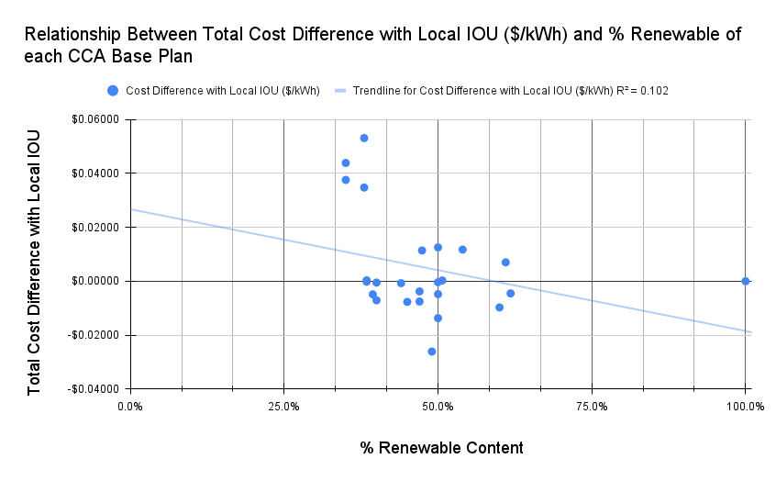

There is no clear relationship between % renewable and total cost difference of base plans
with outlier without outlier

Slide 21
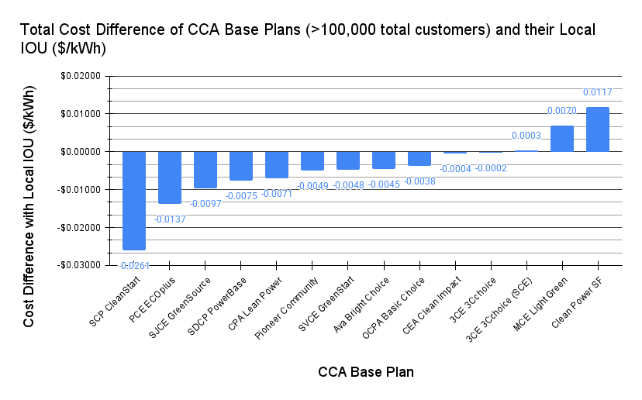
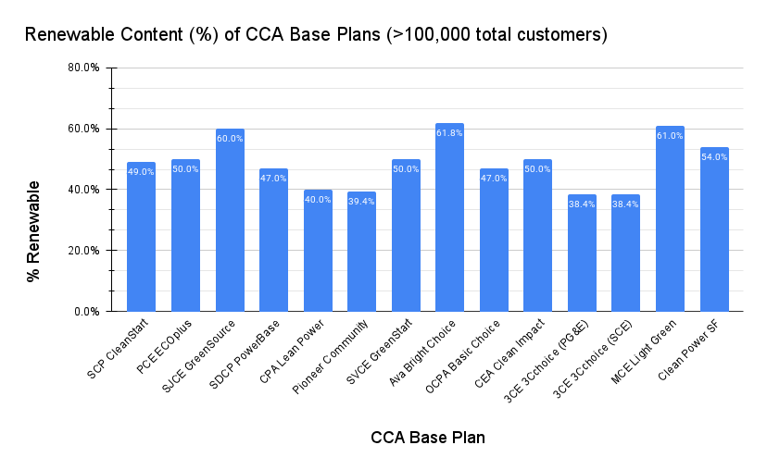
How the CCAs’ base plans compare in competition with their local IOU (minimum 100,000 total customers)
Larger-scale CCAs can keep rates more competitive with the IOU
Average total cost difference of CCAs with >100,000 total customers: -$.000455/kWh

Slide 22
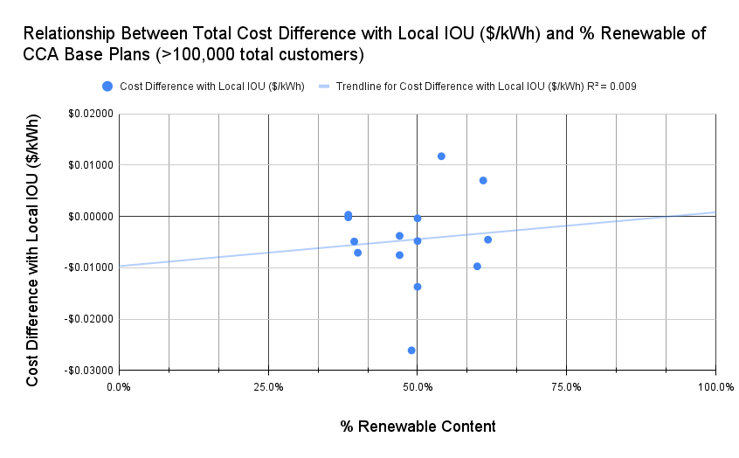
The relationship between renewable content and cost difference of base plans (min. 100,000 total customers)
There is not a relationship between % renewable content and cost difference of CCA base plans (min. 100,000 total customers)

Slide 23
Theories why base plans with more renewable content aren’t more expensive (min. 100,000 total customers)
Power Charge Indifference Adjustment (PCIA) fees/FF (locked in)
  PCIA fees: fees incurred by IOUs from long-term electricity contracts for customers who converted to CCAs and no longer purchase electricity from the IOU
    Vary by the CCA and can change in value over time
    Newer CCAs tend to have lower PCIA fees than older CCAs
  Franchise Fees: city/county fees for the poles, wires, and other IOU infrastructure on public property
Quality of renewable contracts between CCAs

Slide 24
Rate Analysis
Total Premium Plan Rates

Slide 25
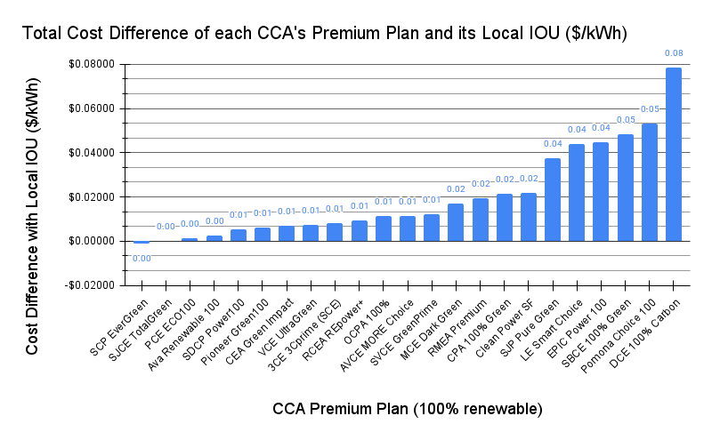
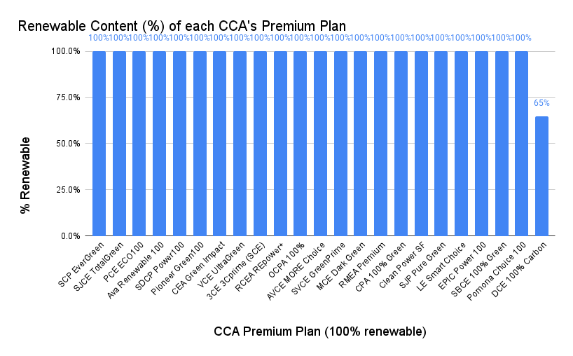
How the CCAs’ premium plans compare in competition with their local IOU
Average total cost difference among all CCAs: $.02031/kWh

Slide 26
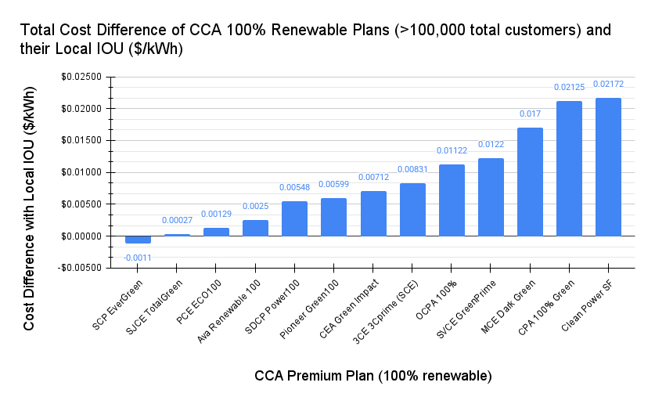
Some CCA premium plans are more competitive with the IOU than others (min. 100,000 total customers)
Average total cost difference among CCAs with >100,000 total customers: $.00871/kWh

Slide 27
Conclusion
Conclusion & Next Steps

Slide 28
CCA program remarks
CCAs support customers with generating their own renewable energy and electrifying their homes
Many of the core programs and incentives are offered by all the largest CCAs across California
While there isn’t much differentiation between CCA programs, some CCAs have created innovative programs for customers
  Are programs like SJCares or CPSF’s Solar Inverter Replacement Program replicable to other CCAs?
CCAs try to reach all customers in their areas, including disadvantaged and low-income customers by offering them greater access to incentives and rebates
Many CCAs have incentive finders that can find personalized incentives through other programs

Slide 29
Rate analysis remarks
The majority of CCAs offer a rate plan that is competitive with the IOU (<$.01/kWh total cost difference)
The greater the scale of the CCA, the more competitive its pricing is with the IOU
  Most CCAs with >100,000 total customers offer base plans that are cheaper than the local IOU
Within the same plans (base or premium), greater renewable content does not necessarily correlate with a higher total cost
CCAs like SCP, 3CE, and CPA keep rates low and competitive, while CCAs like Ava guarantee a competitive rate with PG&E (5% cheaper than PG&E for its base plan) instead of setting the lowest possible rate
Of the larger CCAs, MCE and CPSF have the least competitive rates, but they aim to compensate for their rates with unique programs and incentives

Slide 30
Rate analysis next steps and questions to ponder
What causes total rates to be so varied between the CCAs?
  Potential theories: quality of renewable contracts signed by each CCA, individual rate-setting policies, scale of CCA, geographic location and proximity to the energy sources, climates/availability of different renewable energy sources, or the difference in desire of customers in each area to commit to renewable energy
Why do the renewable % and competitiveness of pricing within rate plans not correlate?
  If the economics of renewable energy was an issue, shouldn’t we see at least a slight correlation between renewable % and total cost difference?
Is there a correlation between the size of a CCA and the competitiveness in its rates?
Why do smaller CCAs exist? Would they be better off forming fewer CCAs with a greater scale to operate more efficiently?

Slide 31
Appendix
Appendix

Slide 32
Appendix
Generation Rates

Slide 33
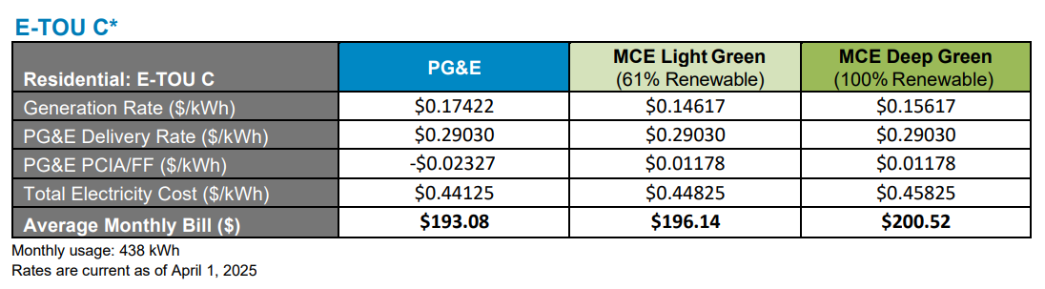
Appendix
Generation rates do not factor in:
Delivery rates
  Transportation costs of delivering the electricity across the grid
PCIA/FF fees (typically)
  PCIA fees: fees incurred by IOUs from long-term electricity contracts for customers who converted to CCAs and no longer purchase electricity from the IOU
  Franchise Fees: city/county fees for the poles, wires, and other IOU infrastructure on public property

Slide 34
Appendix
Generation Rates - Base Plans

Slide 35
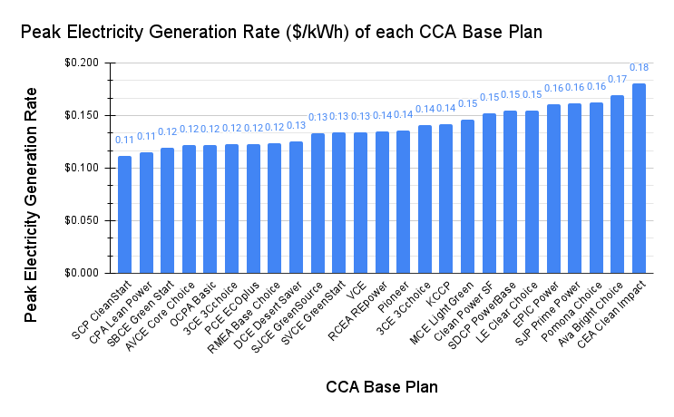
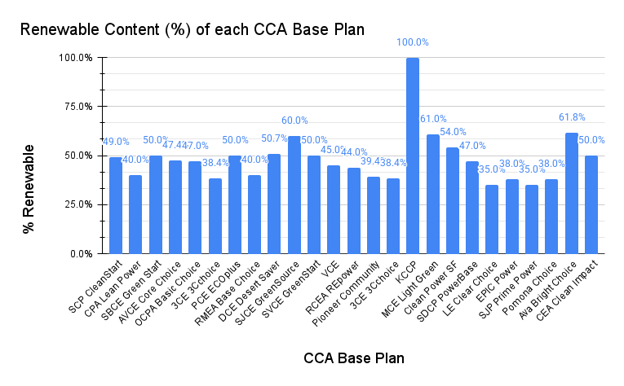
Appendix
Electricity generation rates of base plans during peak hours (4-9 p.m.)

Slide 36
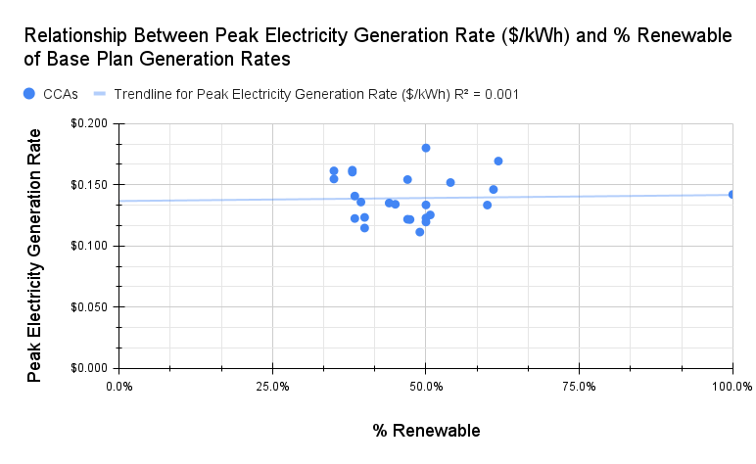
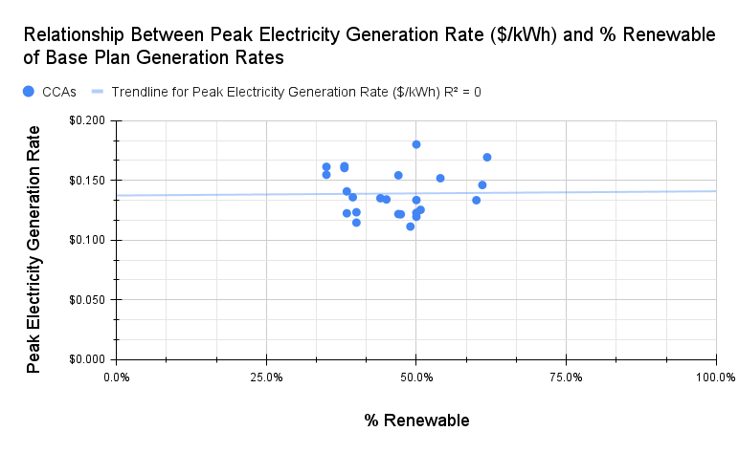
Appendix
There is no relationship between peak electricity generation rate and renewable content among base plans
with outlier
without outlier

Slide 37
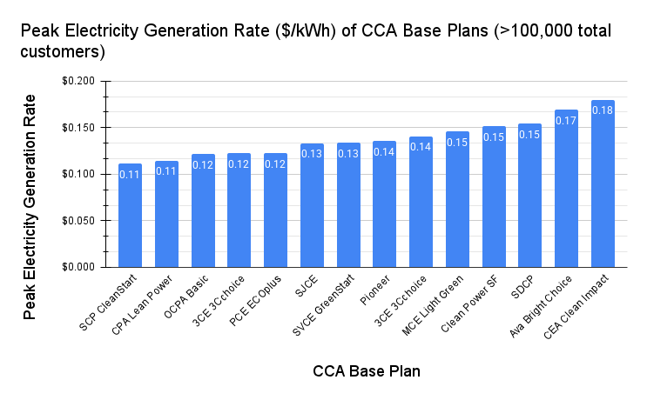
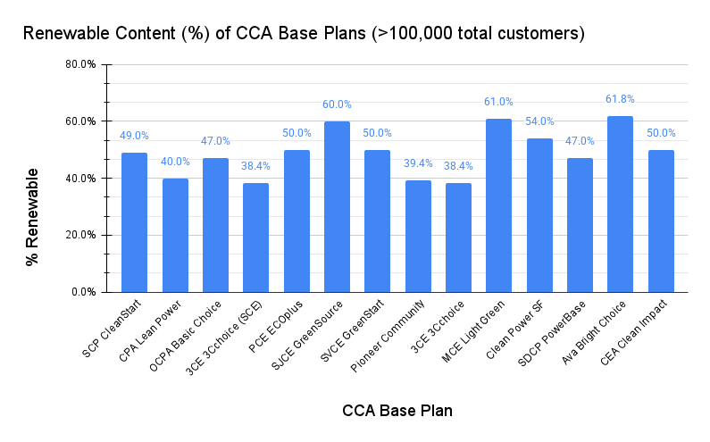
Appendix
Electricity generation rates of base plans (min. 100,000 total customers) during peak hours (4-9 p.m.)

Slide 38
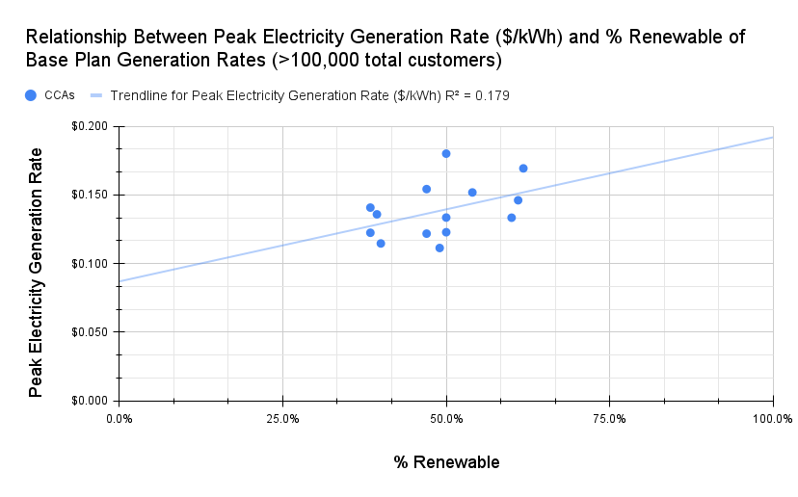
Appendix
There is a very weak positive relationship between peak electricity generation rate and % renewable content

Slide 39
Appendix
Generation Rates - Premium Plans

Slide 40
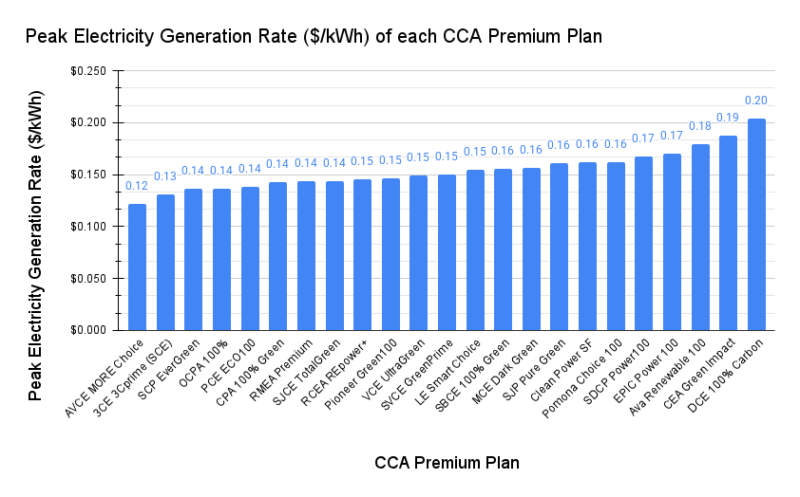
Appendix
Peak electricity generation rates of premium plans

Slide 41
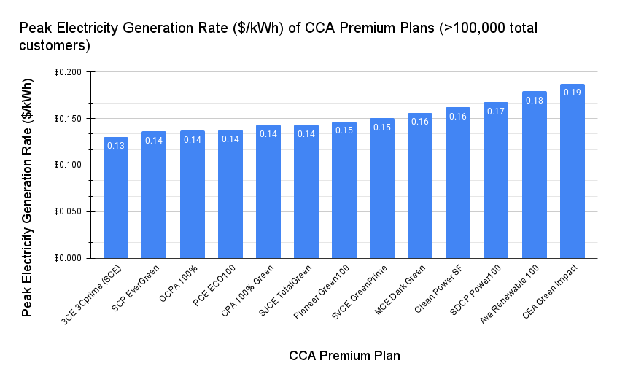
Appendix
Peak electricity generation rates of premium plans (min. 100,000 total customers)
Despite the $.06/kWh range in generation rate, most of these premium plans are within $.02/kWh of their local IOU in total cost (including Ava and CEA).

