Slide 1

Solar-driven Microgrids and Super Green Building
deliver unparalleled economic, environmental, and resilience benefits
Craig Lewis
Executive Director
Clean Coalition
650-796-2353 mobile
craig@clean-coalition.org
Santa Barbara
18 September 2025

Slide 2
Clean Coalition (nonprofit)
Mission
To accelerate the transition to renewable energy and a modern grid through
technical, policy, and project development expertise.
Renewable Energy End-Game
100% renewable energy; 25% local, interconnected within the distribution grid and ensuring resilience without dependence on the transmission grid; and 75% remote, fully dependent on the transmission grid for serving loads.
Notes:
2

Slide 3
Green Rebuild Initiative (GRI)
GRI overiview
The Green Rebuild Initiative (GRI) aims to help ensure that the homes that get rebuilt in Pacific Palisades and Altadena (and beyond) will be done in a Super Green fashion. The target audiences are property owners, architects & designers, and builders. Super Green homes are 100% electric and feature enough solar to achieve Net Zero Energy (NZE) -- and are configured with energy storage to benefit from the unparalleled resilience delivered by Solar Microgrids.
GRI website
https://clean-coalition.org/programs/green-rebuild-initiative/
Notes:
3

Slide 4
Types of microgrids
A microgrid is a combination of energy resources, definitely including generation, that are coordinated to serve specified loads, including in an islanded fashion.
A Solar Microgrid is a behind-the-meter (BTM) microgrid that solely relies on solar for energy generation when islanded. A Solar Microgrid relies on energy storage to time-shift solar and ensure energy availability at night etc.
A Hybrid Solar Microgrid is a Solar Microgrid that includes additional sources of energy generation, beyond just solar.
A Community Microgrid a microgrid that covers a target grid area and relies on existing distribution feeders (ie, power lines) to operate when islanded. Community Microgrids typically include both front-of-meter (FOM) and BTM resources, including Solar Microgrids, and require effective participation from utilities, which have mostly erected barriers to date.

Slide 5
Value-of-Resilience (VOR) details
VOR123
VOR123 is the value-of-resilience (VOR) from Solar Microgrids methodology that the Clean Coalition has developed to normalize VOR across all types of facilities & geographies. The VOR normalization is founded in tiering loads into three categories: Tier 1 (critical), Tier 2 (priority), and Tier 3 (discretionary). Since each Tier has its own resilience requirement and VOR, this methodology is called VOR123.
VOR123 webinar
https://clean-coalition.org/news/webinar-valuing-resilience-solar-microgrids-thursday-5-nov-2020/
Notes:
5

Slide 6
Percentage of time online for Tier 1, 2, and 3 loads for a Solar Microgrid designed for the University of California Santa Barbara (UCSB) with enough solar to achieve net zero and 200 kWh of energy storage per 100 kW solar.
Typical load tier resilience from Solar Microgrids
Percentage of total load
Tier 3 = Discretionary load, ~75% of total load
Tier 2 = Priority load, ~15% of total load
Tier 1 = Critical, life-sustaining load, ~10% of total load
Percentage of time

Slide 7
A typical diesel generator is configured to maintain 25% of the normal load for two days. If diesel fuel cannot be resupplied within two days, goodbye. This is hardly a solution for increasingly necessary long-term resilience. In California, Solar Microgrids provide a vastly superior trifecta of economic, environmental, and resilience benefits.
Diesel generators are designed for limited resilience
Percentage of total load
Tier 3 = Discretionary load, ~75% of total load
Tier 2 = Priority load, ~15% of total load
Tier 1 = Critical, life-sustaining load, ~10% of total load
Percentage of time

Slide 8
Local solar & storage optimize grid outcomes
Local solar & storage
optimize grid outcomes

Slide 9
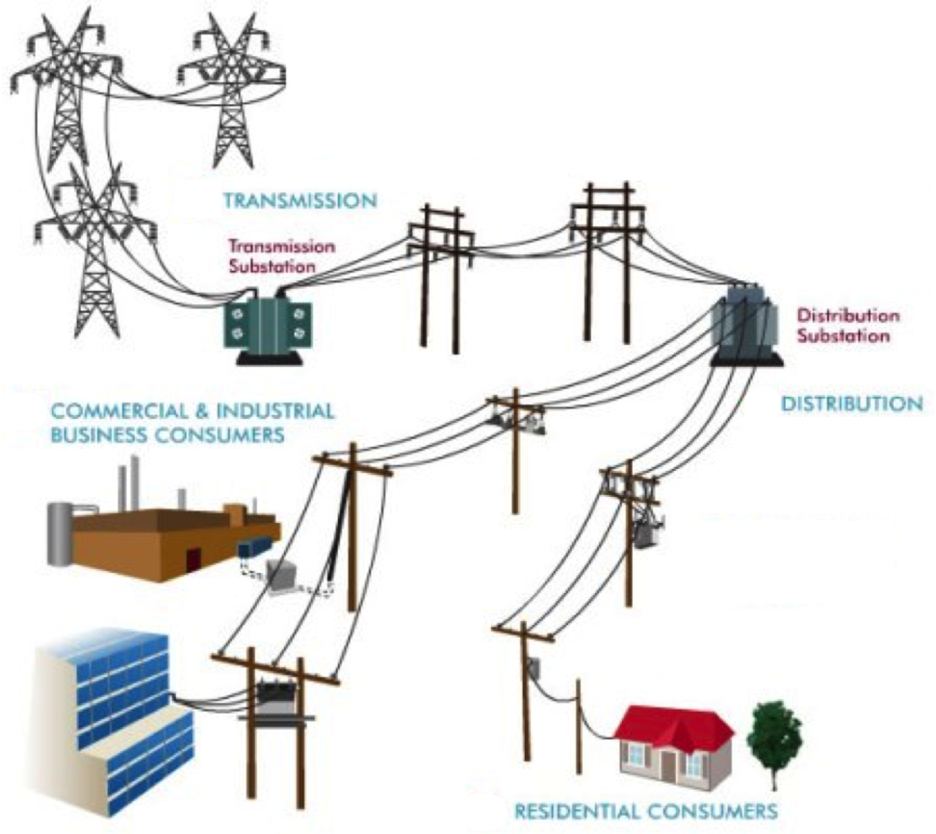
Local means within the distribution grid
High-Voltage
Transmission
grid
Low-Voltage
Transmission
grid
Distribution
grid
Notes:
Market distortions like the erroneous metering & assessment of Transmission Access Charges (TAC) for California IOUs creates massive market distortions that steal value from local generation, hurt ratepayers, and preempt energy resilience.
Non-PTO utilities (metered sub-systems) currently operate under the system we are proposing. The Clean Coalition TAC fix would bring consistent TAC treatment to DG resources in all utility service territories.

Slide 10
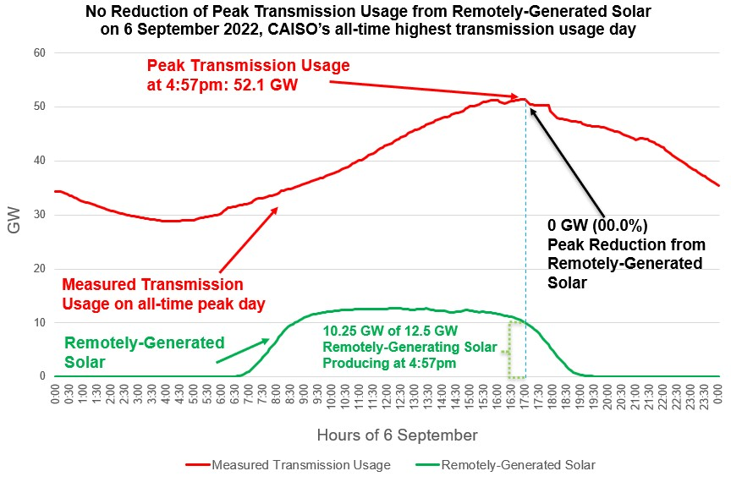
Transmission stress & cost is a massive problem

Slide 11
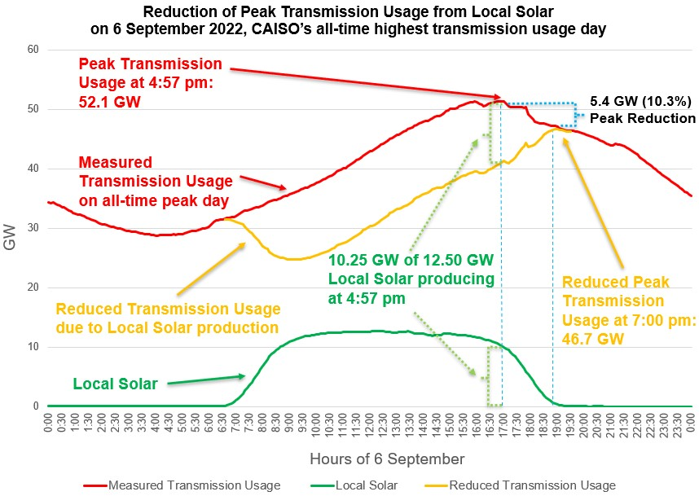
Local Solar reduces transmission stress & costs
Local Solar reduces Peak Transmission Usage by close to 50% of the installed local solar capacity. The effect is amplified by energy storage.
Bringing down the peak with distributed generation and demand flexibility will reduce transmission investments, saving ratepayers hundreds of billions of dollars over the next two decades.
Reducing the Peak Transmission Usage by around 10% is enough to prevent most major outages.

Slide 12

Super Green home design
100% Electric, Net Zero Energy, and Solar Microgrid
Craig Lewis
Executive Director
Clean Coalition
650-796-2353 mobile
craig@clean-coalition.org
Santa Barbara
Optimizing the trifecta of Economic, Environmental, and Resilience benefits
30 May 2025

Slide 13
Green Rebuild Initiative
Mission:
The Green Rebuild Initiative (GRI) aims to facilitate sustainable and resilient rebuilds through “Super Green” home designs that are all-electric, Net Zero Energy (NZE), and supported by Solar Microgrids for unparalleled resilience. The GRI also encourages homes to be designed for high energy efficiency and low embedded carbon, while being engineered to withstand extreme weather events and built with non-toxic materials.
Actions:
              Educate property owners, architects, builders, policymakers, lenders, insurers, and everyone else about the superiority of Super Green homes.
              Illuminate the economic benefits of Super Green designs, including the associated tax benefits and other incentives.
              Provide easy access to specifications associated with Super Green designs.
              Share showcase Super Green home designs.
              Connect parties for Super Green outcomes, including property owners, architects, builders, and associated experts.
Notes:
13

Slide 14
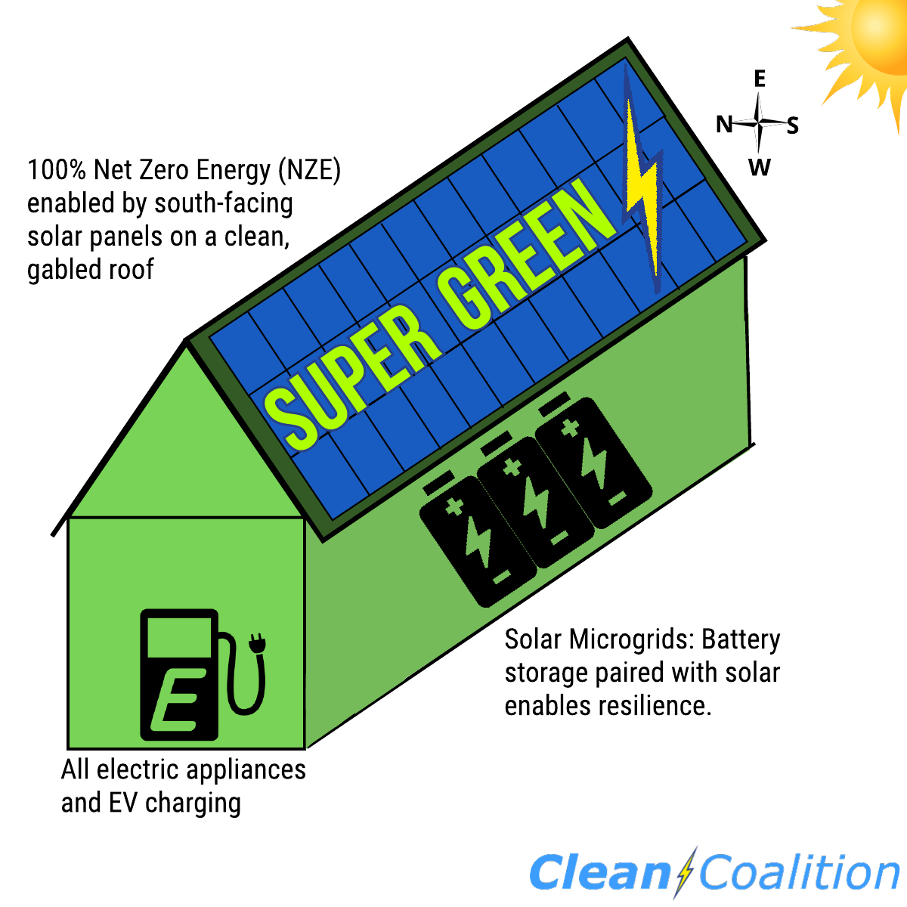
What is Super Green?
100% Electric: No gas service to the home and ideally an all-EV household.
Net Zero Energy (NZE): Onsite solar energy production at least equals the annual energy consumption across the premise, including to cover home EV charging.
Solar Microgrid: Combines a battery to the solar for economic optimization and achieving unparalleled energy resilience.

Slide 15
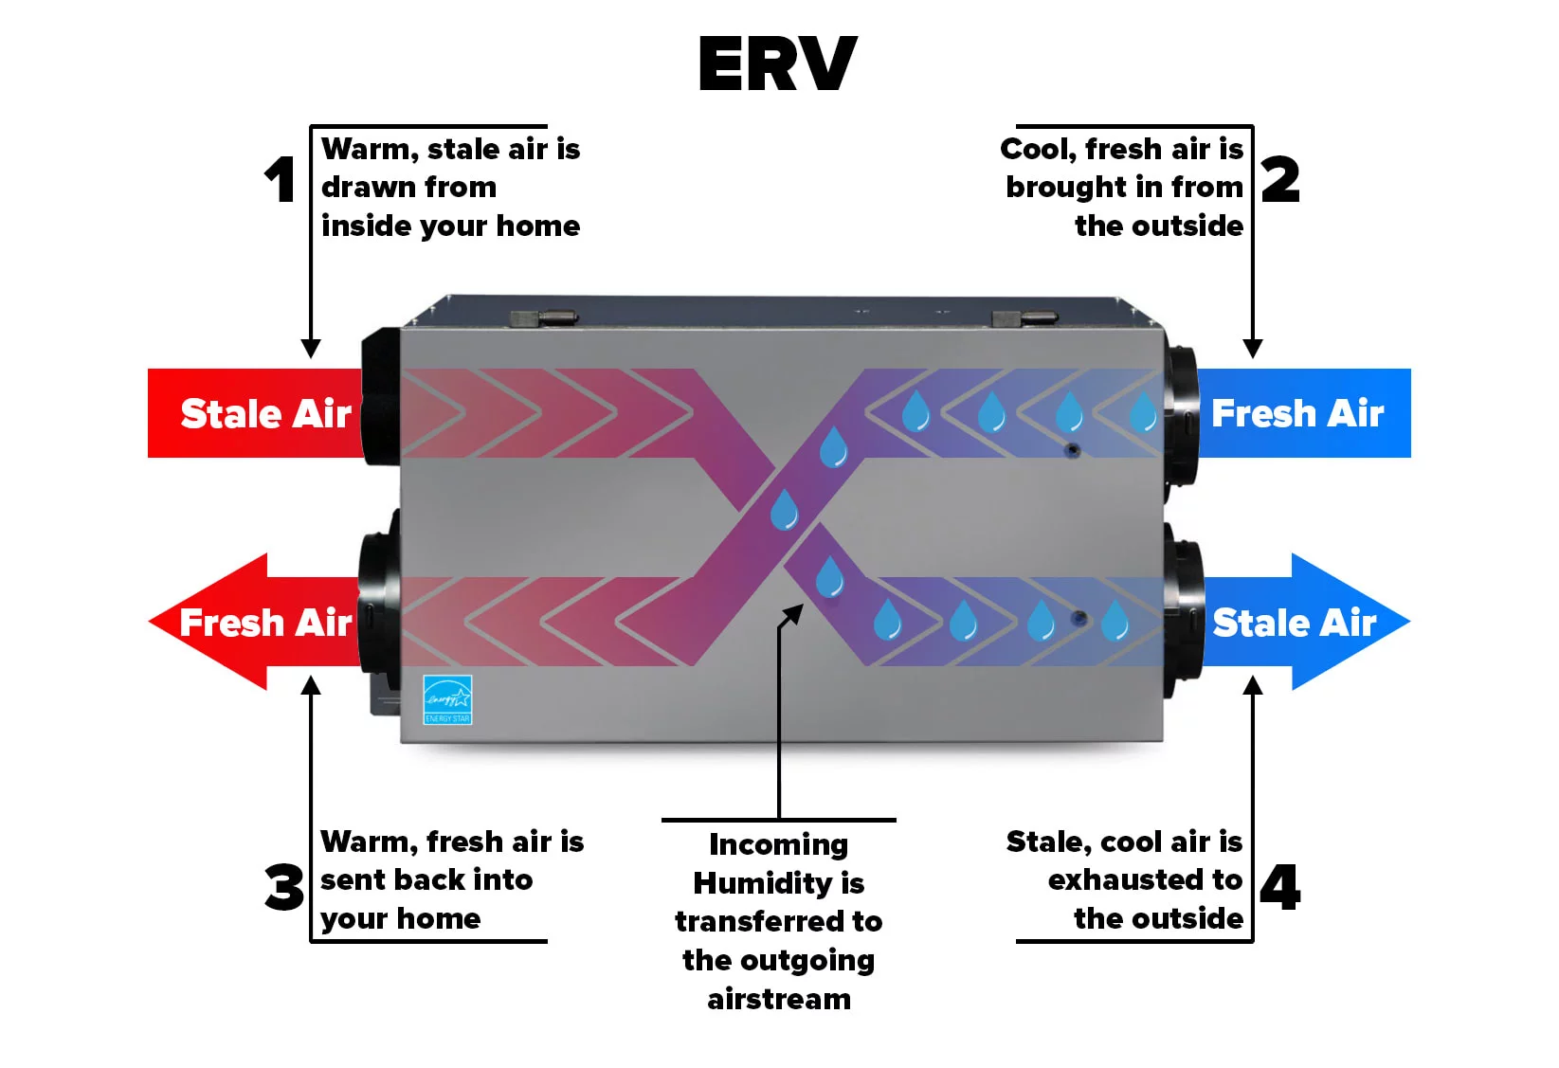
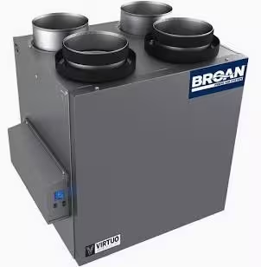
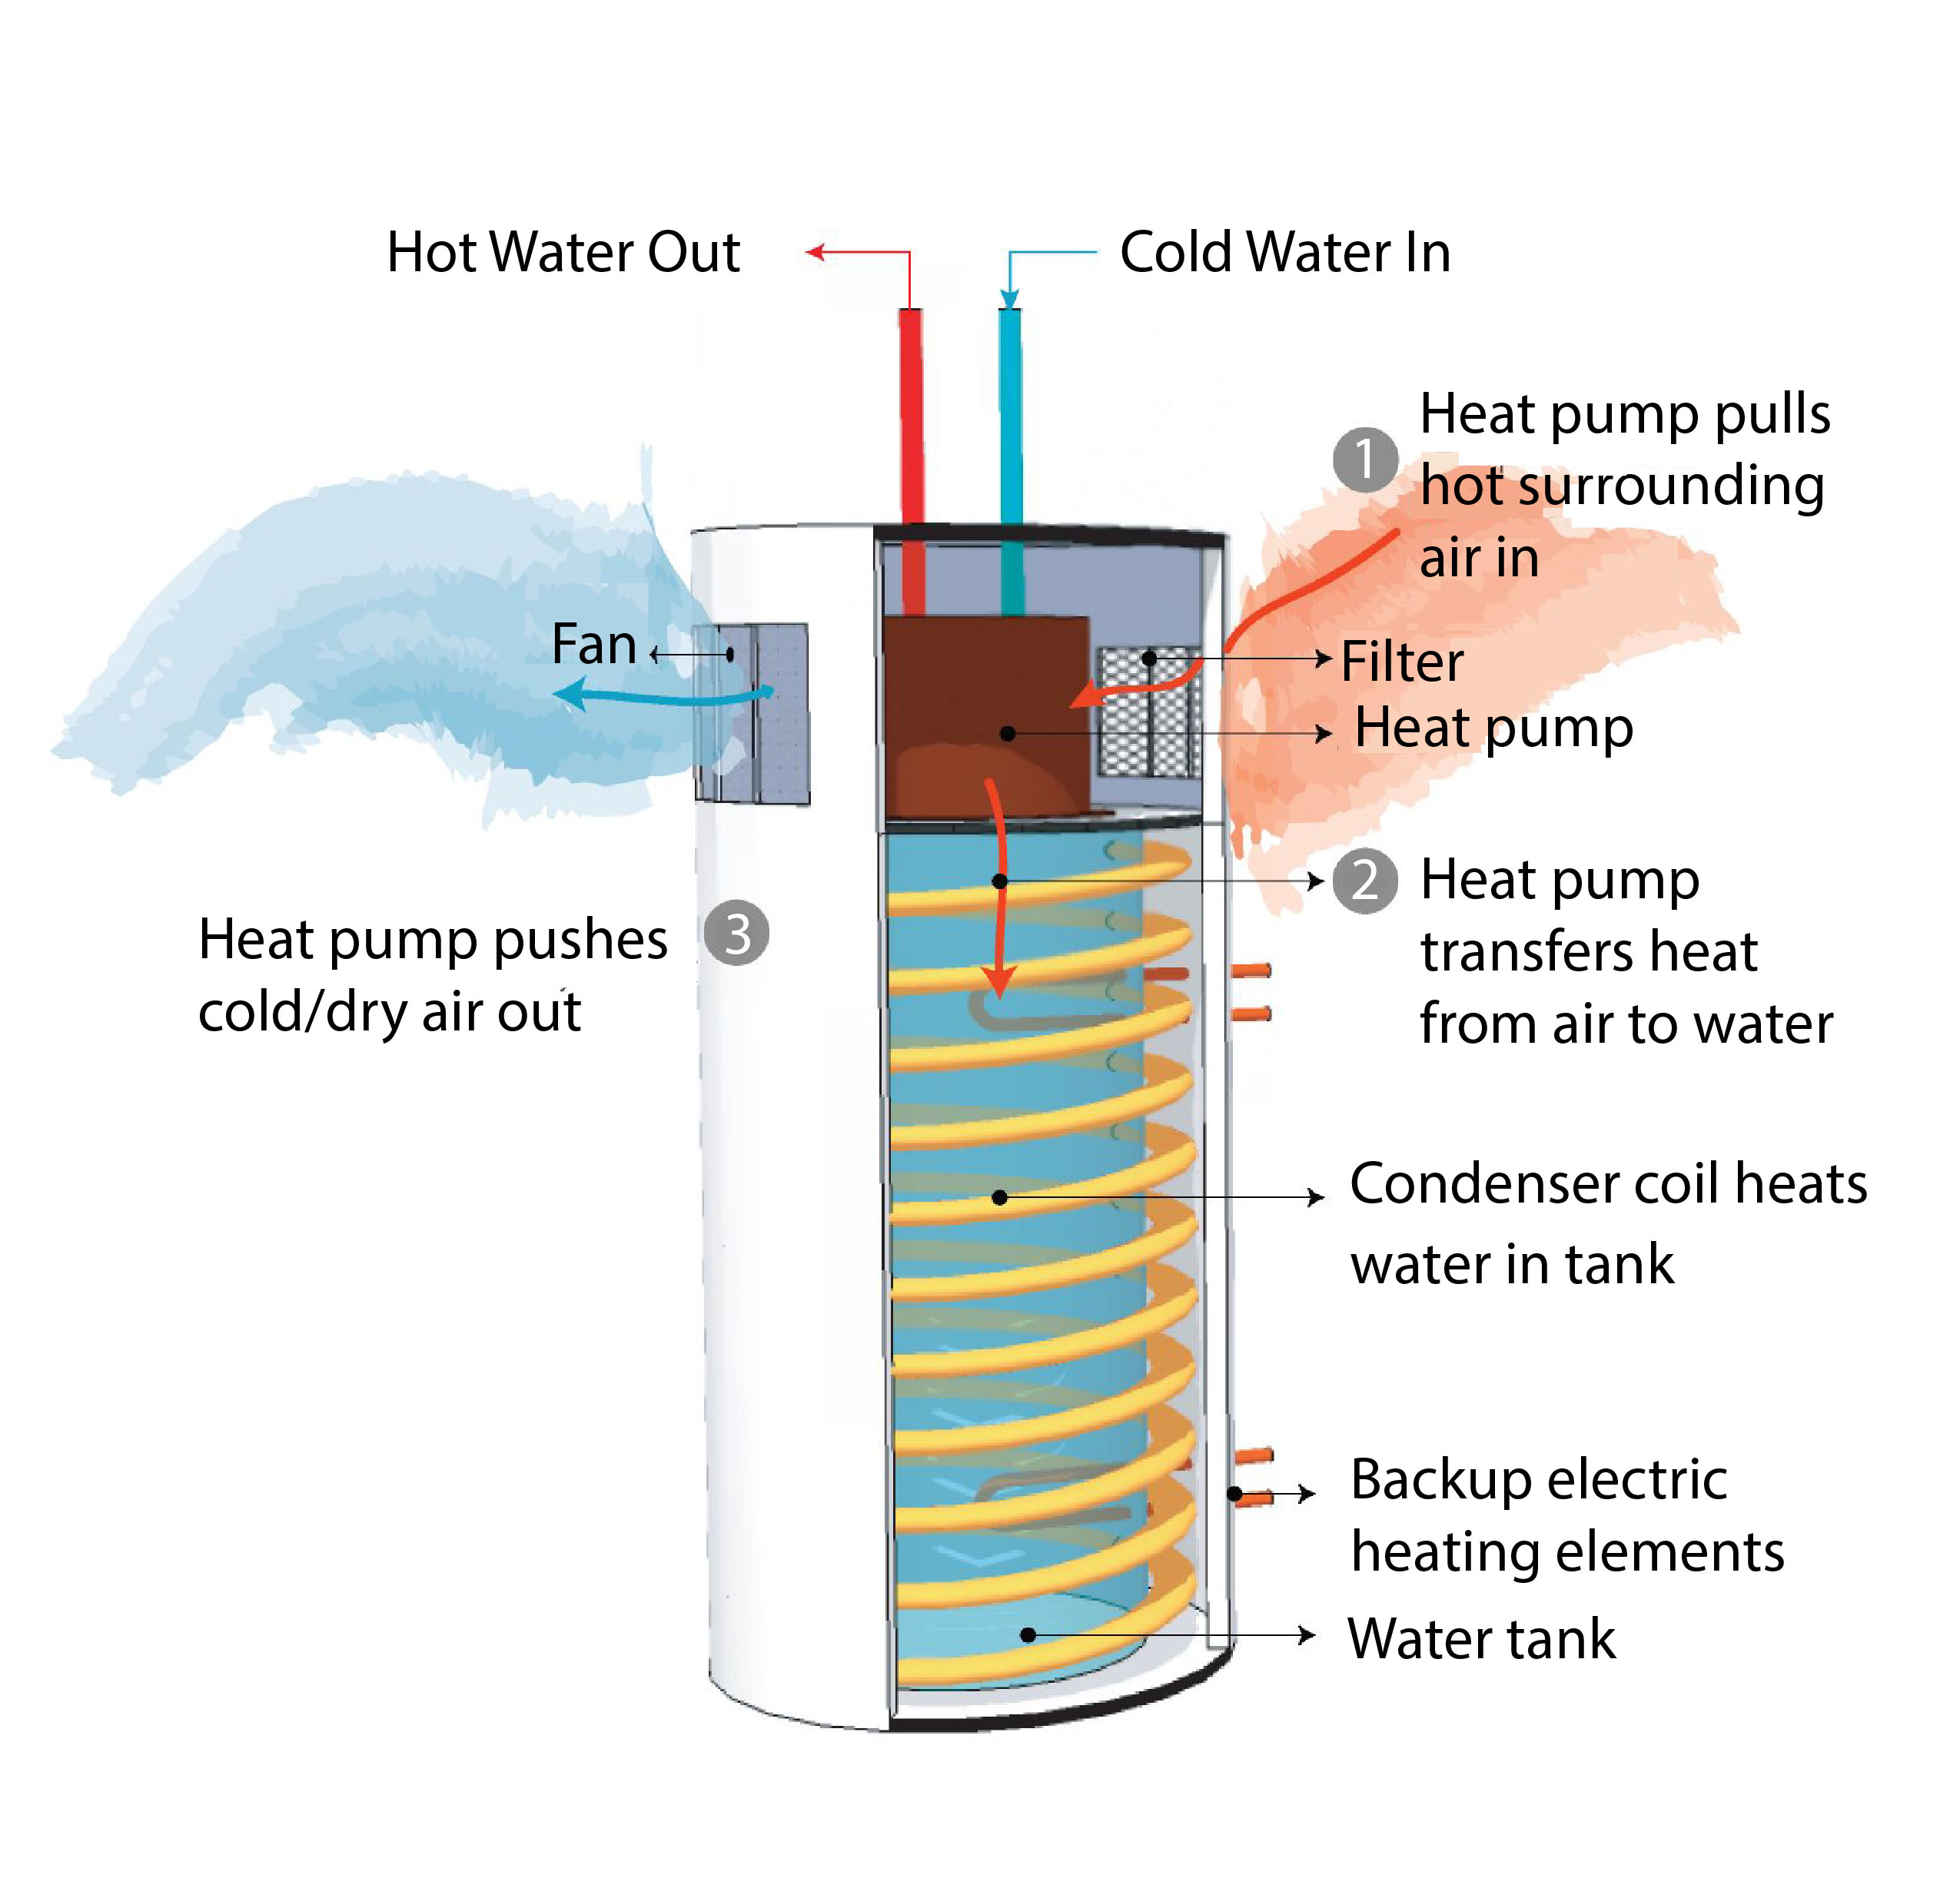
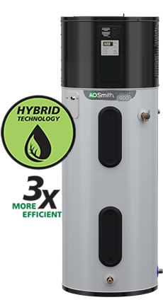

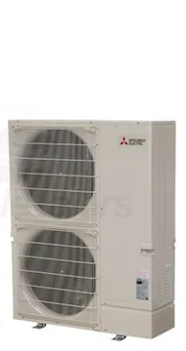

Super Green: 100% Electric
Specifications
Mechanical and Plumbing
  Heat Pump HVAC
  Heat Pump Water Heater
  ERV: Energy Recovery Ventilator
  E-Fireplace: Napoleon Alluravision 60” [Optional]
  Heat Pump Pool Water Heater [Optional]
Electrical
  LED Light Bulbs
  Occupancy/Vacancy Sensors
  Dimming Switches
  Span Panel [Optional]
Notes:
Sealed Ducting, No Flex Duct (G90 Zinc) w/ R6 Insulation
Wall and Ceiling Registers - Titus

Slide 16



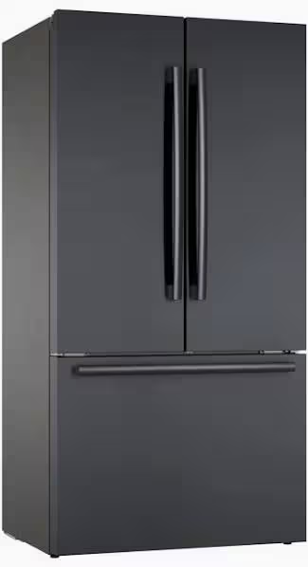
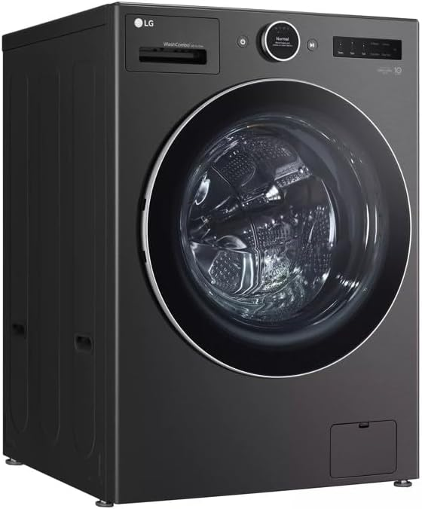
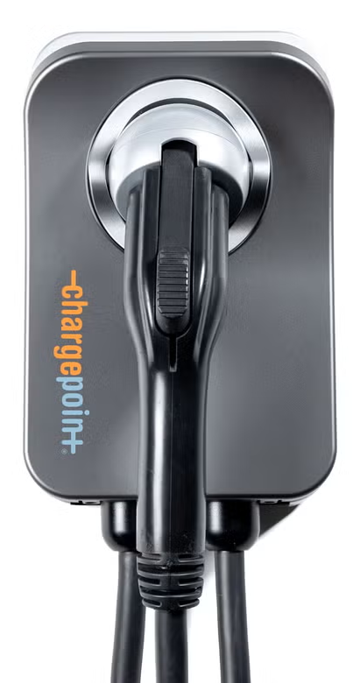
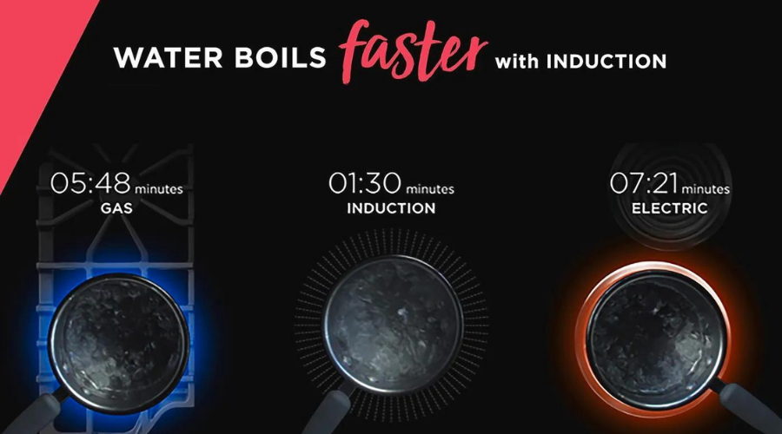
Super Green: 100% Electric
Appliances
  Induction Cooktop
  EnergyStar Refrigerator
  EnergyStar Dishwasher
  EnergyStar Washing Machine
  Energy Efficient Microwave
  Heat Pump Dryer
  EV Charging Outlet and/or Charger
  (Level 2 capable)
Energy Efficient
100% Electric
Induction Cooktops

Slide 17

Super Green: Net Zero Energy (NZE)
NZE requires the solar to produce at least as much energy as the home consumes over the course of a year. Solar needed to achieve NZE for homes with Title 24 levels of energy efficiency and two EVs (22,000 miles of home EV charging per year):
1,500sf home requires 9.8kW of solar
(24 solar panels).
2,500sf home requires 14.8kW of solar
(36 solar panels).
California Energy Code Title 24 (Part 6) falls far short of NZE:
1,500sf home only requires 2kW
(5 solar panels)
2,500sf home only requires 3kW of solar
(7 solar panels).
Notes:
CalGreen Title 24 Building Code Compliance

Slide 18
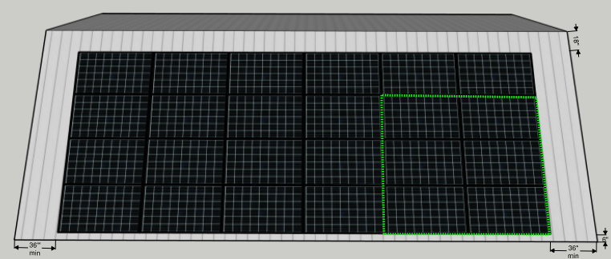
Super Green: Solar to achieve 1,500sf NZE home
Total single roof area required to achieve NZE for a 1,500 sf house is 700 sf, to accommodate 507 sf of solar (9.8 kW) plus setbacks
South-facing rooftop at a 30° pitch is ideal
6 solar panels needed to NZE one EV, assuming 12,000 miles of home charging per year
14,600 kWh per year is the estimated energy consumption for a typical 4-person household in a 1,500sf home.
A 9.8kW solar array (assuming 1,512kWh/kW-yr) is required to achieve Net Zero Energy (NZE), which includes charging two EVs
Note: an EV driving 12,000 miles per year will require 3,600kWh of energy per year to charge, which can be offset by 6 solar panels. This model also assumes there is a second EV using 10,000kWh per year.
Assumes QCELL 410W solar panels, each with dimensions of 6.2 ft x 3.4 ft (21.1 sf per panel).
24 solar panels required to achieve NZE, requiring 507 sf for the solar layout, and producing 14,808 kWh per year.
Total roof area required is 700 sf, including setbacks of 3 feet on side edges, 1.5 feet from the ridge, and 0.5 feet from the bottom edge (the bottom setback is needed to ensure proper rain drainage into a gutter).

Slide 19
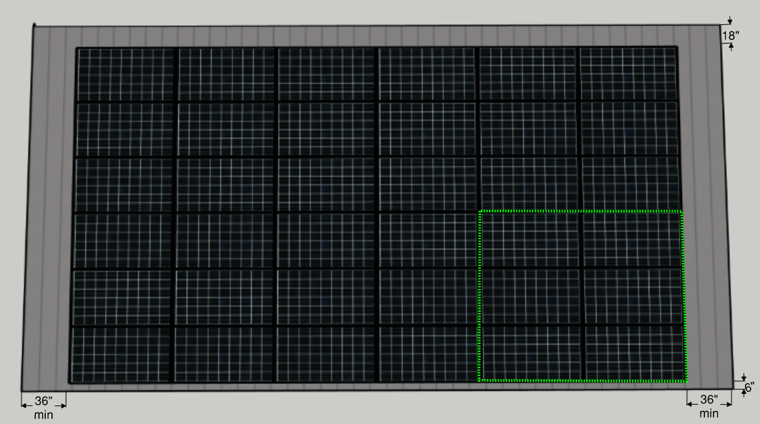
Super Green: Solar to achieve 2,500sf NZE home
Total single roof area required to achieve NZE for a 2,500 sf house is 1,000 sf, to accommodate 760 sf of solar (14.8 kW) plus setbacks
South-facing rooftop at a 30° pitch is ideal
6 solar panels needed to NZE one EV, assuming 12,000 miles of home charging per year
21,221 kWh per year is the estimated energy consumption for a typical 2,500sf 4-person household
A 14.8kW solar array (assuming 1,512kWh/kW-yr) is required to achieve Net Zero Energy (NZE), which includes charging two EVs
Note: an EV driving 12,000 miles per year will require 3,600kWh of energy per year to charge, which can be offset by 6 solar panels. This model also assumes there is a second EV using 10,000kWh per year.
Assumes QCELL 410W solar panels, each with dimensions of 6.2 ft x 3.4 ft = 21.1 square feet
36 solar panel required to achieve NZE, requiring 760 sf for the solar layout, and producing 22,223 kWh per year.
Total roof area required is 1,000 sf, including setbacks of 3 feet on side edges, 1.5 feet from the ridge, and 0.5 feet from the bottom edge (the bottom setback is needed to ensure proper rain drainage into a gutter).

Slide 20
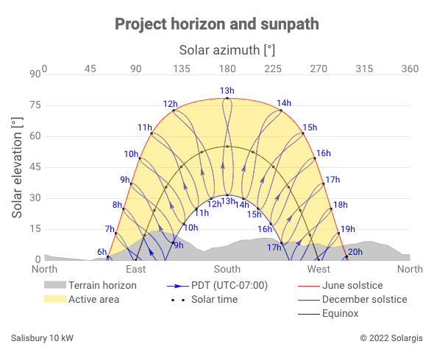
Solar should be as close to south-facing as possible

Slide 21
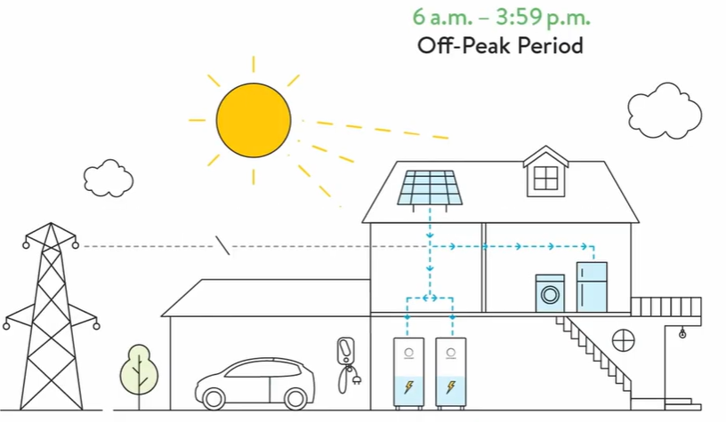
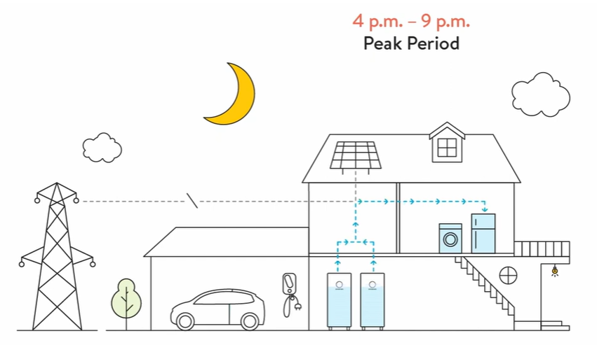
Super Green: Solar Microgrid
Off-Peak Period
Power from Sun
During the day the home draws power from its solar array and charges the home battery.
Peak Period
Power from Battery
Power is drawn from the home’s battery, and Peak Utility-based costs are avoided
© Sonnen
Notes:
Operate independently from the utility company

Slide 22
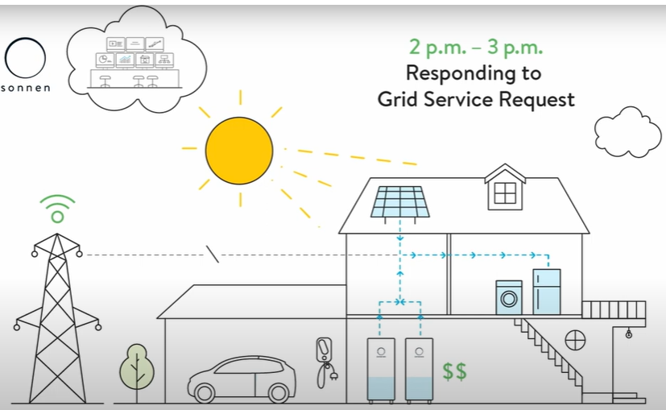
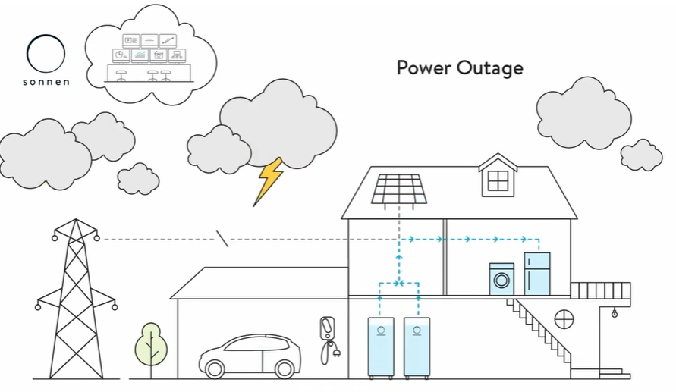
Super Green: Solar Microgrid
Grid Service Request
Earn Credits
Homeowner can earn credits from the utility company by providing excess power during a Grid Service Request. These credits can be used to offset future utility charges
Power Outage
Off-Grid Mode
During a planned and/or unexpected power outage, homeowners can shift consumption to Critical Loads and consume energy entirely from their solar + battery system. Critical Loads include only essential appliances and circuits, (Refrigerator, Microwave, WiFi, fire-life-safety devices and select outlets).
Whole-home Back Up Optional
© The Climate Center
© Sonnen
Notes:
Operate independently from the utility company

Slide 23
Value-of-Resilience (VOR) details
VOR123
VOR123 is the value-of-resilience (VOR) from Solar Microgrids methodology that the Clean Coalition has developed to normalize VOR across all types of facilities & geographies. The VOR normalization is founded in tiering loads into three categories: Tier 1 (critical), Tier 2 (priority), and Tier 3 (discretionary). Since each Tier has its own resilience requirement and VOR, this methodology is called VOR123.
VOR123 webinar
https://clean-coalition.org/news/webinar-valuing-resilience-solar-microgrids-thursday-5-nov-2020/
Notes:
23

Slide 24
Percentage of time online for Tier 1, 2, and 3 loads for a Solar Microgrid designed for the University of California Santa Barbara (UCSB) with enough solar to achieve net zero and 200 kWh of energy storage per 100 kW solar.
Typical load tier resilience from Solar Microgrids
Percentage of total load
Tier 3 = Discretionary load, ~75% of total load
Tier 2 = Priority load, ~15% of total load
Tier 1 = Critical, life-sustaining load, ~10% of total load
Percentage of time

Slide 25
A typical diesel generator is configured to maintain 25% of the normal load for two days. If diesel fuel cannot be resupplied within two days, goodbye. This is hardly a solution for increasingly necessary long-term resilience. In California, Solar Microgrids provide a vastly superior trifecta of economic, environmental, and resilience benefits.
Diesel generators are designed for limited resilience
Percentage of total load
Tier 3 = Discretionary load, ~75% of total load
Tier 2 = Priority load, ~15% of total load
Tier 1 = Critical, life-sustaining load, ~10% of total load
Percentage of time

Slide 26
Load Management is key to Solar Microgrids
SPAN Panels are king of residential Load Management
Control circuits from anywhere
Real-time on/off control over every circuit in the home from the SPAN Home App + scheduling with Amazon Alexa.
Learn from deep energy insights
360-degree view of your home’s energy from a smartphone or tablet helps you save more.
Save on energy bills
Quantify the impact of appliances on your energy bill, and make smarter decisions to save.
Set a powerful foundation
Future-proof your home for upgrades such as EV, solar, battery storage, heat pumps, induction cooktops, and more.
https://www.span.io/

Slide 27

Super Green is a lucrative personal investment
Achieving Super Green for a new 2,500 sq ft home adds approximately $50,000 to construction costs, compared to standard California requirements known as Title 24.
About 30% of that cost can typically be recovered through tax credits, rebates, and other incentives.
Even without any tax benefits or other incentives, the investment in SCE territory yields a 10% annual, tax-free, risk-free return through reduced energy bills.
This return is comparable to a long-term certificate of deposit (CD) offering a 15% annual percentage rate (APR), which is taxable. Hence, lucrative for mortgage rates up to 15%.
Notes:
27

Slide 28

Sierra Blanca
Community & Solar Microgrids
Craig Lewis
Executive Director
650-796-2353 mobile
craig@clean-coalition.org
31 Aug 2023

Slide 29
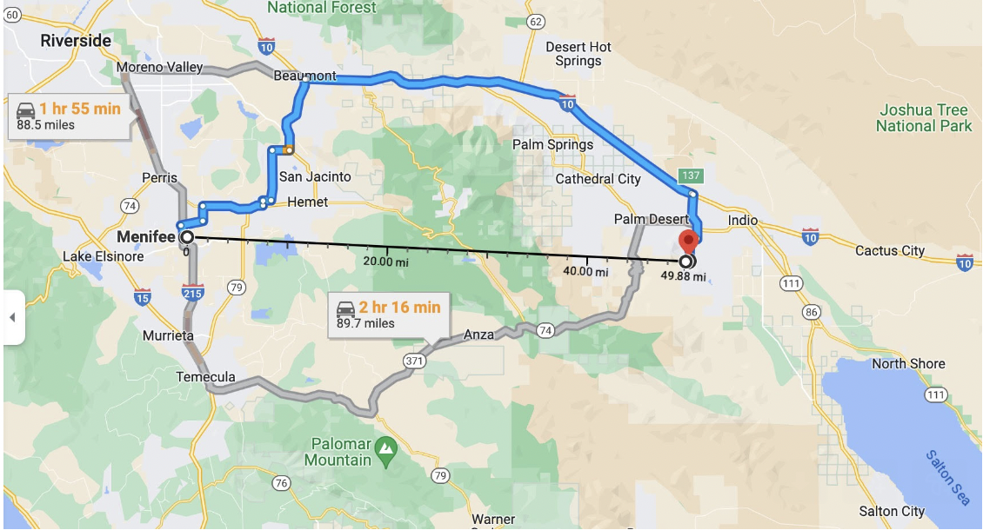
Menifee solar community provides local example
https://www.latimes.com/opinion/story/2023-07-09/la-home-electrification-new-construction-menifee-microgrid
https://www.cbsnews.com/losangeles/news/menifees-microgrid-community-offers-energy-self-sufficiency/?intcid=CNM-00-10abd1h

Slide 30
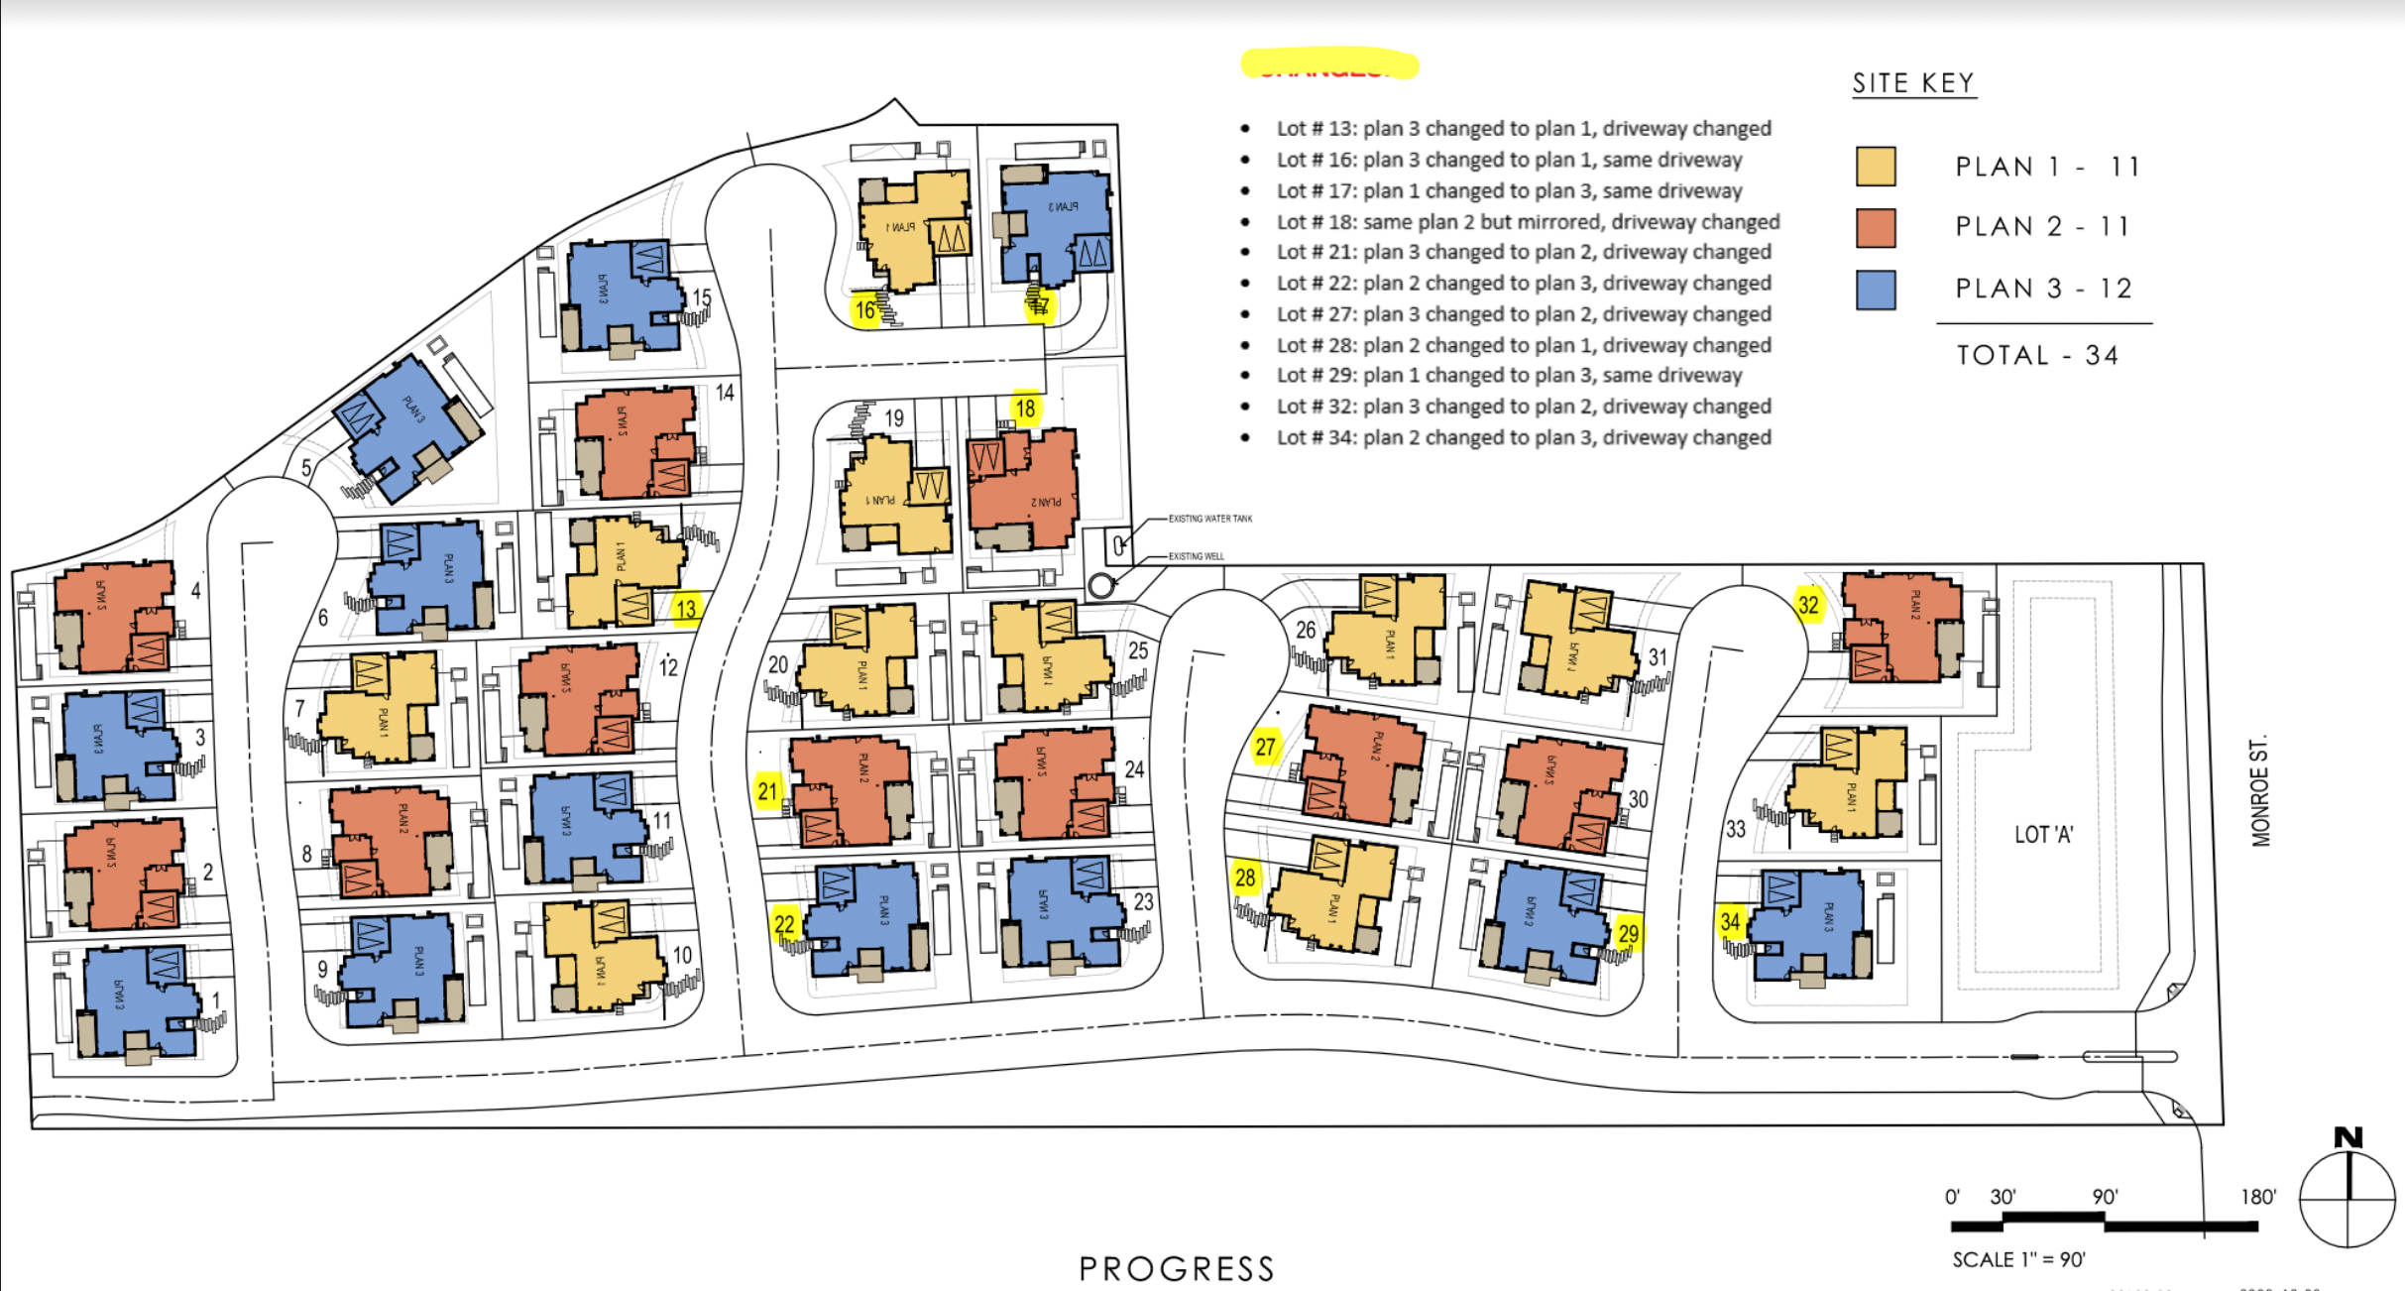
34-home Sierra Blanca community

Slide 31
Sierra Blanca energy system layout – Scenario A
Legend
Average house with average Solar Microgrid:
19.25 kWdc solar
10 kWac / 26.4 kWh battery
20’x10’ battery container hosting 500 kW & 1 MWh
Private electricity grid

Slide 32
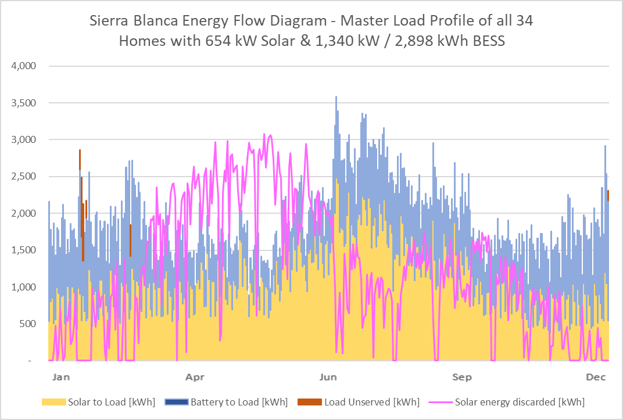
Scenario A: 654 kW solar and 1,340 kW & 2,898 kWh BESS across the community

Slide 33
Berkeley Efficient & Resilient Mixed-Use Showcase
(BERMUS)
Berkeley Efficient & Resilient Mixed-Use Showcase (BERMUS)
Notes:
33

Slide 34

Key BERMUS features
All-electric, 8-story, commercial and permanently affordable housing community.
65 units of 100% affordable housing with ground floor commercial offices and retail spaces.
Affordable home ownership via condominiums that provide homeownership benefits from original tenancy, with all being disadvantaged and low-income.
Net Zero Energy (NZE) building with a solar canopy covering the entire roof area, including a large rooftop patio and roof-mounted mechanical equipment for HVAC etc.
GridOptimal with the Solar Microgrid providing all energy during the 4-9pm grid-constrained period daily.
Solar Microgrid resilience ensuring indefinite resilience for the critical loads during grid outages of any duration, with significant resilience to all other loads based on solar energy availability and battery state-of-charge. Meets the full performance requirements of the CEC-recommended VOR123 value-of-resilience (VOR) methodology.

Slide 35
Backup
Backup

Slide 36
Goleta Load Pocket Community Microgrid
Goleta Load Pocket Community Microgrid

Slide 37
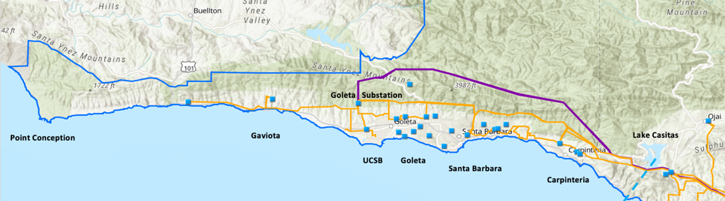
Goleta Load Pocket (GLP)
The GLP is the perfect opportunity for a comprehensive Community Microgrid
GLP spans 70 miles of California coastline, from Point Conception to Lake Casitas, encompassing the cities of Goleta, Santa Barbara (including Montecito), and Carpinteria.
GLP is highly transmission-vulnerable and disaster-prone (fire, landslide, earthquake).
200 megawatts (MW) of solar and 400 megawatt-hours (MWh) of energy storage will provide 100% protection to GLP against a complete transmission outage (“N-2 event”).
  200 MW of solar is equivalent to about 5 times the amount of solar currently deployed in the GLP and represents about 25% of the energy mix.
  Multi-GWs of solar siting opportunity exists on commercial-scale built-environments like parking lots, parking structures, and rooftops; and 200 MW represents about 7% of the technical siting potential.
  Other resources like energy efficiency, demand response, and offshore wind can significantly reduce solar+storage requirements.

Slide 38
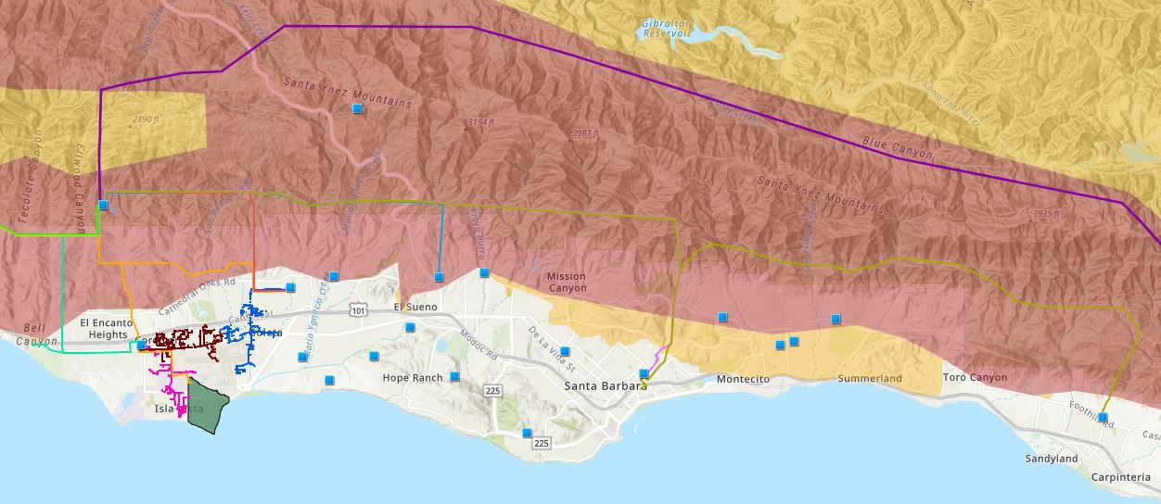

Core load area of the GLP
Legend
Feeder #4157
Feeder #4169
220 kV Transmission
Tier 3 Fire Threat
16kV Gladiola Feeder
Feeder #3556
Feeder #4227
Santa Barbara Airport
Tier 2 Fire Threat
16kV Gaucho Feeder
Feeder #4311
Feeder #3565
Substations
UCSB
16kV Professor Feeder
Feeder #3559

Slide 39
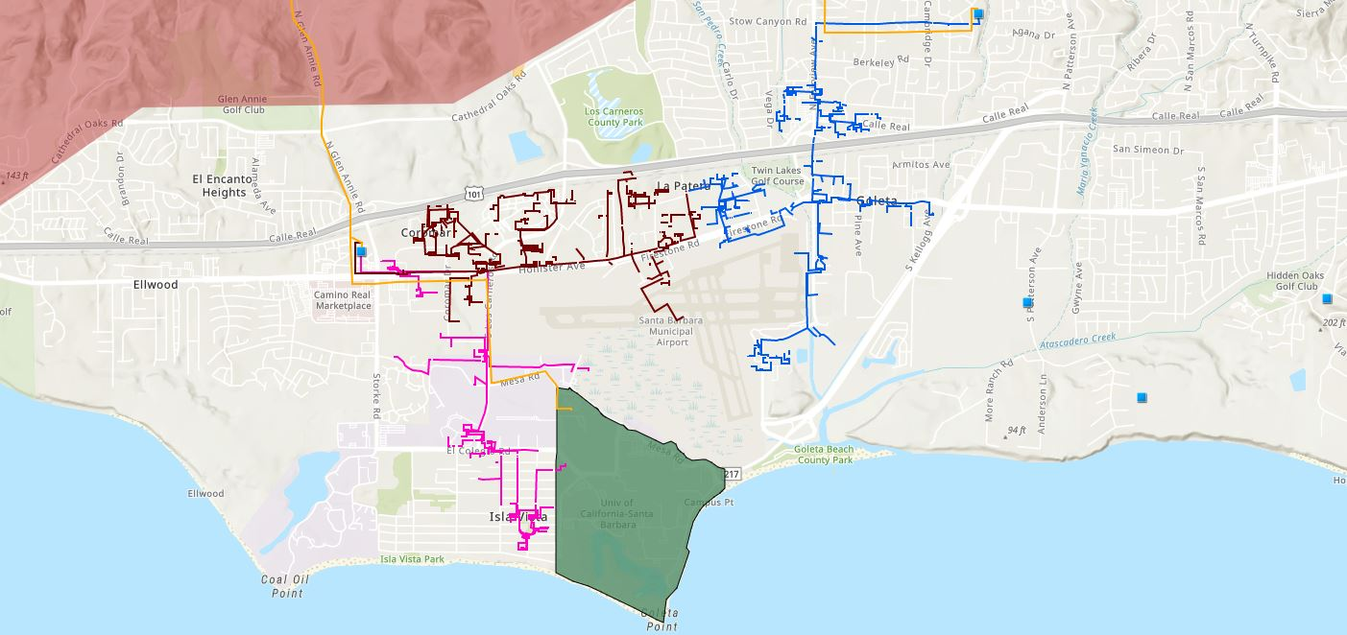








First targeted chunk of the GLP Community Microgrid
Bella Battery Energy Storage Project (120 MWh)
Direct Relief (Solar Microgrid)
Vegas Substation
Dos Pueblos High School (Solar Microgrid)
Goleta Energy Storage Project
(240 MWh)
SB Airport
Fire Station # 8
Ellwood Gas Peaker Plant
Isla Vista Substation
UCSB
Fire Station # 17
Goleta Sanitary District
Legend
16kV Gladiola Feeder
University of California Santa Barbara
Goleta Valley Cottage Hospital
66 kV Feeder #4311
16kV Gaucho Feeder
Dos Pueblos High School
Direct Relief
Substations
16kV Professor Feeder
Fire Stations
Deckers
Tier 3 Fire Threat
Santa Barbara Airport
Goleta Sanitary District
Planned Battery Energy Storage

Slide 40
First targeted chunk of the GLP Community Microgrid
Goleta Substation (220-to-66kV)
66kV distribution feeder #4311 with multiple branches
Vegas Substation (66-to-16kV)
Goleta Substation has eight feeders, seven 66 kV & one 16 kV, that serve the entire GLP
Fire Station #8
Direct Relief
+ Solar Microgrid
San Marcos
+ Solar Microgrid
66kV underground interconnection
Tier 2 & 3 facilities
Dos Pueblos
+ Solar Microgrid
Tier 2 & 3 facilities
Karl Storz + Solar Microgrid
Goleta Energy Storage Project (240 MWh)
City of Goleta
+ Solar
Isla Vista Substation (66-to-16kV)
Deckers
+ Solar
Goleta Cottage Hospital
Ellwood Gas Peaker Plant
GenOn Battery Energy Storage (120 MWh)
Tier 2 & 3 facilities
SBA (runway lights & ATC)
Diagram Elements
66 kV Distribution Feeder #4311
16 kV Gladiola Feeder
16 kV Gaucho Feeder
16 kV Professor Feeder
16 kV Los Carneros Feeder
16 kV Ace Feeder
16 kV Storke Feeder
Planned Battery Energy Storage
Ellwood Gas Peaker Plant
Grid isolation switch (open, closed)
Smart meter switch (open, closed)
Fire Station #17
SBA (Main Terminal)
Costco
+ Solar
Goleta Sanitary District
UCSB
+ Solar

Slide 41
SBUSD Solar Microgrids case study
Santa Barbara Unified School District (SBUSD)
Solar Microgrids case study

Slide 42
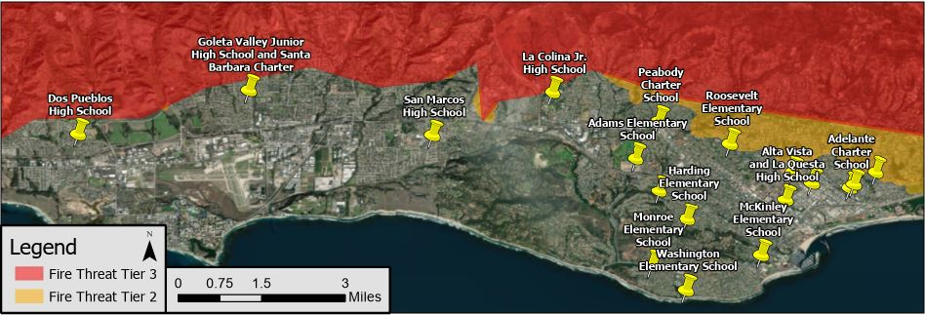
Santa Barbara Unified School District (SBUSD)
The entire Santa Barbara region is surrounded by extreme fire risk (earthquake & landslide risk too) and is extremely vulnerable to electricity grid outages.
The SBUSD is a major school district that increasingly recognizes the value-of-resilience (VOR) and has embraced the Clean Coalition’s vision to implement Solar Microgrids at a number of its key schools and other critical facilities.
SMHS is in the middle of the extensive SBUSD service area.

Slide 43
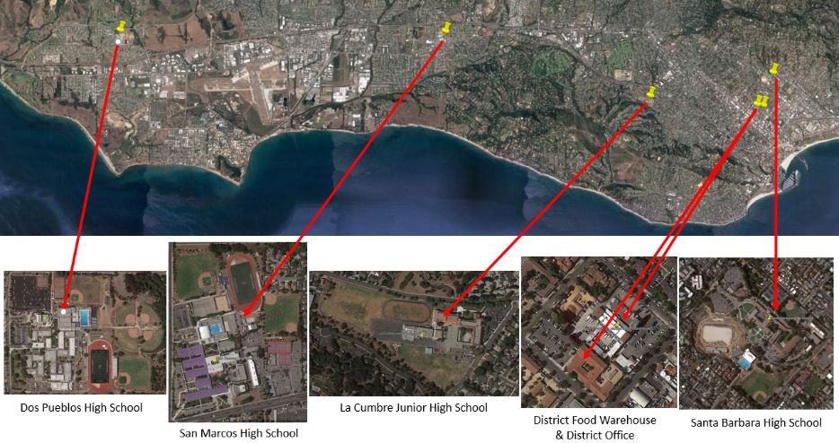
Six SBUSD Solar Microgrid sites

Slide 44
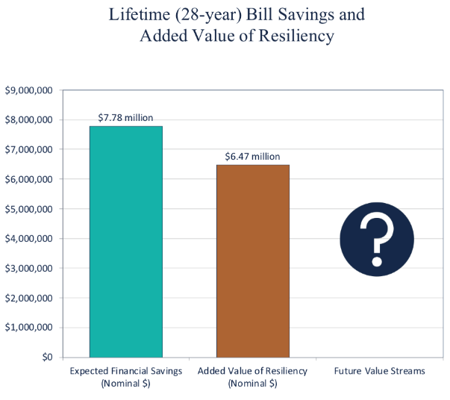
Guaranteed SBUSD bill savings and free VOR

Slide 45
Large farm case study in Carpinteria, CA
Large farm case study in Carpinteria, CA
Notes:
45

Slide 46
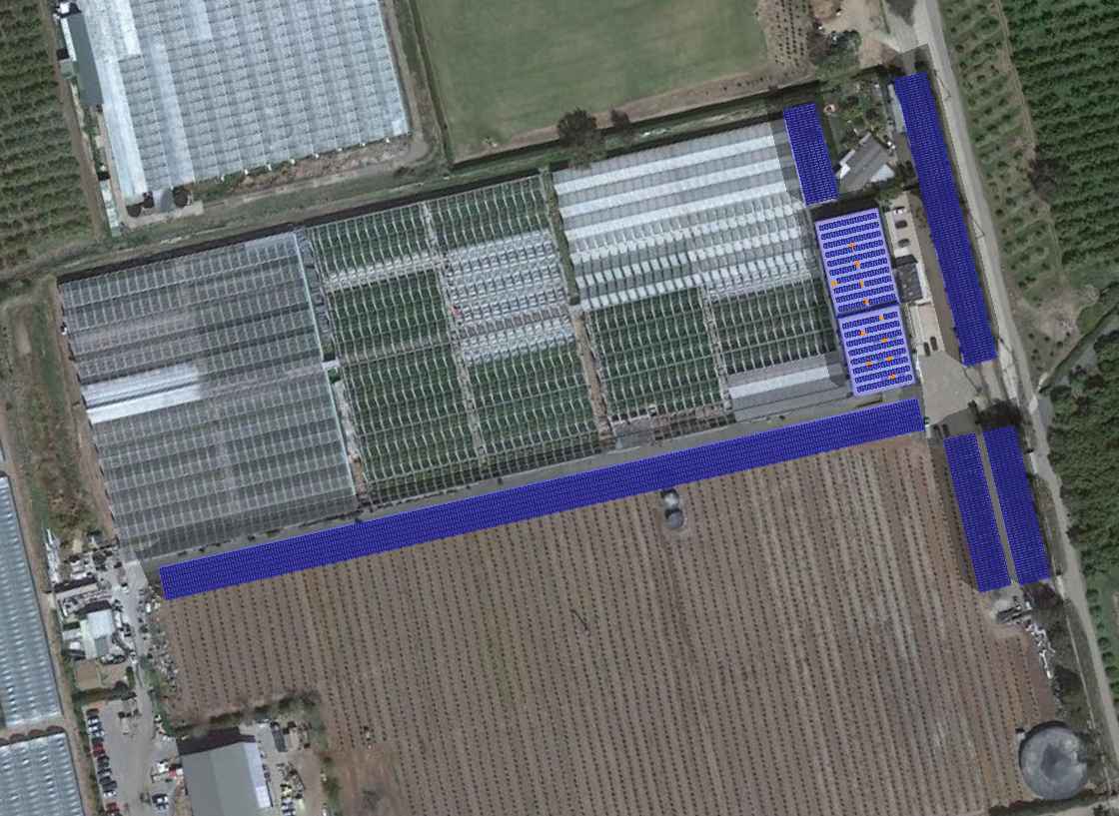


1.5 MWdc of solar for GH2 meter
Brand Farms
Greenhouse #2 Meter
Solar Microgrid Site Layout
C-5
Service Meter
#259000-062804
C-4
3 MW / 6 MWh BESS
Potential Location
R-1
Potential Solar Siting Locations:
C-1
710 kW Solar Canopy
R-2
C-2
142 kW Solar Canopy
C-3
142 kW Solar Canopy
C-4
89 kW Solar Canopy
C-5
269 kW Solar Canopy
C-2
R-1
84 kW Rooftop Solar
R-2
66 kW Rooftop Solar
Total Solar Siting Potential: 1,500 kW
Annual Generation: 2,492,565
Total Annual Loads:
Master Load Profile: 3,804,085 kWh
C-1
C-3

Slide 47

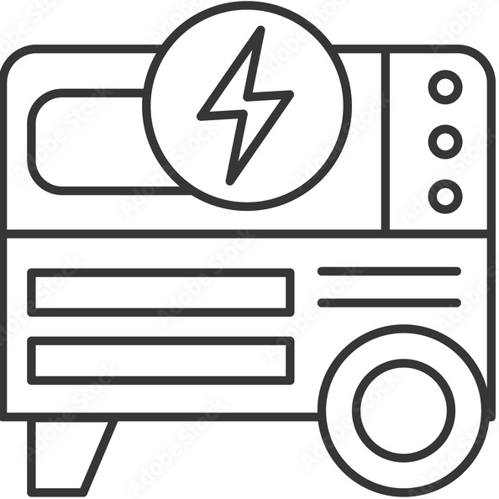
DC-coupled Solar Microgrid to serve 2.5 MWdc of added DC loads to Greenhouse2 meter
Solar
Battery
1.5 MWdc
6 MWh
350-500 Vdc LEDs
4-6 hr/day, Oct-Mar
Converter
Converter
DC Loads
Peak: 2.5 MWdc
800 Vdc
DC bus
Converter
Inverter 530 kW
Diesel Generator
Main Circuit Breaker
AC Loads
Peak: 291 kWac
MCB
480 Vac
3-phase
Line Side Taps
ATS
Automatic Transfer Switch
M
SCE Meter (limit of 665 kWac)
800 A, 480 Vac, 3-phase
SCE Grid
Transformer
500 kVA

Slide 48
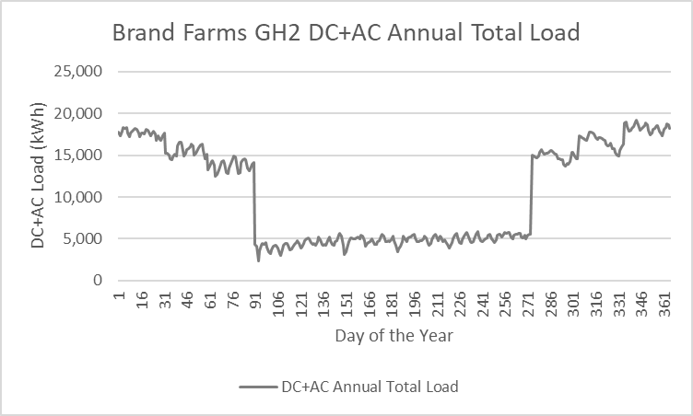
Greenhouse2 economics assuming all future
AC & DC loads can be served by the grid

Slide 49
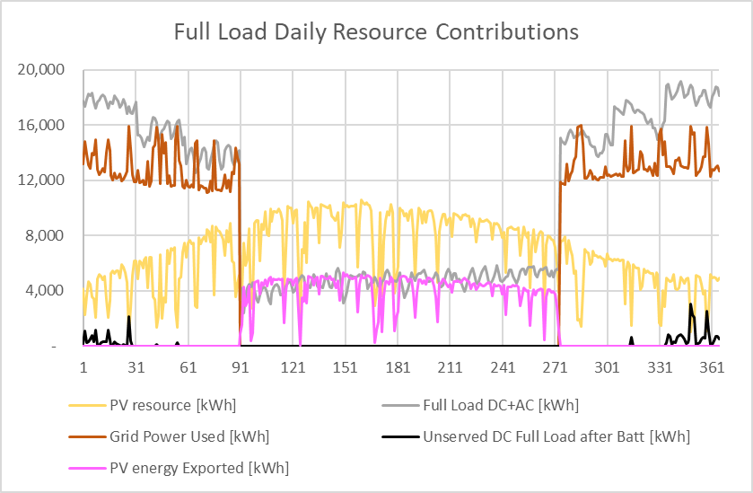
Greenhouse2 Energy Flow after addition of $10 million Solar Microgrid and 2.5 MWdc of DC loads
Energy Flow Diagram
1.5 MW solar and 3 MW / 6 MWh energy storage

Slide 50
Orcas Community Microgrid (OCM)
Orcas Community Microgrid (OCM)

Slide 51
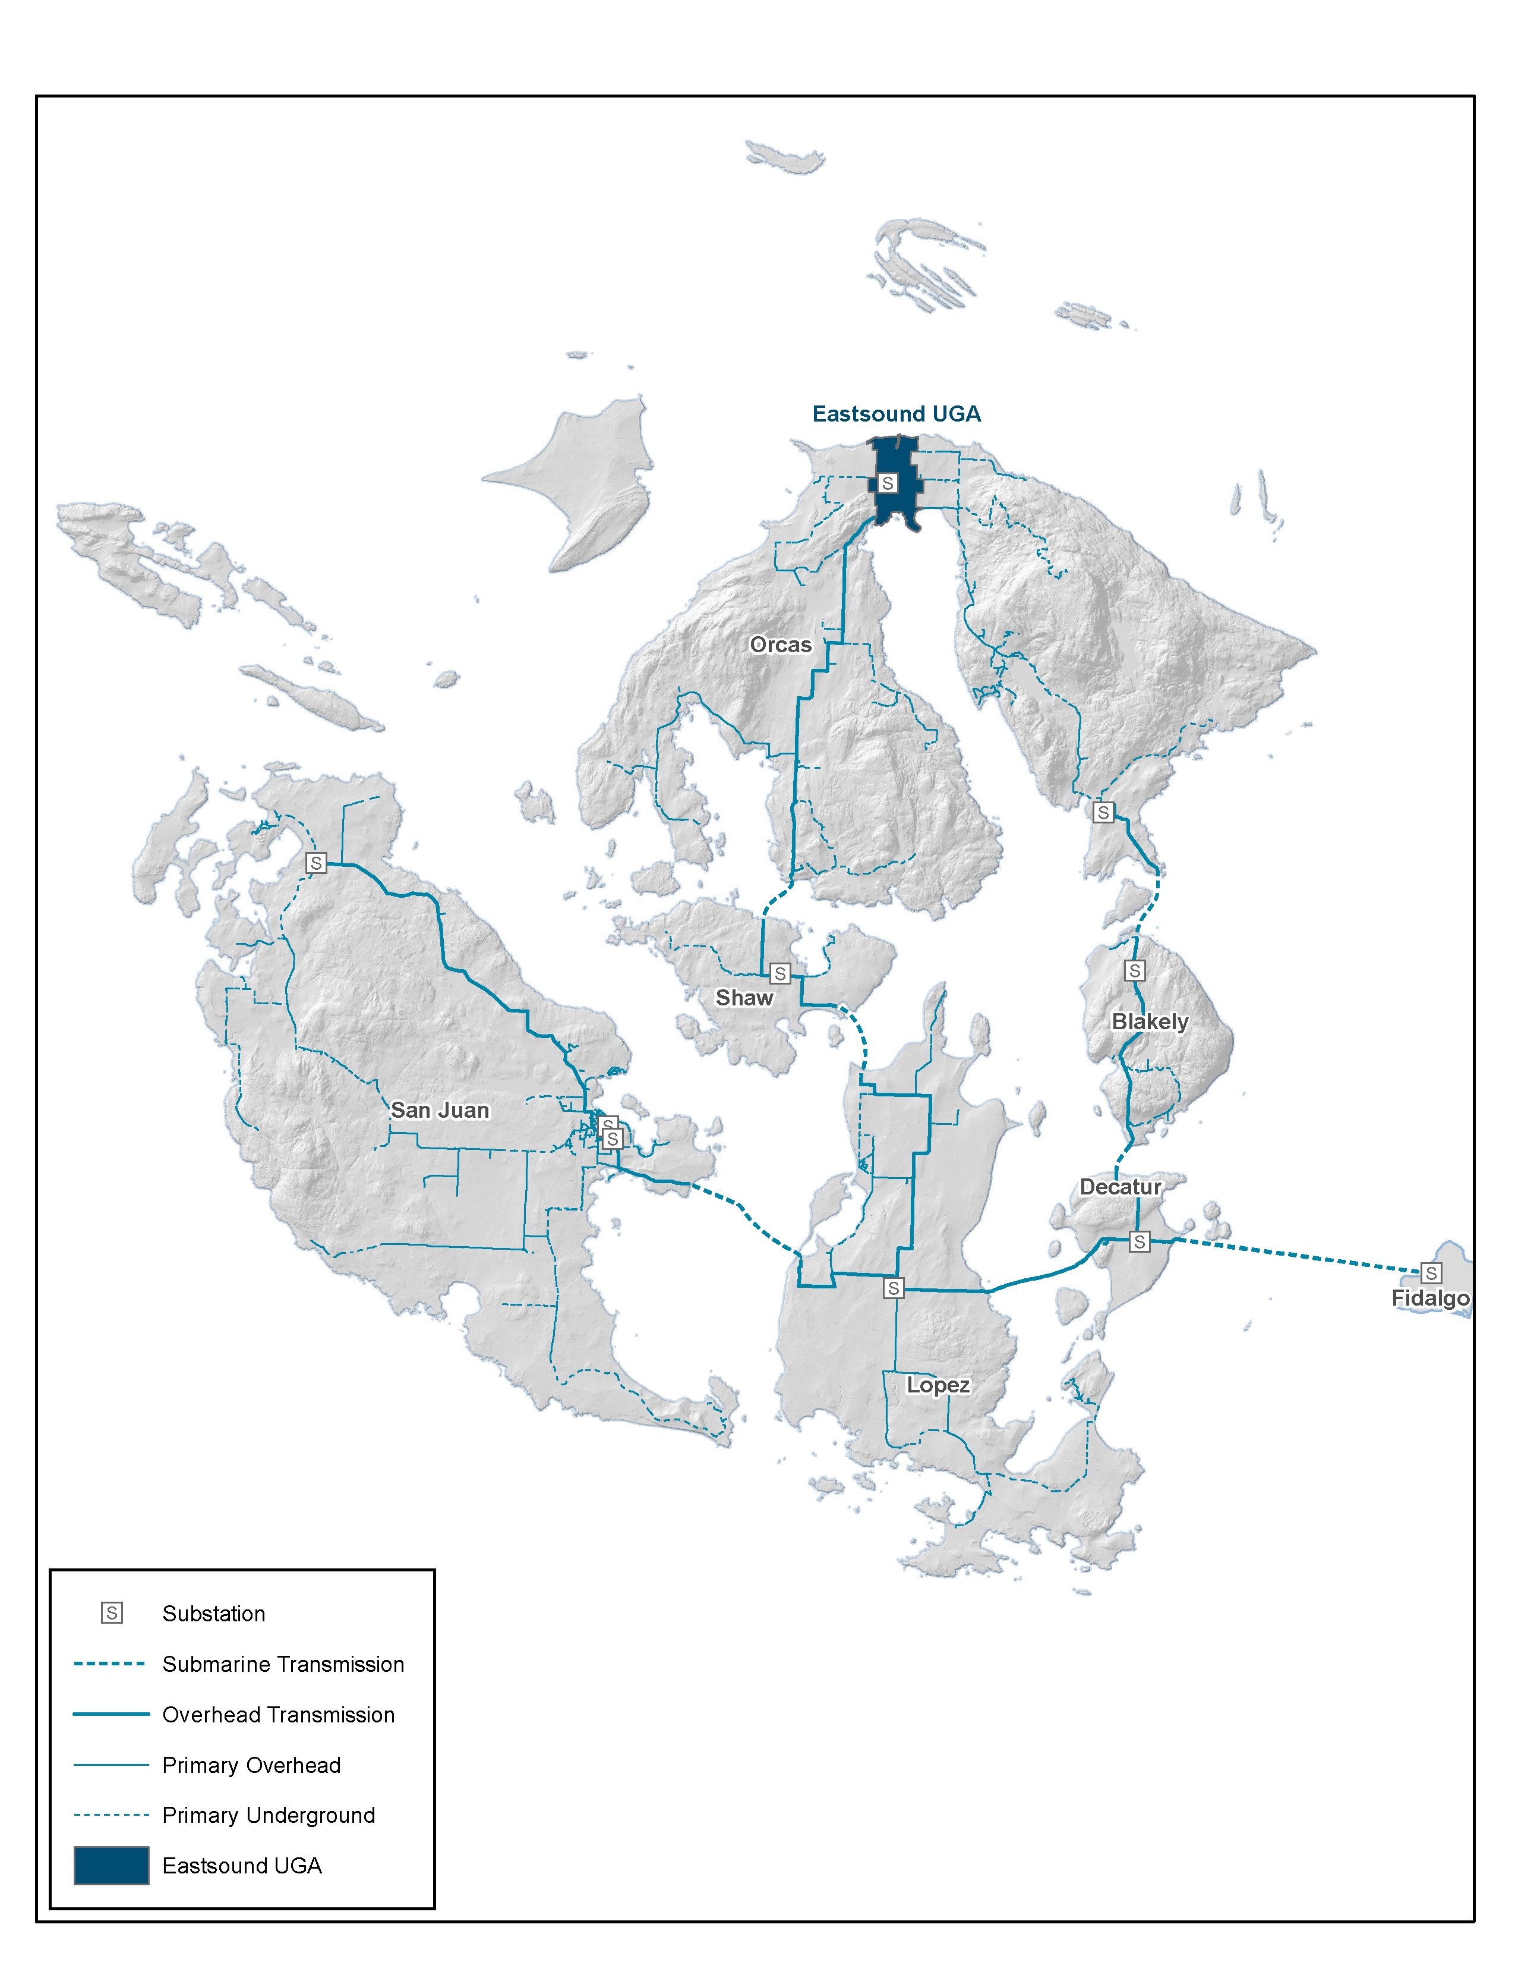
Grand OCM plan for the entire San Juan Islands
Figure 1: OPALCO’s service territory covers San Juan County and includes 20 islands. Eastsound is shaded towards the top of Orcas Island and represents the initial Orcas Community Microgrid location. Over time, the Community Microgrid will expand to cover all of Orcas and then eventually the entire OPALCO service territory.

Slide 52
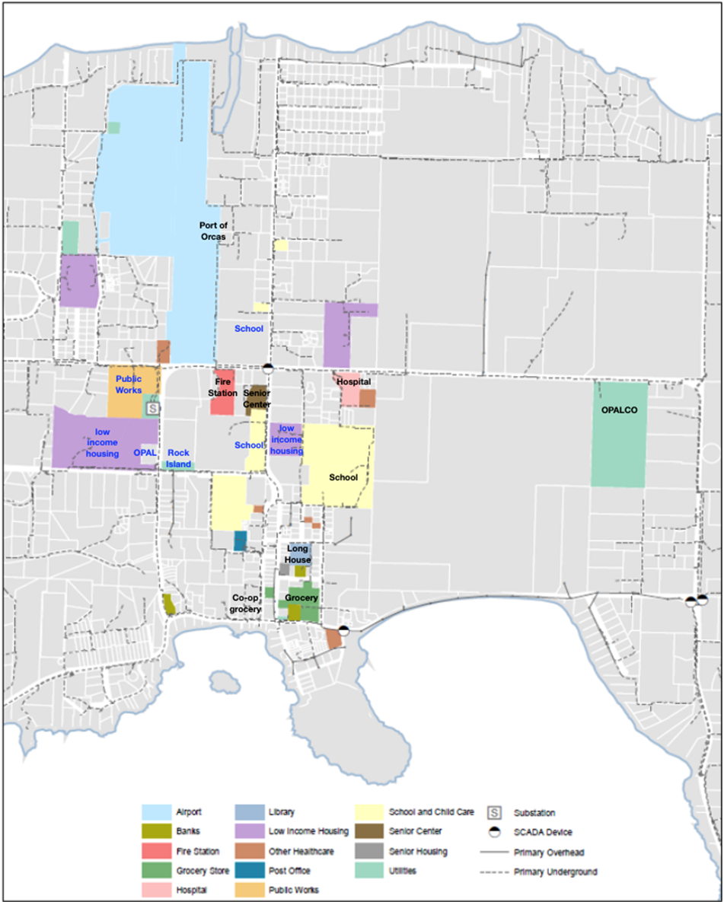
Eastsound Tier 1 & 2 facilities map
Figure 2: Eastsound facilities that are being provisioned with priority Community Microgrid resilience in the initial Orcas Community Microgrid design are shaded. Tier 1 Critical Community Facilities (CCFs) are shaded and labeled with black text, while Tier 2 CCFs are shaded in blue text. Figures 3 and 4 further depict the initial Orcas Community Microgrid in block diagram form.

Slide 53
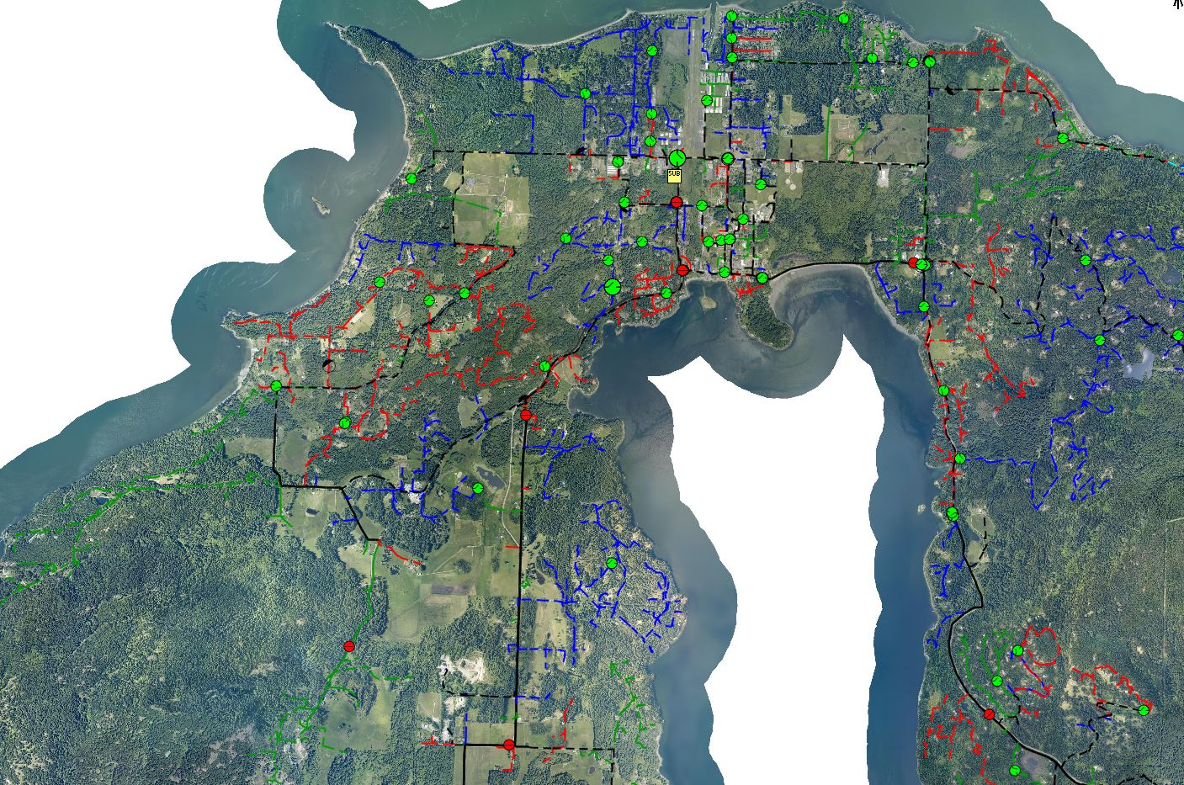


OCM map for Orcas Island
Feeder (A phase)
Feeder (B phase)
Feeder (C phase)
Underground feeder (Three phase)
Overhead feeder (Three phase)
Manual existing grid switches (open)
Manual existing grid switches (closed)
Microgrid area
Eastsound Substation
OPALCO headquarters
2.7 MWh battery (primary location)
New 1-phase GIS
New 3-phase GIS
Upgraded 3-phase GIS
Existing 69 kV transmission line
1 MW biopower facility
1 MW Biopower facility
Notes:
L shaped microgrid area instead of square
ATP – EMTP is a PLS CAD
Real time dynamic simulator

