Slide 1

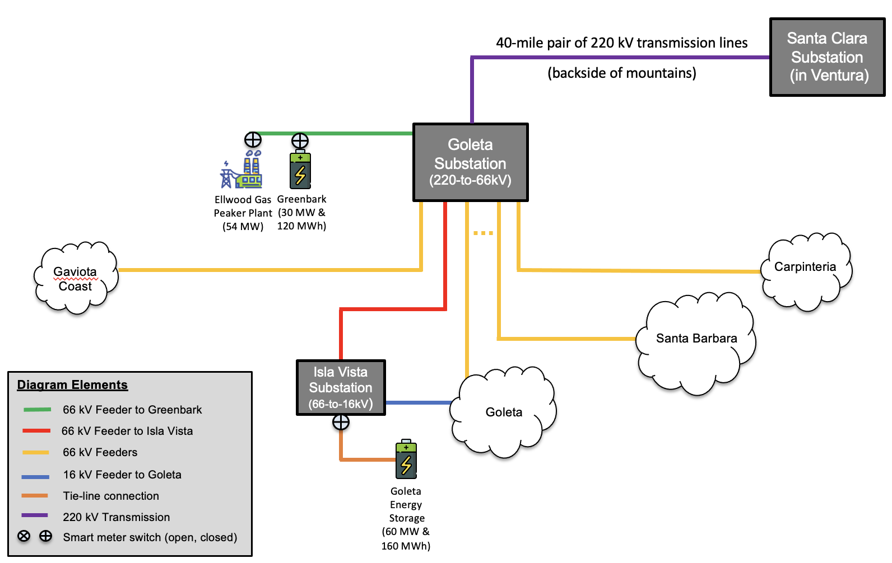
Local Energy Storage
delivers unparalleled economic, environmental, and resilience benefits –
and Goleta leads the way
Craig Lewis
Executive Director
650-796-2353 mobile
craig@clean-coalition.org
5 December 2025

Slide 2
Clean Coalition (nonprofit)
Mission
To accelerate the transition to renewable energy and a modern grid through
technical, policy, and project development expertise.
Renewable Energy End-Game
100% renewable energy; 25% local, interconnected within the distribution grid and ensuring resilience without dependence on the transmission grid; and 75% remote, fully dependent on the transmission grid for serving loads.
Notes:
‹#›

Slide 3
DER deliver an unparalleled trifecta of economic, environmental, and resilience benefits
Distributed Energy Resources (DER)
deliver an unparalleled trifecta of economic, environmental, and resilience benefits

Slide 4
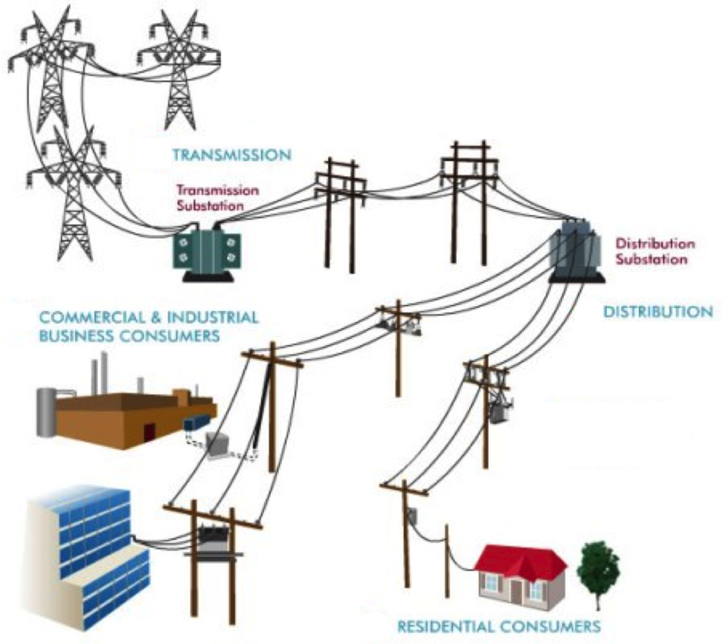
Distributed means local, within distribution grid
High-Voltage
Transmission
grid
Low-Voltage
Transmission
grid
Distribution
grid
Notes:
Market distortions like the erroneous metering & assessment of Transmission Access Charges (TAC) for California IOUs creates massive market distortions that steal value from local generation, hurt ratepayers, and preempt energy resilience.
Non-PTO utilities (metered sub-systems) currently operate under the system we are proposing. The Clean Coalition TAC fix would bring consistent TAC treatment to DG resources in all utility service territories.

Slide 5
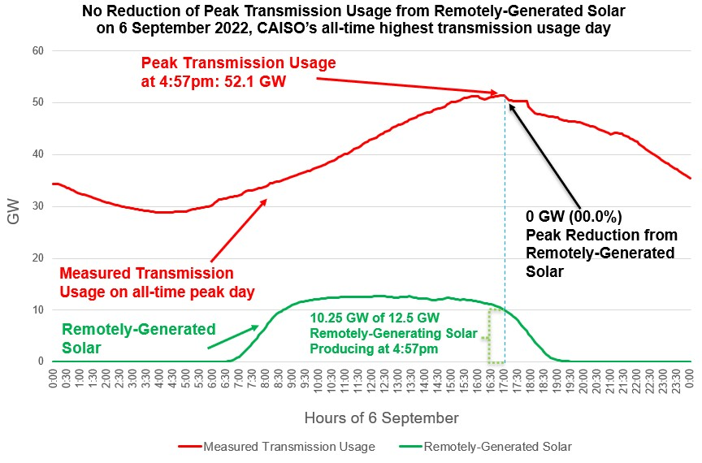
Transmission stress & cost is a massive problem

Slide 6
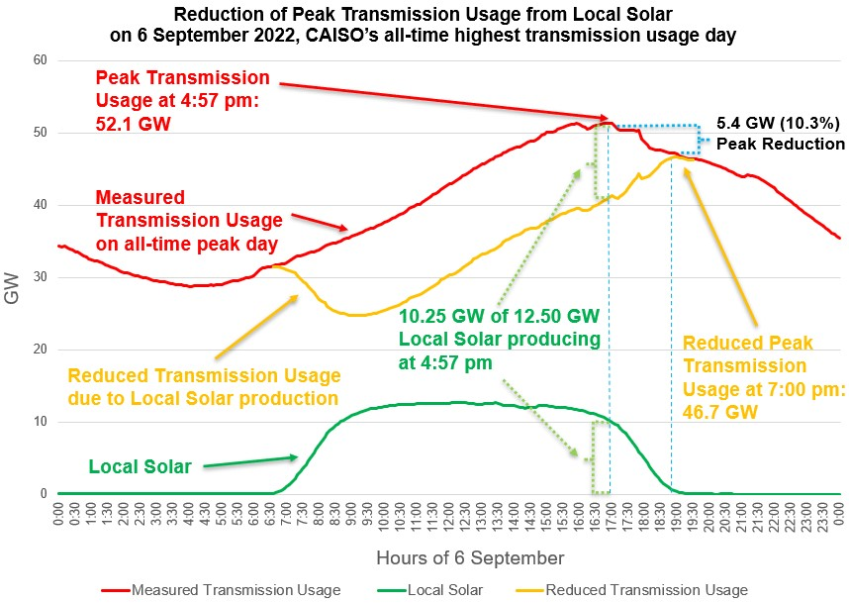
Local Solar reduces transmission stress & costs
Local Solar reduces Peak Transmission Usage by close to 50% of the installed local solar capacity. The effect is amplified by energy storage. It also maximizes delivery of remote renewables.
Bringing down the peak with distributed generation and demand flexibility will reduce transmission investments, saving ratepayers hundreds of billions of dollars over the next two decades.
Reducing the Peak Transmission Usage by around 10% is enough to prevent most major outages.

Slide 7
GLP is a transmission-vulnerable case study
Goleta Load Pocket (GLP) is a transmission-vulnerable case study

Slide 8
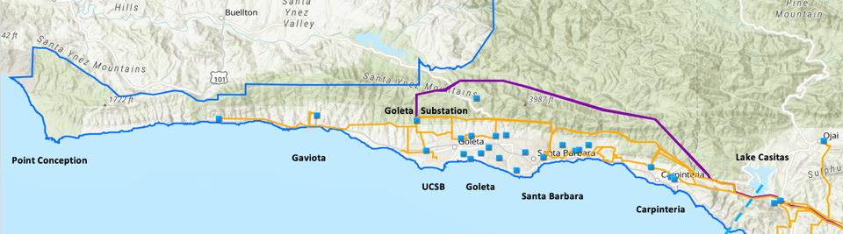
Goleta Load Pocket (GLP)
The GLP is the perfect opportunity for a comprehensive Community Microgrid
GLP spans 70 miles of California coastline, from Point Conception to Lake Casitas, encompassing the cities of Goleta, Santa Barbara (including Montecito), and Carpinteria.
GLP is highly transmission-vulnerable and disaster-prone (fire, landslide, earthquake).
200 megawatts (MW) of solar and 400 megawatt-hours (MWh) of energy storage will provide 100% protection to GLP against a complete transmission outage (“N-2 event”).
  200 MW of solar is equivalent to about 5 times the amount of solar currently deployed in the GLP and represents about 25% of the energy mix.
  Multi-GWs of solar siting opportunity exists on commercial-scale built-environments like parking lots, parking structures, and rooftops; and 200 MW represents about 7% of the technical siting potential.
  Other resources like energy efficiency, demand response, and offshore wind can significantly reduce solar+storage requirements.

Slide 9

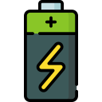
Greenbark in perfect location to serve entire GLP
40-mile pair of 220 kV transmission lines
(backside of mountains)
Santa Clara Substation
(in Ventura)
Goleta Substation (220-to-66kV)
Greenbark
(30 MW &
120 MWh)
Ellwood Gas Peaker Plant
(54 MW)
Gaviota
Coast
Carpinteria
Santa Barbara
Diagram Elements
Tie-line connection
Constrained 66 kV Feeder to Isla Vista
66 kV Feeders
16 kV Professor Feeder to Goleta
220 kV Transmission
Smart meter switch (open, closed)
Isla Vista Substation (66-to-16kV)
Goleta
Goleta
Energy
Storage
(60 MW &
160 MWh)

Slide 10







Local Energy Storage enables Community Microgrids
Goleta Substation (220-to-66kV)
66kV distribution feeder #01800 with multiple branches
Vegas Substation (66-to-16kV)
Goleta Substation has ten feeders, eight 66 kV & two 16 kV, that serve the entire GLP
Fire Station #8
Direct Relief
+ Solar Microgrid
San Marcos
+ Solar Microgrid
Tier 2 & 3 facilities
66kV distribution feeder #01683 with multiple branches
Dos Pueblos
+ Solar Microgrid
Tie-line connection
Tier 2 & 3 facilities
Karl Storz + Solar Microgrid
Goleta Energy Storage Project (240 MWh)
City of Goleta
+ Solar
Isla Vista Substation (66-to-16kV)
Tie-line
connection
Deckers
+ Solar
Goleta Cottage Hospital
Tier 2 & 3 facilities
SBA (runway lights & ATC)
Ellwood Gas Peaker Plant
Greenbark BESS (120 MWh)
Diagram Elements
Tie-line connection
66 kV Distribution Feeders
16 kV Gladiola Feeder
16 kV Gaucho Feeder
16 kV Professor Feeder
16 kV Los Carneros Feeder
16 kV Ace Feeder
16 kV Storke Feeder
Planned Battery Energy Storage
Ellwood Gas Peaker Plant
Grid isolation switch (open, closed)
Smart meter switch (open, closed)
Fire Station #17
SBA (Main Terminal)
Costco
+ Solar
Goleta Sanitary District
UCSB
+ Solar

Slide 11
IVCM is being staged for MIP funding
Isla Vista Community Microgrid (IVCM) is being staged for funding via California’s Microgrid Incentive Program (MIP)

Slide 12
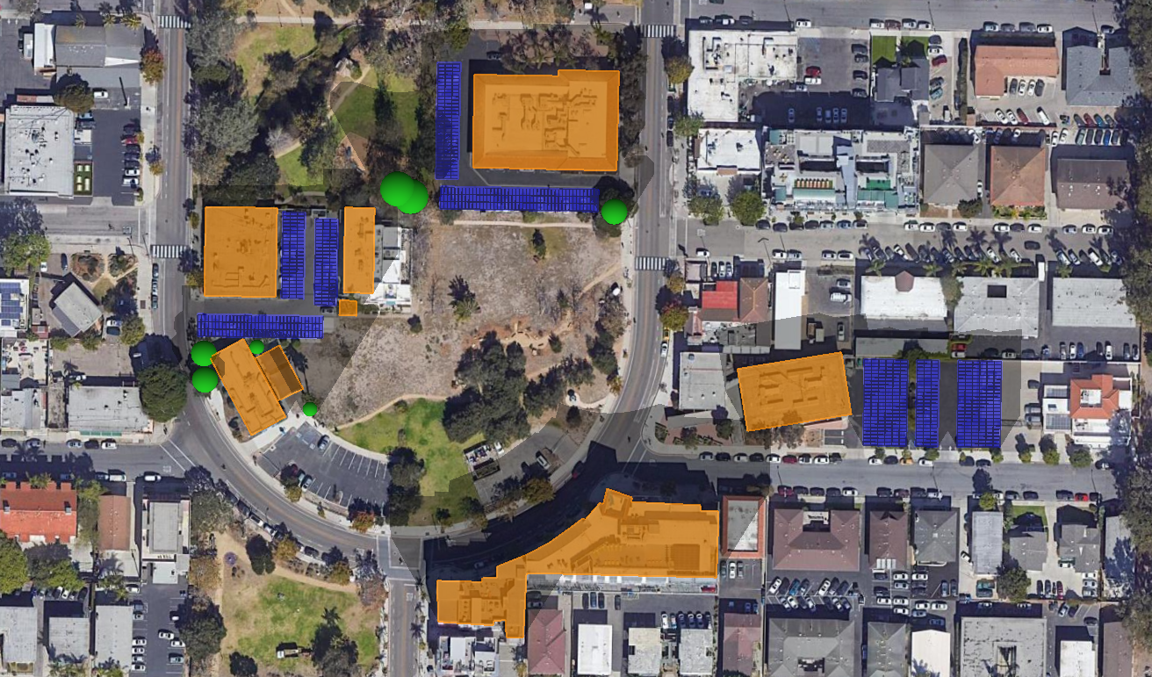






IVCM project resource map - 494 kWdc solar
Isla Vista Community Microgrid
Total annual load (2022-2025 Average):
Year 1: 1,336,759 kWh
Year 10: 1,597,522 kWh
Peak load (CY 2022):
Year 1: 321 kW
Year 10: 384 kW
Solar sizing:
494 kWdc
Total annual solar generation:
Year 1: 838,610 kWh
Year 10: 801,618 kWh
BESS Sizing:
Year 1: 1,927 kW / 7,708 kWh
Year 10: 1,927 kW / 5,860 kWh
135 kWdc solar
147 kWdc solar
1,927 kW / 7,708 kWh BESS
212 kWdc solar
Potential BESS location
New FOM solar
Project boundary
Trees
Obstructions/Buildings

Slide 13
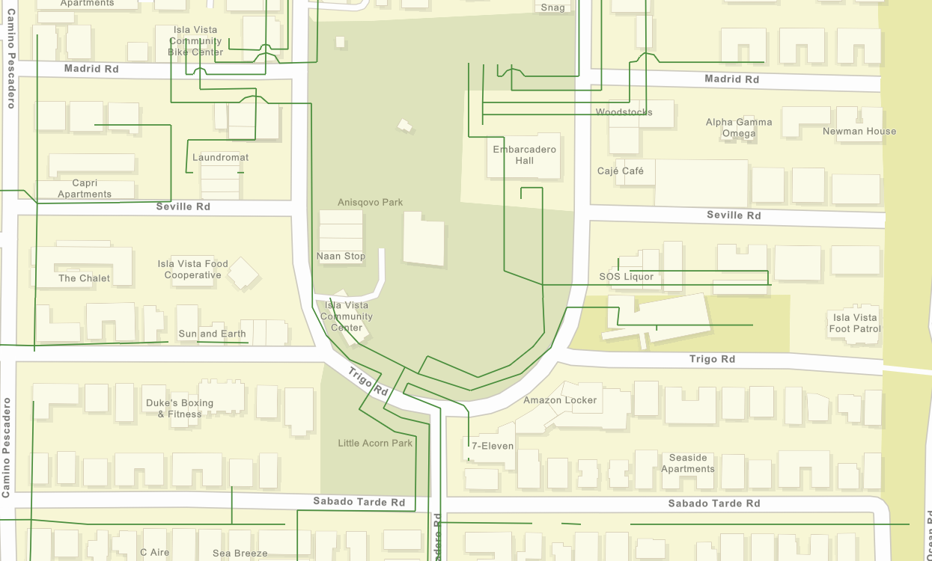
IVCM project area
Embarcadero Hall
Isla Vista Neighborhood Clinic
Isla Vista
Community Center
Isla Vista
Theater
Isla Vista
Police Station
Map Elements
IVCM Gladiola Feeder (16 kV)
Gladiola Feeder (16 kV)
Project area
Grid Isolation Switch

Slide 14
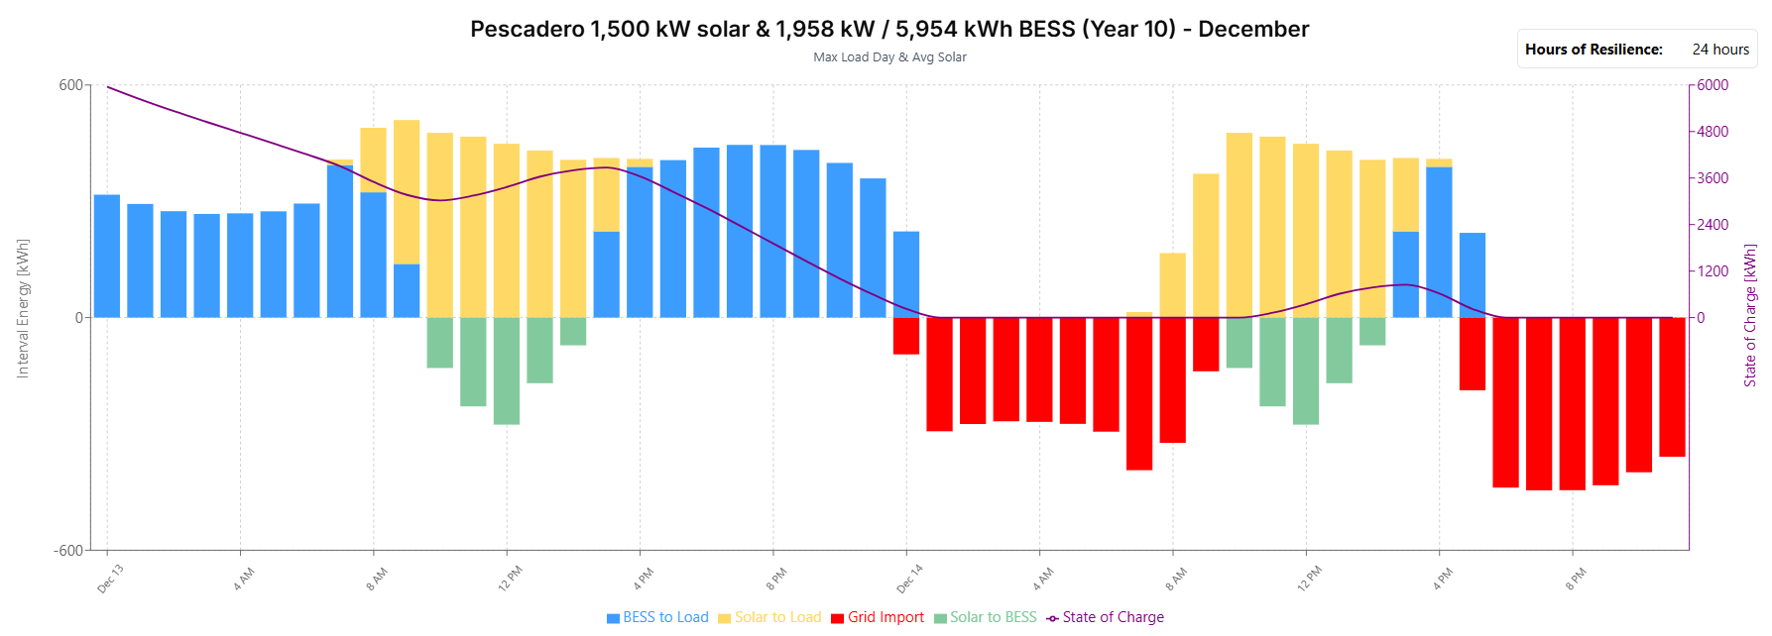
IVCM resilience duration energy flow
40 hours of resilience in Year 10 (with charge/discharge losses)
494 kWdc (1,250 kWac) solar & 1,927 kW / 5,860 kWh BESS (Year 10)
41th hour has a shortfall of 153 kWh with the BESS providing 89 kWh and solar providing 6 kWh

Slide 15
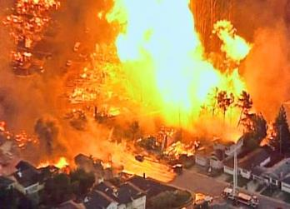
Natural gas infrastructure is not resilient
Assertion: Gas-driven generation is often claimed to be resilient.
Reality: Gas infrastructure is not resilient and takes much longer to restore than electricity infrastructure.
Threats: Gas infrastructure can be flat-out dangerous and highly vulnerable to earthquakes, fires, landslides, and terrorism.
2010 San Bruno Pipeline Explosion
Source: The City and County of San Francisco Lifelines Study

Slide 16
Community Microgrid Initiative
The Clean Coalition established the Community Microgrid Initiative in 2010 to harness local solar and energy storage to deliver an unparalleled trifecta of economic, environmental, and resilience benefits to communities.
https://clean-coalition.org/community-microgrid-initiative/
Notes:
‹#›

Slide 17
Greenbark BESS is perfect LES case study
Greenbark Battery Energy Storage System (BESS) is a perfect Local Energy Storage (LES) case study
And it is in Goleta

Slide 18
Five distinguishing Greenbark features
Perfect location to provide resilience across the entire Goleta Load Pocket (GLP).
Maximum solar energy, from both local & remote locations, thereby minimizing gas power plant usage (curtail gas instead of solar).
Significant distances from other facilities, including housing.
Same safe BESS technology that is already deployed in multiple GLP locations, including in the Goleta Energy Storage project and the Valecito Energy Storage Resilience project in Carpinteria.
Significant economic benefits to the local community, in addition to all California ratepayers (all ratepayer pay equally for transmission grid investments).

Slide 19
Greenbark is sited at the perfect location
Greenbark is sited at the perfect location to provide resilience across the entire Goleta Load Pocket (GLP)

Slide 20
Greenbark in perfect location to serve entire GLP
40-mile pair of 220 kV transmission lines
(backside of mountains)
Santa Clara Substation
(in Ventura)
Goleta Substation (220-to-66kV)
Greenbark
(30 MW &
120 MWh)
Ellwood Gas Peaker Plant
(54 MW)
Gaviota
Coast
Carpinteria
Santa Barbara
Diagram Elements
66 kV Feeder to Greenbark
66 kV Feeder to Isla Vista
66 kV Feeders
16 kV Feeder to Goleta
Tie-line connection
220 kV Transmission
Smart meter switch (open, closed)
Isla Vista Substation (66-to-16kV)
Goleta
Goleta
Energy
Storage
(60 MW &
240 MWh)

Slide 21
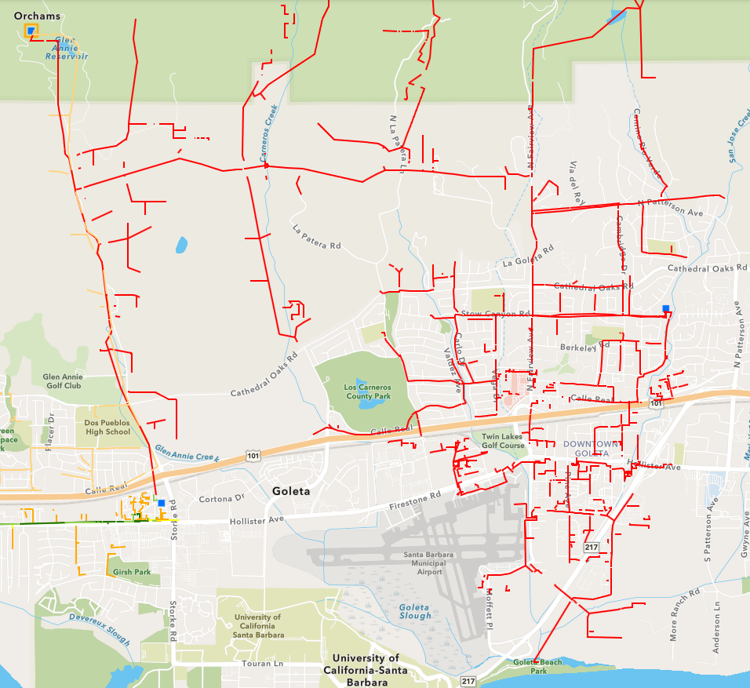
Backfeeding energy to the Goleta Substation from other Goleta locations is highly constrained
Goleta Substation
Isla Vista Substation
Goleta Energy Storage

Slide 22
Greenbark will maximize solar for the GLP
Greenbark will maximize solar for the Goleta Load Pocket (GLP)
And minimize gas power plant usage in Goleta and beyond

Slide 23
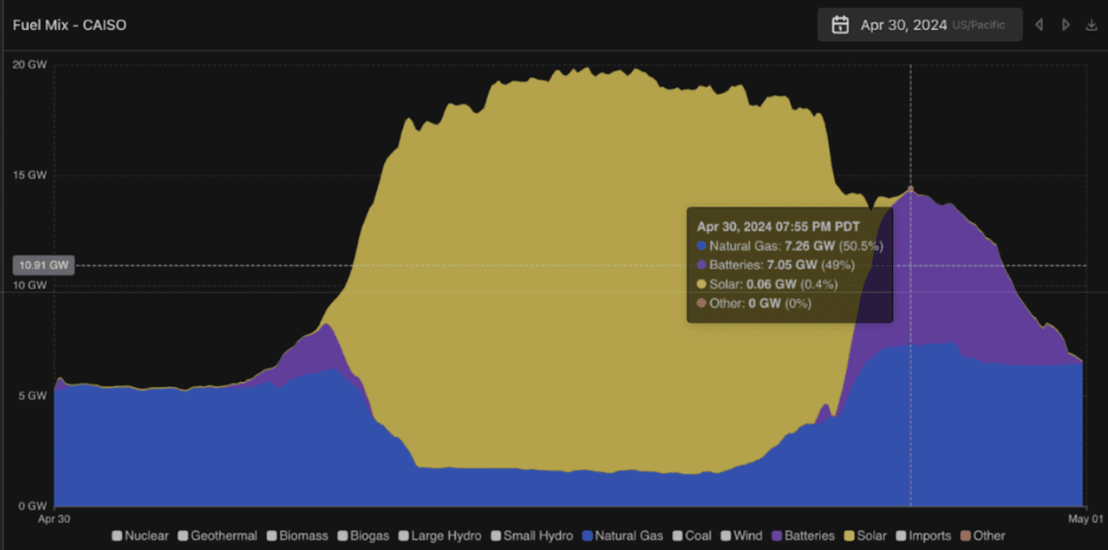
Greenbark will enable maximized solar in the GLP
Graph demonstrates the fuel mix during one day in 2024, showing that batteries (purple) displace natural gas (blue) during the evening, and solar dominates during the day (GridStatus 2024, https://blog.gridstatus.io/caiso-batteries-apr-2024/).

Slide 24
Transmission stress & cost is a massive problem

Slide 25
Local Solar reduces transmission stress & costs
Local Solar reduces Peak Transmission Usage by close to 50% of the installed local solar capacity. The effect is amplified by energy storage. It also maximizes delivery of remote renewables.
Bringing down the peak with distributed generation and demand flexibility will reduce transmission investments, saving ratepayers hundreds of billions of dollars over the next two decades.
Reducing the Peak Transmission Usage by around 10% is enough to prevent most major outages.

Slide 26
Greenbark is sited at a significant distance to other facilities, including housing, and safe BESS technology
Greenbark is sited at a significant distance to other facilities, including housing
And designed with same safe BESS technology that is has been successfully operating in the GLP for five years

Slide 27
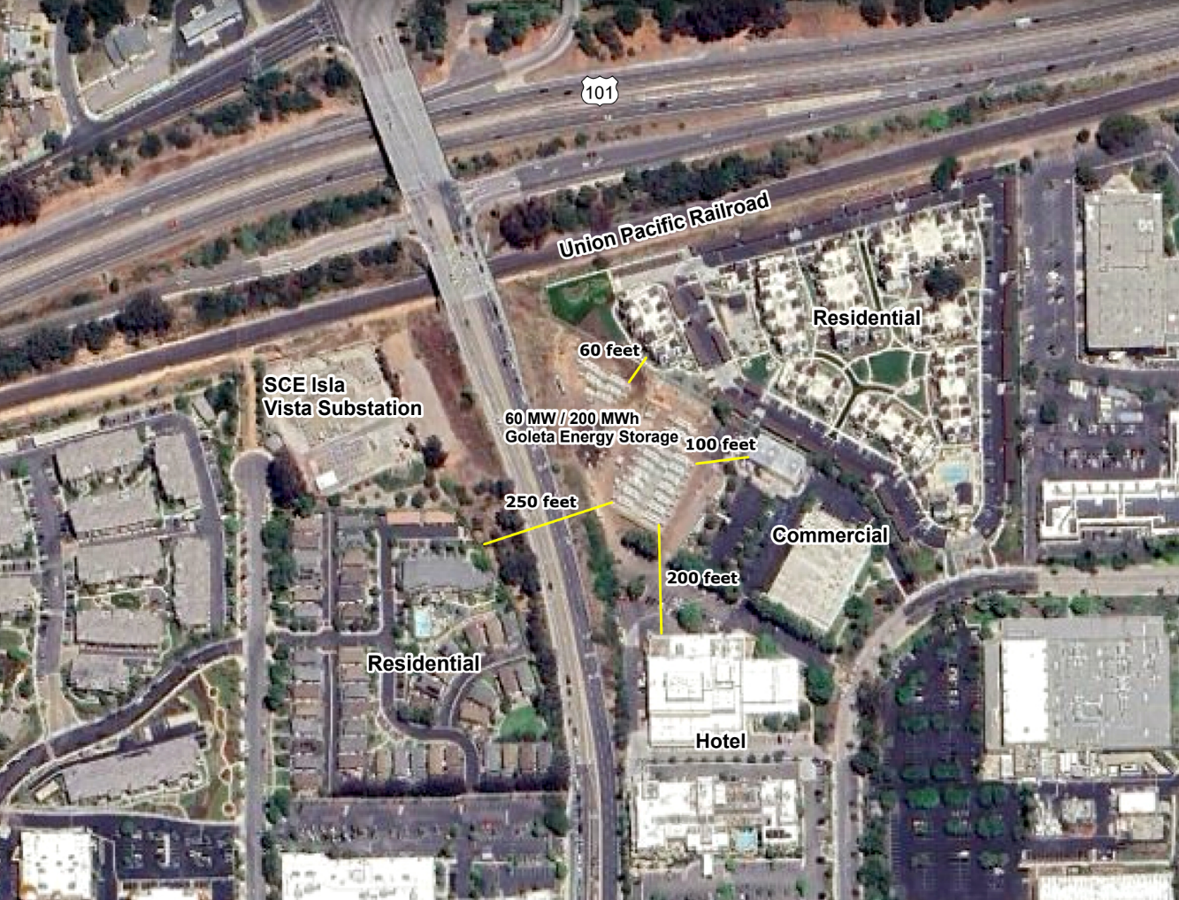
The operational Goleta Energy Storage project is 60 feet from housing

Slide 28
Greenbark (120 MWh) is 5x further from housing

Slide 29
Greenbark delivers significant local economic benefits
Greenbark delivers significant local economic benefits
Notes:
‹#›

Slide 30
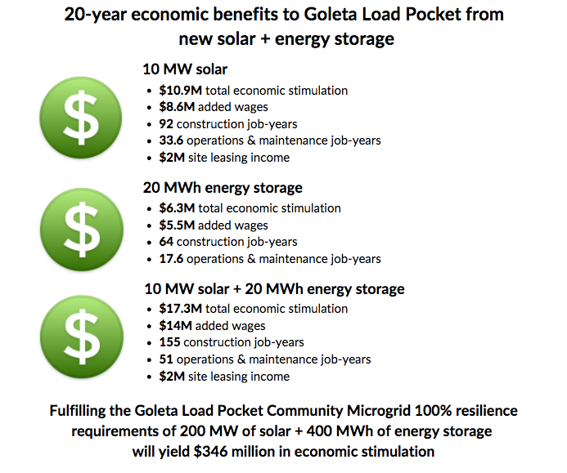
Greenbark will create significant economic benefits to the local community
Economic benefits to the GLP from new solar + energy storage
Greenbark (120 MWh energy storage)
$37.8M total economic stimulation
$33M added wages
384 construction job – years
105.6 operations & maintenance job – years
These results were calculated using the Clean Coalition's 20-year economic benefit study, which was developed using the National Renewable Energy Laboratory’s (NREL) Jobs and Economic Development Impact (JEDI) models.
Clean Coalition’s 20-year economic benefit study

Slide 31
Backup slides
Backup slides
Notes:
‹#›

Slide 32
How to enable Distributed Energy Resources (DER)
How to Enable Distributed Energy Resources (DER)
Notes:
‹#›

Slide 33
How to enable Distributed Energy Resources (DER)
Adhere to science and resist irrationality.
Unleash solar on built-environments, without restriction beyond normal building & safety codes:
  Rooftops.
  Parking lots.
  Parking structures.
Enable distributed energy storage by preempting gratuitous burdens beyond normal building & safety codes:
  Battery Energy Storage Systems (BESS) are now regularly being deployed at commercial & industrial sites in sizes of 10 MWh, which require about 2,500 square feet of siting space, including room for servicing and perimeter bollards and/or fencing.
  Local BESS are often being deployed in combination with local solar in order to deliver unparalleled resilience to facilities and communities.

Slide 34
Value-of-Resilience (VOR)
Value-of-Resilience (VOR)

Slide 35
Percentage of time online for Tier 1, 2, and 3 loads for a Solar Microgrid designed for the University of California Santa Barbara (UCSB) with enough solar to achieve net zero and 200 kWh of energy storage per 100 kW solar.
Typical load tier resilience from Solar Microgrids
Percentage of total load
Tier 3 = Discretionary load, ~75% of total load
Tier 2 = Priority load, ~15% of total load
Tier 1 = Critical, life-sustaining load, ~10% of total load
Percentage of time

Slide 36
A typical diesel generator is configured to maintain 25% of the normal load for two days. If diesel fuel cannot be resupplied within two days, goodbye. This is hardly a solution for increasingly necessary long-term resilience. In California, Solar Microgrids provide a vastly superior trifecta of economic, environmental, and resilience benefits.
Diesel generators are designed for limited resilience
Percentage of total load
Tier 3 = Discretionary load, ~75% of total load
Tier 2 = Priority load, ~15% of total load
Tier 1 = Critical, life-sustaining load, ~10% of total load
Percentage of time

Slide 37
Value-of-Resilience (VOR) details
VOR123
VOR123 is the value-of-resilience (VOR) from Solar Microgrids methodology that the Clean Coalition has developed to normalize VOR across all types of facilities & geographies. The VOR normalization is founded in tiering loads into three categories: Tier 1 (critical), Tier 2 (priority), and Tier 3 (discretionary). Since each Tier has its own resilience requirement and VOR, this methodology is called VOR123.
VOR123 webinar
https://clean-coalition.org/news/webinar-valuing-resilience-solar-microgrids-thursday-5-nov-2020/
Notes:
‹#›

