Slide 1
Core principles for a local-first DSO framework
Ben Schwartz
Policy Director
626-232-7573 mobile
ben@clean-coalition.org
8 May 2026

Slide 2
Clean Coalition (non-profit)
Mission
To accelerate the transition to renewable energy and a modern grid through
technical, policy, and project development expertise.
Renewable Energy End-Game
100% renewable energy; 25% local, interconnected within the distribution grid and ensuring resilience without dependence on the transmission grid; and 75% remote, fully dependent on the transmission grid for serving loads.
Notes:
2

Slide 3
A DSO must manage more than energy balancing
Service | Key to Delivering Service
Energy Balancing | Capacity of real power (W)
Voltage Balancing | Location of reactive power (VAr)
Frequency Balancing | Speed of sourcing or sinking real power (W)
The Duck Curve Chart only addresses Energy Balancing, but Inverter-Based Distributed Energy Resources (IBDER) can provide unparalleled balancing of all three dimensions.
Notes:
3

Slide 4
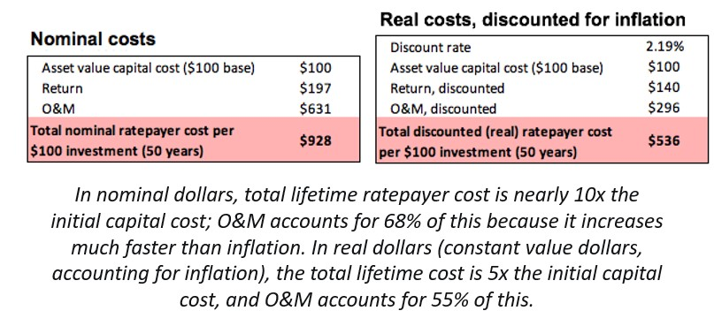
Rising grid costs make local optimization essential
Transmission Access Charges (TAC): These are volumetric ($/kWh) charges assessed to customers to recover costs of historical and present investments in transmission infrastructure.
  The chart below shows that the average TAC rate in the IOU service territories has more than tripled over the last 11 years.
  Since 2008, the IOU’s base annual Transmission Revenue Requirement (TRR) has increased from $4.6 billion to $21 billion.
Future Transmission: CAISO estimates that $30 billion in transmission capex will be needed over the next 20 years (for the high-voltage system only, not including low-voltage).
The upfront capital cost of a transmission project is only 10% the full cost in nominal dollars shouldered by the ratepayers when considering profit and O&M over 50-year transmission depreciation schedules.
2025 TAC (wholesale rates)
PG&E | $0.037/kWh
SCE | $0.0153/kWh
SDG&E | $0.066/kWh
Notes:
https://docs.cpuc.ca.gov/PublishedDocs/Published/G000/M503/K138/503138442.PDF - $4.6 to $21 billion (RESOLUTION E-5252)
4

Slide 5
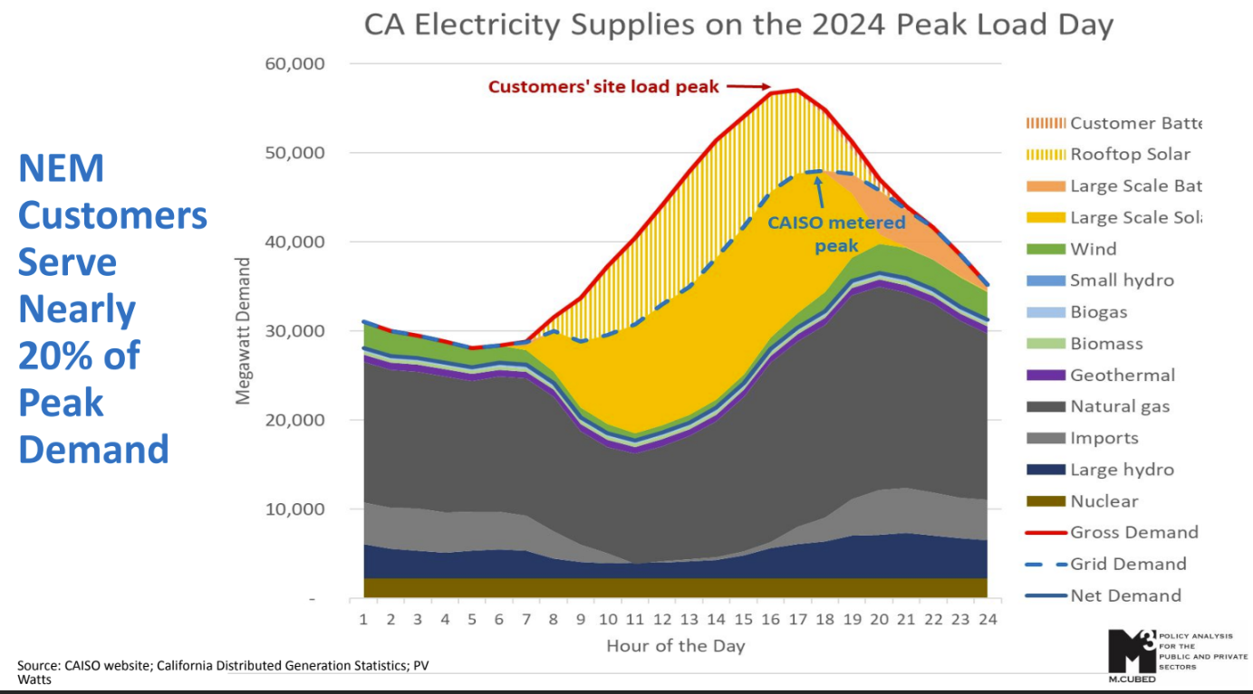
Significant BTM capacity already exists

Slide 6
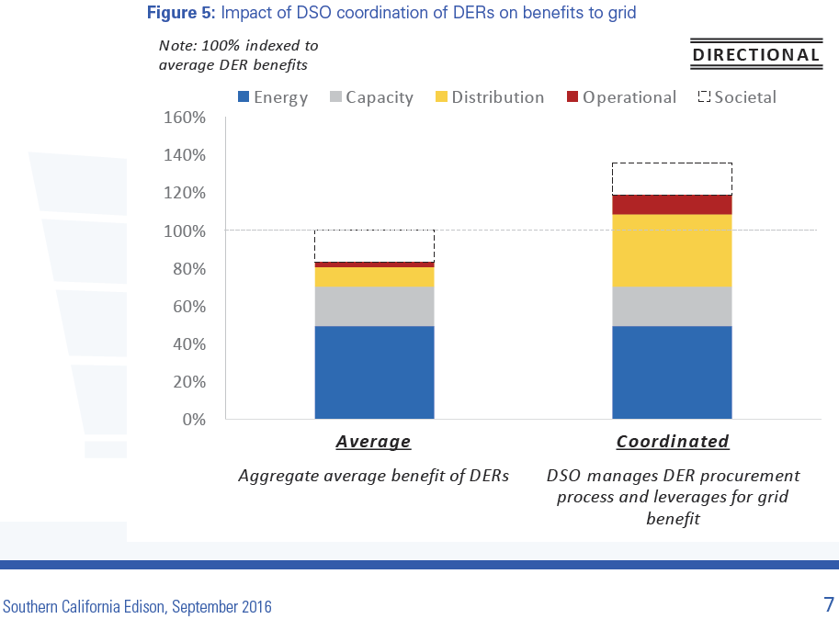
A well-implemented DSO is an affordability solution
These conditions require a distribution-level operator whose incentives are aligned with local optimization, DER participation, and avoided infrastructure cost.

Slide 7
Designing a Local-First DSO
A DSO should be designed to optimize the local grid first.
Its role should be to balance local supply and demand to the maximum extent feasible before relying on upstream imports or exports by:
Using DER to provide voltage, frequency, resilience, and other local reliability services.
Maximizing utilization of existing infrastructure through non-wires alternatives.
Supporting a local market structure that creates transparent, bankable value streams for DER.
Managing external grid interactions at the T-D interface.
The DSO’s financial incentives should primarily be aligned with speedy interconnection, timely energization, efficient DER operation, and avoided infrastructure costs.

Slide 8
Building an Effective DSO
The framework should preserve a clear boundary between distribution optimization and bulk-system dispatch.
DER should be compensated for local energy, voltage/frequency support, congestion relief, deferred T&D investments, and contributions to local fossil peaker plants retirements.
The DSO should use open-access procurement or market mechanisms, not bilateral opaque utility discretion.
The DSO should operate grid-level DERMS and coordinate with third-party and CCA edge DERMS through open, interoperable interfaces.
The DSO should be evaluated on local balancing, avoided infrastructure cost, interconnection speed, and DER participation.
  Utility earnings should be tied to performance outcomes, not capital deployment alone.
The DSO framework should minimize conflicts of interest between local grid optimization and capital incentives tied to upstream infrastructure.

Slide 9
DSO Valuation: Making Local Value Bankable
A DSO cannot function if local value is acknowledged in theory but not compensated in practice.
Existing frameworks including LNBA/ACC recognize that DER have locational value, but do not address the full value stack for a resource deployed in a particular location.
  The ACC focuses on generic system avoided cost value that does not incorporate future benefits from reduced load, congestion, and transmission requirements.
  LNBA has often been implemented in a way that is too coarse and planning-oriented, making it insufficient as a bankable operational value framework for a true DSO.
A DSO should work with applicants and resource owners to optimize a value stack that maximizes ratepayer benefits.
Preventing double compensation is important, but it should not become an excuse to erase legitimate, distinct value streams such as local congestion relief, avoided distribution upgrades, voltage support, flexibility, and resilience-related system benefits.

Slide 10
DSO-Enabled Microgrids
The DSO should be allowed to identify substation areas where aggregating DER into a future Community Microgrid configuration creates measurable local reliability & resilience value.
  The Commission has approved Substation-level Microgrid projects before, such as the Calistoga Substation Microgrid project.
The valuation framework should be able to recognize that value before the full portfolio is completely built out to properly incentivize resource deployments.
  Grid forming and black start capabilities are required for a Community Microgrid. Both are project cost drivers that could be properly incentivized in recognition of the value of resilience.

Slide 11
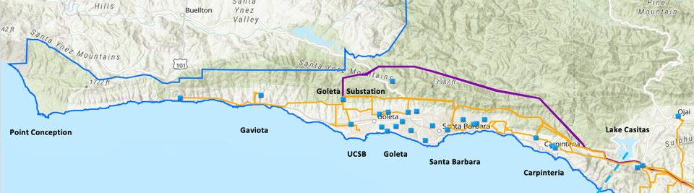
GLP Community Microgrid as a DSO Use Case
The Goleta Load Pocket (GLP) demonstrates the need for DER-driven reliability and resilience
GLP spans 70 miles of California coastline, from Point Conception to Lake Casitas, encompassing the cities of Goleta, Santa Barbara (including Montecito), and Carpinteria.
GLP is highly transmission-vulnerable and disaster-prone (fire, landslide, earthquake).
200 megawatts (MW) of solar and 400 megawatt-hours (MWh) of energy storage will provide 100% protection to GLP against a complete transmission outage (“N-2 event”).
  200 MW of solar is equivalent to about 5 times the amount of solar currently deployed in the GLP and represents about 25% of the energy mix.
  Multi-GWs of solar siting opportunity exists on commercial-scale built-environments like parking lots, parking structures, and rooftops; and 200 MW represents about 7% of the technical siting potential.
  Other resources like energy efficiency, demand response, and offshore wind can significantly reduce solar+storage requirements.

Slide 12
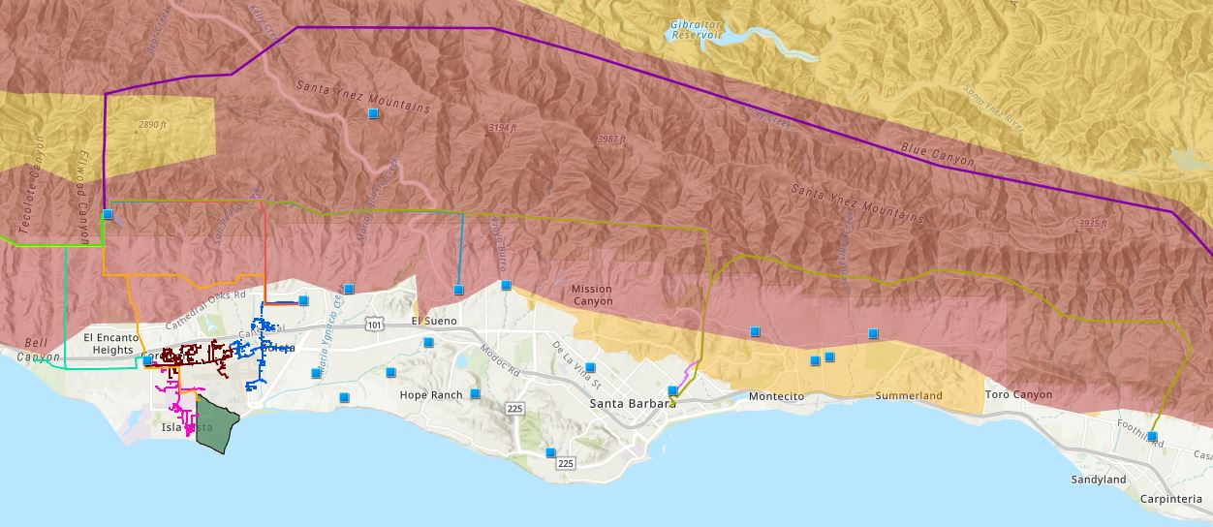

Core load area of the GLP
Legend
Feeder #4157
Feeder #4169
220 kV Transmission
Tier 3 Fire Threat
16kV Gladiola Feeder
Feeder #3556
Feeder #4227
Santa Barbara Airport
Tier 2 Fire Threat
16kV Gaucho Feeder
Feeder #4311
Feeder #3565
Substations
UCSB
16kV Professor Feeder
Feeder #3559

Slide 13
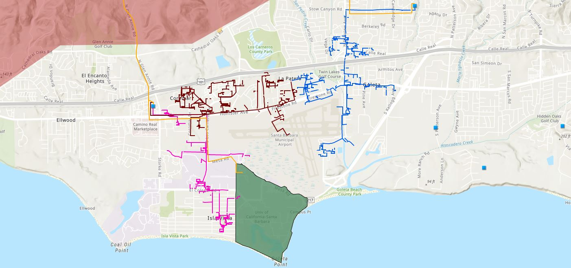








Target 66kV feeder serves critical GLP loads
Bella Battery Energy Storage Project (120 MWh)
Direct Relief (Solar Microgrid)
Vegas Substation
Dos Pueblos High School (Solar Microgrid)
Goleta Energy Storage Project
(240 MWh)
SB Airport
Fire Station # 8
Ellwood Gas Peaker Plant
Isla Vista Substation
UCSB
Fire Station # 17
Goleta Sanitary District
Legend
16kV Gladiola Feeder
University of California Santa Barbara
Goleta Valley Cottage Hospital
66 kV Feeder #4311
16kV Gaucho Feeder
Dos Pueblos High School
Direct Relief
Substations
16kV Professor Feeder
Fire Stations
Deckers
Tier 3 Fire Threat
Santa Barbara Airport
Goleta Sanitary District
Planned Battery Energy Storage

Slide 14
Target 66kV feeder grid area block diagram
Goleta Substation (220-to-66kV)
66kV distribution feeder #4311 with multiple branches
Vegas Substation (66-to-16kV)
Goleta Substation has eight feeders, seven 66 kV & one 16 kV, that serve the entire GLP
Fire Station #8
Direct Relief
+ Solar Microgrid
San Marcos
+ Solar Microgrid
66kV underground interconnection
Tier 2 & 3 facilities
Dos Pueblos
+ Solar Microgrid
Tier 2 & 3 facilities
Karl Storz + Solar Microgrid
GridStor BESS
(240 MWh)
City of Goleta
+ Solar
Isla Vista Substation (66-to-16kV)
Deckers
+ Solar
Goleta Cottage Hospital
Ellwood Gas Peaker Plant
Greenbark BESS
(120 MWh)
Tier 2 & 3 facilities
SBA (runway lights & ATC)
Diagram Elements
66 kV Distribution Feeder #4311
16 kV Gladiola Feeder
16 kV Gaucho Feeder
16 kV Professor Feeder
16 kV Los Carneros Feeder
16 kV Ace Feeder
16 kV Storke Feeder
Planned Battery Energy Storage
Ellwood Gas Peaker Plant
Grid isolation switch (open, closed)
Smart meter switch (open, closed)
Fire Station #17
SBA (Main Terminal)
Costco
+ Solar
Goleta Sanitary District
UCSB
+ Solar

Slide 15
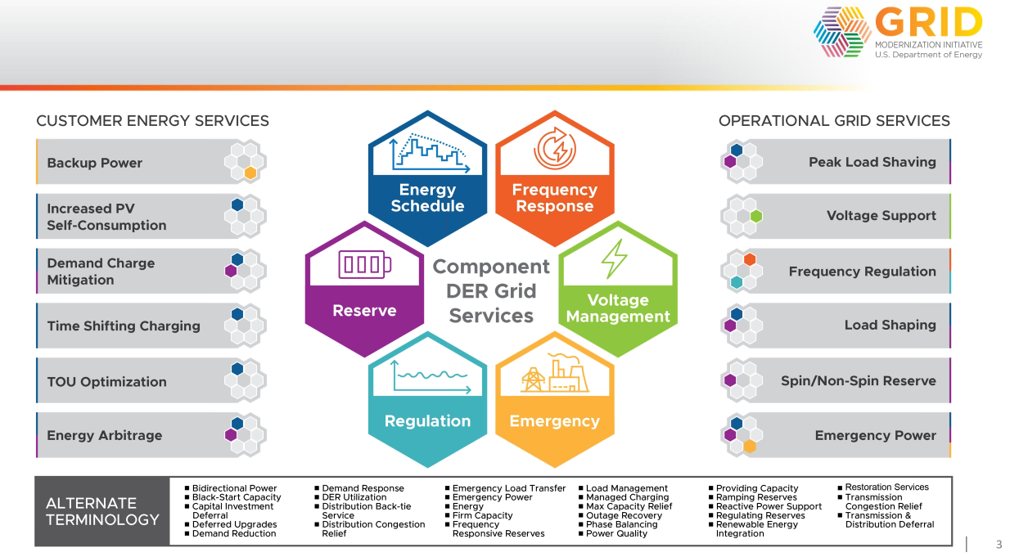
Grid services that can be provided by DER
**Spin/Non-Spin Reserve is likely not critical at the distribution level**

Slide 16
Questions?
Any questions?
Email: ben@clean-coalition.org

