Slide 1

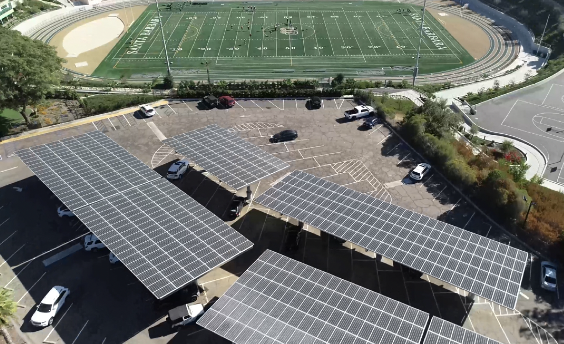
Careers in Clean Local Energy
Craig Lewis
Executive Director
Clean Coalition
craig@clean-coalition.org
9 September 2026

Slide 2
Clean Coalition (nonprofit)
Mission
To accelerate the transition to renewable energy and a modern grid through
technical, policy, and project development expertise.
Renewable Energy End-Game
100% renewable energy; 25% local, interconnected within the distribution grid and ensuring resilience without dependence on the transmission grid; and 75% remote, fully dependent on the transmission grid for serving loads.
Notes:
2

Slide 3
Clean Local Energy stakeholders
Municipalities
Property Owners
Policymakers
Residents
8 key stakeholders
Utilities
Philanthropic
Funders
Solution Providers
Financiers

Slide 4
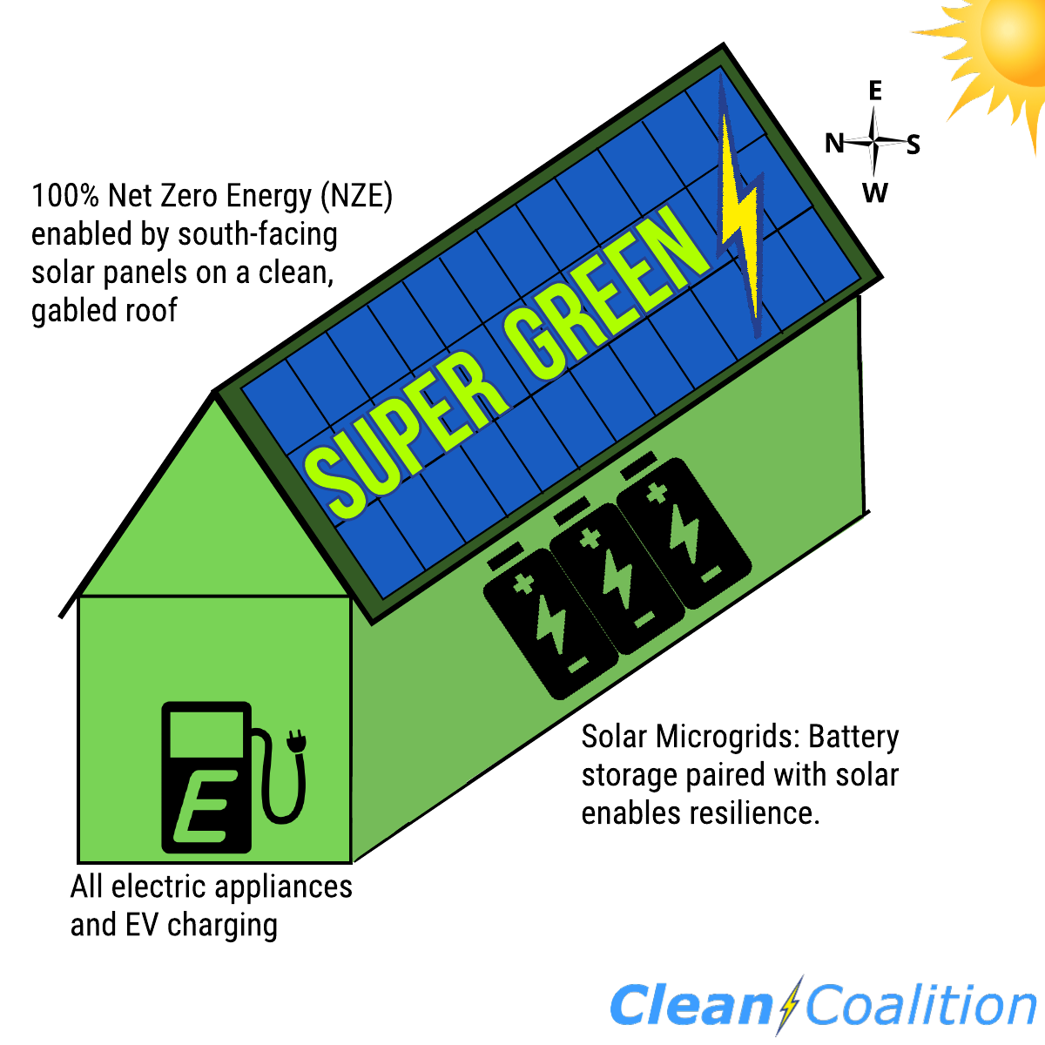
Super Green Building
100% Electric: No gas service to the home and ideally an all-EV household.
Net Zero Energy (NZE): Onsite solar energy production at least equals the annual energy consumption across the premise, including to cover home EV charging.
Solar Microgrid: Combines a battery to the solar for economic optimization and achieving unparalleled energy resilience.

Slide 5
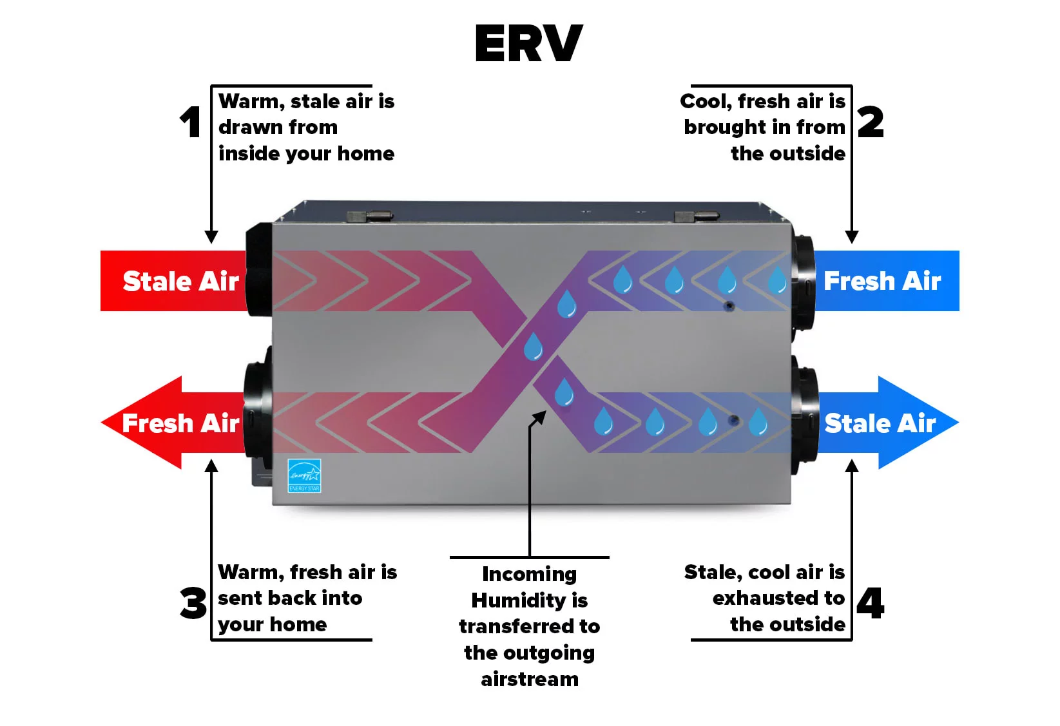
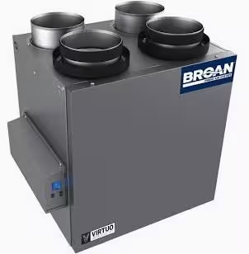
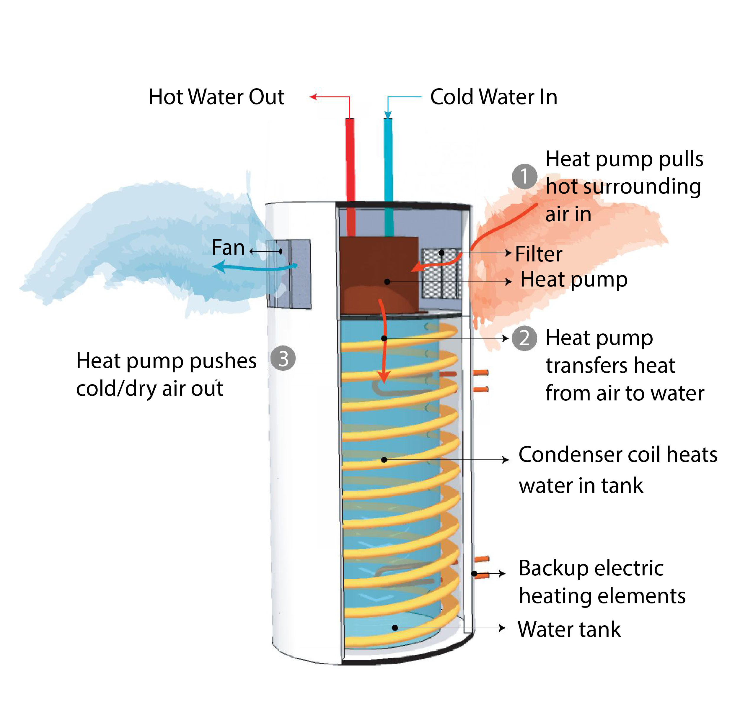
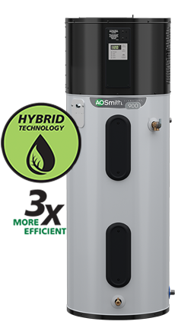
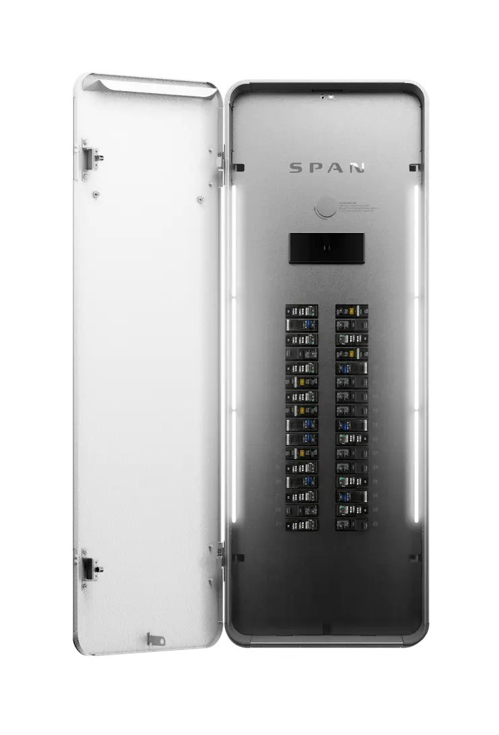
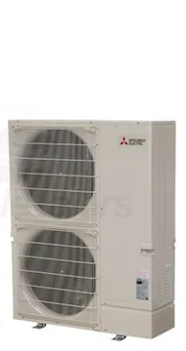

Super Green: 100% Electric
Specifications
Mechanical and Plumbing
  Heat Pump HVAC
  Heat Pump Water Heater
  ERV: Energy Recovery Ventilator
  E-Fireplace: Napoleon Alluravision 60” [Optional]
  Heat Pump Pool Water Heater [Optional]
Electrical
  LED Light Bulbs
  Occupancy/Vacancy Sensors
  Dimming Switches
  Span Panel [Optional]
Notes:
Sealed Ducting, No Flex Duct (G90 Zinc) w/ R6 Insulation
Wall and Ceiling Registers - Titus

Slide 6



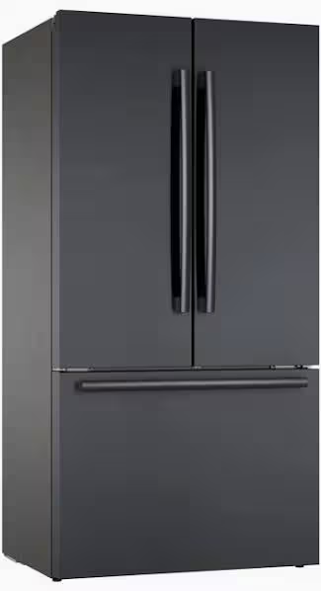
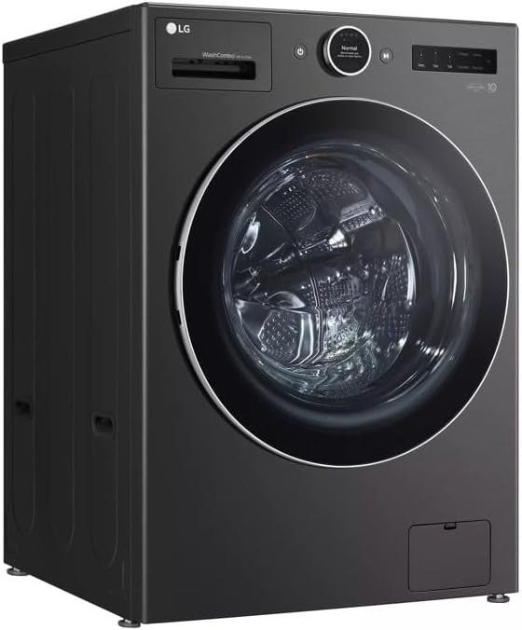
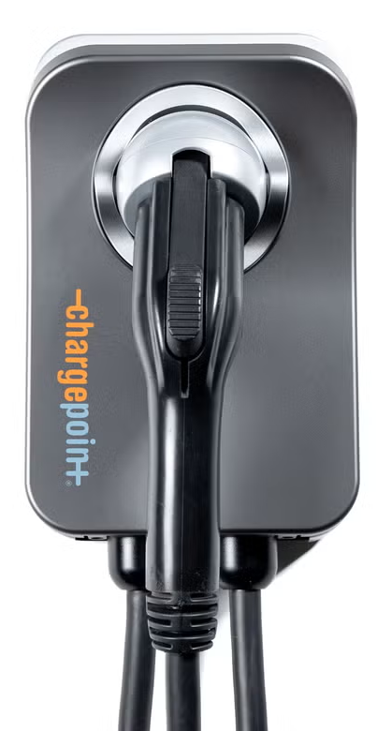
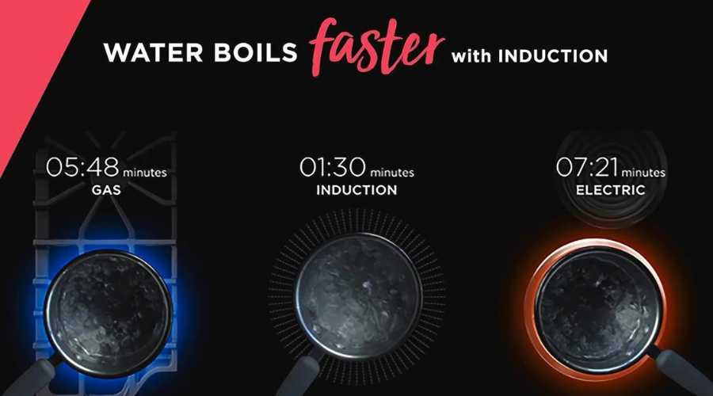
Super Green: 100% Electric
Appliances
  Induction Cooktop
  EnergyStar Refrigerator
  EnergyStar Dishwasher
  EnergyStar Washing Machine
  Energy Efficient Microwave
  Heat Pump Dryer
  EV Charging Outlet and/or Charger
  (Level 2 capable)
Energy Efficient
100% Electric
Induction Cooktops

Slide 7
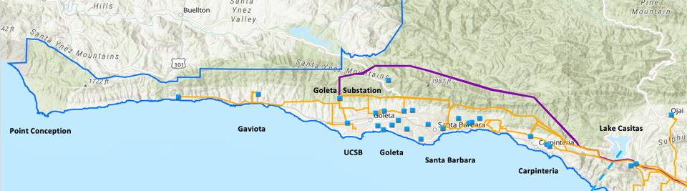
Goleta Load Pocket (GLP)
The GLP is the perfect opportunity for a comprehensive Community Microgrid
GLP spans 70 miles of California coastline, from Point Conception to Lake Casitas, encompassing the cities of Goleta, Santa Barbara (including Montecito), and Carpinteria.
GLP is highly transmission-vulnerable and disaster-prone (fire, landslide, earthquake).
200 megawatts (MW) of solar and 400 megawatt-hours (MWh) of energy storage will provide 100% protection to GLP against a complete transmission outage (“N-2 event”).
  200 MW of solar is equivalent to about 5 times the amount of solar currently deployed in the GLP and represents about 25% of the energy mix.
  Multi-GWs of solar siting opportunity exists on commercial-scale built-environments like parking lots, parking structures, and rooftops; and 200 MW represents about 7% of the technical siting potential.
  Other resources like energy efficiency, demand response, and offshore wind can significantly reduce solar+storage requirements.

Slide 8








Local Energy Storage enable Community Microgrids
Goleta Substation (220-to-66kV)
66kV distribution feeder #4311 with multiple branches
Vegas Substation (66-to-16kV)
Goleta Substation has eight feeders, seven 66 kV & one 16 kV, that serve the entire GLP
Fire Station #8
Direct Relief
+ Solar Microgrid
San Marcos
+ Solar Microgrid
66kV underground interconnection
Tier 2 & 3 facilities
Dos Pueblos
+ Solar Microgrid
Tier 2 & 3 facilities
Karl Storz + Solar Microgrid
Goleta Energy Storage Project (240 MWh)
City of Goleta
+ Solar
Isla Vista Substation (66-to-16kV)
Deckers
+ Solar
Goleta Cottage Hospital
Ellwood Gas Peaker Plant
GenOn Battery Energy Storage (120 MWh)
Tier 2 & 3 facilities
SBA (runway lights & ATC)
Diagram Elements
66 kV Distribution Feeder #4311
16 kV Gladiola Feeder
16 kV Gaucho Feeder
16 kV Professor Feeder
16 kV Los Carneros Feeder
16 kV Ace Feeder
16 kV Storke Feeder
Planned Battery Energy Storage
Ellwood Gas Peaker Plant
Grid isolation switch (open, closed)
Smart meter switch (open, closed)
Fire Station #17
SBA (Main Terminal)
Costco
+ Solar
Goleta Sanitary District
UCSB
+ Solar

Slide 9
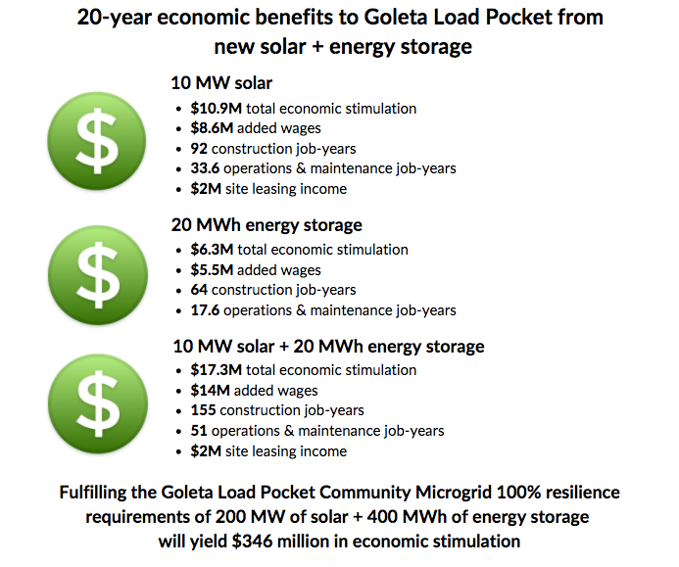
Greenbark will create significant economic benefits to the local community
Economic benefits to the GLP from new solar + energy storage
Greenbark (120 MWh energy storage)
$37.8M total economic stimulation
$33M added wages
384 construction job – years
105.6 operations & maintenance job – years
These results were calculated using the Clean Coalition's 20-year economic benefit study, which was developed using the National Renewable Energy Laboratory’s (NREL) Jobs and Economic Development Impact (JEDI) models.
Clean Coalition’s 20-year economic benefit study

Slide 10
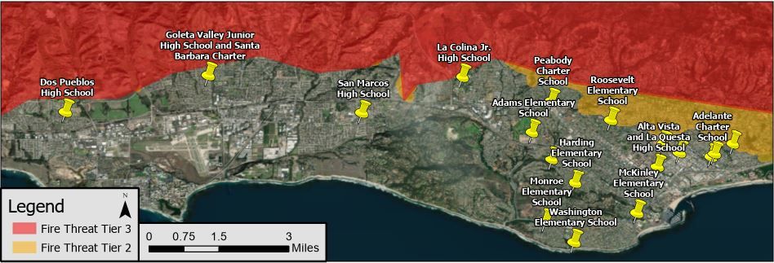
Santa Barbara Unified School District (SBUSD)
The entire Santa Barbara region is surrounded by extreme fire risk (earthquake & landslide risk too) and is extremely vulnerable to electricity grid outages.
The SBUSD is a major school district that increasingly recognizes the value-of-resilience (VOR) and has embraced the Clean Coalition’s vision to implement Solar Microgrids at a number of its key schools and other critical facilities.
SMHS is in the middle of the extensive SBUSD service area.

Slide 11
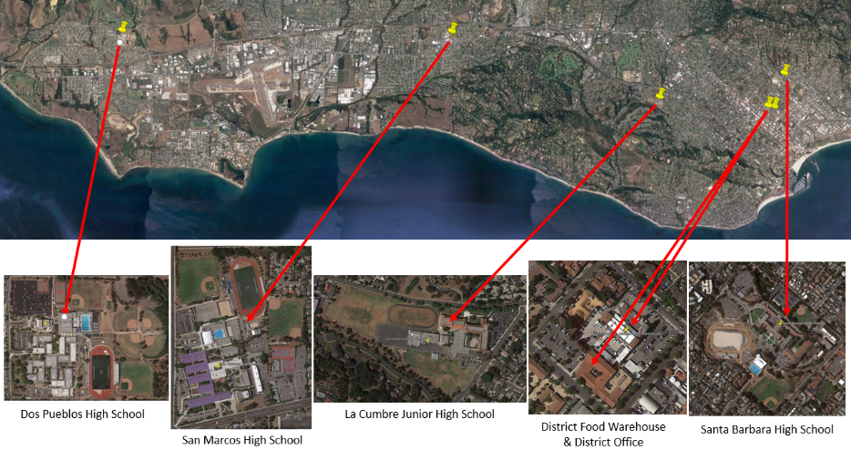
Six SBUSD Solar Microgrid sites

Slide 12
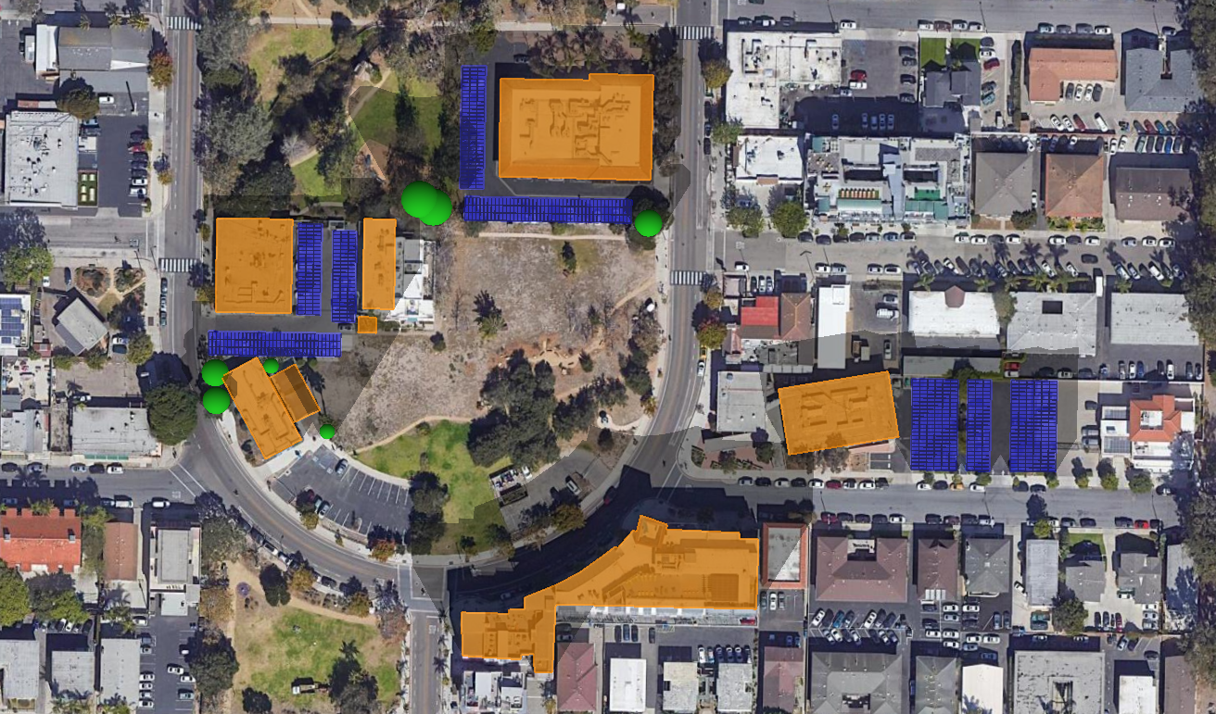






Isla Vista Community Microgrid
Isla Vista Community Microgrid
Total annual load (2022-2025 Average):
Year 1: 1,336,759 kWh
Year 10: 1,597,522 kWh
Peak load (CY 2022):
Year 1: 321 kW
Year 10: 384 kW
Solar sizing:
494 kWdc
Total annual solar generation:
Year 1: 838,610 kWh
Year 10: 801,618 kWh
BESS Sizing:
Year 1: 1,927 kW / 7,708 kWh
Year 10: 1,927 kW / 5,860 kWh
135 kWdc solar
147 kWdc solar
1,927 kW / 7,708 kWh BESS
212 kWdc solar
Potential BESS location
New FOM solar
Project boundary
Trees
Obstructions/Buildings

Slide 13
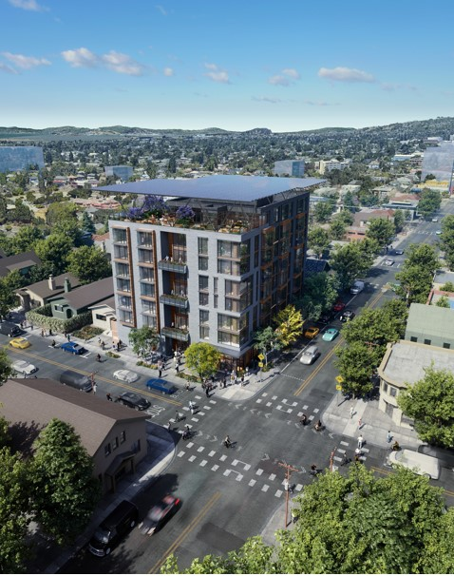
Berkeley Efficient & Resilient Mixed-Use Showcase
All-electric, 8-story, commercial and permanently affordable housing community.
65 units of 100% affordable housing with ground floor commercial offices and retail spaces.
Affordable home ownership via condominiums that provide homeownership benefits from original tenancy, with all being disadvantaged and low-income.
Net Zero Energy (NZE) building with a solar canopy covering the entire roof area, including a large rooftop patio and roof-mounted mechanical equipment for HVAC etc.
GridOptimal with the Solar Microgrid providing all energy during the 4-9pm grid-constrained period daily.
Solar Microgrid resilience ensuring indefinite resilience for the critical loads during grid outages of any duration, with significant resilience to all other loads based on solar energy availability and battery state-of-charge. Meets the full performance requirements of the CEC-recommended VOR123 value-of-resilience (VOR) methodology.

Slide 14
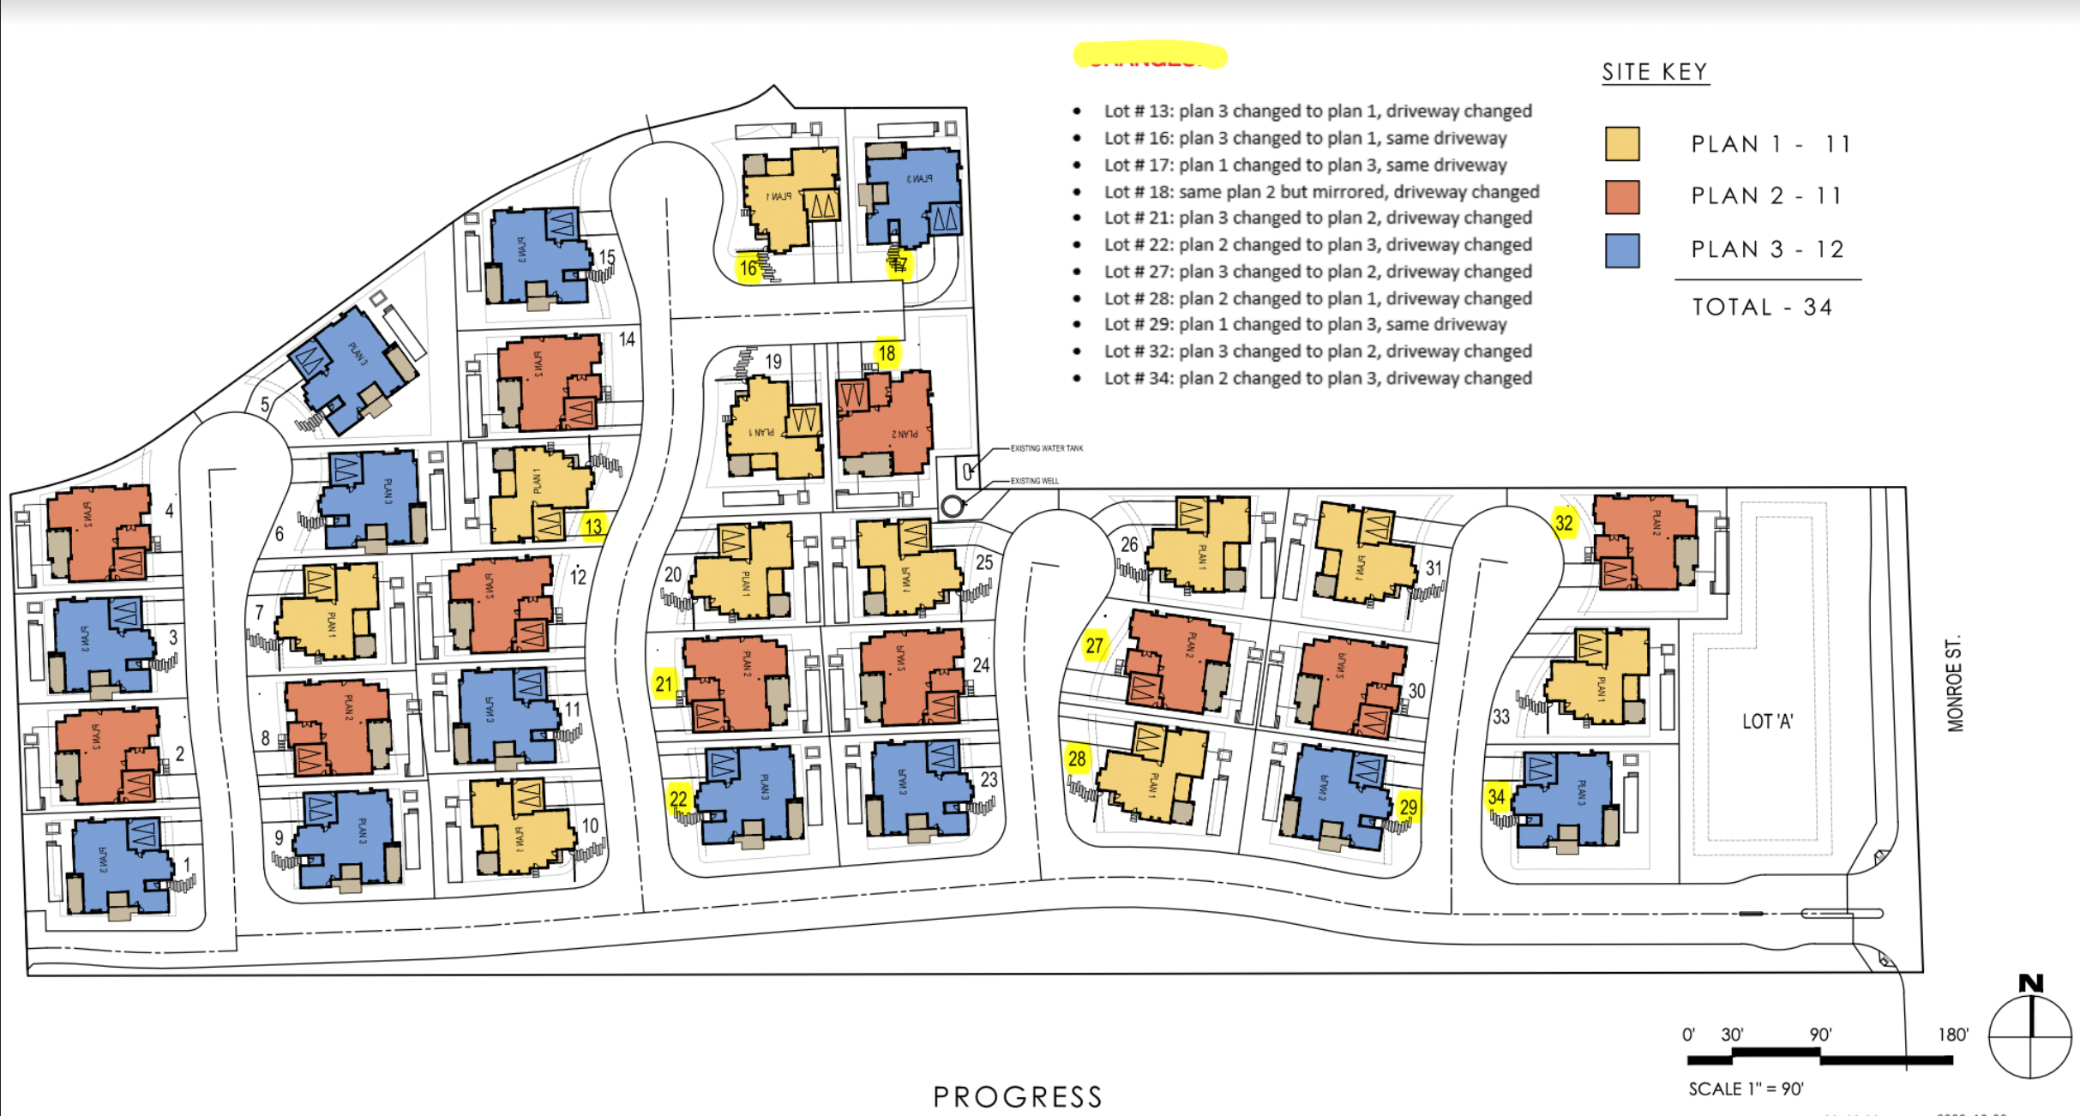
Sierra Blanca 34-home community

Slide 15
Sierra Blanca energy system layout
Legend
Average house with average Solar Microgrid:
19.25 kWdc solar
10 kWac / 26.4 kWh battery
20’x10’ battery container hosting 500 kW & 1 MWh
Private electricity grid

