Slide 1

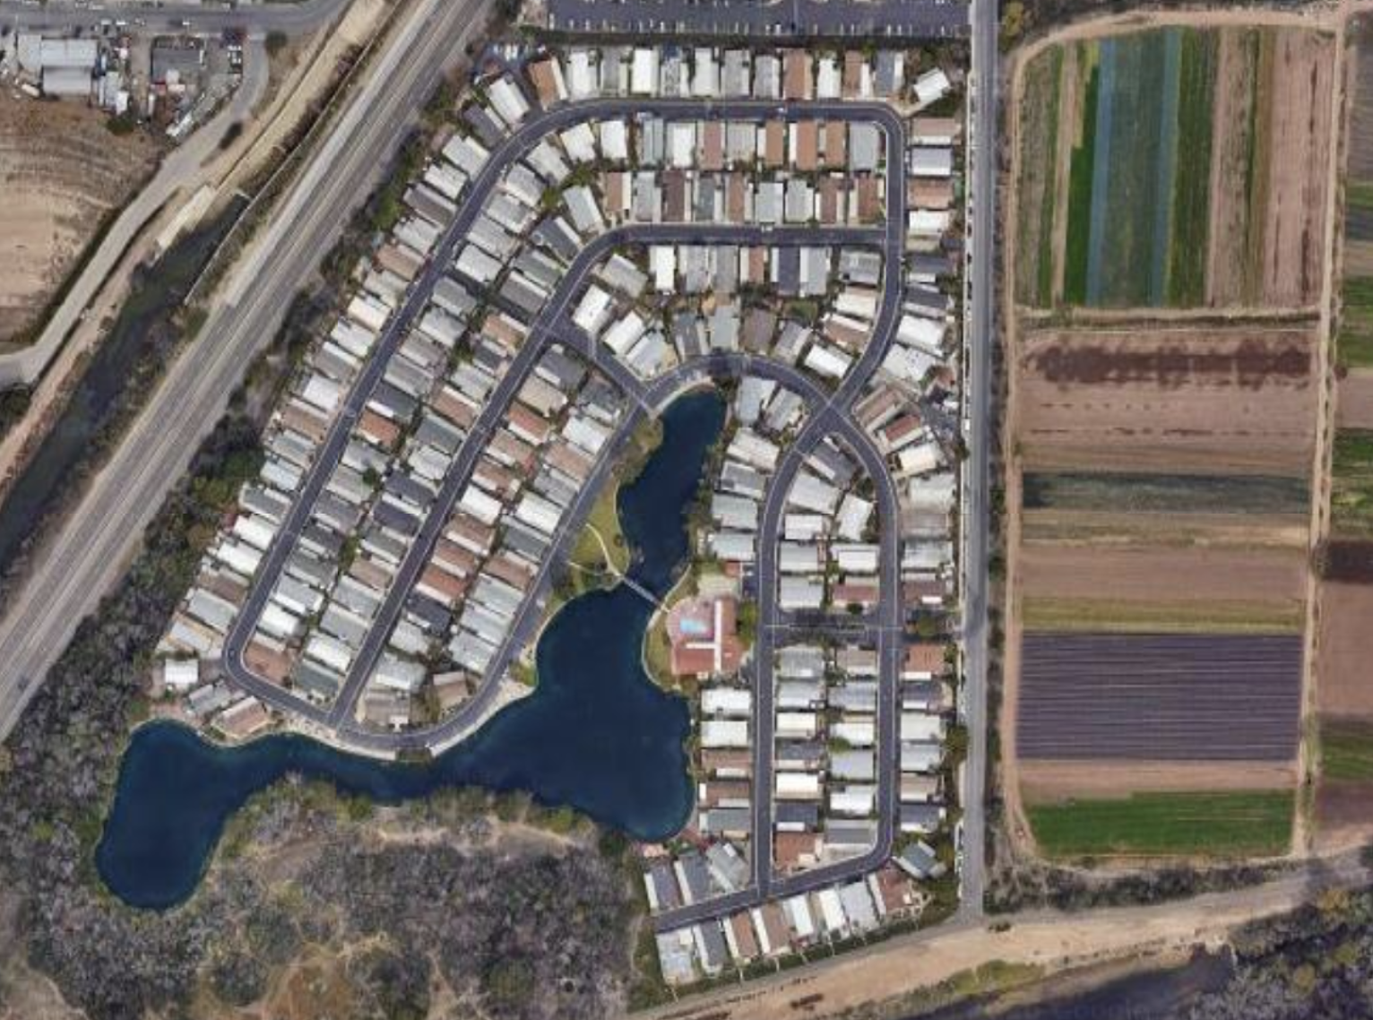
RGLM Community Microgrid
Informational Meeting
Craig Lewis
Executive Director
650-796-2353 mobile
craig@clean-coalition.org
Akshay Pagare
Director of Engineering
707-326-7785 mobile
akshay@suryapowerflow.com
Stella Symonds
Programs Associate
925-885-9224 mobile
stella@clean-coalition.org
22 Aug 2026

Slide 2
Clean Coalition (nonprofit)
Mission
To accelerate the transition to renewable energy and a modern grid through
technical, policy, and project development expertise.
Renewable Energy End-Game
100% renewable energy; 25% local, interconnected within the distribution grid and ensuring resilience without dependence on the transmission grid; and 75% remote, fully dependent on the transmission grid for serving loads.
Notes:
‹#›

Slide 3
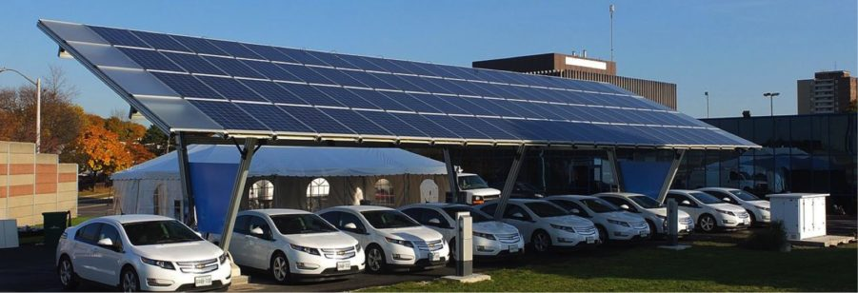
Clean Coalition Community & Solar Microgrids
Creating Groundbreaking Models
The Clean Coalition designs and stages cutting-edge Community Microgrid & Solar Microgrid projects that can be replicated in any utility service territory. By showcasing the value and feasibility of these projects, and the vast potential for siting distributed energy resources in the built environment, we’re helping proliferate clean local energy and community resilience.
Facilitating Real-World Projects
At the Clean Coalition, we base our work on concrete project experience. The projects we design highlight the regulatory and policy issues that are impeding the development of clean local energy projects, and the tools and best practices needed to overcome those barriers.
Notes:
‹#›

Slide 4


Grid Titans & Surya (developer, contractor, financier)
Grid Titans is a California based clean energy contractor specializing in engineering, procurement and construction of solar, battery storage, and microgrid installations, with a strong track record delivering large scale commercial projects.
Surya is an energy development firm founded to bring clean energy to nonprofits, municipalities, campuses, and communities. We believe energy infrastructure is community infrastructure. Every project is an opportunity to build a more resilient, equitable grid.
Notes:
‹#›

Slide 5
Overview
Background
Electrification opportunities
Community Microgrid opportunity
Solar Microgrid opportunities for individual homes
Recommendations, survey, Q&A
Notes:
‹#›

Slide 6
Overview
Background
Electrification opportunities
Community Microgrid opportunity
Solar Microgrid opportunity for individual homes
Recommendations, survey, Q&A
Notes:
‹#›

Slide 7
Benefits of a solar-driven microgrids
Economic
  Provides electricity costs savings compared to buying electricity from the utility.
  Provides value-of-resilience (VOR) compared to implementing & operating a fossil-fueled generator.
  Provides a fixed cost of electricity compared to rapidly rising utility costs.
Environmental
  Provides solar electricity, a pure renewable energy resource.
  Reduces peak usage of the grid when it is most stressed during the peak periods, which throughout California are 4-9pm.
  Eliminates energy losses associated with traversing transmission & distribution grids, typically 15%.
Resilience
  Provides 100% ride-through during grid outages of limited durations – you won’t notice when the grid goes down.
  Provides indefinite resilience for at least critical loads, with cost correlated to the percentage of load being served with 100% resilience.

Slide 8
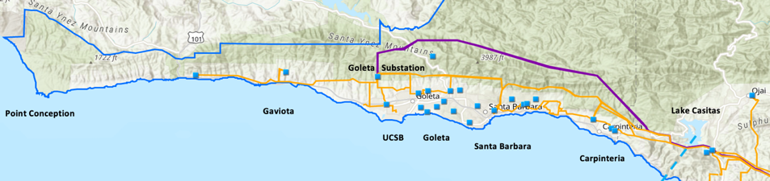
Goleta Load Pocket (GLP) & Resilience
2x 40 mile transmission lines serving the GLP
GLP is highly transmission-vulnerable and disaster-prone (fire, landslide, earthquake).
Our region faces frequent power outages, up to 8.5 per year. Our outage rate is more than three times worse than the least reliable electrical utility in the country.¹
Our region ranks second-worst in the lower 48 states for the value received by electrical service customers, measured by the Price-Reliability Index (PRI).¹
New York Times article on 18 August 2026: What if America Went Completely Dark? highlighting severe grid vulnerability to natural disasters – and human malfeasance.
Solar-driven microgrids at RGL are the key pathway to delivering resilience to the RGL community overall – and to individual homes as well.
¹ “Roadmap to Recovery: Power On.” Santa Barbara South Coast Chamber of Commerce.

Slide 9
Overview
Background
Electrification opportunities
Community Microgrid opportunity
Solar Microgrid opportunity for individual homes
Recommendations, survey, Q&A
Notes:
‹#›

Slide 10
Electrification measures
Individual homes can procure Solar Microgrids that specifically provide substantial energy cost savings and resilience at the household level, while providing carryover benefits to the overall RGLM community.
Regardless of configuration, Solar Microgrids allow the adoption of EVs and electrification of appliances without the exorbitant cost of upgrading RGLM's private grid, which is expected to otherwise cost an average of about $10,000 per home. Electrification includes:
HVAC heat pumps
hot water heat pumps
induction cooktops
electric dryers
EV charging infrastructure
On average, HVAC and hot water heat pumps are 3-4x more efficient than their gas counterparts, lowering associated energy usage by 70%. Financial incentives exist for these measures, and more are on the way to ensure that the economics are attractive.

Slide 11

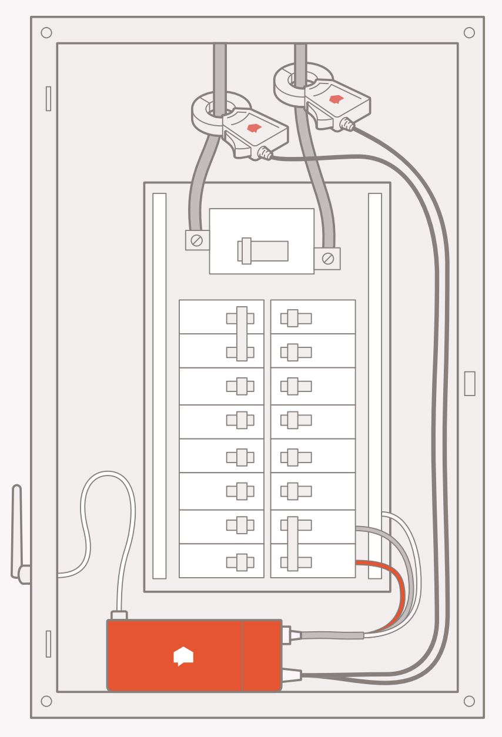
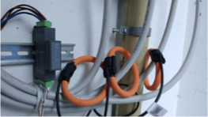
Metering via simple loop sensors

Slide 12
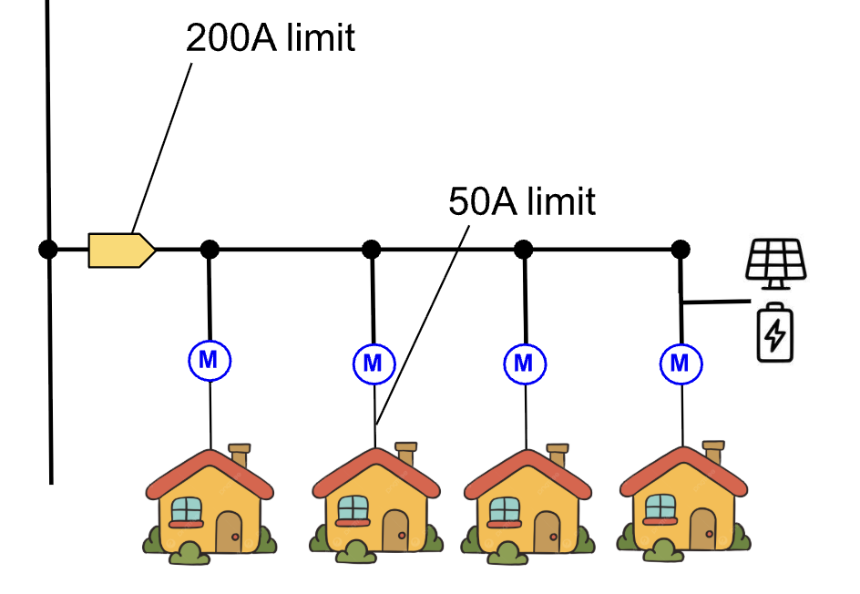
Electrical layout - Block-of-4 homes
Mobile homes are connected in blocks-of-4, with a 200A usage limit, via undergrounded feeders. Each individual home has a 50A limit, which is very easy to upgrade to 200A.
Solar & storage interconnected on a block-of-4 feeder will ensure that the 200A limit is maintained, without having to upgrade any undergrounded wiring.

Slide 13
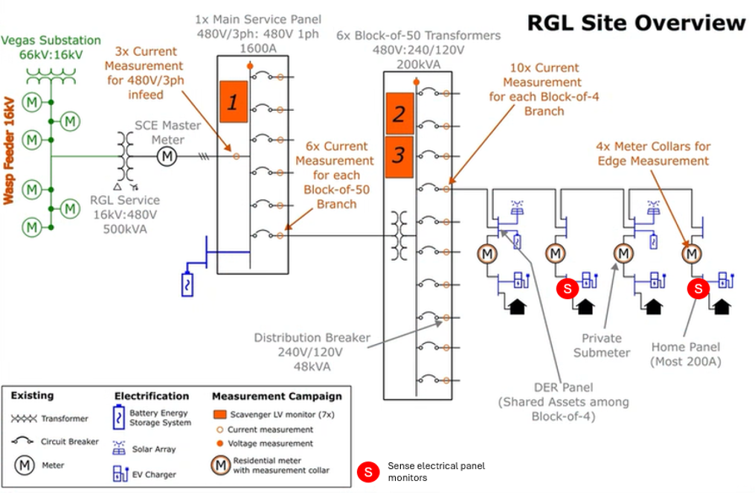
RGL Single Line Diagram

Slide 14
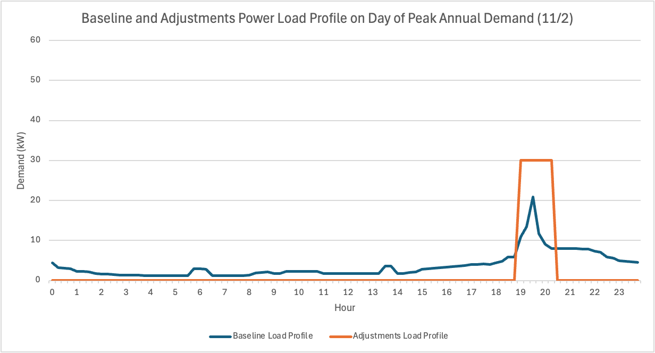
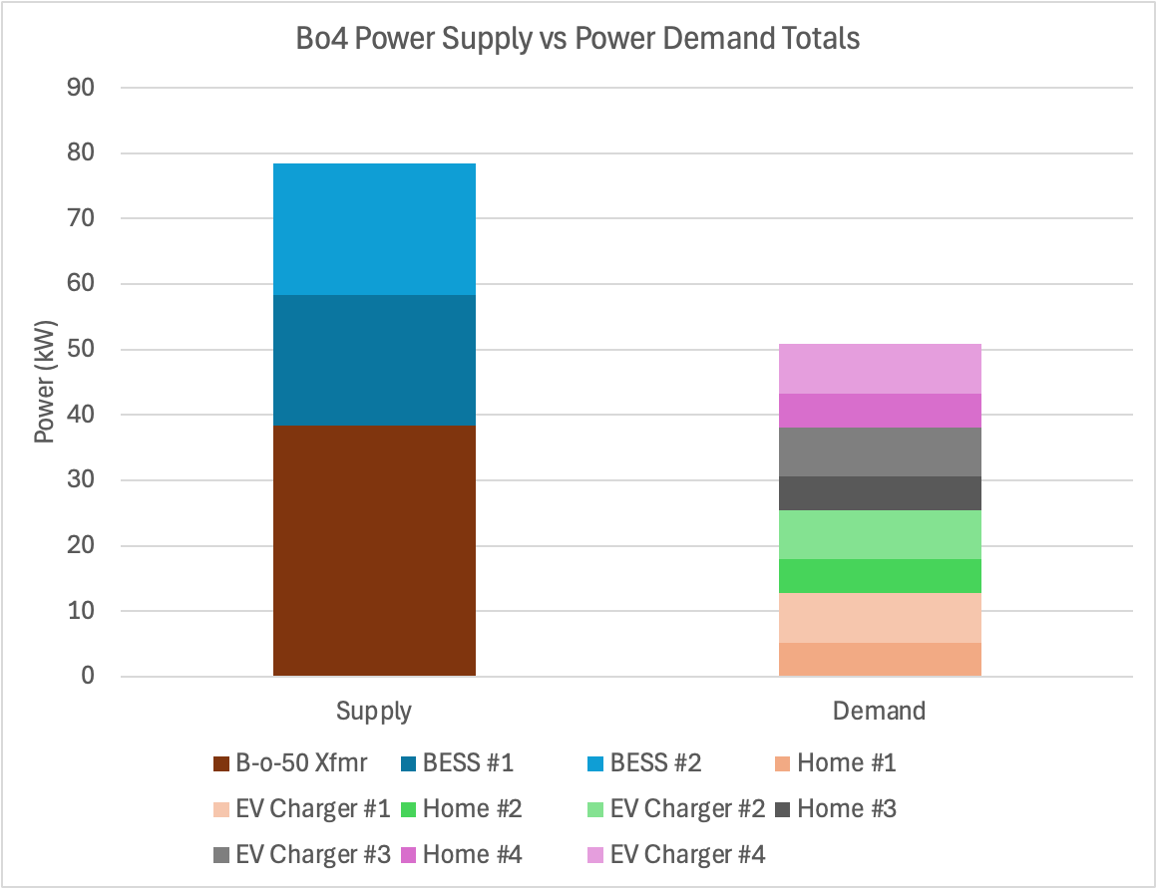
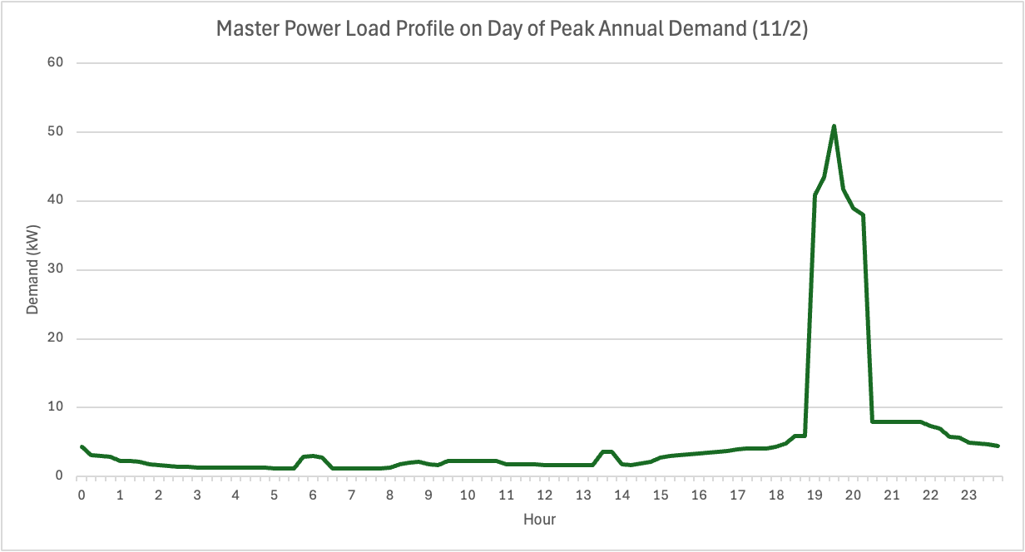
Power capacity analysis of Block-of-4 homes
The load profiles were aligned so that the Bo4’s maximum possible power demand of 51 kW would occur due to added EV loads.
A maximum of 38.4 kW of power can be supplied by the Block-of-50 (Bo50) transformer, assuming its circuit breakers are upgraded from 175A to 200A.
Each Bo4 is daisy chained together in series (see single-line-diagram on slide 3).

Slide 15
Overview
Background
Electrification opportunities
Community Microgrid opportunity
Solar Microgrid opportunity for individual homes
Recommendations, survey, Q&A
Notes:
‹#›

Slide 16
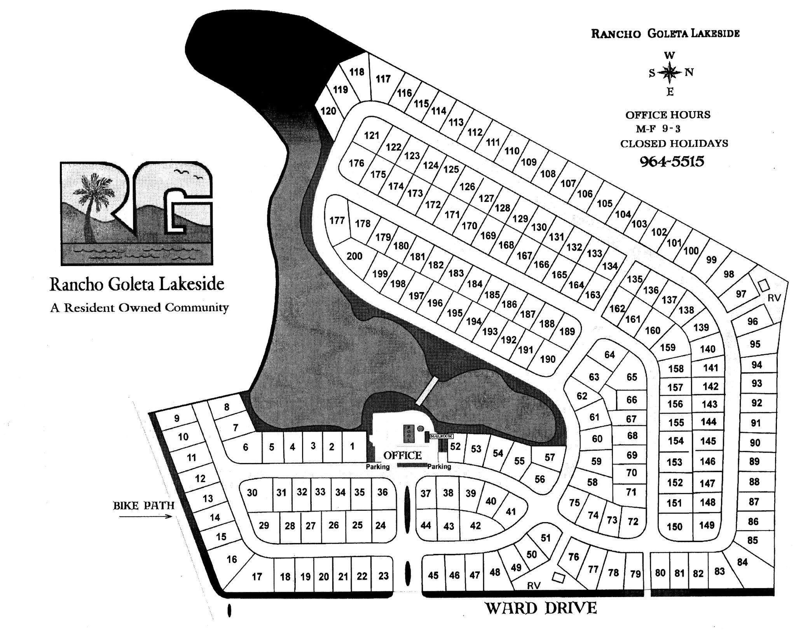
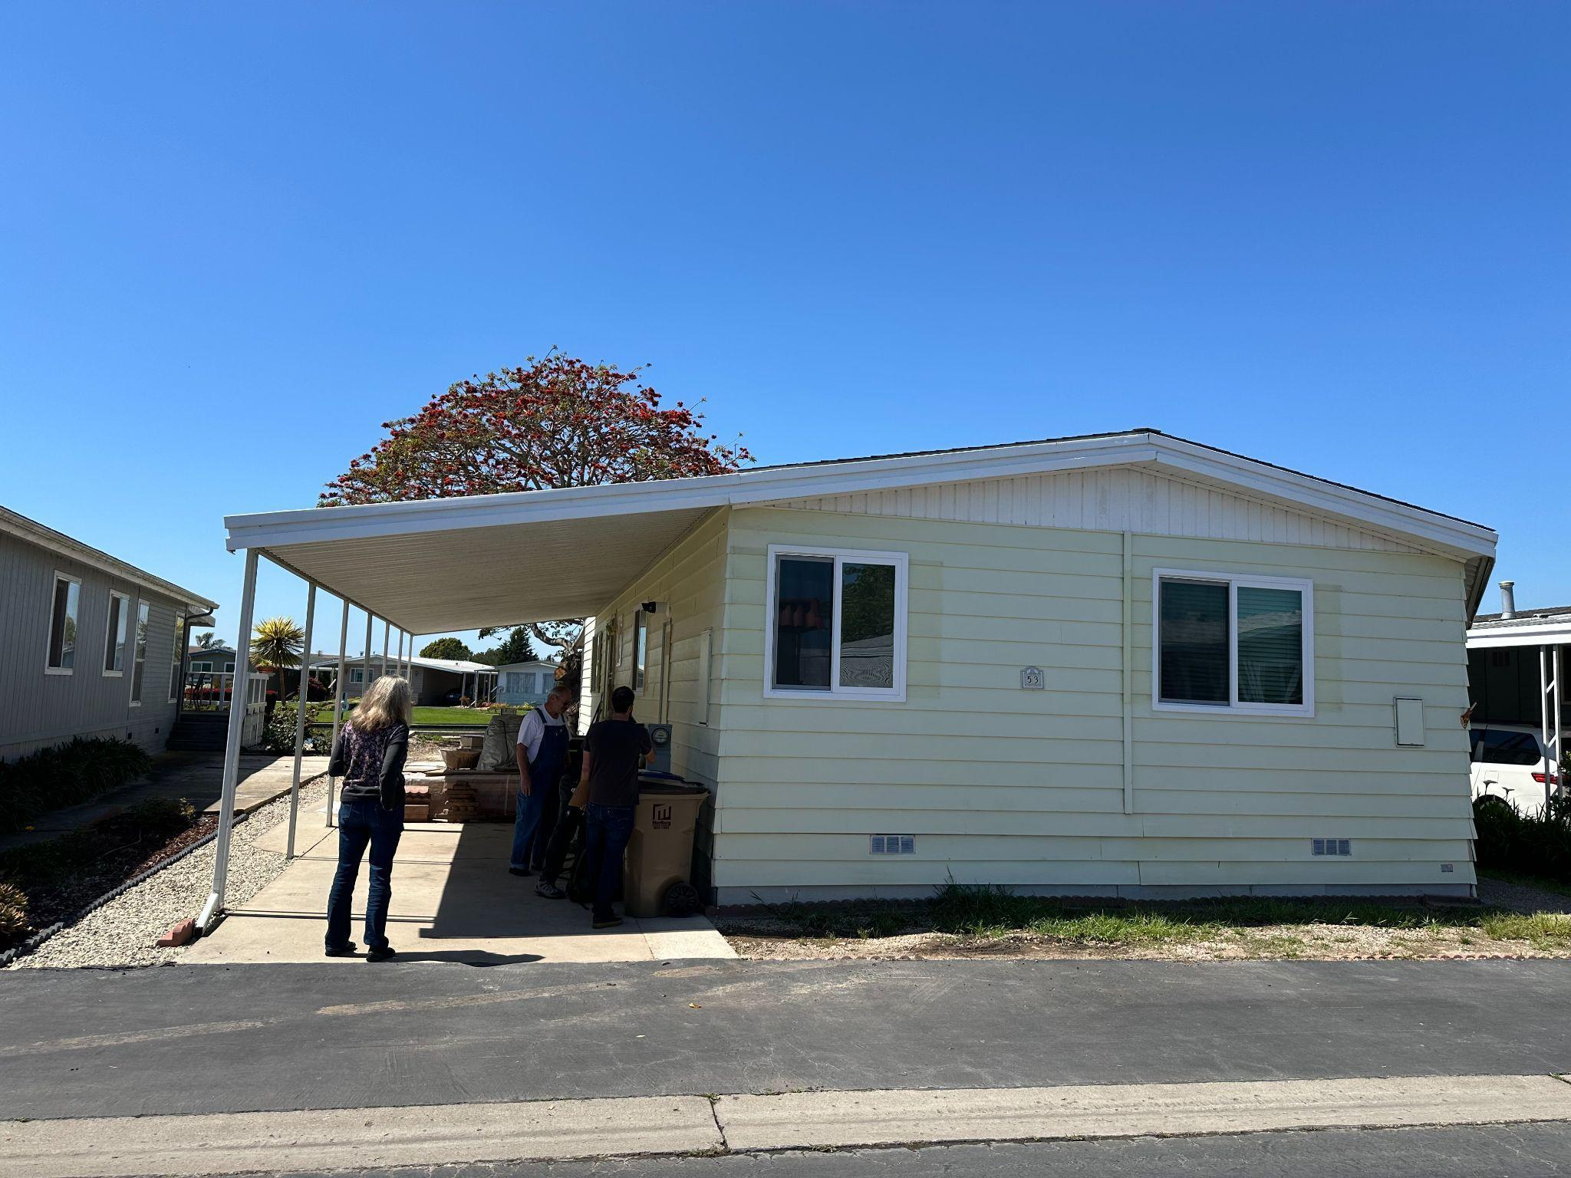
RGLM Community Microgrid opportunity
200 mobile homes, many ready for replacement, in disadvantaged area of Goleta.
Single master meter with SCE and privately submetered at each home.
Private underground distribution grid that is significantly constrained with upgrades needed to enable significant electrification, including EV adoption.
Solar to be distributed across the homes and combined with a single central battery to create a solar-driven microgrid to deliver a trifecta of economic, environmental, and resilience benefits.
Perfect opportunity to showcase the importance of Master Metering for optimizing economics from solar and resilience from microgrids.
RGLM layout of 200 mobile homes
Typical RGLM mobile home

Slide 17
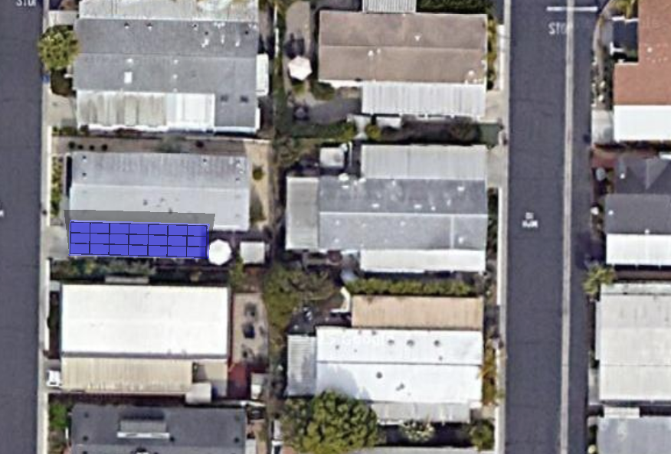

Community Microgrid solar & storage layout
Rancho Goleta Lakeside
945 Ward Dr, Santa Barbara
25 homes receive:
12.6 kWdc solar (average) via 21x 600W panels
23 kW / 27 kWh storage via 2x Tesla Powerwall 3s
Potential BESS location
New BTM solar
Notes:
CM
electrification measures - no grid upgrades needed
PPA
electricity bill
alternative - own home
costs
incentives available
clean coalition can help bring

Slide 18
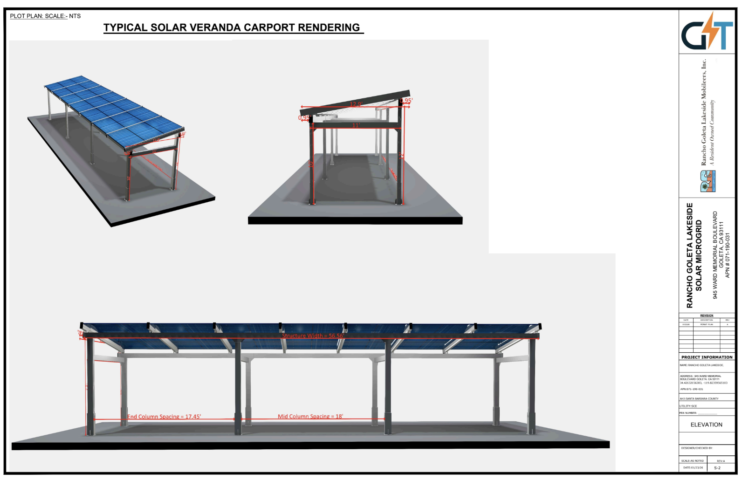
Carport solar rendering

Slide 19
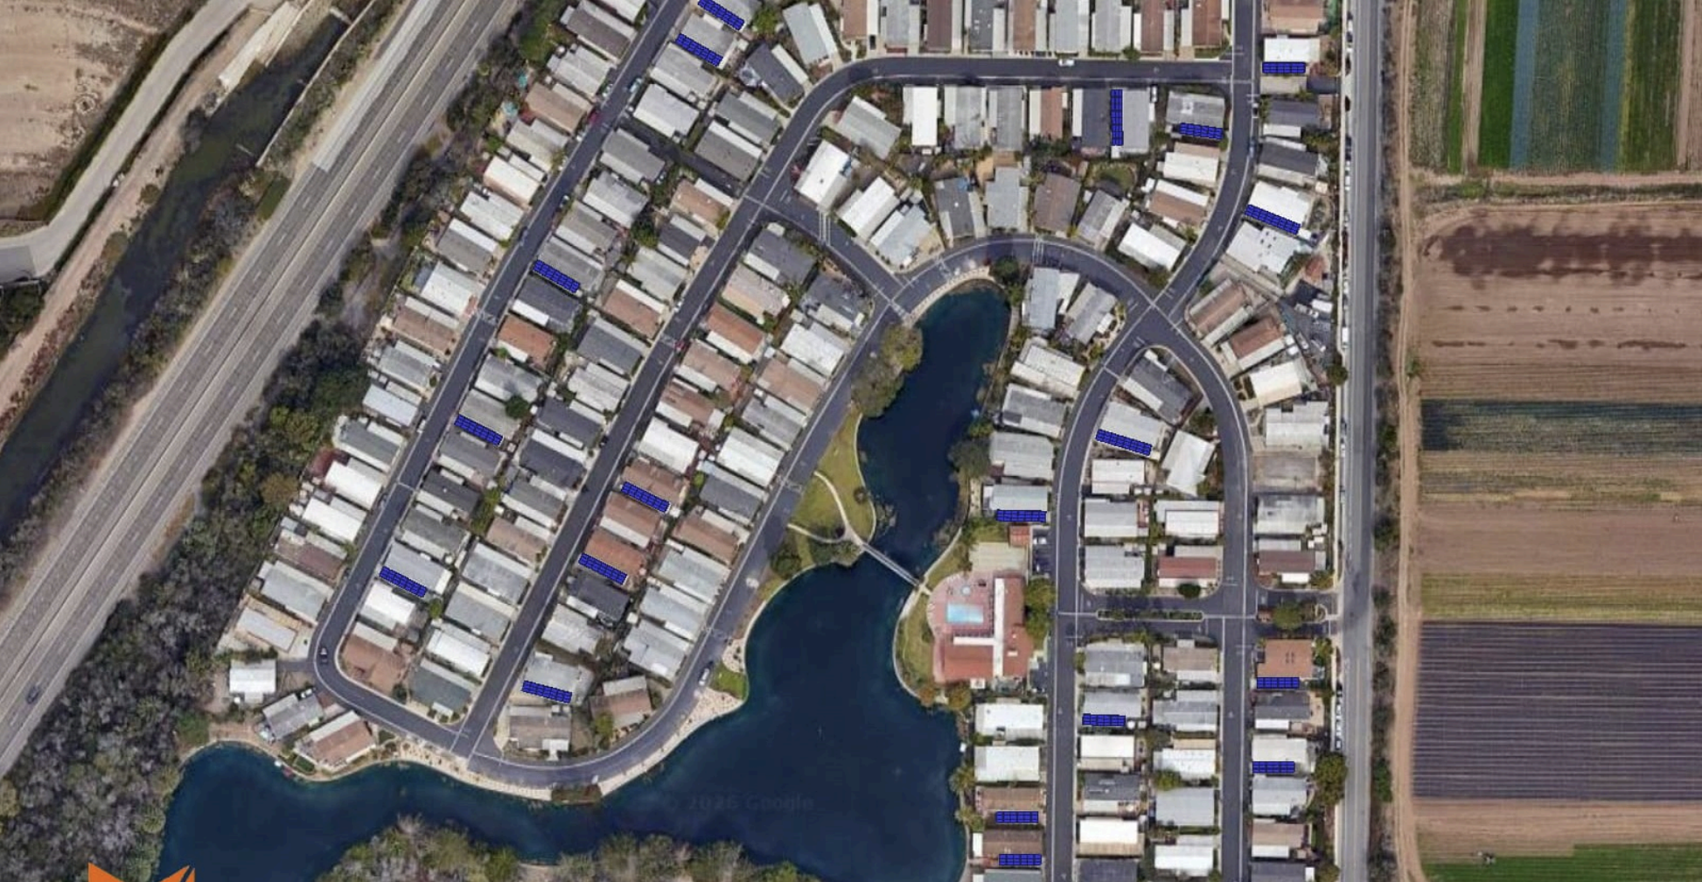
Distributed solar & storage layout
383.4 kWdc solar (78% net zero energy of all of RGLM’s electricity usage)
1,184.5 kW / 1,390.5 kWh via 50x Tesla Powerwall 3 batteries & 1x larger battery

Slide 20
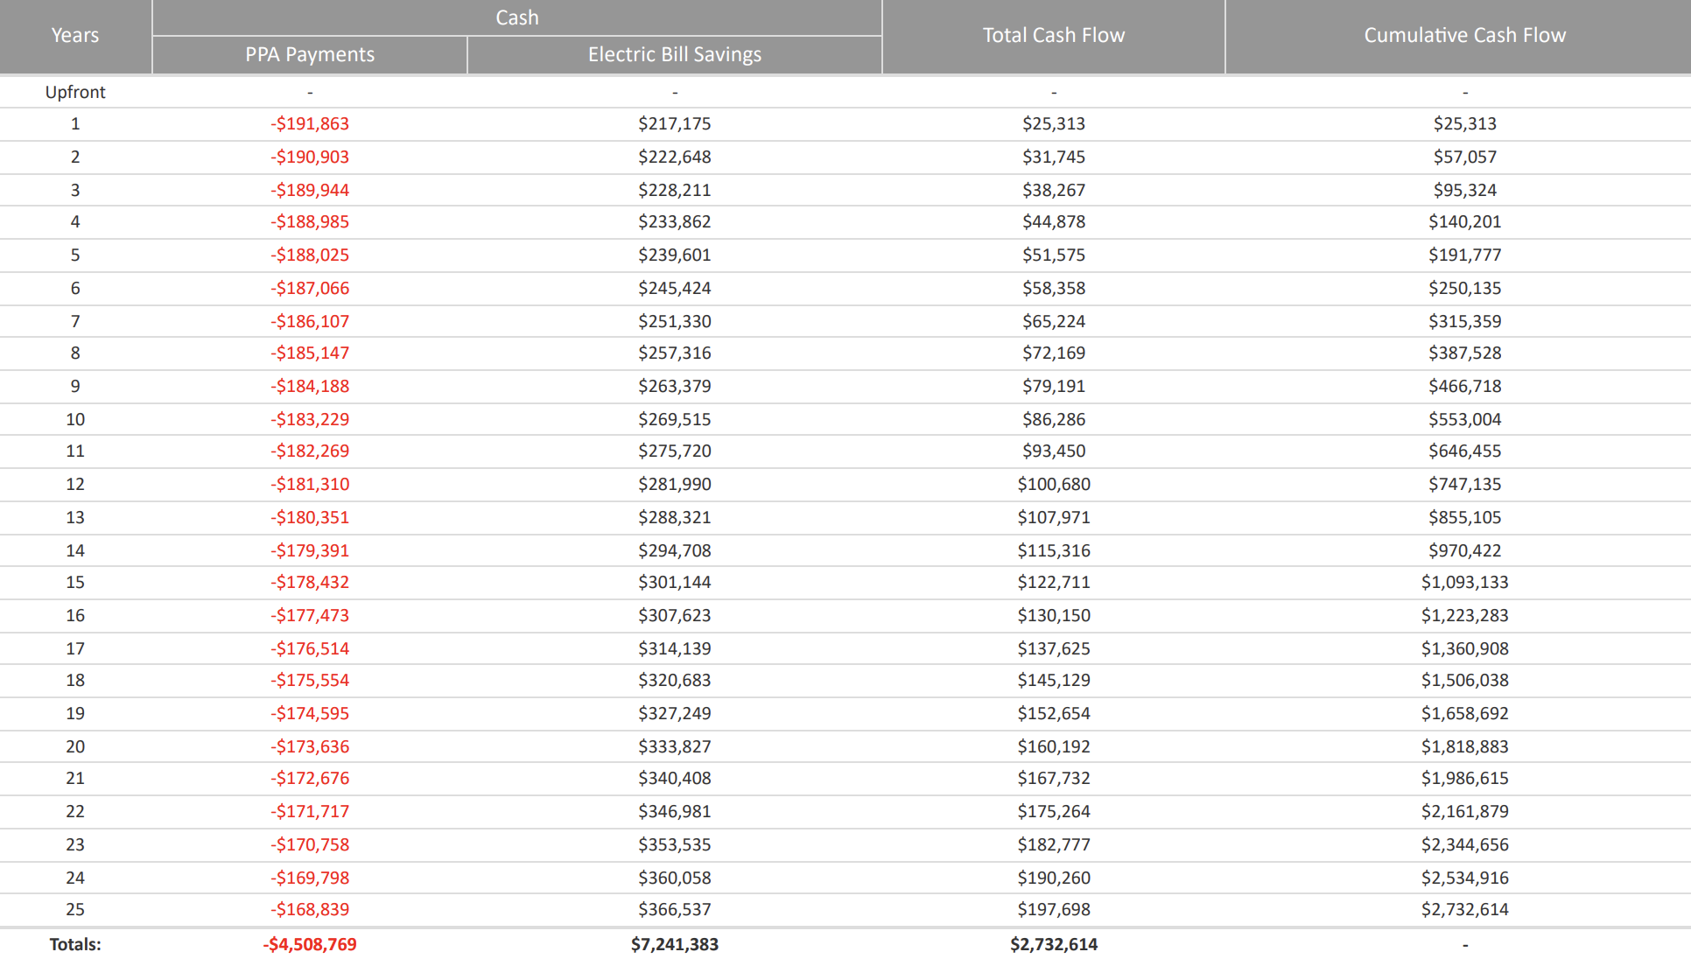
Cash flow - distributed option

Slide 21
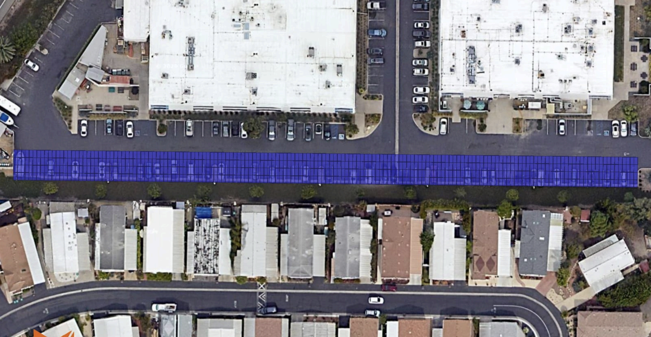
Centralized solar & storage layout
383.4 kWdc solar (78% net zero energy of all of RGLM’s electricity usage)
367.2 kW / 1,468.8 kWh via 1x Tesla Megapack 2 XL (4hr) battery

Slide 22
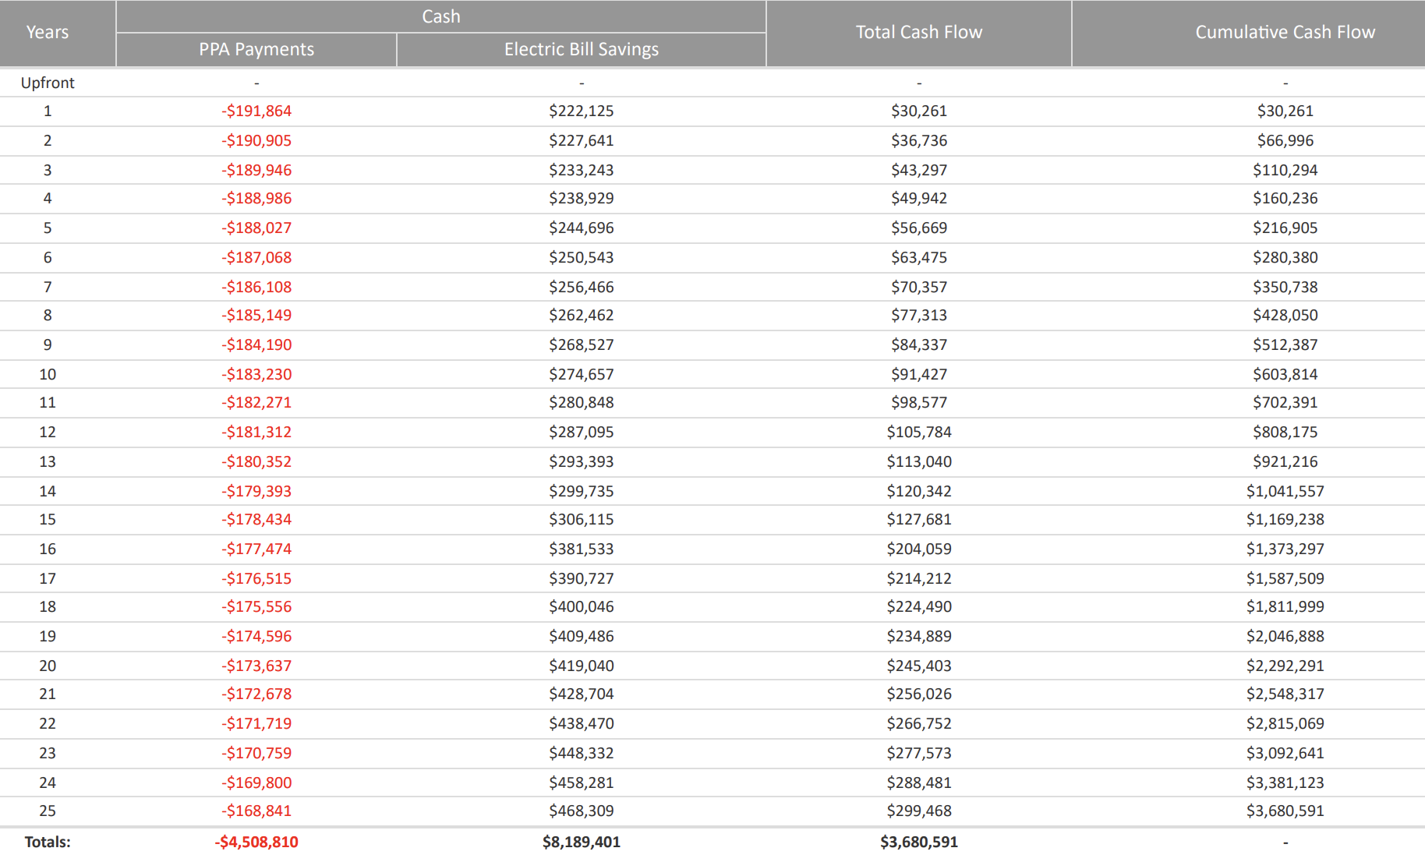
Cash flow - centralized option

Slide 23
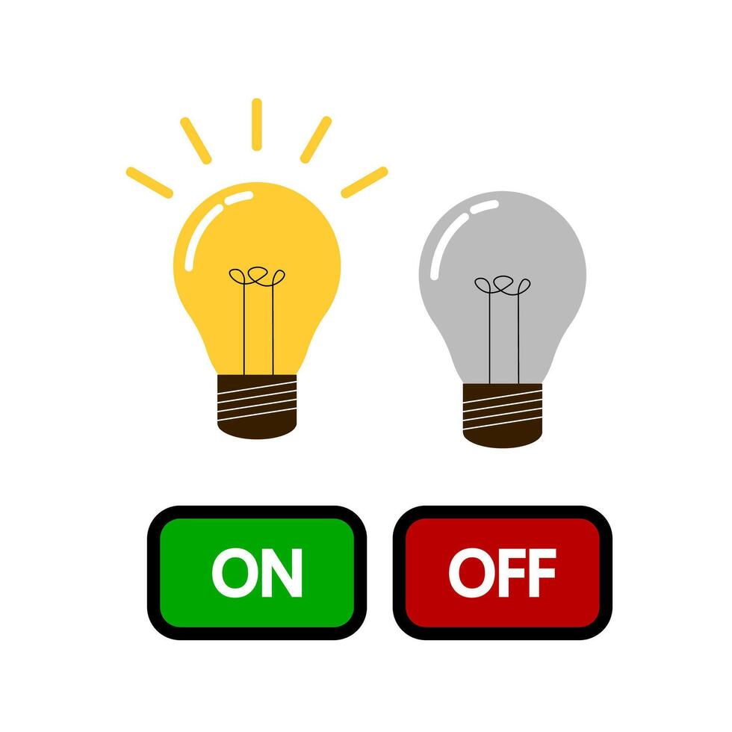
Savings with a Community Microgrid
WITHOUT a Community Microgrid:
On average, RGLM pays $0.35/kWh. Considering average electricity use of a mobile home (5,000 kWh) → annual bill of $1,750.
Electricity prices escalate at an estimated 5% annually. Conservatively, in just 5 years, your annual bill would raise to $2,234. That’s an increase of almost $500!
WITH a Community Microgrid:
RGLM pays $0.30/kWh for all solar generation and $0.35/kWh for remaining electricity from the grid.
Considering average electricity use of a mobile home (5,000 kWh) → annual bill of $1,575.
Electricity costs are frozen for 25 years.
When the power goes out, your critical loads (fridge, Wi-Fi, some lighting) stay on.
When the power goes out, you can’t serve any of your loads.
With a Community Microgrid, the average mobile home would save $1,795 in electricity costs in the first 5 years, in addition to benefiting from resilience. As electricity prices escalate, savings will increase.

Slide 24
Overview
Background
Electrification opportunities
Community Microgrid opportunity
Solar Microgrid opportunity for individual homes
Recommendations, survey, Q&A
Notes:
‹#›

Slide 25
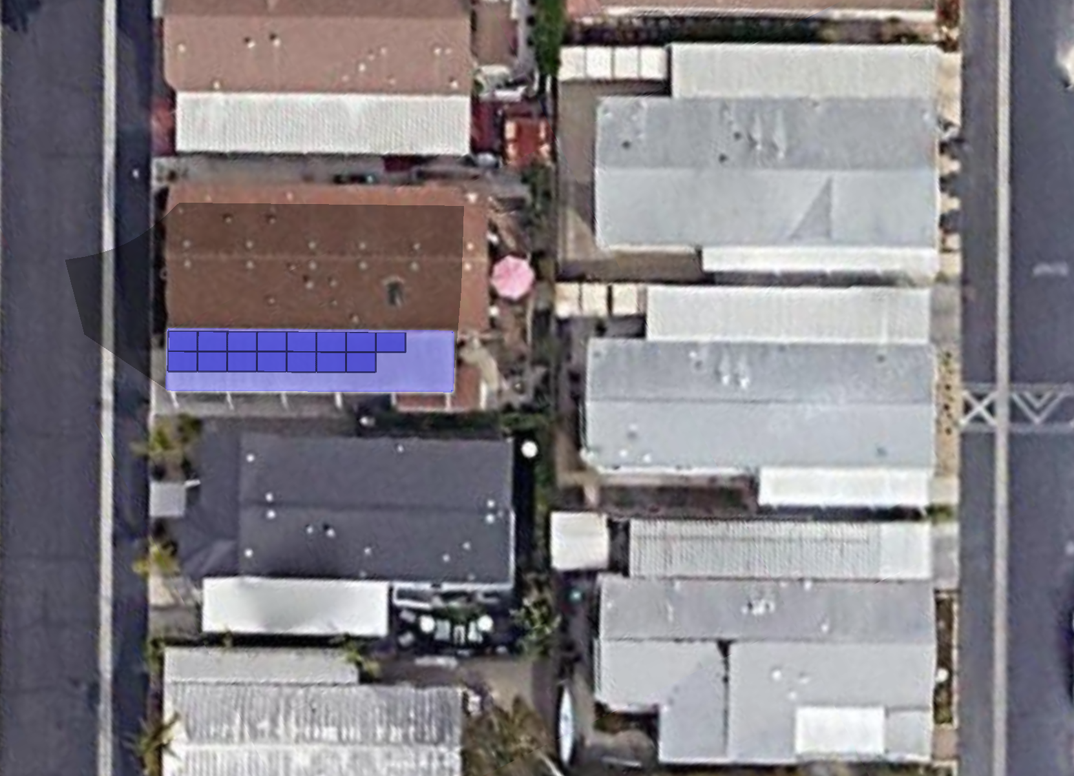
Individual Solar Microgrid
Rancho Goleta Lakeside
945 Ward Dr, Santa Barbara
Solar & storage:
6.9 kWdc solar (average) via 15x REC 460W panels
11.5 kW / 13.5 kWh storage via 1x Tesla Powerwall 3
Potential BESS location
New BTM solar

Slide 26
Individual Solar Microgrid Costs
Individual Solar Microgrid Costs
6.9 kWdc solar with 15x REC460 panels: | $23,700
13.5 kWh storage with 1x Tesla Powerwall 3: | $14,500
Total: | $38,200

Slide 27
Overview
Background
Electrification opportunities
Community Microgrid opportunity
Solar Microgrid opportunity for individual homes
Recommendations, survey, Q&A
Notes:
‹#›

Slide 28
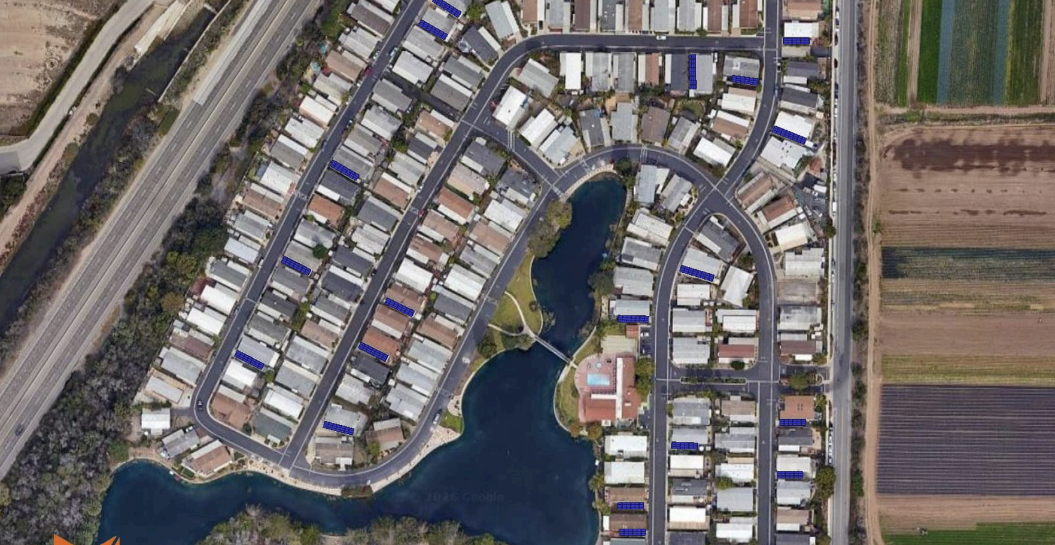
Recommendations
We recommend that RGLM moves forward with a Community Microgrid to take advantage of the trifecta of economic, environmental, and resilience benefits.
In addition, residents should consider moving forward with an individual solar microgrid for their home.

Slide 29
Survey and Q&A
The CC would like to do metering on households that will potentially be sites for solar + storage.
How many households would be interested in installing solar and storage at their homes?
How many households are interested in heavy electrification? This includes EV charging, HVAC heat pumps, and hot water heat pumps.
Reach out with any questions: stella@clean-coalition.org

Slide 30
Backup slides
Backup slides

Slide 31
Clean Coalition’s Solar Microgrid Methodology
Step 1
Step 2
Step 3
Step 4
Step 5
Load
Profiles
  Baseline: Historic site energy use
  Adjustment: Future anticipated loads (EVs, electrification)
  Master: Baseline + Adjustment Profiles
  Critical: Mission-critical, life-sustaining loads that warrant 100% resilience
  Tools:
  Clean Coalition’s Solar Microgrid Analysis Platform (SMAP)
  UtilityAPI
Resource
Scenarios
  Design & size solar and Battery Energy Storage Systems (BESS)
  Run shading analyses + energy modeling
  Determine resilience based on different resource scenarios
  Tools:
  Helioscope
  Clean Coalition’s SMAP
Site
Layouts
  Best practices when performing site walks
  Identifying critical load pathways
  Mapping site layouts
  Tools:
  Clean Coalition’s site walk checklist and photo instructions
  Site layout templates
  Google Slides/ PowerPoint
Economic
Analysis
  Analyze cash purchase vs. PPA economic transactions
  Apply financial incentives such as the Investment Tax Credit (ITC), Self Generation Incentive Program (SGIP), and depreciation.
  Assess the Value of Resilience
  Tools:
  Energy Toolbase Developer
  Clean Coalition’s SMAP
Reporting & Recommendations
  Create final reports with key visuals and summary tables
  Present findings and propose next steps
Tools:
  Energy Toolbase Developer
  Google Slides/PowerPoint
Notes:
‹#›

Slide 32
Load profile types
Load Type | Definition
Baseline load profile | The historical annual usage of electrical loads per site that forms the basis for creating the master load profile.
Adjustment load profile | Adjustments for anticipated EV Charging Infrastructure (EVCI), electrification, energy efficiency, and new facilities.
Master load profile | The forecasted annual load profile used for this study’s analysis, created from the baseline load profile plus adjustments for anticipated EV Charging Infrastructure (EVCI), electrification, energy efficiency, and new facilities.
Critical load profile | Annual load profile of the critical loads.
Critical loads | Electrical loads that are necessary to be provided with 100% energy resilience during grid outages
Total Critical Load Required (TCLR) | Total amount of energy required to serve the critical loads over the specified time period.

