Slide 1
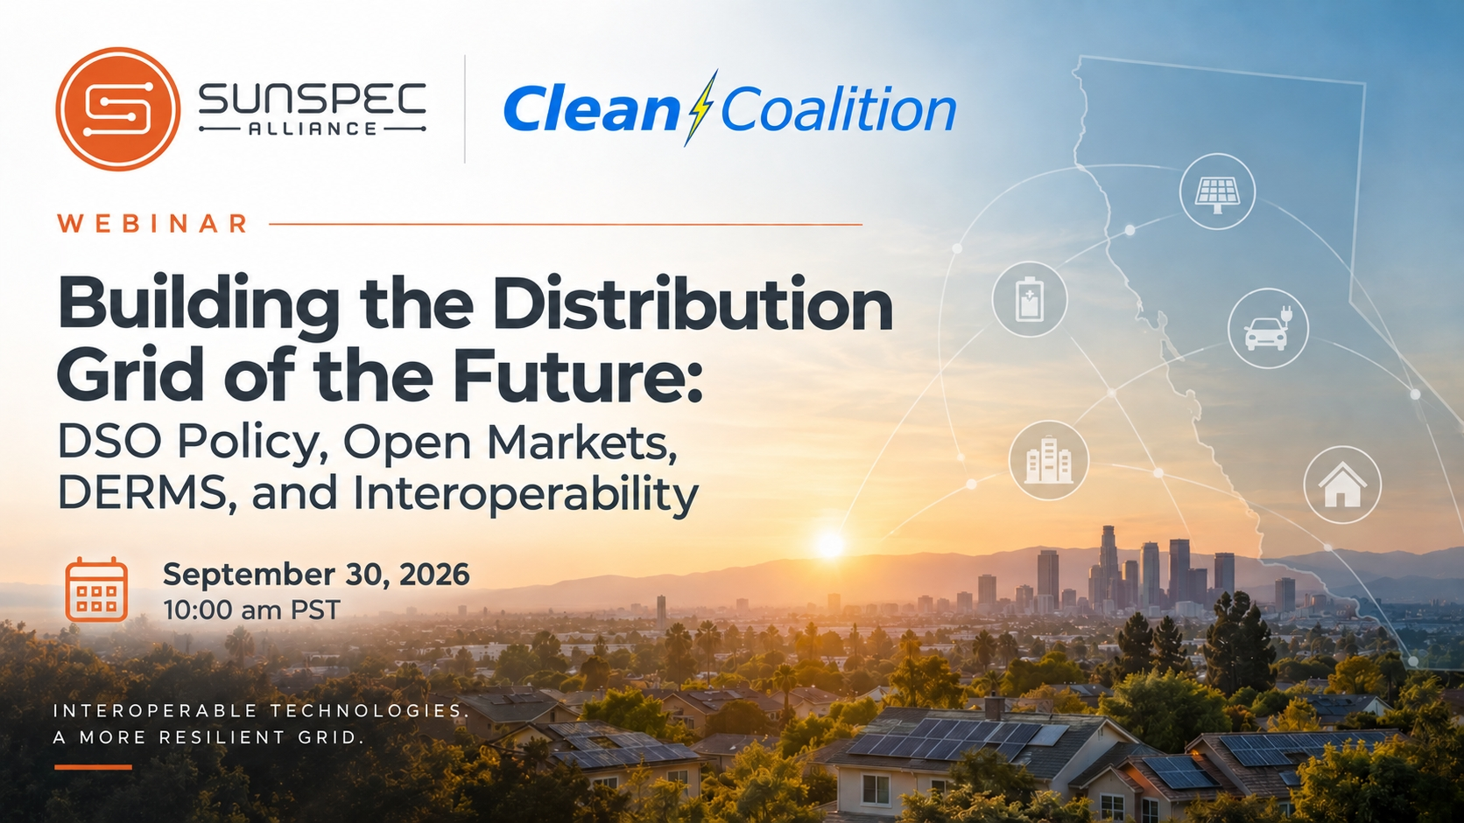

Slide 2

Antitrust and Intellectual Property Admonition
All SunSpec meetings are conducted in accordance with the SunSpec Antitrust Policy and Intellectual Property Provisions defined in the SunSpec Member Agreement. This agreement can be found at https://sunspec.org/sunspec-membership-agreement
SunSpec strictly prohibits market participants, and their employees who take part in these activities, from using their participation as a forum for engaging in practices or communications that violate antitrust laws.
Confidential or proprietary information should not be discussed in open session. Please contact SunSpec management if you have any questions.

Slide 3

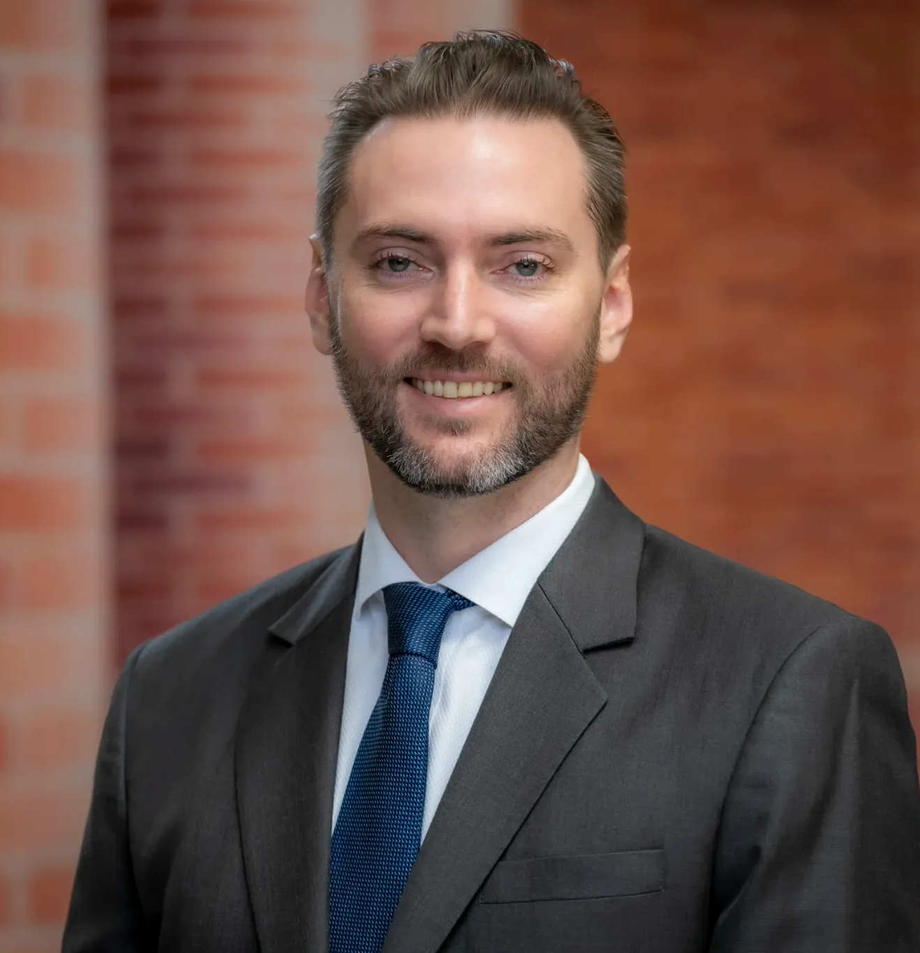
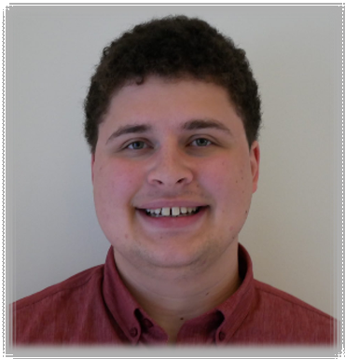
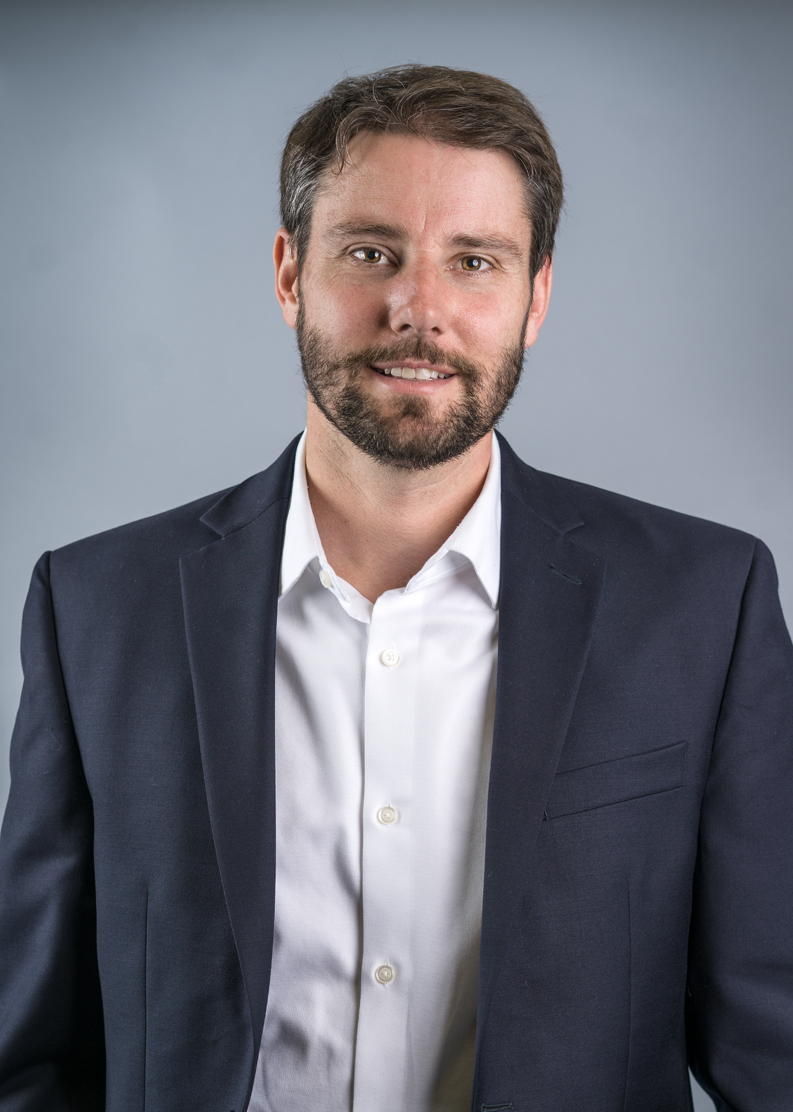
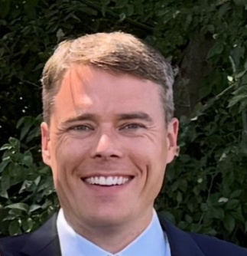
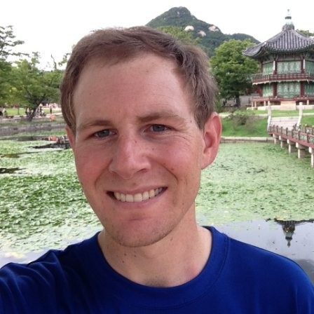




FEATURED SPEAKERS
Building the Distribution Grid of the Future
DSO Policy, Open Markets, DERMS & Interoperability • September 30, 2026
Dylan Tansy
Ben Schwartz
Chris Cook
Jared Satrom
Jay Johnson
Executive Director
Policy Director
Director of Energy Programs
Director of Energy Markets – CAISO
Chief Technology Officer
SunSpec Alliance
Clean Coalition
Central Coast Community Energy
Voltus
DER Security Corp
Presented by SunSpec Alliance + Clean Coalition

Slide 4

Grid Optimization by Leveraging DER (GOLD):
Implementing a Truly “Local-First” Distribution System Operator
Ben Schwartz
Policy Director
626-232-7573 mobile
ben@clean-coalition.org
30 Sep 2026

Slide 5
Clean Coalition (non-profit)
Mission
To accelerate the transition to renewable energy and a modern grid through technical, policy, and project development expertise.
Renewable Energy End-Game
100% renewable energy; 25% local, interconnected within the distribution grid and ensuring resilience without dependence on the transmission grid; and 75% remote, fully dependent on the transmission grid for serving loads.
Notes:
5

Slide 6
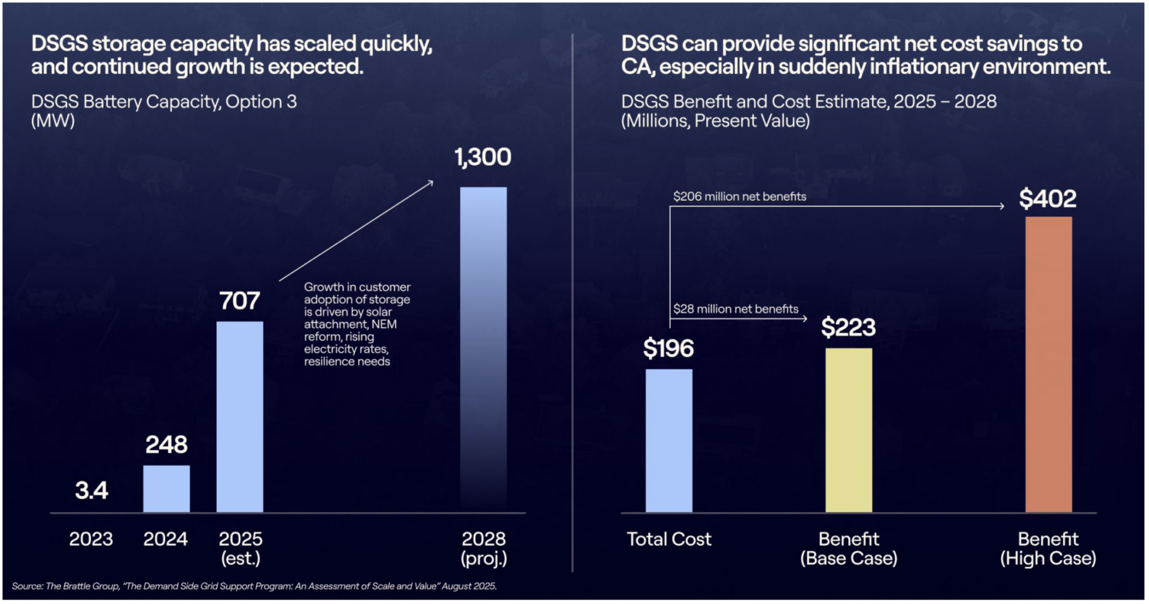
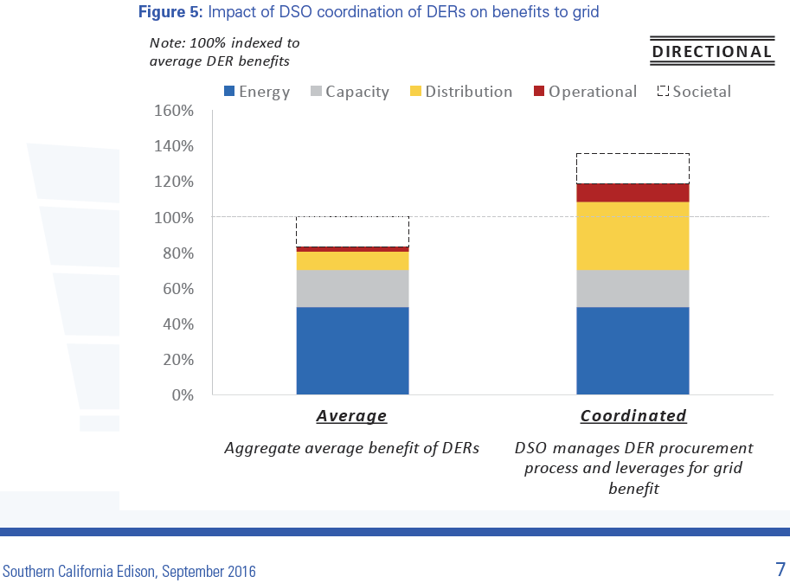
A Well-Implemented Distribution System Operator is an Affordability Solution
A distribution system operator (DSO) capable of optimizing the grid for DER participation and orchestrating aggregated DER can create significant ratepayer savings by improving grid utilization, avoiding costly infrastructure upgrades, and increasing the pace of electrification.
DSGS has rapidly scaled distributed battery capacity, demonstrating clear ratepayer benefits. Source: Brattle Group, The DSGS Program: An Assessment of Scale and Value, August 2025

Slide 7
Striking GOLD Through Three Key Dimensions
Grid Optimization by Leveraging Distributed Energy Resources (GOLD)
A framework to strategically deploy and orchestrate solar, storage, EVs, flexible loads, smart inverters, and other DER.
Implementing GOLD means “local-first” planning that makes better use of existing infrastructure, enables efficient grid operation, & supports growing electricity demand.
GOLD provides value across three fundamental dimensions: balancing the grid, speed-to-power, and resilience.
1. Balancing the Grid (three dimensions)
Service | Key to Delivering Service
Energy Balancing | Capacity of real power (W)
Voltage Balancing | Location of reactive power (VAr)
Frequency Balancing | Speed of sourcing or sinking real power (W)
The Duck Curve only addresses Energy Balancing, but Inverter-Based DER can provide unparalleled balancing of all three dimensions.
Notes:
California also needs to get far more out of the infrastructure and distributed resources already connected to the grid — both to control costs and accelerate electrification.
7

Slide 8
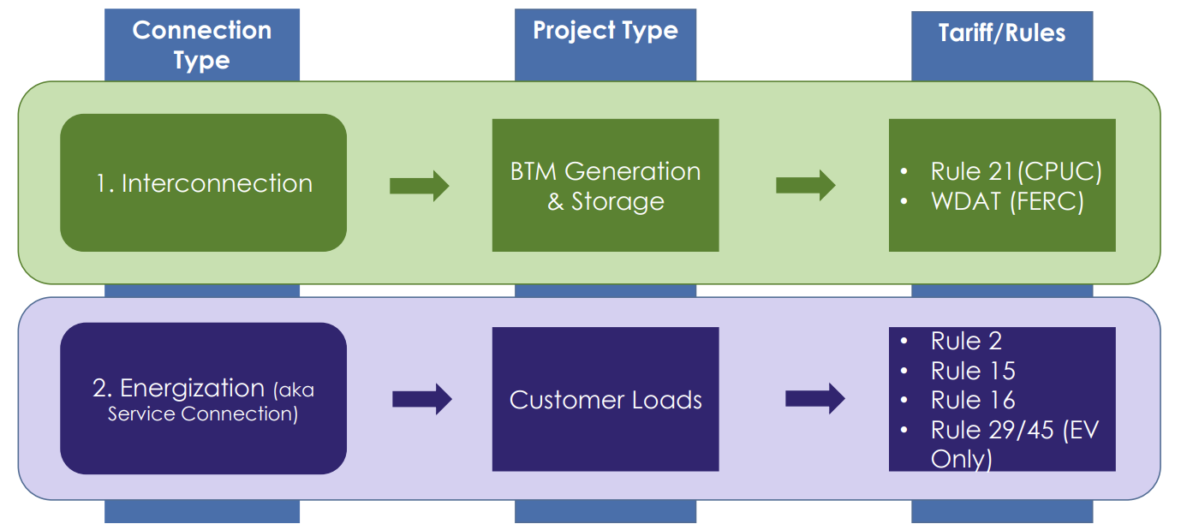
2. Speed-to-Power (and Maximizing Grid Utilization)
An effective DSO should enable timely energizations and interconnections
Flexible loads/generation connection options (PG&E’s FlexConnect Program)
A market structure with transparent opportunities and value streams for DER
A 'prime directive' to maximize use of existing infrastructure through non-wires alternatives to ensure all upgrades are right sized.
The DSO’s compensation should incentivize speedy interconnection, timely energization, efficient DER operation, and avoided infrastructure costs.

Slide 9
3. Resilience and Microgrids
The DSO should be allowed to identify areas where aggregating DER for a future Community Microgrid deployment creates measurable local reliability and resilience value.
  This could include substations, critical feeders, end-of-feeder locations, or critical facilities.
  The CPUC has previously approved Substation-level Microgrids, including the Calistoga Substation Microgrid project.
Valuing resilience benefits of DER even in advance of a Community Microgrid deployment can incentivize additional DER installations designed to support community resilience.
  Example: Grid forming and black start capabilities required for a Community Microgrid can be project cost drivers.
  A clear price signal to incentivize resilience could increase DER deployments capable of supporting Community Microgrids.

Slide 10
Core Architecture for a Scalable Local-First DSO
Eight Core DSO Components
A DSO is more than DERMS—it is the planning, market, data, communications, valuation, and governance architecture that turns local DER capabilities into bankable grid services and verifiable ratepayer savings.
Open Markets & Access | Neutral Governance | Interoperability & Communications | Decision-Grade Data
Value & Compensation | M&V / Settlement | Integrated Planning & T-D Coordination | Incentives & Accountability

Slide 11


Virtual Power Plant Program
Battery Pilot Development
September 30, 2026
Christopher Cook, PE
Director of Energy Programs
Notes:
Thank speaker
Chris Cook, Director of Energy Programs
Excited to share a new milestone
In 3CE’s Energy Programs Portfolio,
The development of our Virtual Power Plant

Slide 12
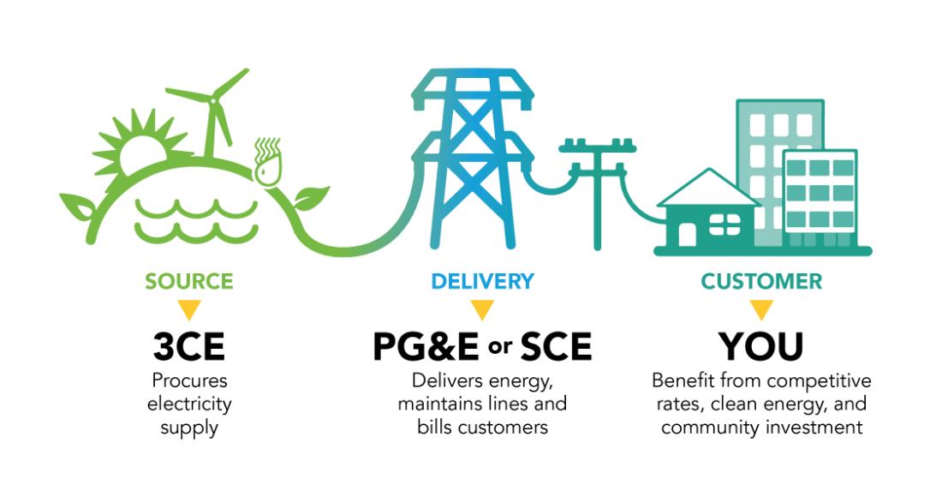

Who is 3CE?
A local public agency — we source your electricity and the utility delivers it.
Notes:
Elaborate on the renewable portfolio on “source”

Slide 13
3CE's Energy Programs Portfolio
Transportation
Electrification
Building Electrification
Agricultural Electrification
Energy Optimization
Notes:
Traditionally have had 3 categories
of electrification
for customers to maximize
the clean and renewable energy
3CE procures...

Slide 14
3CE's Energy Programs Portfolio
Transportation
Electrification
Building Electrification
Hourly Flex Pricing Pilot
Virtual Power Plant
Agricultural Electrification
Energy Optimization
Notes:
Primarily through two customer offerings HFP and RBRP
Found limited by reliance on IOU meter data for RTP and limited by technology's ability to control devices for RBRP

Slide 15
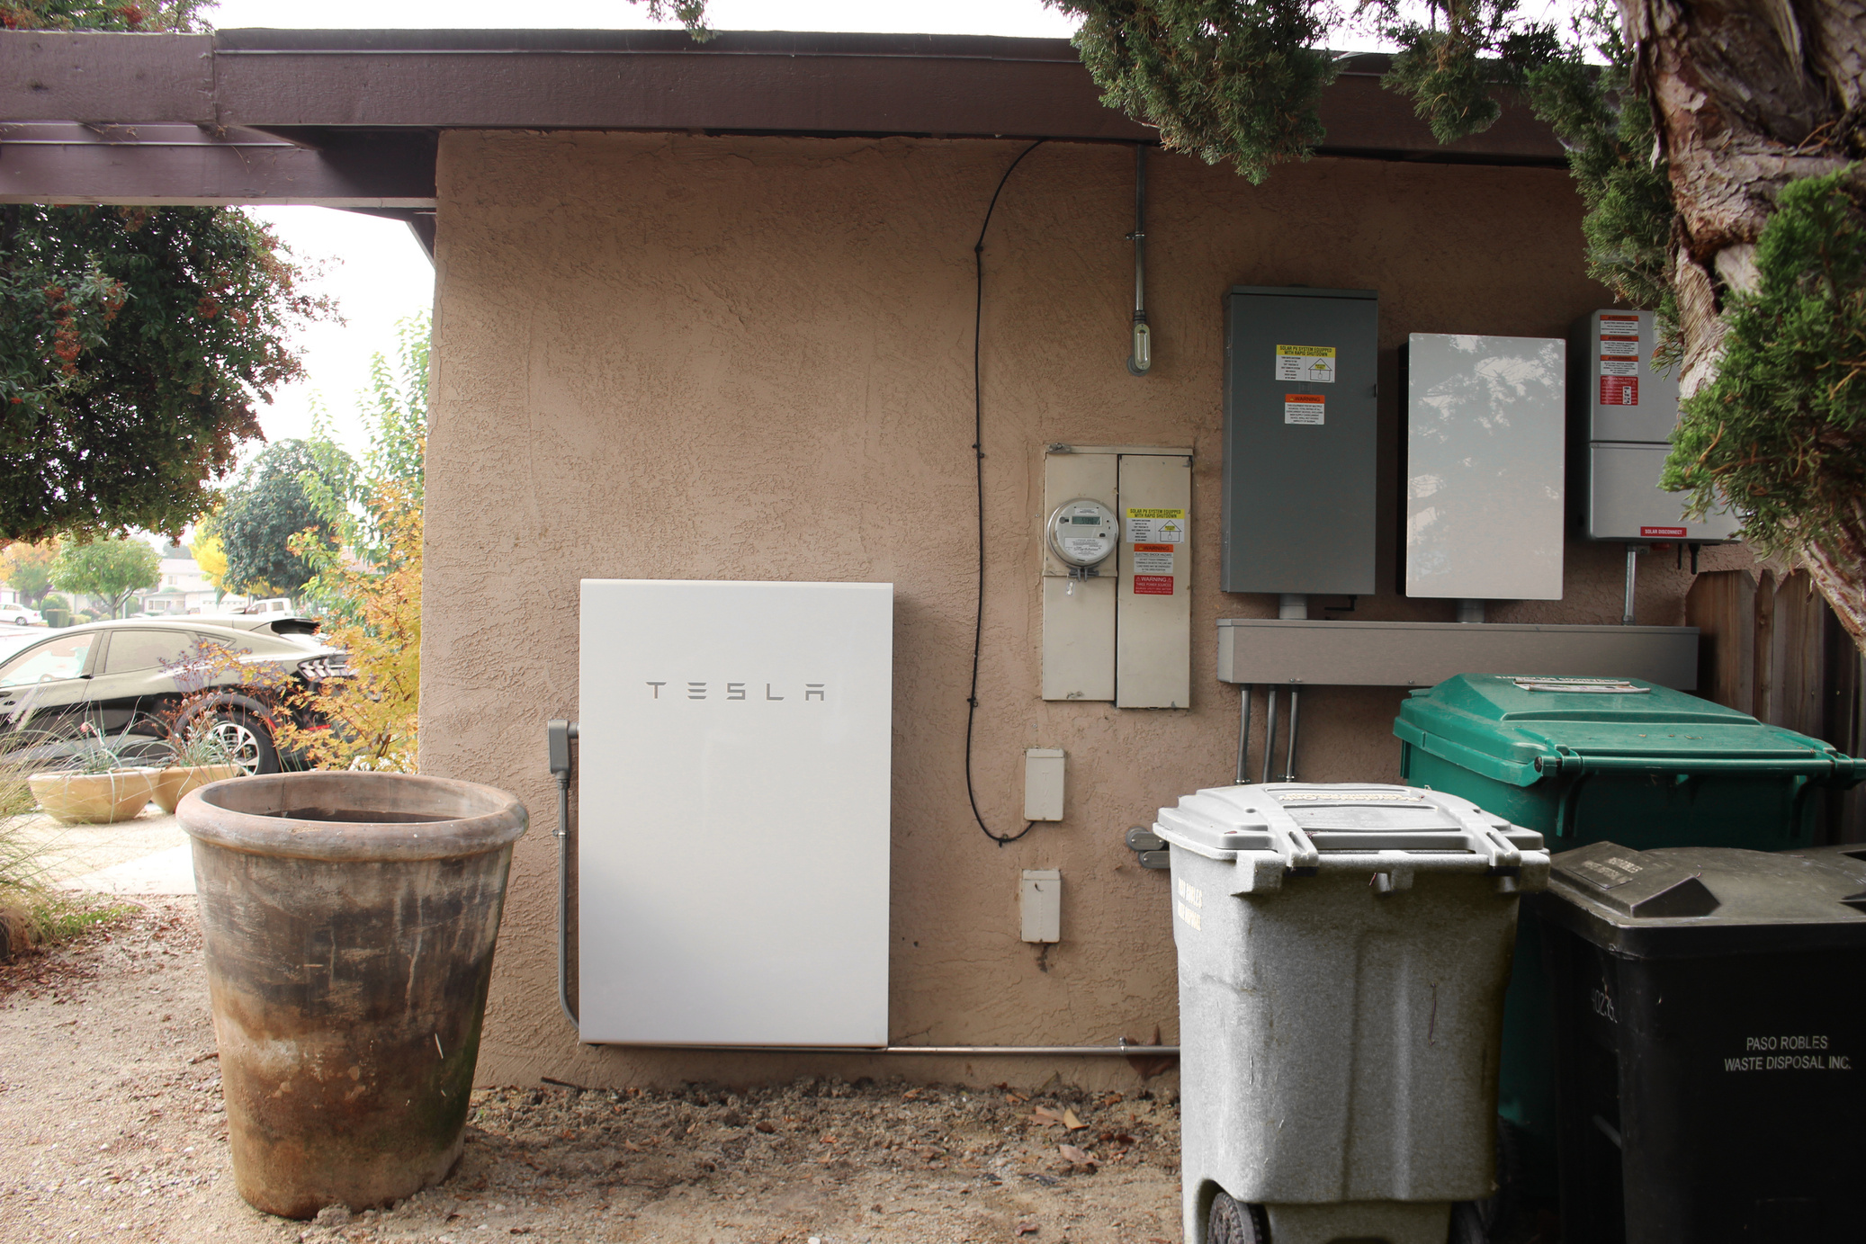
Goals
Leverage Latest Technology to:
Improve Grid Reliability
Empower Customers
Further Clean + Renewable Energy Goals
Notes:
Optimize grid operations by shifting energy use away from the most expensive and least renewable hours
Enhance grid reliability, especially during peak demand periods
Lower overall electricity costs by reducing peak demand pressures

Slide 16
VPP Phases
VIRTUAL POWER PLANT PROGRAM | STEP 1: DERMS Platform Development
Notes:
Note, the full role out can extend past residential customers, including C&I, member agency, microgrid, etc

Slide 17
VPP Phases
VIRTUAL POWER PLANT PROGRAM VIRTUAL POWER PLANT PROGRAM | STEP 1: DERMS Platform Development
 | STEP 2: Integration of Existing Programs
 | PHASE 1: Behind-the-Meter Batteries | PHASE 2: EV Charging Infrastructure | PHASE 3: Heat Pump & Smart Thermostats | PHASE 4: Additional Technology

Slide 18
VPP Phases
VIRTUAL POWER PLANT PROGRAM | STEP 1: DERMS Platform Development
 | STEP 2: Integration of Existing Programs
 | PHASE 1: Behind-the-Meter Batteries | PHASE 2: EV Charging Infrastructure | PHASE 3: Heat Pump & Smart Thermostats | PHASE 4: Additional Technology

Slide 19
VPP Phases
VIRTUAL POWER PLANT PROGRAM | STEP 1: DERMS Platform Development
 | STEP 2: Integration of Existing Programs
 | PHASE 1: Behind-the-Meter Batteries | PHASE 2: EV Charging Infrastructure | PHASE 3: Heat Pump & Smart Thermostats | PHASE 4: Additional Technology
 | STEP 3: Service Provider Capacity Contribution
 | STEP 4: Third-Party Administered Programs
Notes:
Note, the full role out can extend past residential customers, including C&I, member agency, microgrid, etc

Slide 20
How the Battery Pilot Works
Customer Flow
ENROLL
EVENTS
INCENTIVES
Application on 3CE’s website
Connect device to Gridshare
3CE identifies grid need, calls event
2-4 hours
DERMS vendor dispatches connected systems
Upfront incentive check
Ongoing accrual of performance incentives – paid annually on bill

Slide 21
Communication Preferences
How is a customer notified?
Where can they learn more?
How to opt out?
Receive email before event call
See event status in manufacturer app and 3CE website
They can opt out of an event by giving notice to 3CE

Slide 22
VPP Benefits
3CE | CUSTOMER
Energy, RA, and REC Cost Avoidance | Pay for Performance Incentives
Support Technical Customer Assistance | Energy Arbitrage Savings
Ability to Scale Economic Impact | Support Multiple Customer Types
GHG Emissions Reduction | Whole Home Electrification Optimization
Notes:
3CE
Resource Adequacy: Use aggregated capacity to meet RA obligations​
Load Modifying Capacity: Cut peak demand and lower procurement costs
CUSTOMER
Energy Arbitrage Savings: Shift usage to cheaper or renewable times​

Slide 23
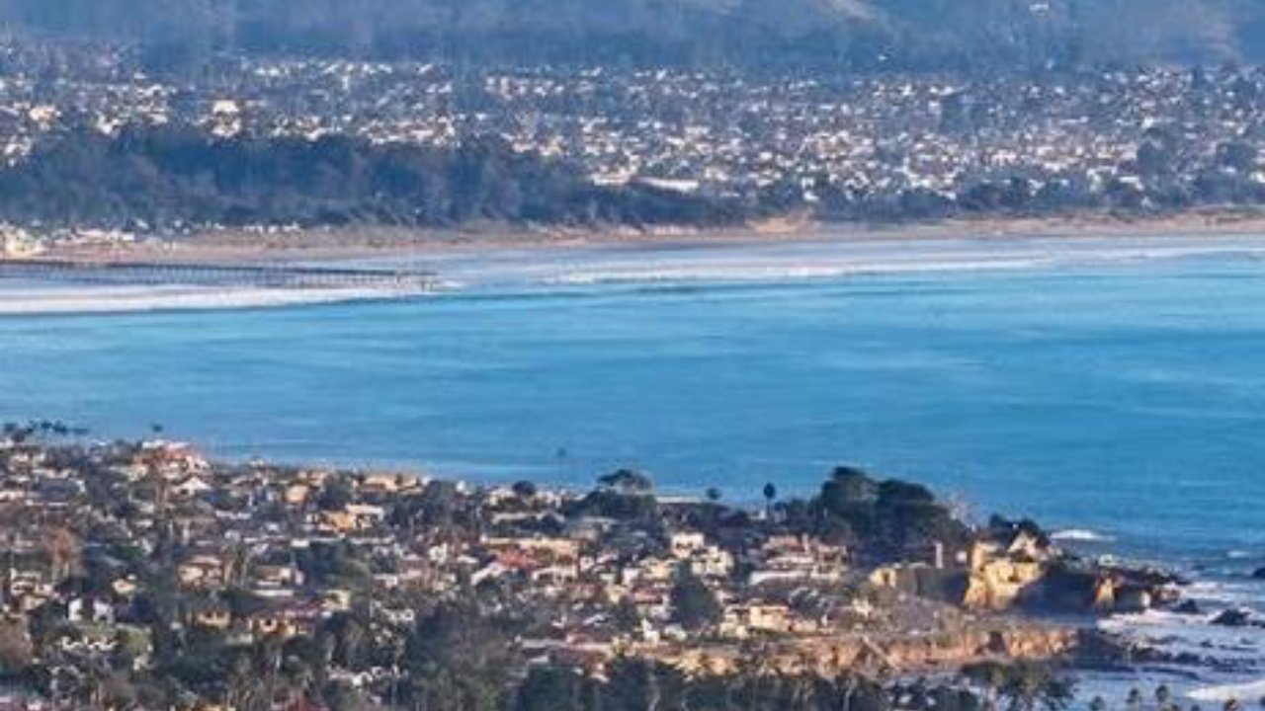

Thank You
STAY CONNECTED
Questions: Christopher Cook · programs@3ce.org
3CEnergy.org
Notes:
Edit- Other questions?
Visit our website, reach out soon, etc.

Slide 24
Distribution Adequacy
A market-based framework to price and dispatch flexibility on the distribution grid
09/30/2026

Slide 25



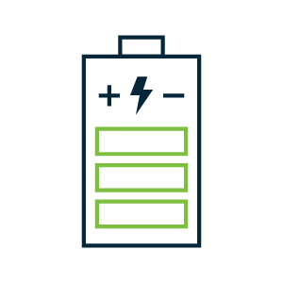
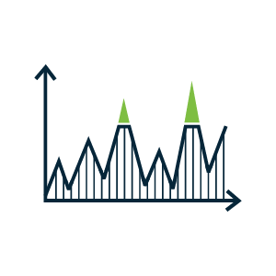
Solving The Missing Money Problem
Distribution-level flexibility has no price signal — Distribution Adequacy gives it one, using the same playbook as Resource Adequacy
Resource Adequacy already pays flexible resources a capacity payment for meeting a system-level Must-Offer Obligation and being economically dispatched by CAISO.
Nothing today pays a resource for showing up specifically where the distribution grid needs it — that’s the “missing money” for locational, distribution-level flexibility.
Distribution Adequacy applies the same RA playbook one level down: developers earn an additional distribution capacity incentive for deploying BTM DERs where CAISO’s price signal shows local need.
The resource is still economically dispatched by CAISO according to price — just with one more locational layer added to the signal.

Slide 26
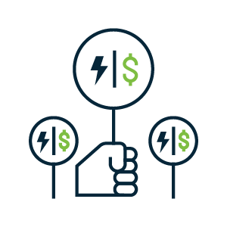

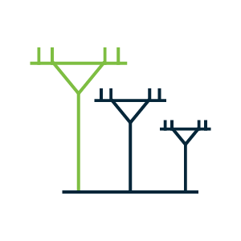
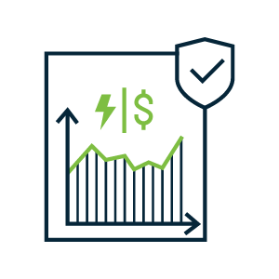

How It Works
One price signal, one dispatch, two key roles for system operators
 | CAISO — Program Administrator | DSO — Signal Provider
Price signal | Combines wholesale LMP + a local ΔDist into one Distribution Adequacy price | Calculates ΔDist from feeder/circuit-level congestion and sends it upstream to CAISO
Dispatch | Runs economic dispatch against the combined price — the same mechanism used for LMP today | May issue voluntary dispatches for emergencies (no penalties)
System modeling | Consumes the DSO’s signal; does not run its own distribution-system model | Runs the distribution-system model needed to compute local scarcity
Accreditation & settlement | Administers the Must-Offer Obligation and pays the Distribution Adequacy capacity credit, alongside System RA | No responsibilities
Operations and Telemetry | Consumes DSO’s telemetry. No direct control. | No direct control over enrolled resources, but obtains telemetry, transmits to CAISO

Slide 27
Distribution Adequacy meets planning horizon and operational horizon needs simultaneously
Distribution Adequacy
Telemetry, Emergency Dispatch
Near Real Time
Operating Reserves (non-spin)
Emergency Reserve programs (30 min notice)
Day Ahead
Financially-binding dispatch of most MOO resources
Multi-Year
Integrated Resource Planning
Month Ahead
Resource procurement
Sub-second
Frequency regulation services
Year Ahead
Resource Obligations and Procurement
Week Ahead
ISO-issued outlooks and operational instructions
Intraday
Incremental procurement from standby resources
Real-Time
5-15 min Energy
Ancillary Services (Spinning Reserves)
Physically-binding operational targets
Distribution Adequacy
Provides long-term price signal for developers
Distribution Adequacy
Day-ahead dispatch

Slide 28
Distributed Adequacy Recap: valuing local flexibility
A distribution-level analog to resource adequacy
TODAY
Distribution flexibility goes unpriced
THE CONCEPT
A capacity payment, like RA, but more granular
Distribution & system capacity should co-optimize, like ancillary services do today
How it could work
Price backbone: DLMP = wholesale LMP + a local congestion adder
Must-offer obligation triggers when local DLMP crosses a threshold
Capacity credit set by local ELCC × a seasonal performance test
Settlement: capacity payment × performance, plus energy at DLMP
Status & why it matters
An early-stage internal concept, not a filed proposal
Real precedent: NY's Term/Auto-DLM, GB's Piclo-run DNO markets
Biggest open question: IOUs standing up real price signals
A stackable product to RA which could attract more investment in DER’s where they’re needed most

Slide 29
SUNSPEC ALLIANCE + CLEAN COALITION WEBINAR
From Standards to Gigawatt Integrations
Unlocking DER potential through interoperability and grid-support functions.
Jay Johnson
CTO, DER Security Corp
September 30, 2026
Notes:
SunSpec Alliance and Clean Coalition webinar. Jay Johnson, CTO, DER Security Corp.

Slide 30
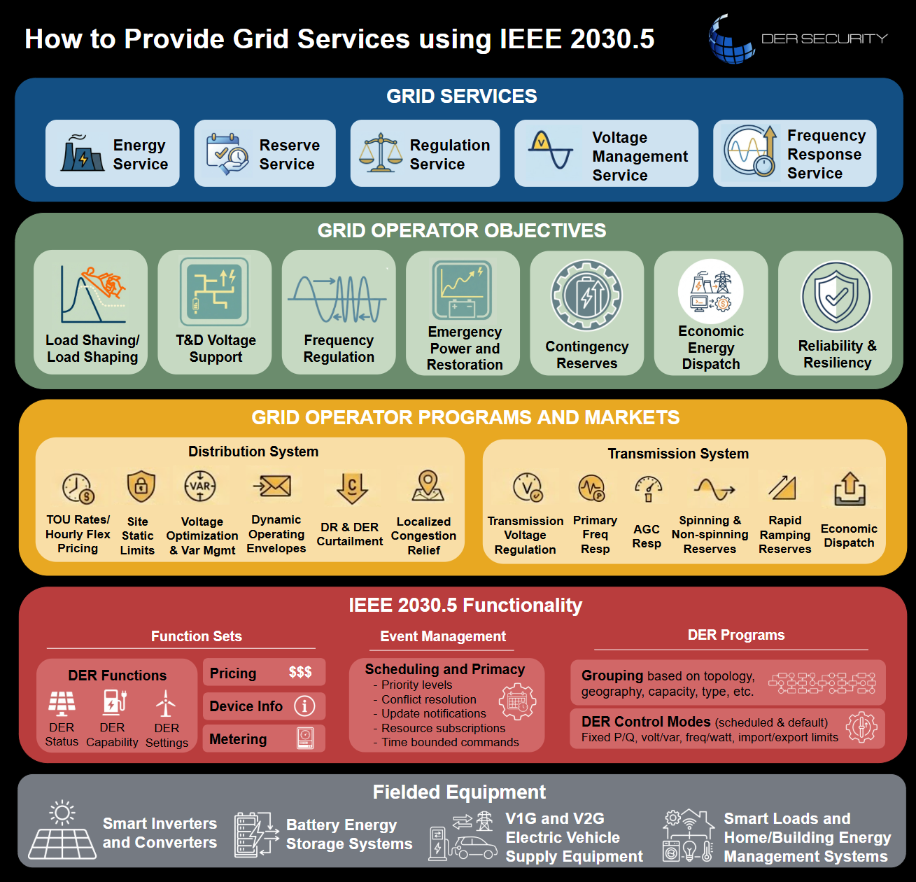
IEEE 1547-2018 · THE POWER CONVERTER
DER to Grid Service
CONVERTER FUNCTIONS
WHAT THE GRID GETS
Volt-VAR,
Volt-Watt,
power factor
Voltage held within ANSI C84.1
Freq-Watt,
fast frequency
response
Frequency support without reserve
IEEE 1547
Voltage and freq ride-through
Ride-through instead of mass tripping
Active power limit, ramp rate,
schedules
Headroom and congestion relief
Autonomous functions deliver sub-second services.
Notes:
IEEE 1547-2018 and UL 1741 SB made grid support mandatory, not optional. The power stage already does voltage regulation, frequency response, ride-through and active power control, and it does them autonomously in under a second. Nothing has to be added to the hardware. The gap is reaching it, which is the next slide.

Slide 31
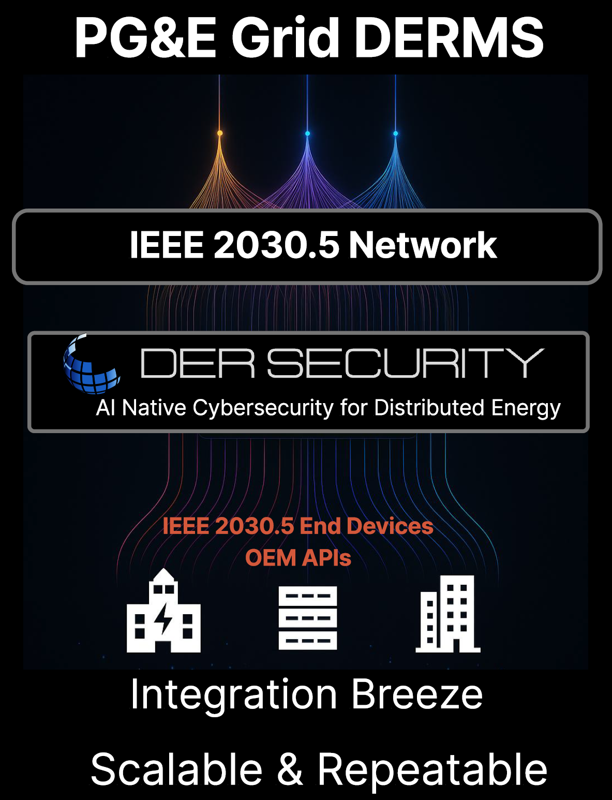
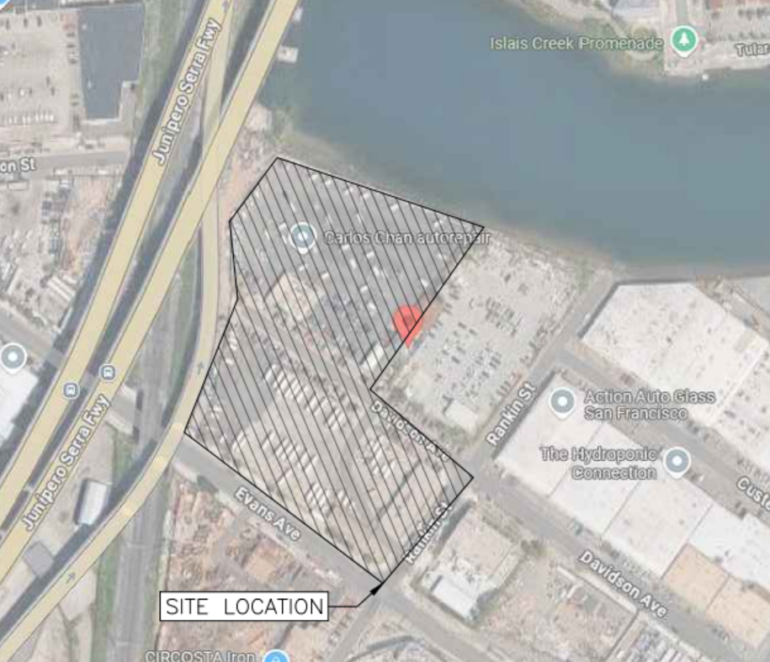
CEC GFO-25-301 · DRIVES
Energizing school bus depots
CEC is funding IEEE 2030.5 native networks. We can energize depots under dynamic limits while the service upgrade waits.
▸
Grid-forming PV, with the buses themselves as the storage.
▸
IEEE 2030.5 FlexConnect gateway to PG&E and SCE.
▸
EVGateway prime, Zum, DERSec.
Example: UL 3141 PCS behind 4000 A service in San Francisco: installation of 226 Direct Current Fast Charging (DCFC) stations, consisting of (203) 30 kW and (23) 60 kW chargers.
Notes:
CEC GFO-25-301 DRIVES. EVGateway is prime, Zum provides the depots, DERSec provides the IEEE 2030.5 aggregation and DER cybersecurity. None of the target depots are FlexConnect-enabled today. The point: energize months earlier and defer ratepayer-funded upgrades. Spotlight: CEC is putting money behind IEEE 2030.5 native networks, not proprietary integrations.

Slide 32
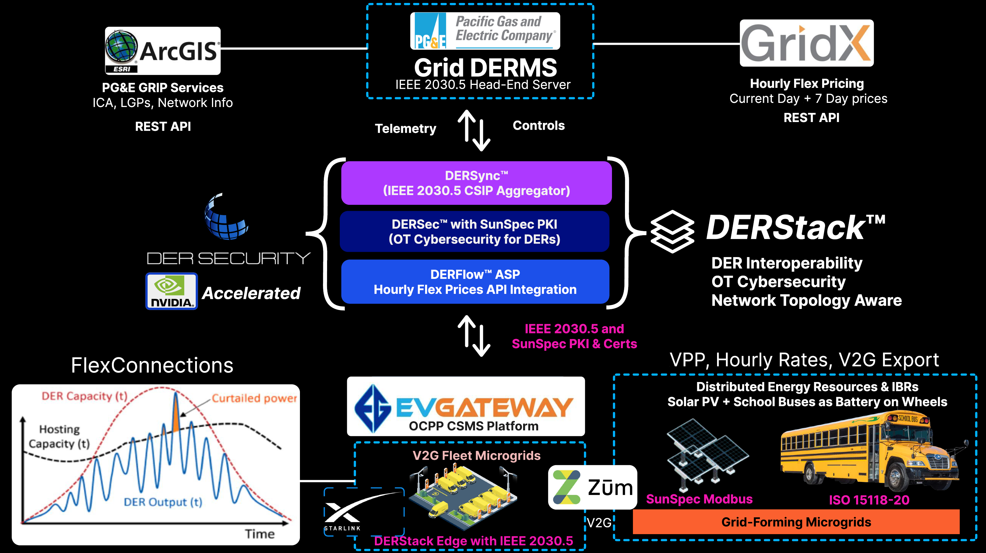

Slide 33

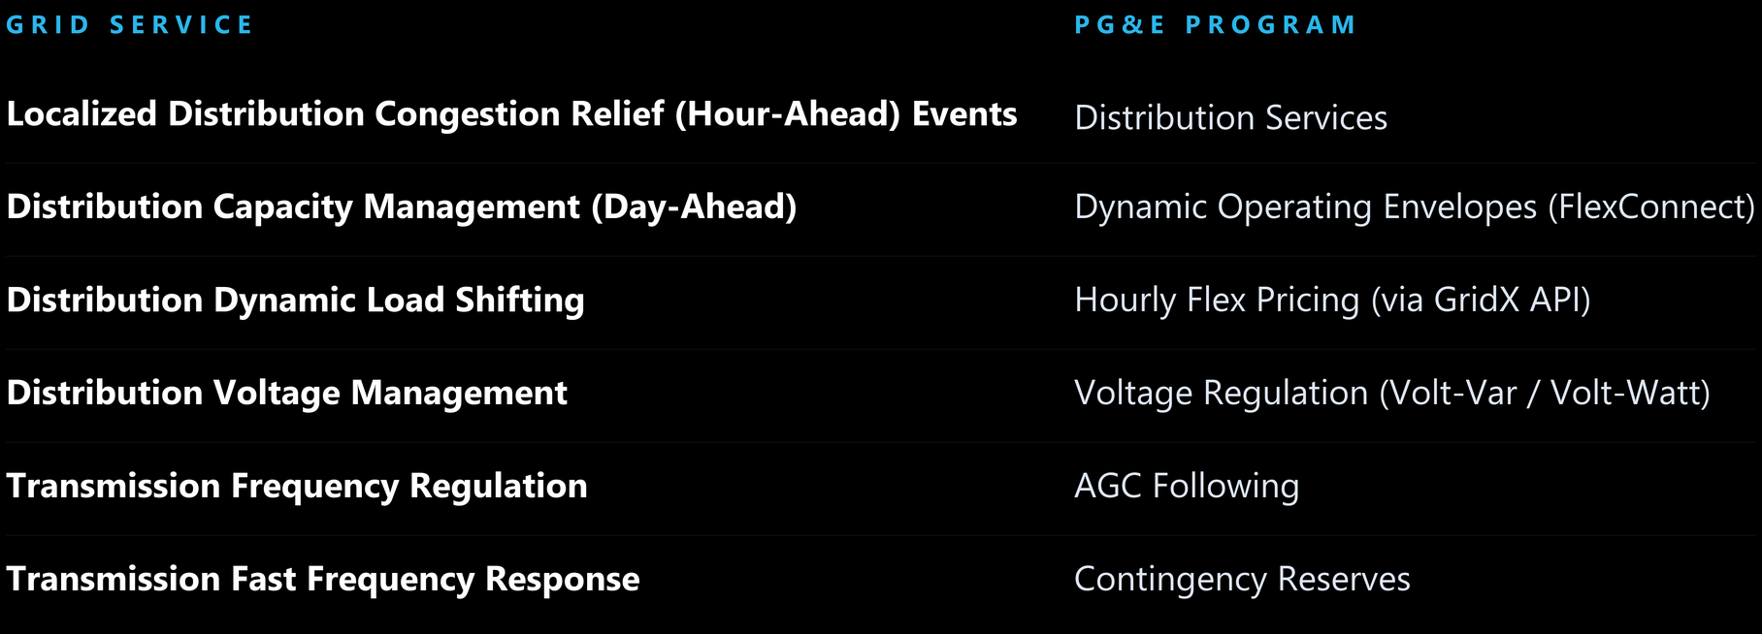
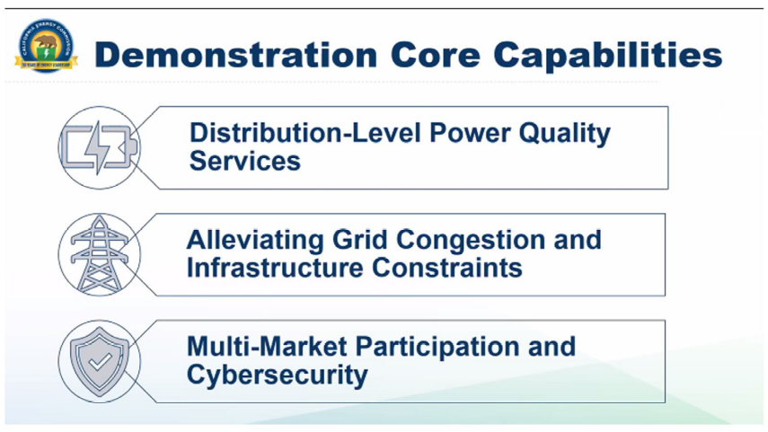
CEC GFO-25-302 · CHOIR
Project SYMPHONY
A field-scale VPP coordinating IBRs for distribution services.
▸
~600 kW Qcells residential fleet in San Leandro.
▸
2 MW of Prologis commercial and industrial capacity.
Notes:
CEC GFO-25-302 CHOIR, our bid is Project SYMPHONY. DERSec prime with Qcells, Prologis and LBNL. LBNL's FAST-DERMS flexible resource scheduler is the optimization layer. Digital-twin-in-the-loop against PG&E's DERMS de-risks the field work. Talk track for the third bullet: EnergyHub reached out this morning asking for detail on our Schneider grid DERMS integration, because they are bidding a project. Name them live only if you are comfortable doing so on a recording.

Slide 34

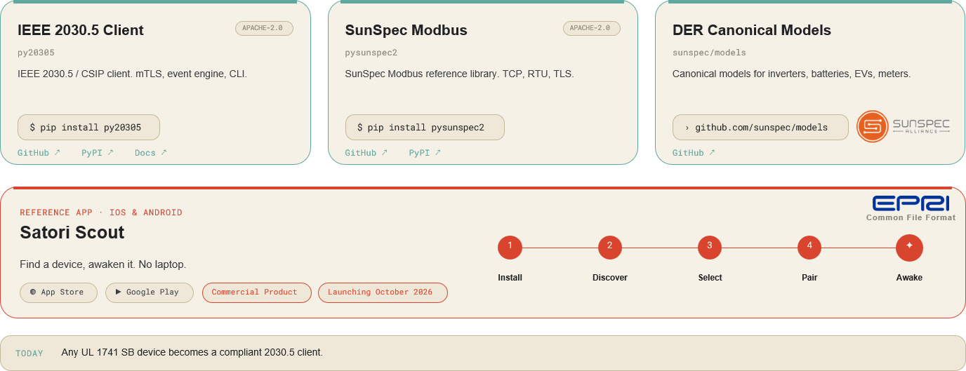


PROJECT SATORI · APACHE 2.0
Open-source DER software!
open-satori.org
Notes:
Satori launched at New York Climate Week with SunSpec Alliance. The client stack is Apache 2.0 and stays open; Satori Scout is the DERSec commercial reference app. The panel is the whole argument for open markets: bespoke integration is what caps VPPs at megawatt scale, and one standard link repeated is what gets you to gigawatts.

Slide 35
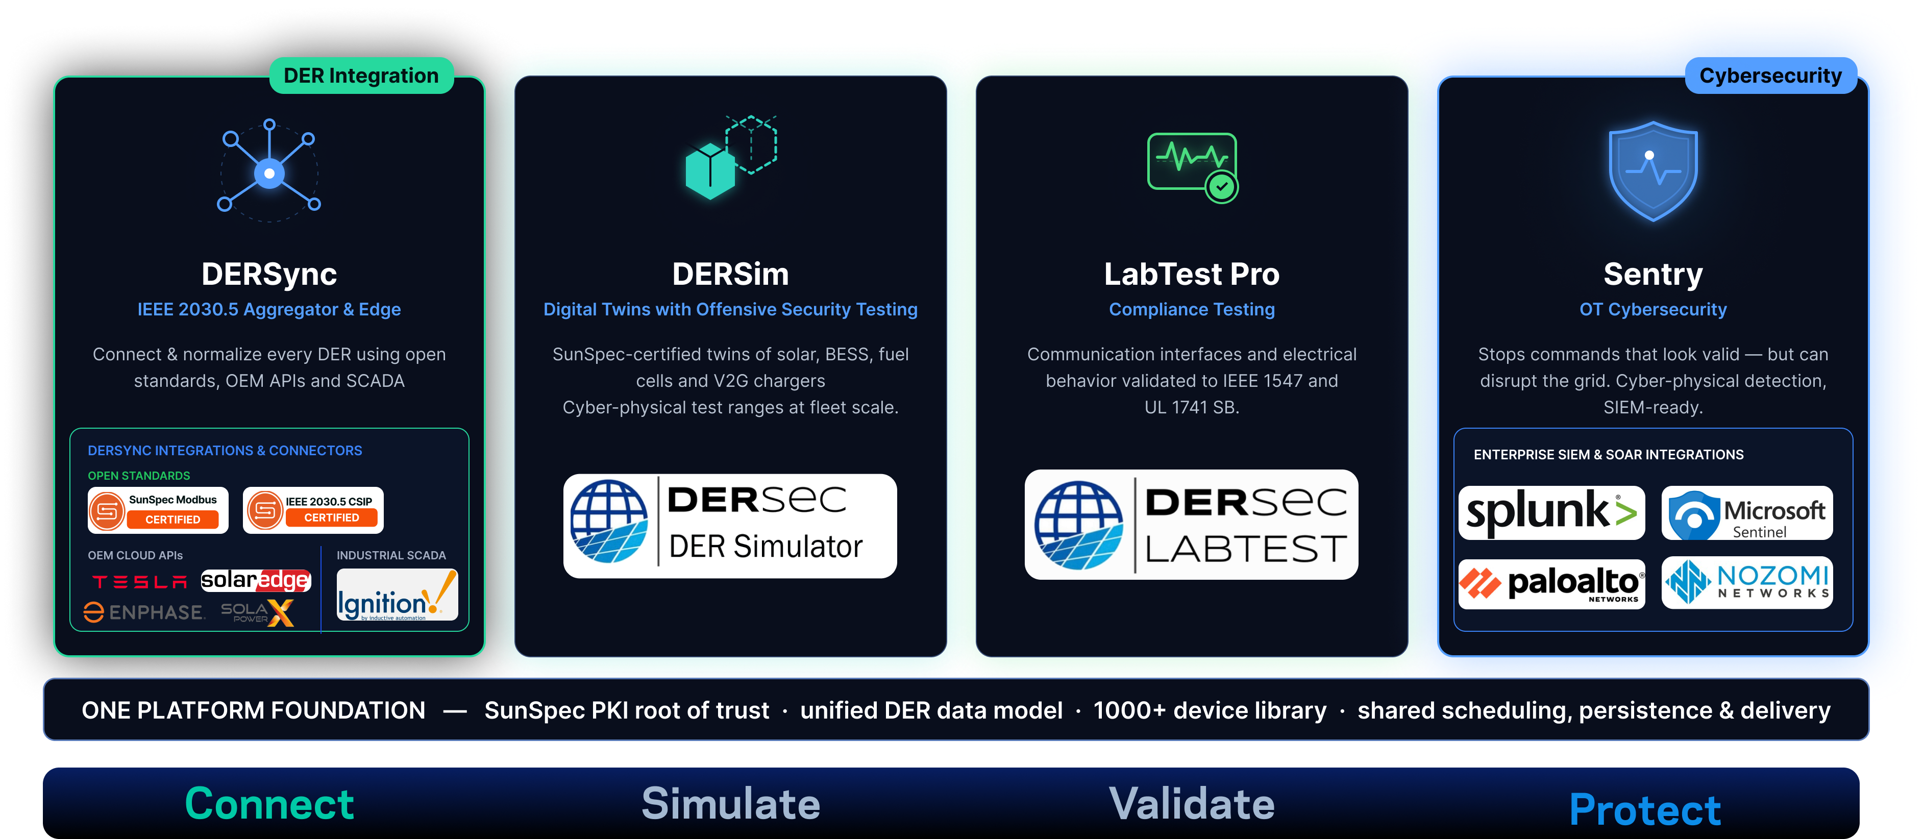
DERSEC · AVAILABLE TODAY
Work with DER Security
dersec.io
Notes:
DERSync is the CSIP aggregator, Sentry is the power-aware IDS, and we ship pre-built connectors into grid DERMS platforms so a utility program does not start from zero. dersec.io, jay@dersec.io.

Slide 36
PANEL and Q&A
Building the Distribution Grid of the Future
DSO Policy, Open Markets, DERMS & Interoperability • September 30, 2026
Dylan Tansy
Ben Schwartz
Chris Cook
Jared Satrom
Jay Johnson
Executive Director
Policy Director
Director of Energy Programs
Director of Energy Markets – CAISO
Chief Technology Officer
SunSpec Alliance
Clean Coalition
Central Coast Community Energy
Voltus
DER Security Corp
Presented by SunSpec Alliance + Clean Coalition

Slide 37

THANK YOU!
Building the Distribution Grid of the Future
Thank you for joining us.
Email membership@sunspec.org with any questions

